Slide 1


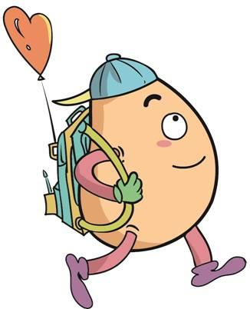






人 教 PEP 版 英 语 五年 级 下 册
Unit 6
Work quietly!
Part B
Let’s learn & Look, match and say

Slide 2


Warm up

Slide 3
Lead in
We should talk quietly in the library.
Where else should we talk quietly?
Let's talk about it.

Slide 4
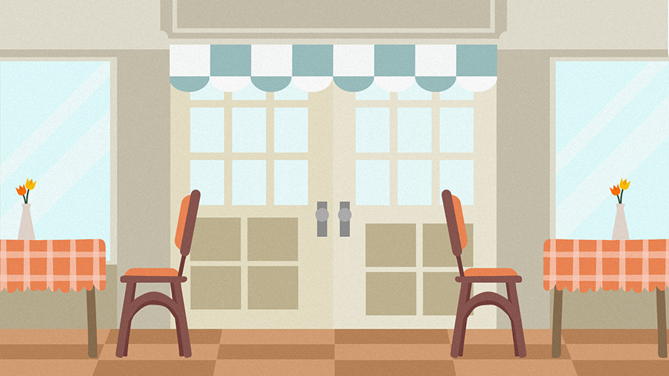
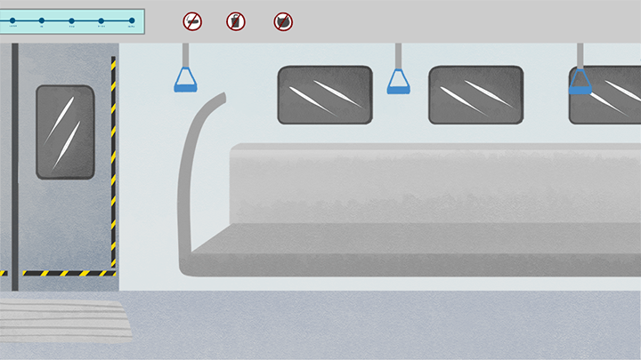

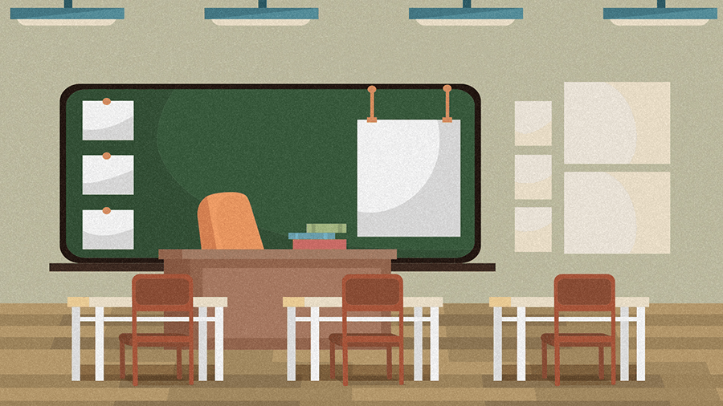
subway
restaurant
hospital
classroom

Slide 5
Presentation
Talk about what should people do in different places.
Learn three signs.
Learn take turns and talk quietly in the classroom.
Talk about what people should do in different places.

Slide 6



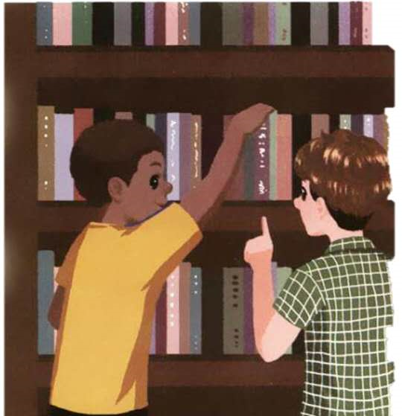

Let’s learn
Learn new words！
talk quietly
小声说话
拓展
work quietly安静地工作
We should talk quietly in the library.

Slide 7
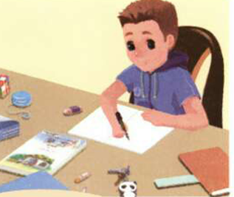
keep your desk clean
保持你的书桌清洁
keep sth. clean保持某物清洁
短语
You should keep your desk clean.

Slide 8
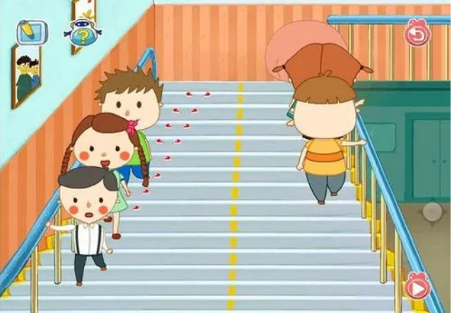
keep to the right 靠右行
keep to the left 靠左行
拓展
Keep to the right, please.请靠右行驶。

Slide 9
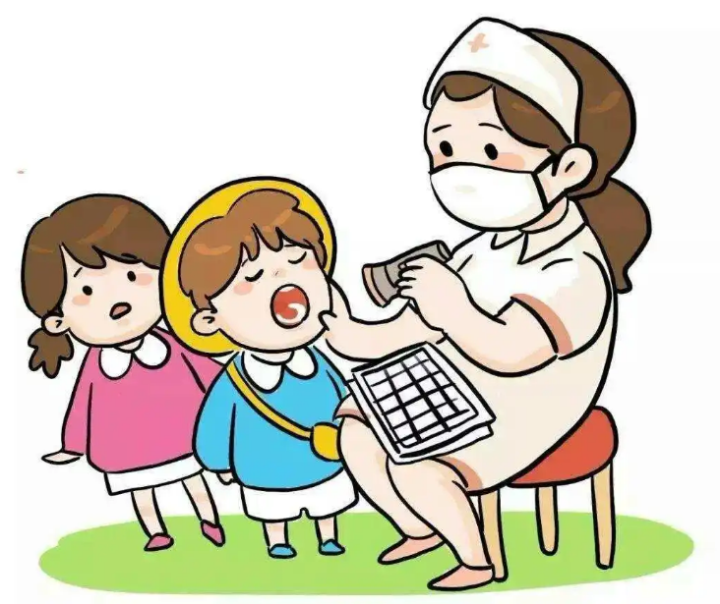
take turns轮流，替换
take turns to do sth./doing sth.
take one’s turn to do sth.
轮到某人做某事
拓展
They take turns to take care of him.他们轮流照顾他。

Slide 10
Read quickly！
快速说出所出现图片表示的英语。

Slide 11

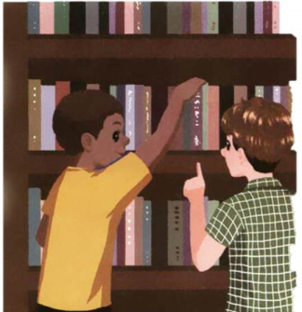
keep your desk clean
take turns
talk quietly
keep to the right

Slide 12
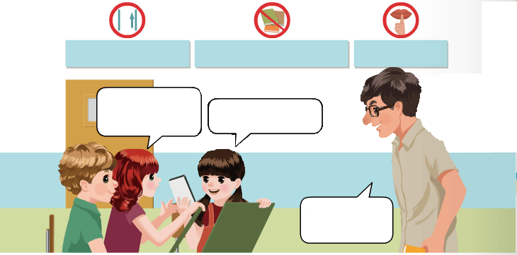
Listen to the tape.
Keep to the right.
Keep your desk clean.
Talk quietly.
Can we use your crayons?
OK. Take turns.
Talk quietly, please.

Slide 13




Language point.
Keep your desk clean.
【详解】该句为祈使句。祈使句主要用来表达请求、命令、建议、叮嘱或祝愿等。它的主语多是 you(通常省略)。
句型结构:行为动词原形 + 其他.
e.g. Keep quiet.
Keep silent!

Slide 14
祈使句的句式：
类 型 |  | 例 句
行为动词引导的祈使句 |  | Sit down! Come in!
Be 引导的祈使句,后常加形容词 |  | Be careful! Be quiet!
Let…引导的祈使句 | Let's + 动词原形.表建议,“我们……” | Let's have a rest. Let's go out and play football.
 | Let us“让我们……”, 表示希望得到对方允许 | Let us buy you a drink. Let us go.

Slide 15
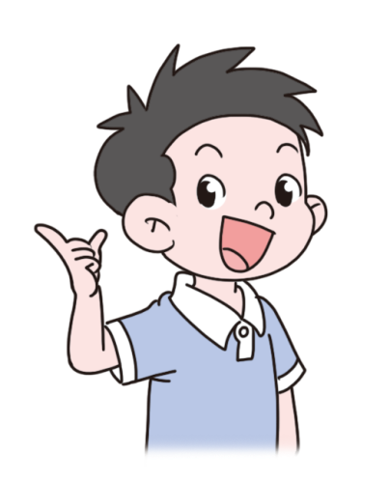
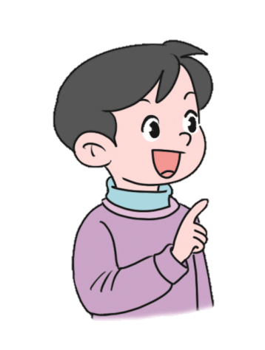

Role play.
OK. Take turns.
Can we use your crayons?
Talk quietly, please.

Slide 16
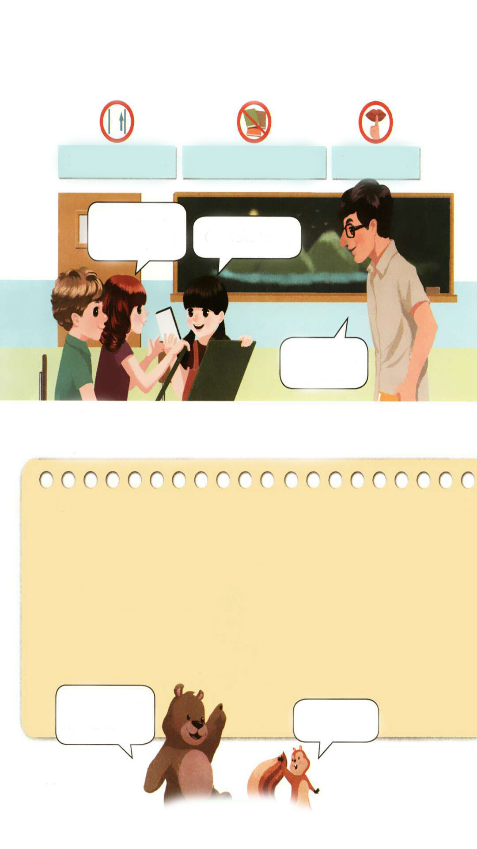
Look for pictures based on phrases.
Keep your desk clean.
Talk quietly.
Keep to the right.

Slide 17



Play a game.
What’s missing?

Slide 18
Look, match and say.
1. He is talking in the library. A. Keep to the right.
2. We are playing a game. B. Talk quietly.
3. She is colouring at her desk. C. Take turns.
4. They are writing in class. D. Keep your desk clean.
5. They are walking on a bridge. E. Work quietly.
He is talking in the library.
Talk quietly.

Slide 19
1. He is talking in the library. A. Keep to the right.
2. We are playing a game. B. Talk quietly.
3. She is colouring at her desk. C. Take turns.
4. They are writing in class. D. Keep your desk clean.
5. They are walking on a bridge. E. Work quietly.
We are playing a game.
Take turns.

Slide 20
1. He is talking in the library. A. Keep to the right.
2. We are playing a game. B. Talk quietly.
3. She is colouring at her desk. C. Take turns.
4. They are writing in class. D. Keep your desk clean.
5. They are walking on a bridge. E. Work quietly.
She is colouring at her desk.
Keep your desk clean.

Slide 21
1. He is talking in the library. A. Keep to the right.
2. We are playing a game. B. Talk quietly.
3. She is colouring at her desk. C. Take turns.
4. They are writing in class. D. Keep your desk clean.
5. They are walking on a bridge. E. Work quietly.
They are writing in class.
Work quietly.

Slide 22
1. He is talking in the library. A. Keep to the right.
2. We are playing a game. B. Talk quietly.
3. She is colouring at her desk. C. Take turns.
4. They are writing in class. D. Keep your desk clean.
5. They are walking on a bridge. E. Work quietly.
They are walking on a bridge.
Keep to the right.

Slide 23
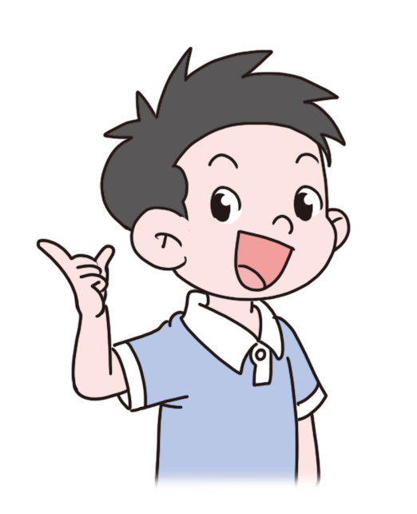
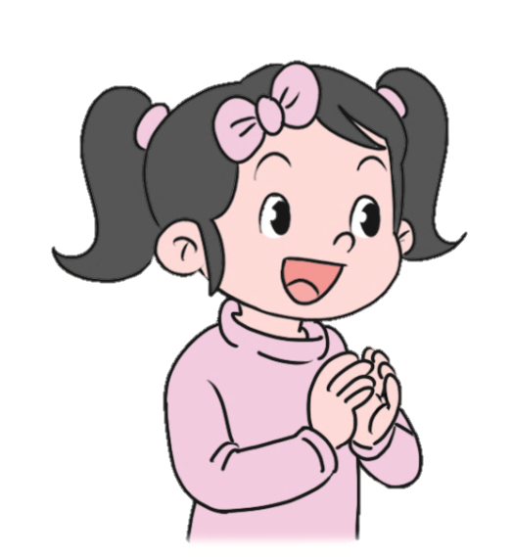
Let’s practice.
We are playing a game.
Take turns.
Work quietly.
They are writing in class.

Slide 24
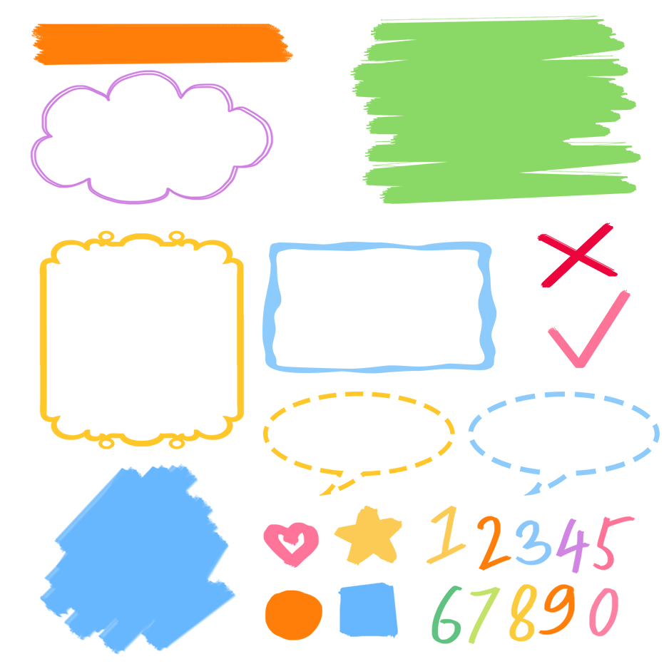
了解表示行为规范的词组
记忆表示行为规范的词组
熟练运用表示行为规范的词组表达

Slide 25
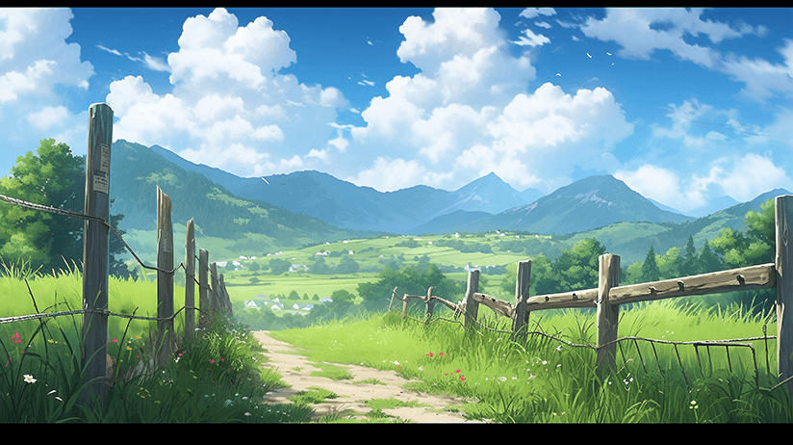
Good to know
Life is not all roses.
人生并不是康庄大道。

Slide 26
Exercises
一、单项选择。
( ) 1. Please ____ turns.
A. take B. takes C. taking
( ) 2. Keep ____the right, please.
A. at B. in C. to
( ) 3.They are ____ on a bridge.
A. walk B. walking C. walks
A
C
B

Slide 27
二、按照要求完成句子。
1.He is talking in the library.(对划线部分提问)
____________________________________
2.class, they, writing, in, are (.)(连词成句)
_________________________________________
3.under, she, music, tree, listening, the, to, is,(.) (连词成句)
____________________________________
Where is he talking?
They are writing in class.
She is listening to music under the tree.

Slide 28

Summary
学习了下列短语： keep to the right, keep your desk clean, talk quietly, take turns等。

Slide 29
Homework
ONE
TWO
Act the dialogue out and show it to your parents.
Talk about the rules and write a short passage.
Do “Look, match and say” with your friends.

Slide 30







