Slide 1









人 教 PEP 版 英 语 五 年 级 下 册
Unit 6
Work quietly!
Part B
Let’s learn & Look, match and say

Slide 2

Warm up
Can you read the words?
where
what
when
quiet
whose
who
can
wall
white
well
wait
weather

Slide 3

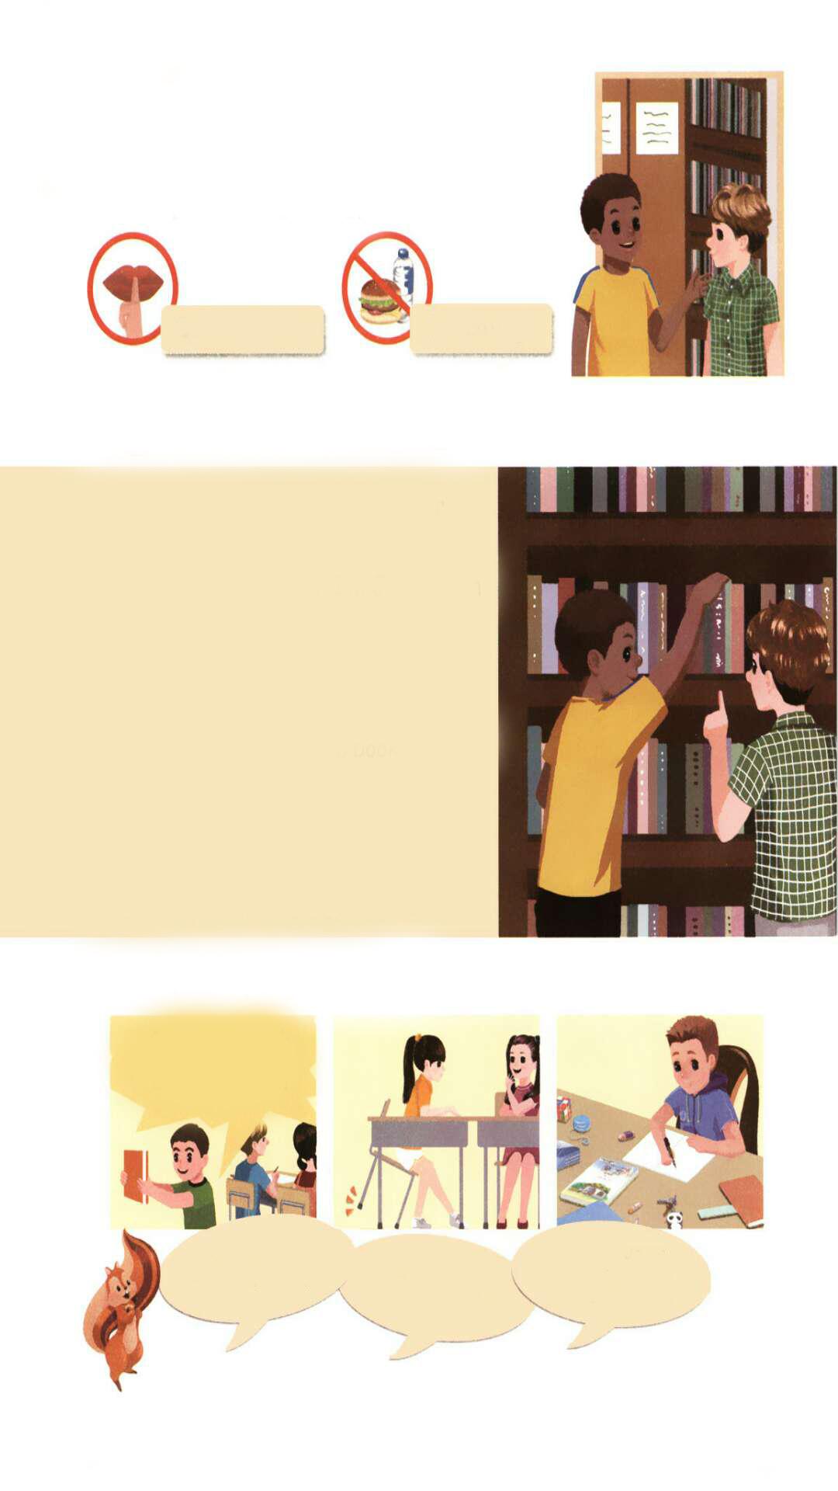
Act out.
Tom:
John:
Tom:
John:
Tom:
John:
Tom:
John:
Tom:
My name is Tom. What’s your name?
Shh. Talk quietly. I’m John. I can show you the English books.
Thanks.
Here they are.
Ok. Can I read the books here?
Yes. Of course.
Anything else?
Yes. Keep your desk clean.
Ok, I will. Thanks.

Slide 4

Lead in
What are the rules in the library?
Talk quietly.

Slide 5

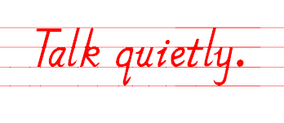

Presentation
小声讲话

Slide 6
Anything else?
Keep you desk clean.

Slide 7

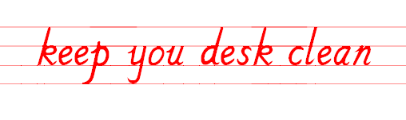
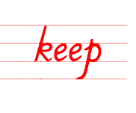
保持你的课桌干净
保持某种状态

Slide 8
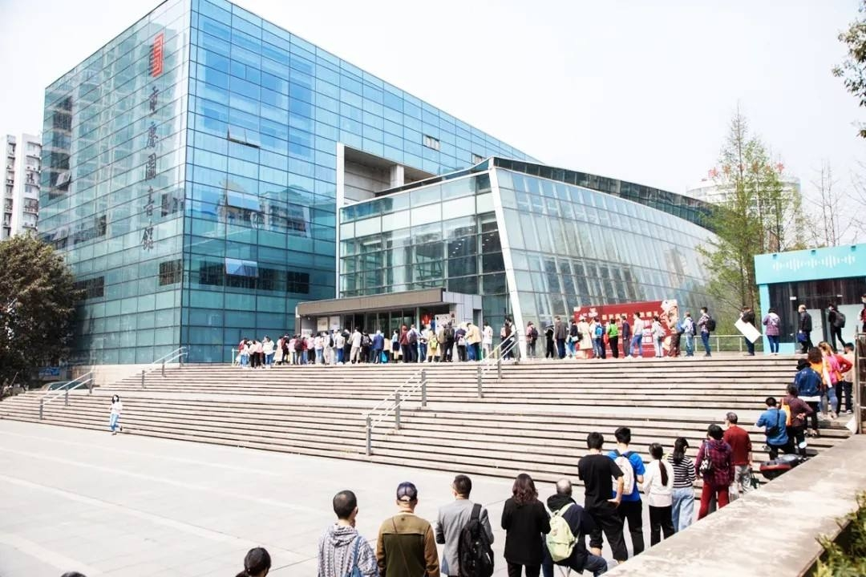

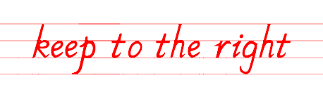
靠右

Slide 9


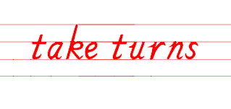
Can I use your pen?
OK. Take turns.
Can I use your pen?
按顺序来

Slide 10
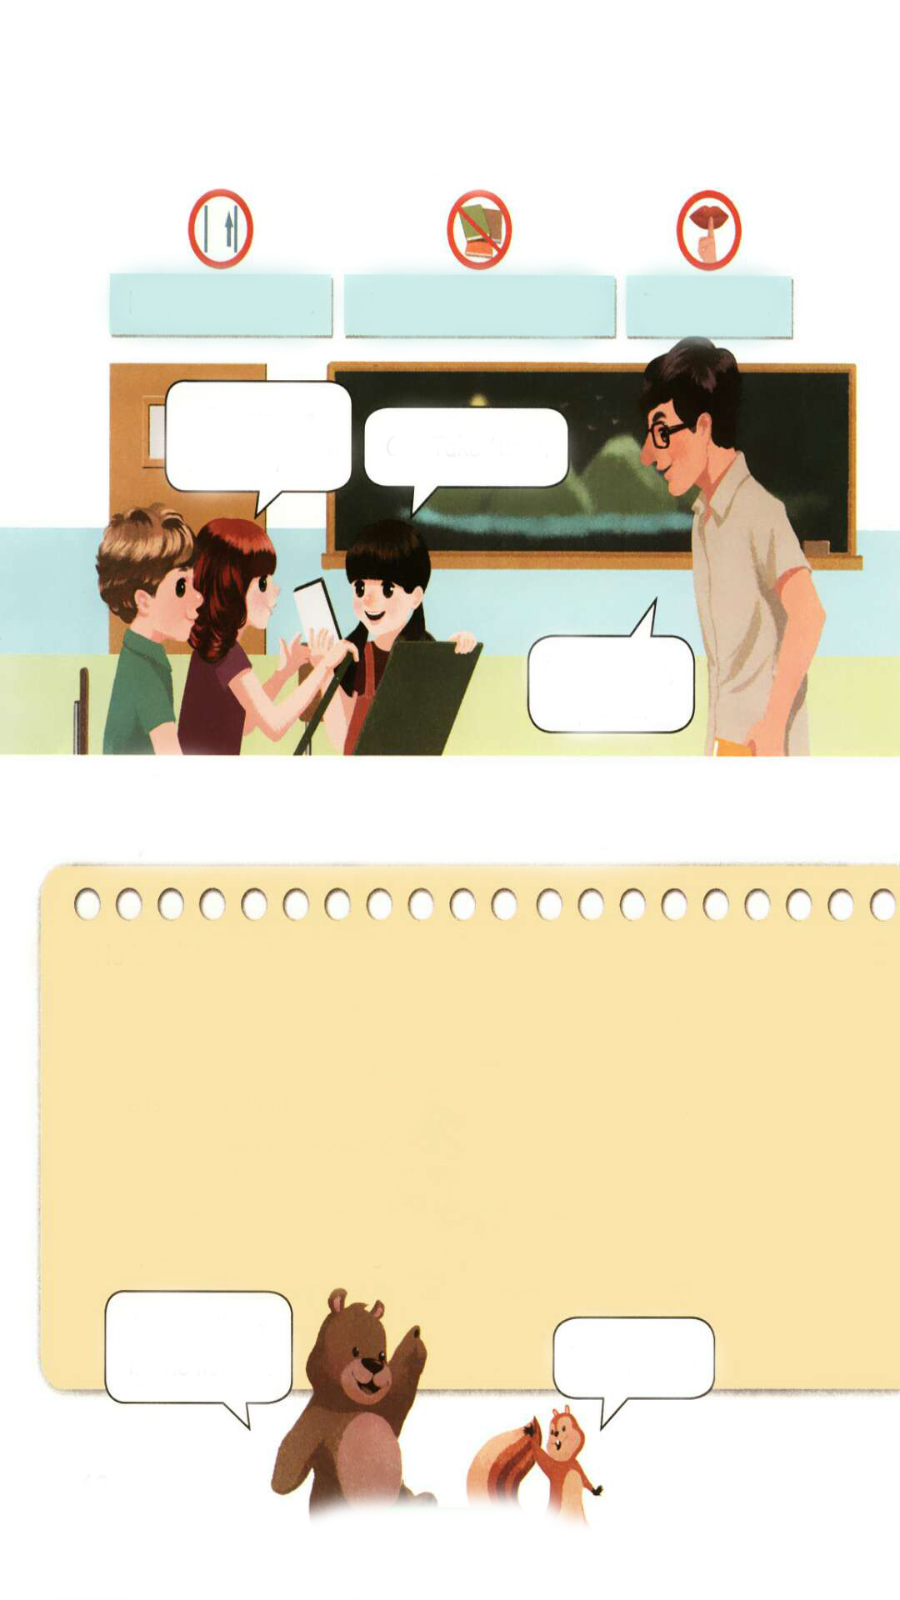
Let’s learn
Read after the tape.
Keep to the right.
Keep your desk clean.
Talk quietly.
Can we use your crayons?
OK. Take turns.
Talk quietly, please.

Slide 11
Language points
Keep your desk clean.
【详解】该句为祈使句。祈使句主要用来表达请求、命令、建议、叮嘱或祝愿等。它的主语多是 you(通常省略)。
句型结构:行为动词原形 + 其他.
e.g. Keep quiet.
Keep silent!

Slide 12
祈使句的句式：
类 型 |  | 例 句
行为动词引导的祈使句 |  | Sit down! Come in!
Be 引导的祈使句,后常加形容词 |  | Be careful! Be quiet!
Let…引 导 的祈使句 | Let's + 动词原形. 表 建议,“我们……” | Let's have a rest. Let's go out and play football.
 | Let us“让我们……”, 表示希望得到对方允 许 | Let us buy you a drink. Let us go.

Slide 13
Look for pictures based on phrases.
Keep your desk clean.
Talk quietly.
Keep to the right.

Slide 14



What’s missing?

Slide 15
I say you do.
Keep your desk clean.
Keep to the right.
Talk quietly.

Slide 16
Act the dialogue.
Keep to the right.
Keep your desk clean.
Talk quietly.
Can we use your crayons?
OK. Take turns.
Talk quietly, please.

Slide 17
Practice
Look, match and say
1. He is talking in the library. A. Keep to the right.
2. We are playing a game. B. Talk quietly.
3. She is colouring at her desk. C. Take turns.
4. They are writing in class. D. Keep your desk clean.
5. They are walking on a bridge. E. Work quietly.
He is talking in the library.
Talk quietly.

Slide 18

I want to know
不以规矩，不能成方圆。 -《孟子》
No rules, no circle.
-Mencius
请遵守学校的规则！
Please follow the school rules！

Slide 19

Exercises
一、汉译英。
keep to the right
保持某种状态 靠右
按顺序来 顺序
小声说话 听音乐
keep
take turns
turn
talk quietly
listening to music

Slide 20
二、单项选择。
( )1. — Are you from China?
— .
A. Yes, I am. B. Yes, I do. C. No, I don't.
( )2. Please turns.
A. takes B. taking C. take
( )3.— What is Grandma doing?
— .
A. She is sleeping. B. She sleeps. C. She is sleep.
A
C
A

Slide 21
三、连词成句。
on a are they walking bridge (.)
__________________________
2. is talking the he library in (.)
__________________________
3. we your use crayons can (?)
__________________________
They are walking on a bridge.
He is talking in the library.
Can we use your crayons?

Slide 22


Summary
学习了下列短语： keep to the right, keep your desk clean, talk quietly, take turns等。
七彩课堂
伴你成长

Slide 23

Homework
ONE
TWO
七彩课堂
伴你成长
Talk about the rules and write a short passage.
Act the dialogue out and show it to your parents.
Do “Look, match and say” with your friends.

Slide 24








