Slide 1


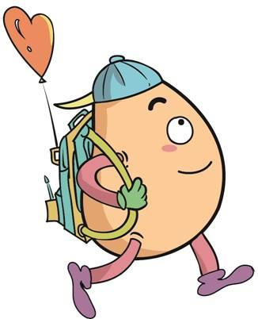






人 教 PEP 版 英 语 五年 级 下 册
Unit 6
Work quietly!
Part B & Part C
Read and write—Story Time

Slide 2

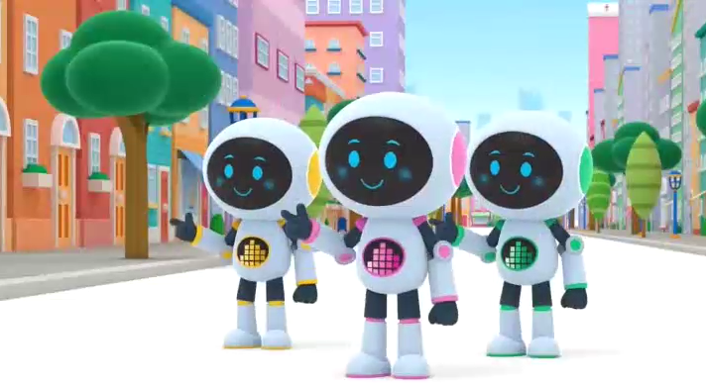
Warm up

Slide 3

Lead in
What is the robot doing?
It is cleaning.

Slide 4
Presentation
Talk about what they are doing.
Talk about what the robots are doing.
Talk about what people are doing.
Zoom and Zip watch the film.

Slide 5



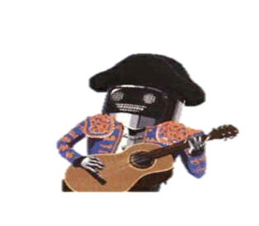



Read and write
Read and answer.
What are they doing?Fill in the form.

Slide 6


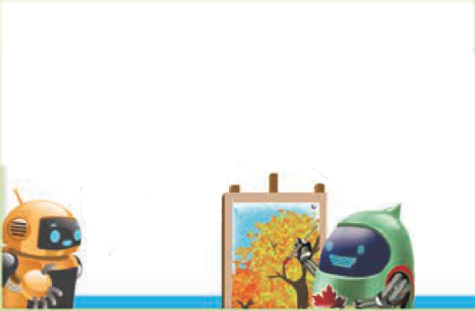
Read and write.
The world robot exhibition
Ni hao. Ni zai gan shen me ne?
Sorry. What are you saying?
Oh, hello.
What are you doing?
I’m drawing a picture.
Have a look.
I’m speaking Chinese.
It’s lovely.

Slide 7

Are you cooking?
Yes. I’m cooking rice. Asako is making sushi.
Can we play music with you?
Sure. Please take turns.
Are you from China?
Yes, I am.
Are you doing kung fu?
You’re so cool! Can you teach me?
Yes, I am.
I’ll show you.
Sure!

Slide 8
What are they doing?
She’s cooking rice. Asako is making sushi.
He’s drawing a picture.
He’s playing music.
He’s doing kung fu.
He’s talking with Robin.

Slide 9
Listen and repeat.
Ni hao. Ni zai gan shen me ne?
Sorry.
What are you saying?
说某种语言用speak.
I’m speaking Chinese.

Slide 10
Oh, hello.
What are you doing?
I’m drawing a picture.
Have a look.
画画
看一看
It’s lovely.

Slide 11
Yes. I’m cooking rice. Asako is making sushi.
Are you cooking?
做饭
做寿司

Slide 12
玩音乐
Sure. Please take turns.
Can we play music with you?
轮流

Slide 13
be from来自
Are you from China?
Yes, I am.
You’re so cool! Can you teach me?
V.教
Sure!

Slide 14
Are you doing kung fu?
Yes, I am.
I’ll show you.
给你看

Slide 15
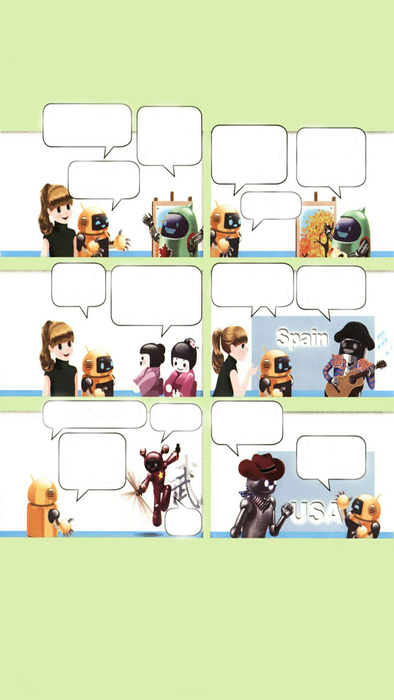
Fill in the blanks.
The Canadian robot is a picture. Asako is sushi.
The Spanish robot is music. Robin is kung fu.
Sarah and Robin are to the Spanish robot.
drawing
making
playing
doing
talking

Slide 16

Act out.
Which robot do you like best? Act it out.

Slide 17

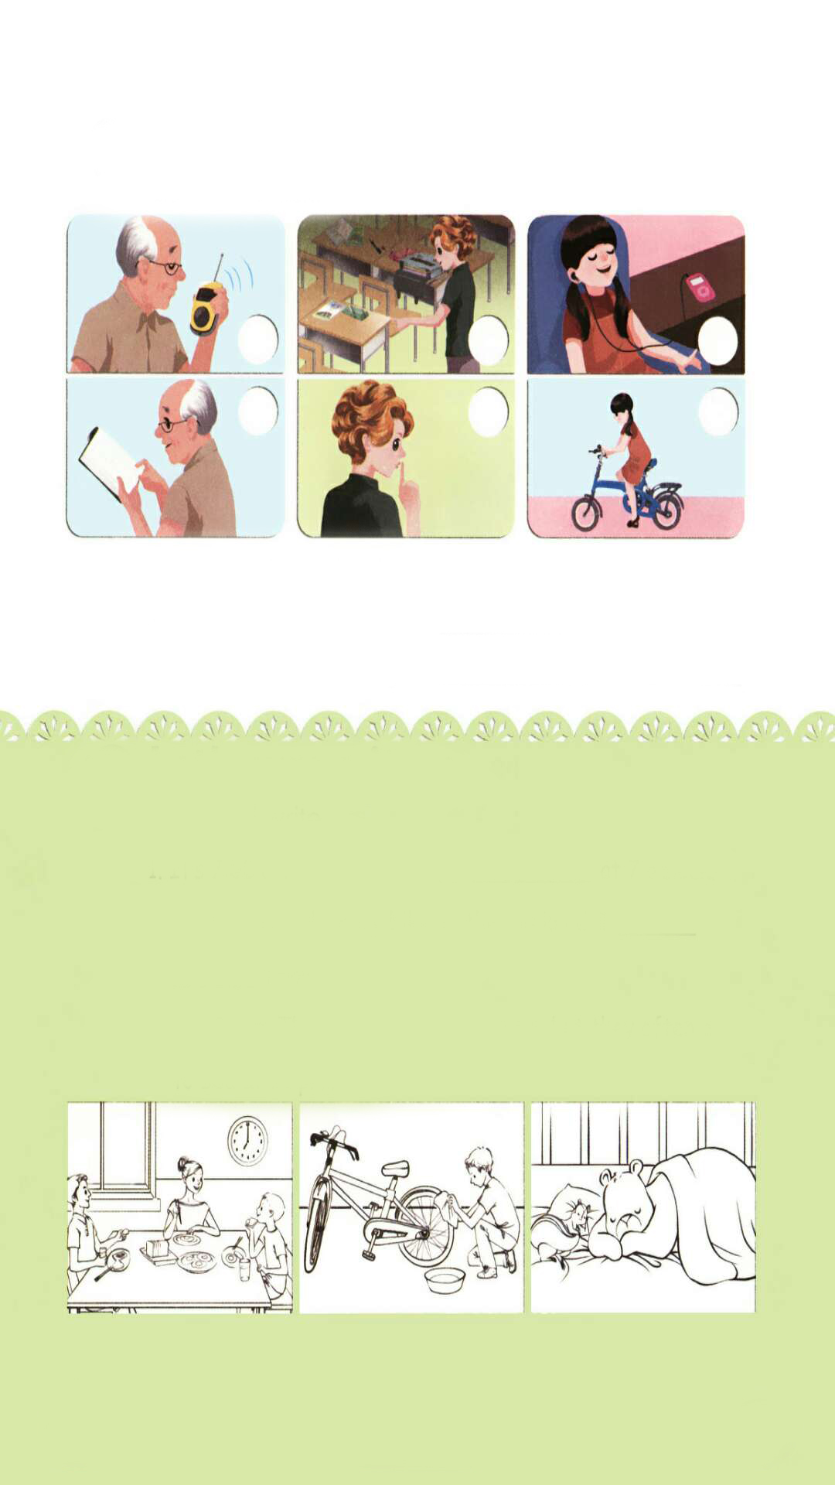
Let’s check
Listen and tick.
√
√
√

Slide 18
1. Robin:
Binbin:
Robin:
2. John:
Mike:
Miss White:
3. Chen Jie:
Zhang Peng:
Mike:
Chen Jie:
ZhangPeng&Mike:
Where is Grandpa, Binbin?
He's in his room. He's reading a book.
Oh, OK.
Mike, can I use your pen, please?
OK, John. Here you are!
Talk quietly!
I'm listening to English music. It's cool.
I like English music.
I like it, too.
Here, listen! Take turns.
Thanks.

Slide 19
Listen again and write.
1. What is Grandpa doing?
2. What is Chen Jie doing?
He is reading a book.
She is listening to English music.

Slide 20

Look and write.
Let’s wrap it up
Game time
It’s 7:00 a.m. We ________ ________ _________
at 7 o’clock.
2. I sometimes clean my bike on the weekend.
I __________ __________ it now.
3. It’s 9 p.m. They _________ _________ now, but they often go to bed at 10 p.m.
are eating breakfast
am cleaning
are sleeping

Slide 21

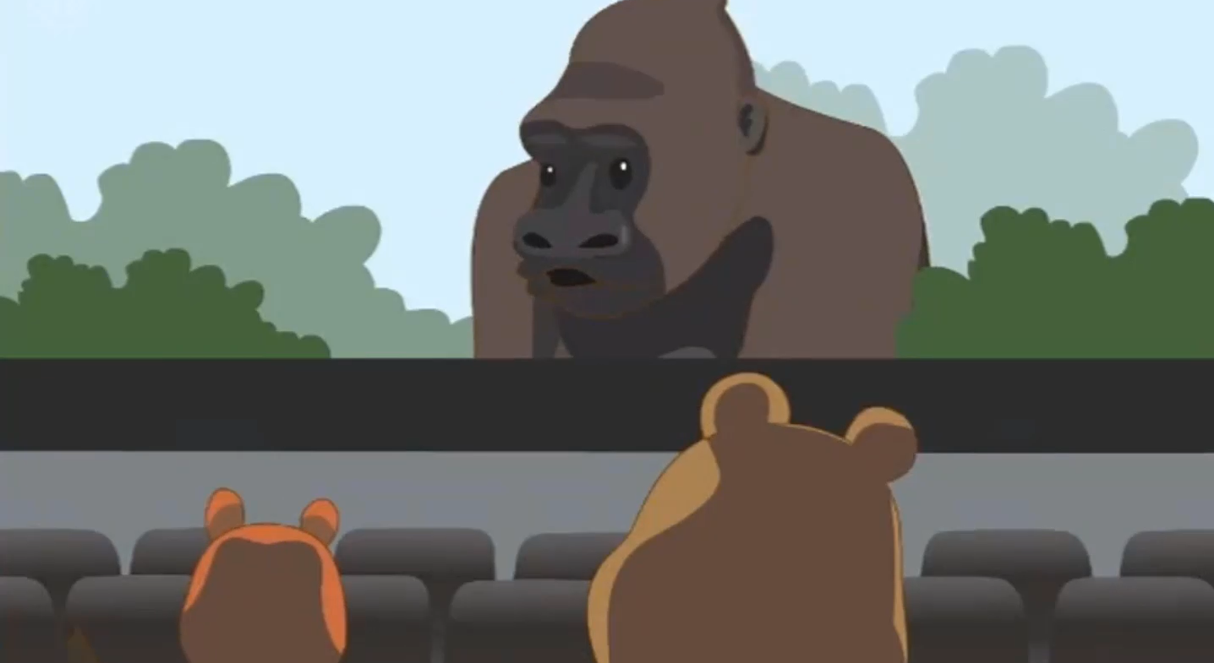
Story time
Watch the video.

Slide 22
Read and answer.
1.Where are Zoom and Zip?
2. What is the film about?
3. What is Zoom eating?
4. Who asked them to talk quietly?
They are in the cinema.
It’s about a gorilla.
He is eating popcorn.
Tiger.

Slide 23
Listen and repeat.
Zip: I love the film.
Zoom: Yes. The gorilla is great!
Zip: Wow! The gorilla is eating a banana.
Zoom: It’s so big and strong.
Zip: What’s that noise?
Zoom: I’m eating popcorn.
Zip: It’s so excting!
Zoom: Yes, it is!
Tiger: Shh! Talk quietly!
Zoom: Sorry!
Zip: Look at the sign.
Zoom: Oh, no!
/ɡəˈrɪlə/大猩猩
强壮的
/ˈpɒpkɔːn/爆米花
令人兴奋的,指物；指人用excited.
看这个标志

Slide 24

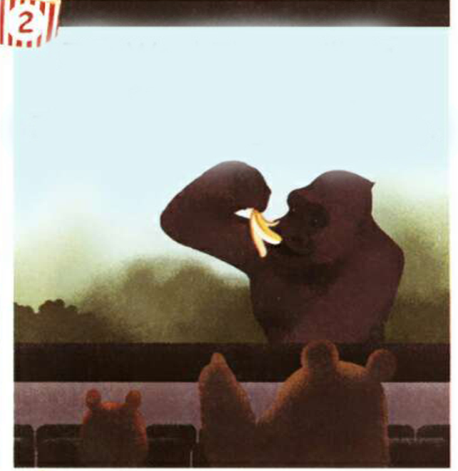
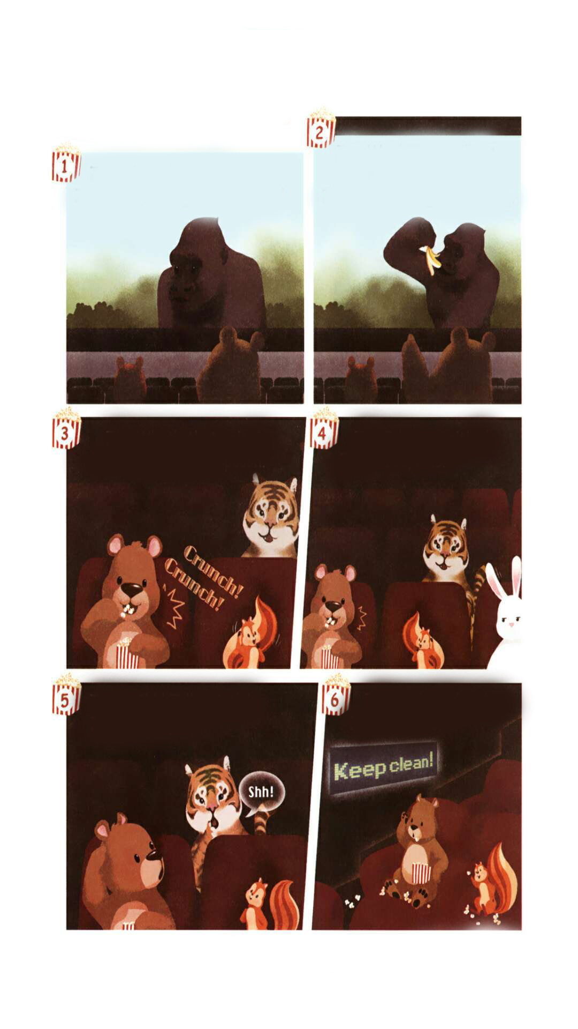
Read again
Zip: I love the film.
Zoom: Yes. The gorilla is great!
Zip: Wow! The gorilla is eating a banana.
Zoom: It’s so big and strong.
Zip: What’s that noise?
Zoom: I’m eating popcorn.
Zip: It’s so excting!
Zoom: Yes, it is!
Tiger: Shh! Talk quietly!
Zoom: Sorry!
Zip: Look at the sign.
Zoom: Oh, no!

Slide 25
Role play.
Zip: I love the film.
Zoom: Yes. The gorilla is great!
Zip: Wow! The gorilla is eating a banana.
Zoom: It’s so big and strong.
Zip: What’s that noise?
Zoom: I’m eating popcorn.
Zip: It’s so excting!
Zoom: Yes, it is!
Tiger: Shh! Talk quietly!
Zoom: Sorry!
Zip: Look at the sign.
Zoom: Oh, no!

Slide 26

流利地朗读
流利地表演
有感情地表演

Slide 27
Exercises
一、英汉互译。
1. 说英语________________________
2. 来自_____________________
3. draw a picture________________
4. play music__________________
5. make sushi_______________
6. look at the sign____________
7. 在周末 ____________
speak English
be from
画画
玩音乐
做寿司
看这个标志
on the weekend

Slide 28
二、将Ⅰ栏与Ⅱ栏组合成短语。
Ⅰ栏 Ⅱ栏
1. draw A. kung fu
2. do B. a picture
3. play C. sushi
4. make D. music

Slide 29
三、单项选择。
( )1. I ____speaking English.
A. am B. is C. are
( )2. —Can you ____ me to dance?
—Sure.
A. teach B. teacher C. teaching
( )3. Look. Robin is ____ rice.
A. make B. making C. makeing
A
A
B

Slide 30
四、按照要求完成句子。
1.I’m drawing a picture.(对划线部分提问)
___________________________
2.me, you, music, can, with, play (?)(连词成句)
___________________________________
3.He is from China. (变为一般疑问句)
____________________________________
What are you doing?
Can you play music with me?
Is he from China?

Slide 31

Summary
1.能够正确听、说、认读单词：exhibition, teach, say, Canadian, Spanish, sushi等。
2.能用I am …句型简单介绍某机器人正在干什么。
3.能够了解不同国家机器人的特点。

Slide 32
Homework
ONE
TWO
Make sentences like Read and write.
Read the story to your parents.
Act the story out in groups.

Slide 33







