Slide 1









人 教 PEP 版 英 语 五 年 级 下 册
Unit 6
Work quietly!
Part B & Part C
Read and write—Story time

Slide 2

Warm up
I say you do
Look! I’m listening to music!
Look! I’m playing with each other!
Look! I’m jumping!
Look! I’m dancing!
Look! I’m drawing!

Slide 3
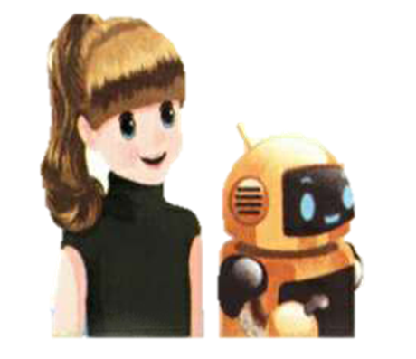
Lead in
Who are they?
They are Sarah and Robin.
What are they doing? Let’s have a look.

Slide 4
Presentation
Read and write
What are Robin and Sarah doing?
They are seeing the world robot exhibition.
展览

Slide 5

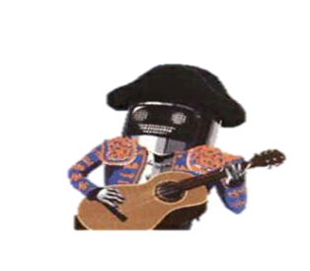
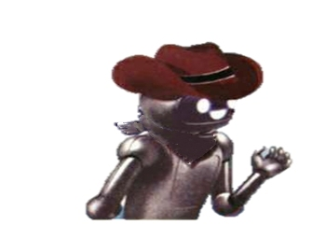
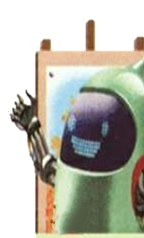


Today, Robin and Sarah are seeing the world robot exhibition. How many kinds of robots do they see?
They see five kinds of robots.
Where are they from?
Cananda
Japan
Spain
China
USA

Slide 6

Listen and fill in the form.
What are they doing?
She’s cooking rice. Asako is making sushi.
He’s drawing a picture.
He’s playing music.
He’s doing kung fu.
He’s talking with Robin.

Slide 7
Listen and read.
Robin:
Robot 1:
Robin:
Robot 1:
Robin:
Robin:
Ni hao. Ni zai gan shen me ne?
Sorry. What are you saying?
I’m speaking Chinese.
Oh, hello. What are you doing?
I’m drawing a picture. Have a look.
It’s lovely.
Are you cooking?

Slide 8
Robot 2:
Sarah:
Robot 3:
Robin:
Robot 4:
Robin:
Robot 4:
Robot 5:
Robin:
Yes. I’m cooking rice. Asako is making sushi.
Can we play music with you?
Sure. Please take turns.
Are you from China?
Yes, I am.
You’re so cool! Can you teach me?
Sure!
Are you doing kung fu?
Yes, I am. I’ll show you.

Slide 9
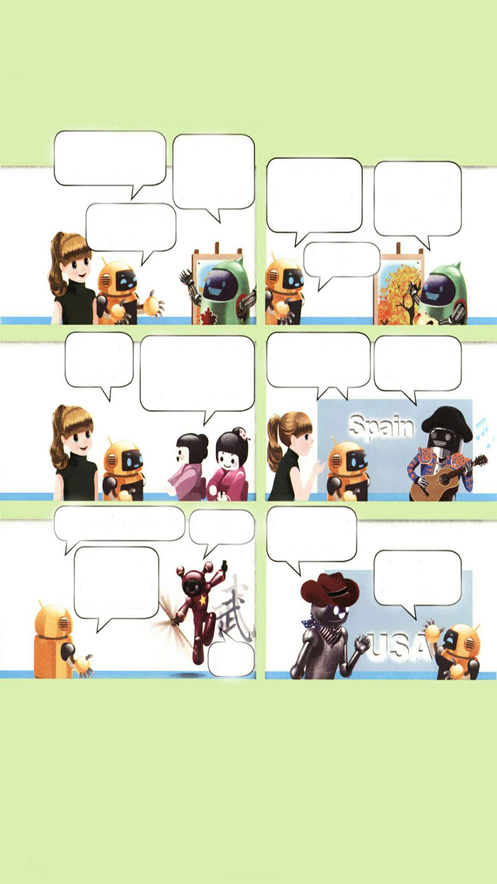
Fill in the blanks.
The Canadian robot is a picture. Asako is sushi.
The Spanish robot is music. Robin is kung fu.
Sarah and Robin are to the Spanish robot.
drawing
making
playing
doing
talking

Slide 10
Which robot do you like best? And act it out.

Slide 11
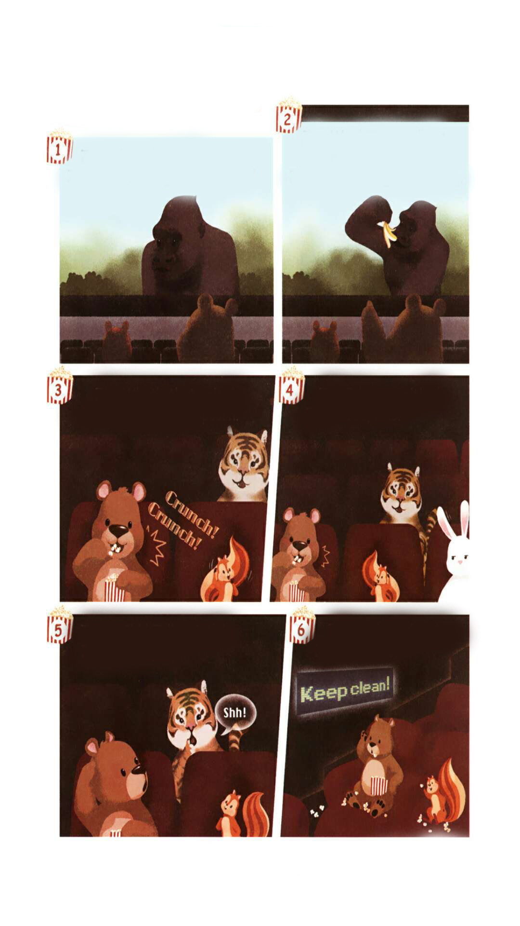
Story time
Where are Zip and Zoom?
They are in the cinema.

Slide 12
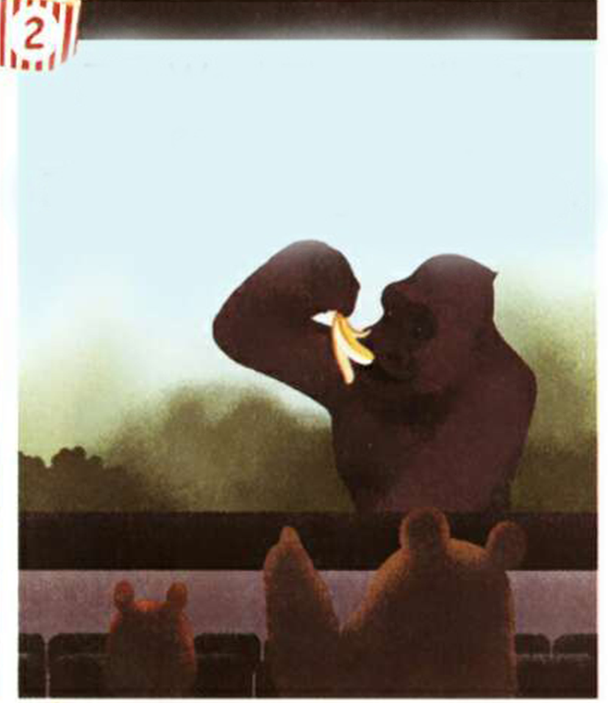
Watch and answer the questions.
点击画面 播放视频
1. What’s the film about?
It’s about a gorilla.
猩猩
2. What is the animal in the film doing?
It’s eating a banana.

Slide 13
The film is good. But why are the tiger and the rabbit not happy? Watch and answer.
Because Zoom is eating popcorn. They are making noise. Zoom and Zip are talking, too.
爆米花

Slide 14
Now Zoom and Zip are quiet. But what happens next?
It’s not clean.
What is the sign about on the wall?
标语
Keep clean.

Slide 15
Read by yourself.
Zip:
Zoom:
Zip:
Zoom:
Zip:
Zoom:
Zip:
Zoom:
Tiger:
Zoom:
Zip:
Zoom:
I love the film.
Yes. The gorilla is great!
Wow! The gorilla is eating a banana.
It's so big and strong.
What's that noise?
I'm eating popcorn.
It's so exciting!
Yes, it is!
Shh! Talk quietly!
Sorry!
Look at the sign.
Oh, no!

Slide 16
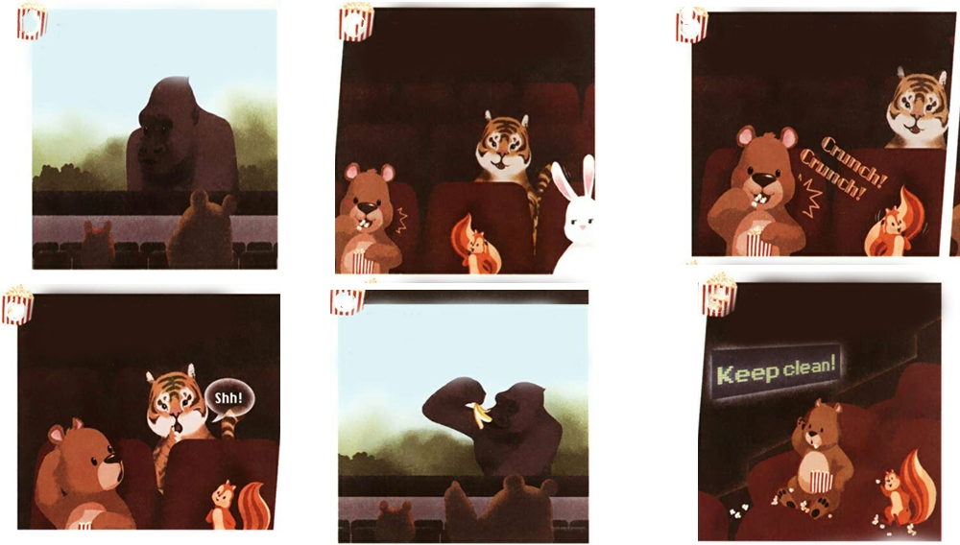
Number the pictures.
①
④
③
⑤
②
⑥

Slide 17
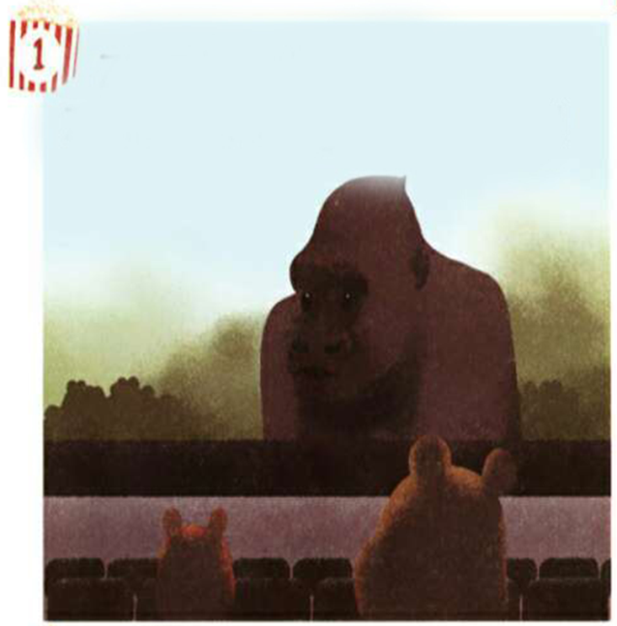

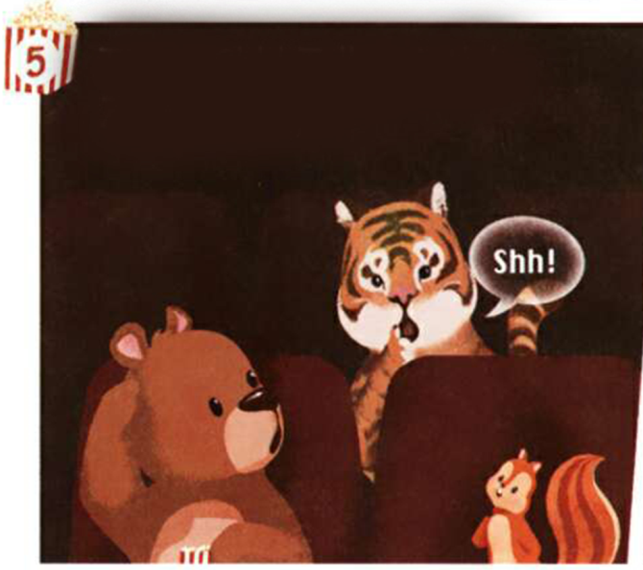
Act it out.

Slide 18
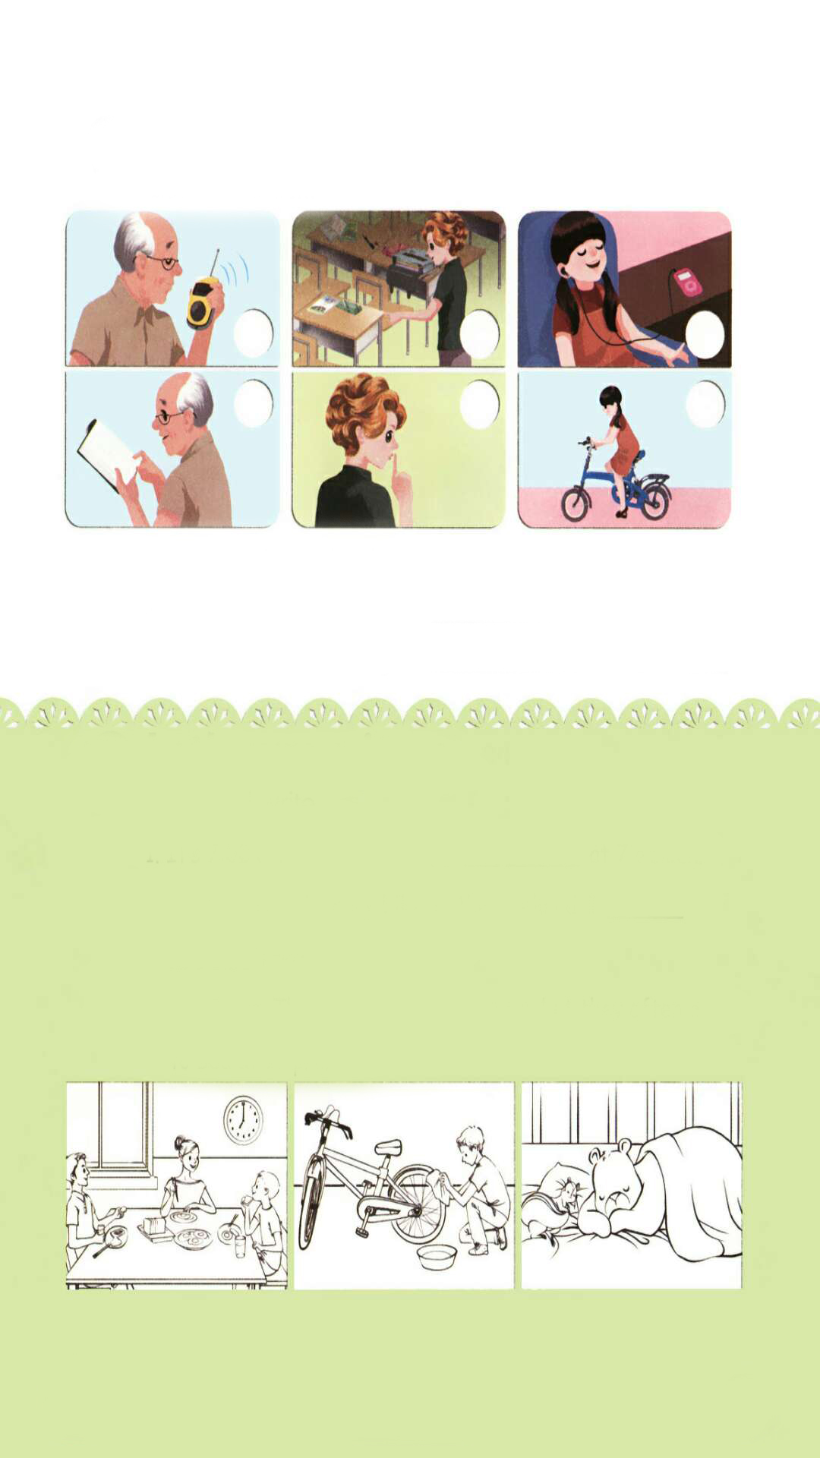
Practice
Let’s check
Listen and tick.
√
√
√

Slide 19
Listen again and write.
1. What is Grandpa doing?
2. What is Chen Jie doing?
He is reading a book.
She is listening to music.

Slide 20
听力材料：
1. Robin:
Binbin:
Robin:
2. John:
Mike:
Miss White:
3. Chen Jie:
Zhang Peng:
Mike:
Chen Jie:
ZhangPeng&Mike:
Where is Grandpa, Binbin?
He's in his room. He's reading a book.
Oh, OK.
Mike, can I use your pen, please?
OK, John. Here you are!
Talk quietly!
I'm listening to English music. It's cool.
I like English music.
I like it, too.
Here, listen! Take turns.
Thanks.

Slide 21
Let’s wrap it up
Look and write.
It’s 7:00 a.m. We ________ ________ _________
at 7 o’clock.
2. I sometimes clean my bike on the weekend.
I __________ __________ it now.
3. It’s 9 p.m. They _________ _________ now, but they often go to bed at 10 p.m.
are eating breakfast
am cleaning
are sleeping

Slide 22

Exercises
一、将Ⅰ栏与Ⅱ栏组合成短语。
Ⅰ栏 Ⅱ栏
1. draw A. kung fu
2. do B. a picture
3. play C. sushi
4. make D. music

Slide 23
二、单项选择。
( )1. I ____speaking English.
A. am B. is C. are
( )2.—Can you ____ me to dance?
—Sure.
A. teach B. teacher C. teaching
( )3. Look. Robin is ____ rice.
A. make B. making C. makeing
A
A
B

Slide 24
三、按要求完成句子。
1. I’m drawing a picture.（就画线部分提问）
______________________________
2. Are you cooking? (作肯定回答。)
______________________________
3. take, please, turns(.) (连词成句。)
______________________________
What are you doing?
Yes, I am.
Please take turns.

Slide 25


Summary
1.能够正确听、说、认读单词：exhibition, teach, say, Canadian, Spanish, sushi等。
2.能用I am …句型简单介绍某机器人正在干什么。
3.能够了解不同国家机器人的特点。
七彩课堂
伴你成长

Slide 26

Homework
ONE
TWO
Make sentences like Read and write.
Read the story to your parents.
七彩课堂
伴你成长
Act the story out in groups.

Slide 27








