Slide 1


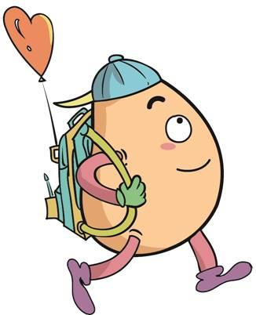






人 教 PEP 版 英 语 五年 级 下 册
Unit 6
Work quietly!
Part B
Let’s try & Let’s talk

Slide 2
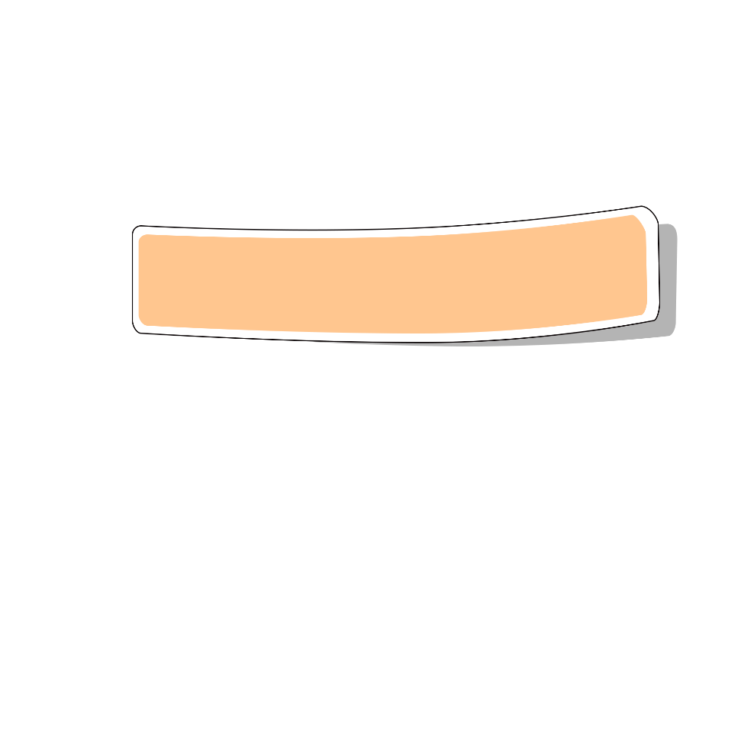
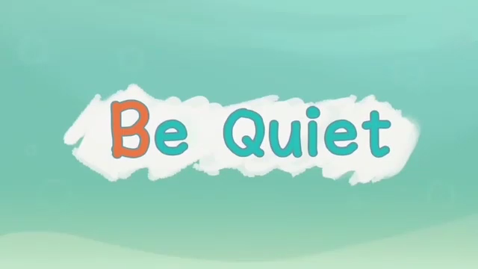
Warm up

Slide 3
Review
Can you read the words?
where
what
when
quiet
whose
who
can
wall
white
well
wait
weather

Slide 4
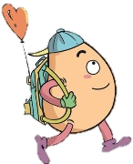
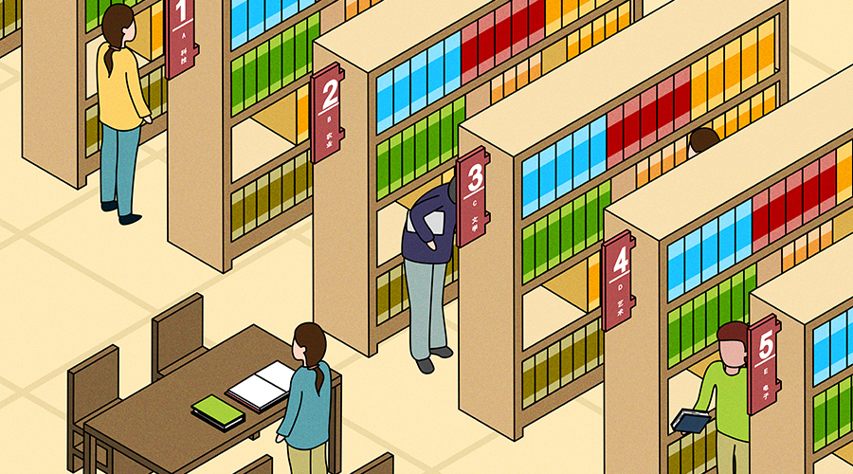
Lead in
Free talk！
Look! Where are they?
They are in the library.

Slide 5
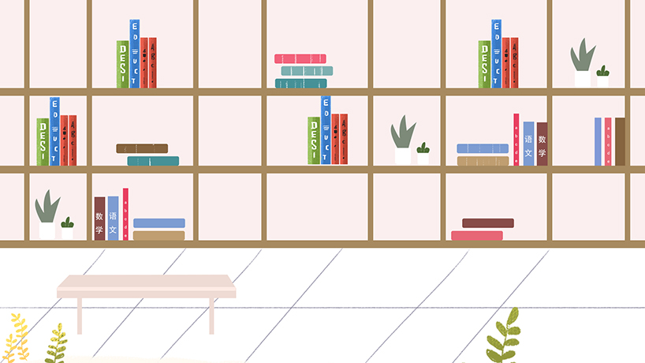
What should we do in the library?

Slide 6
Presentation
Talk about the things to pay attention to.
Talk about talking quietly in the library.
Talk about talking quietly and keep the desk clean in the library.
Talk about other things to pay attention to.

Slide 7


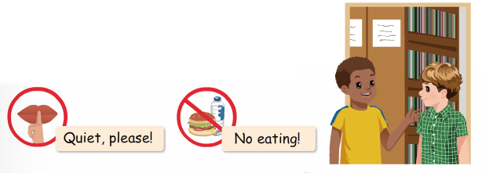
Let’s try
Listen and circle.

Slide 8
Let’s check！
Tom: Hi, I am new here. Is this the library?
John: Yes, it is. Can I help you?
Tom: Yes. Where are the English books?
John: Oh. Over here!
Teacher: Shh! Talk quietly!

Slide 9
Listen and choose.
根据对话内容选择正确答案。
1. _____ is new.
A. Tom B. John
2. The English books are ____.
A. in my schoolbag B. over here
3. They are in the _______.
A. library B. classrom

Slide 10

Let’s talk
Watch and answer！
Where are they?
2. What book can John show Tom?
3. Can Tom read the books in the library?
4. Should Tom keep his desk clean?

Slide 11
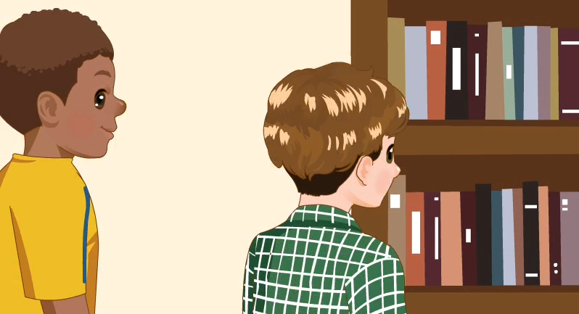

Slide 12
Where are they?
2. What book can John show Tom?
3. Can Tom read the books in the library?
4. Should Tom keep his desk clean?
They are in the library.
He can show him the English book.
Yes, he can.
Yes, he should.

Slide 13

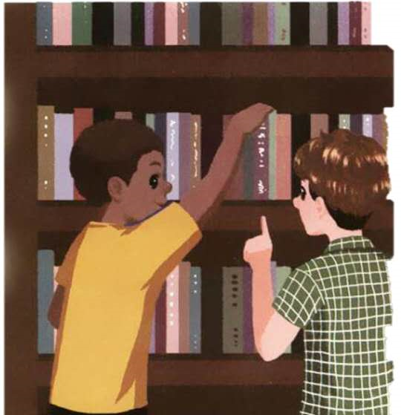
Listen to the tape.
Tom:My name is Tom. What’s your name?
John:Shh. Talk quietly. I’m John. I can
show you the English books.
Tom:Thanks.
John:Here they are.
Tom:Ok. Can I read the books here?
John:Yes. Of course.
Tom:Anything else?
John:Yes. Keep your desk clean.
Tom:Ok, I will. Thanks.

Slide 14
Read in roles.
Tom:My name is Tom. What’s your name?
John:Shh. Talk quietly. I’m John. I can
show you the English books.
Tom:Thanks.
John:Here they are.
Tom:Ok. Can I read the books here?
John:Yes. Of course.
Tom:Anything else?
John:Yes. Keep your desk clean.
Tom:Ok, I will. Thanks.

Slide 15

Read and act
1.Read it together.
2.Each student
reads a sentence.
Tip: Choose one to read in two. 选择一种两人练习。
3. Read in roles.
自己分配角色。

Slide 16
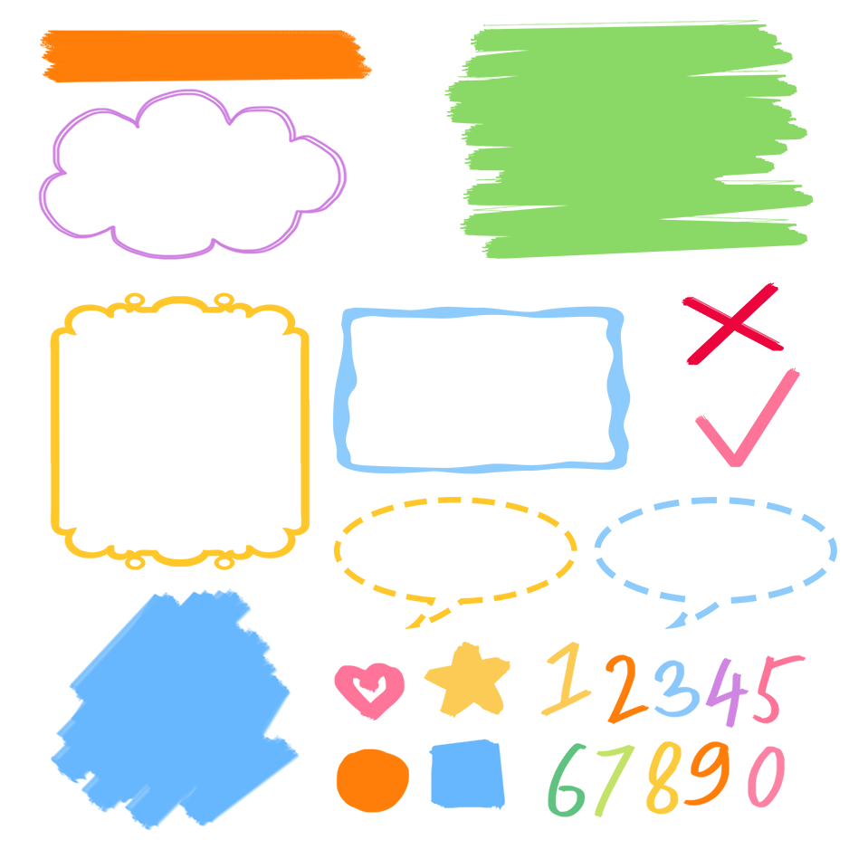
流利地朗读
流利地表演
有感情地表演

Slide 17
Listen and repeat
给……看
adv.安静地；adj. quiet安静的
Tom:My name is Tom. What’s your name?
John:Shh. Talk quietly. I’m John. I can
show you the English books.
Tom:Thanks.
John:Here they are.
Tom:Ok. Can I read the books here?
John:Yes. Of course.
Tom:Anything else?
John:Yes. Keep your desk clean.
Tom:Ok, I will. Thanks.
此句是部分倒装句；正常语序为They are here.
还有别的事吗？
保持某种状态

Slide 18
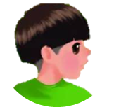
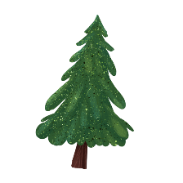


Language point.
Here they are.
【详解】这是一个部分倒装句,正常语序是“They are here.”“Here we are.”的意思是“我们在这儿。”等于“We are here.”。
e.g. Look, here he is.

Slide 19
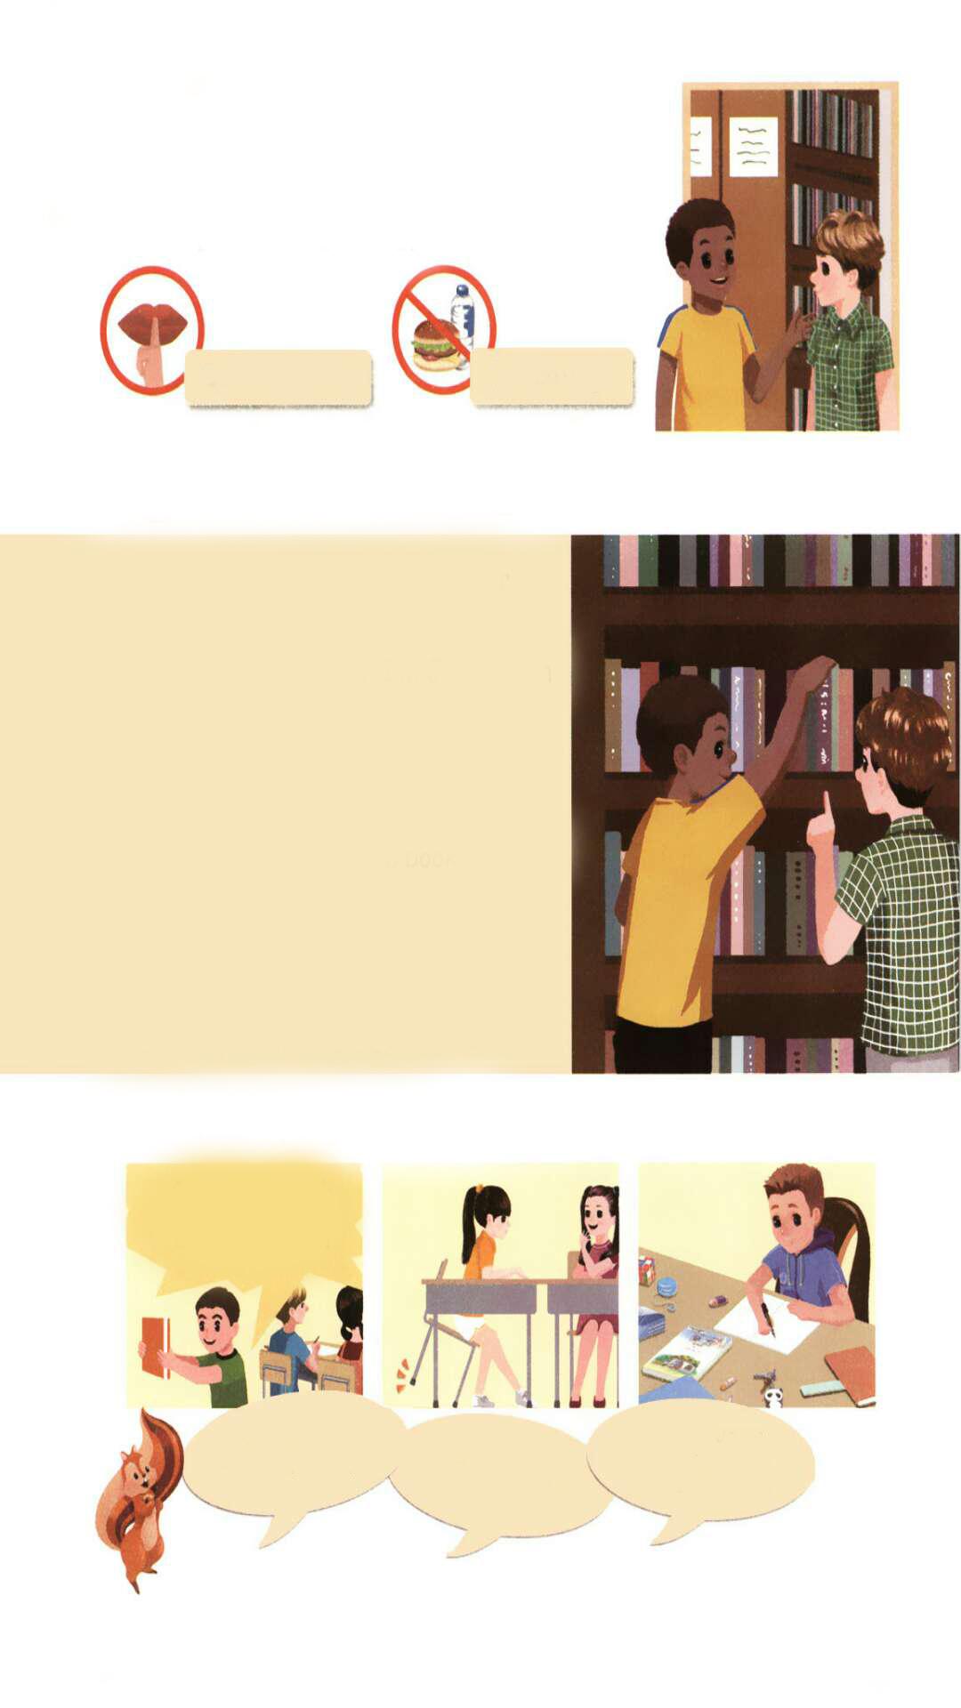
Match, say and act.
Oh, my English book is here!!!
Keep your desk clean!
Work quietly!
Talk quietly!

Slide 20
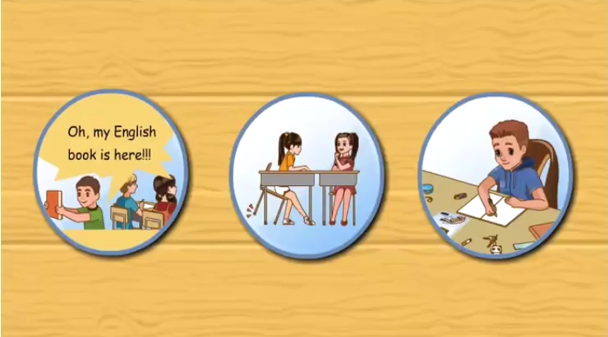
Let’s check.

Slide 21
Work in pairs.
Make dialogues and act.
Oh, my English book is here!!!
A:What are you doing?
B:I’m looking for my English book.Oh,my English book is here!!!
A:Shh.Talk quietly.
B:Sorry.
Talk quietly!

Slide 22
A:What are you doing?
B:I’m reading.
A:Can I sit here?
B:Of course.Work quietly,please!
A:OK,I will.
Work quietly!

Slide 23
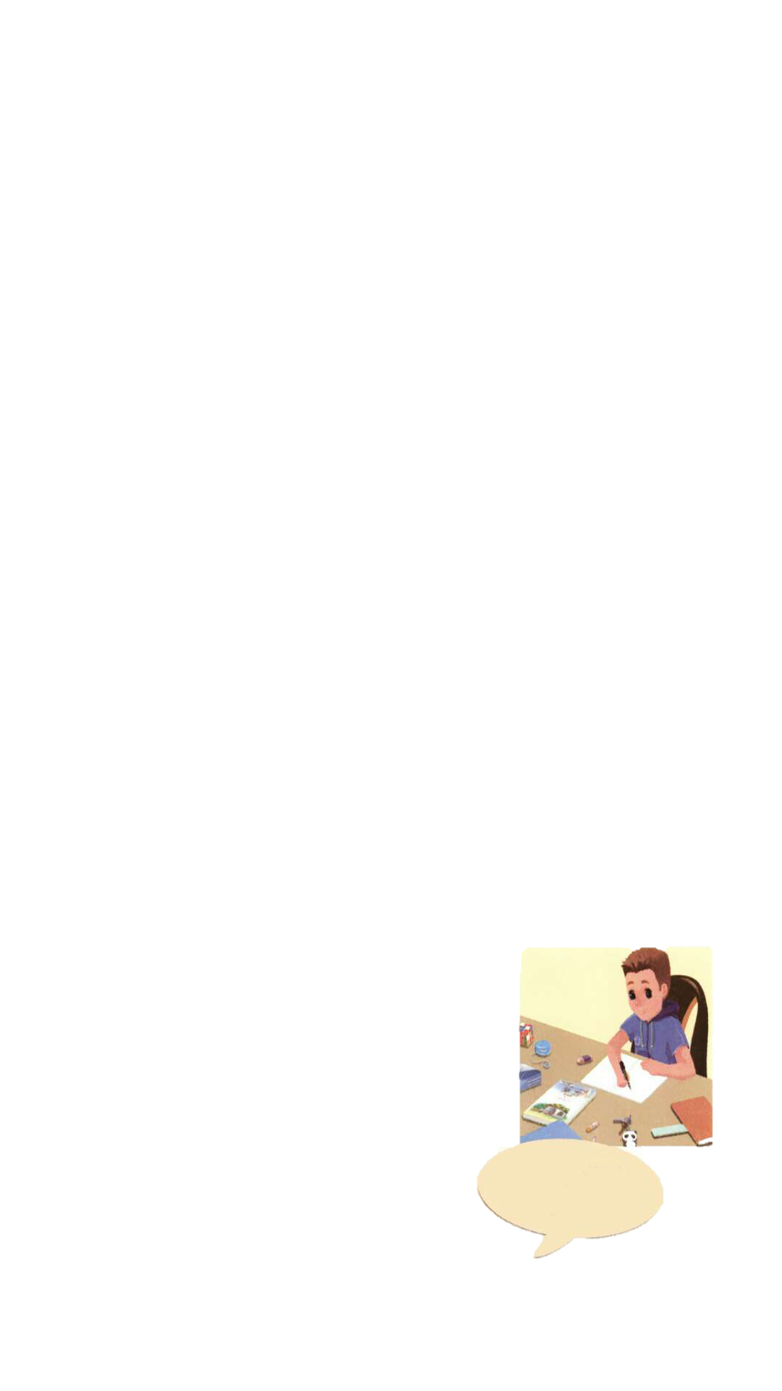
A:What are you doing?
B:I’m doing my homework.
A:Keep your desk clean.
B:OK,I will.
Keep your desk clean!

Slide 24

Good to know
Do one thing at a time, and do well!
一次只做一件事，做到最好！

Slide 25
Exercises
一、按要求写单词。
1. quiet（副词）_______
2. 给我看看你的书（英语）______________
3. new（反义词）_______
4. 看书（汉译英）___________
5. in the library（英译汉）_______
quietly
show me your book
old
read books
在图书馆

Slide 26
二、单项选择。
( )1. Talk________, please.
A. quiet B. quietly C. be quiet
( )2.—________ your desk clean.
—Ok.
A. Keep B. Keeps C. Keeping
( )3. —What’s your name?
—________
A. I’m John. B. I’m eleven. C. I’m tall.
B
A
A

Slide 27
三、按照要求完成句子。
1.You should keep your desk clean. (改为祈使句)
____________________________________
2.you, I, the, can, books, show, English(.)(连词成句)
____________________________________
3.He can read the books here. (改为一般疑问句)
_____________________________
Keep your desk clean.
I can show you the English books.
Can he read the books here?

Slide 28

Summary
学习了下列句型：
— Talk quietly.
— Keep your desk clean.
— Here they are.

Slide 29
Homework
ONE
TWO
Act the dialogue out with your friends.
Make a short dialogue using the sentences we have learnt.
Tell your father talk quietly.

Slide 30







