Slide 1









人 教 PEP 版 英 语 五 年 级 下 册
Unit 6
Work quietly!
Part B
Let’s try & Let’s talk

Slide 2


Warm up
Let’s chant.
Where is my cat?
Where is she?
Who can find her?
One, two, three.
What does she drink? What does she eat? Where is she hiding? Under my seat.
点击画面 播放视频

Slide 3

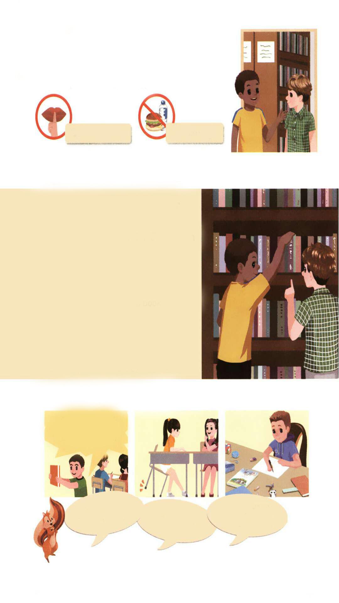
Lead in
Look! Where are they?
They are in the library.
What happens? Let’s listen and circle.

Slide 4
Presentation
Let’s try
Listen and circle.
√
Quiet, please!
No eating!

Slide 5

听力材料：
Tom: Hi, I am new here. Is this the library?
John: Yes, it is. Can I help you?
Tom: Yes. Where are the English books?
John: Oh. Over here!
Teacher: Shh! Talk quietly!

Slide 6
What else can they do in the library?
They can
read storybooks.
Can they talk and laugh loudly in the library?
There are some rules in the library.

Slide 7

Let’s talk
Let’s listen and find out the rules.
Talk quietly.
小声讲话
Keep you desk clean.
保持你的课桌干净。

Slide 8
Listen again and answer the questions.
What books does John show Tom?
The English books.
Can he read the books in the library?
Yes, he can.

Slide 9
Listen and read.
Tom:
John:
Tom:
John:
Tom:
John:
Tom:
John:
Tom:
My name is Tom. What’s your name?
Shh. Talk quietly. I’m John. I can show you the English books.
Thanks.
Here they are.
Ok. Can I read the books here?
Yes. Of course.
Anything else?
Yes. Keep your desk clean.
Ok, I will. Thanks.
给人看
其他的事情
保持某种状态

Slide 10
Language point
Here they are.
【详解】这是一个部分倒装句,正常语序是“They are here.”“Here we are.”的意思是“我们在这儿。”等于“We are here.”。
e.g. Look, here he is.

Slide 11

Read and act.
Tom:
John:
Tom:
John:
Tom:
John:
Tom:
John:
Tom:
John:
Tom:
Hi, I’m new here. Is this the library?
Shh. Talk quietly…Yes, it is. Can I help you?
Yes. Where are the English books?
Oh. Let me show you. Here you are.
Thanks. My name is Tom. What’s your name?
I’m John.
John. Can I read the books here?
Yes. Of course.
Anything else?
Yes. Keep your desk clean.
OK. I will. Thanks.

Slide 12
Practice
Match, say and act.
Oh, my English book is here!!!
Keep your desk clean!
Work quietly!
Talk quietly!

Slide 13
Work in pairs.
Oh, my English book is here!!!
Keep your desk clean!
Work quietly!
Talk quietly!

Slide 14

Exercises
一、按要求写单词。
1. show A. 给人看
2. anything else B. 保持某种状态
3. keep C. 小声地
4. quietly D. 其它的事情

Slide 15
二、选择填空。
( )1. Talk________, please.
A. quiet B. quietly C. be quiet
( )2.—________ your desk clean.
—Ok.
A. Keep B. Keeps C. Keeping
( )3. —What’s your name?
—________
A. I’m John. B. I’m eleven. C. I’m tall.
B
A
A

Slide 16
三、连词成句。
can show the books English I you (.)
__________________________________
2. desk keep clean your(.)
__________________________________
3. I the read here books can (?)
___________________________________
I can show you the English books.
Keep your desk clean.
Can I read the books here?

Slide 17


Summary
学习了下列句型：
— Talk quietly.
— Keep your desk clean.
七彩课堂
伴你成长

Slide 18

Homework
ONE
TWO
Act the dialogue out with your friends.
Make a short dialogue using the sentences we have learnt.
七彩课堂
伴你成长
Tell your father talk quietly.

Slide 19








