Slide 1


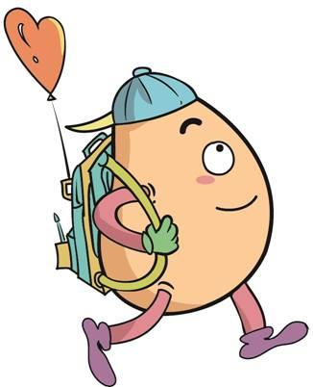






人 教 PEP 版 英 语 五年 级 下 册
Unit 6
Work quietly!
Part A
Let’s learn & Look and say

Slide 2

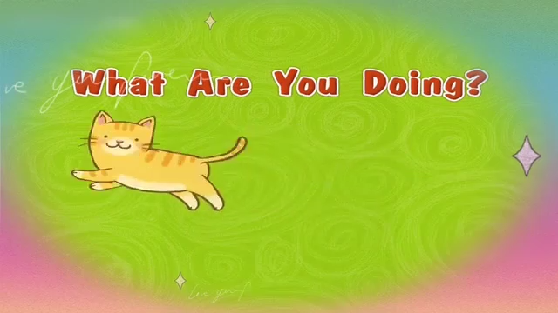
Warm up

Slide 3
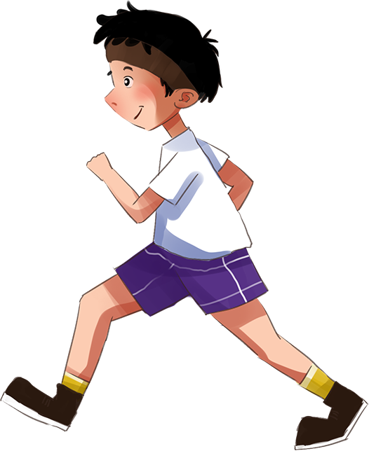
Lead in
Today is Monday. Tell me what you are doing.
6:00 a.m.
Today is Monday. I have a busy day.
It’s 6:00. I’m running.

Slide 4
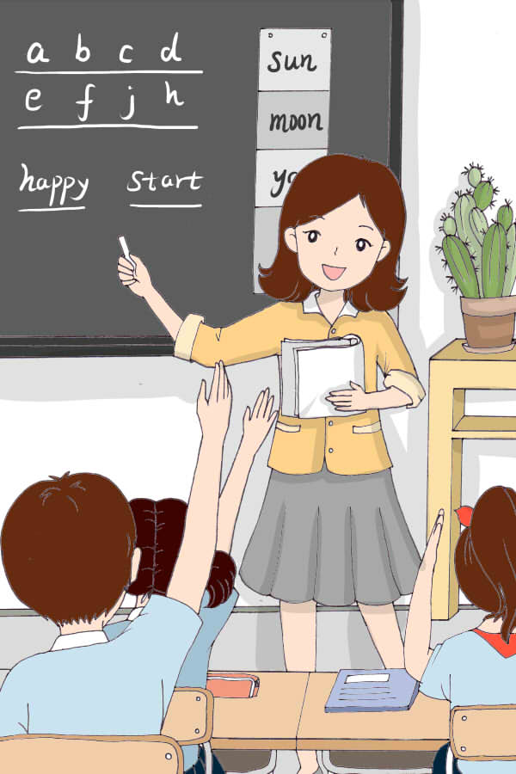
10:00 a.m.
It’s 10:00. I’m having an English
class.

Slide 5

2:00 p.m.
It’s 2:00 p.m. I’m reading a book.

Slide 6
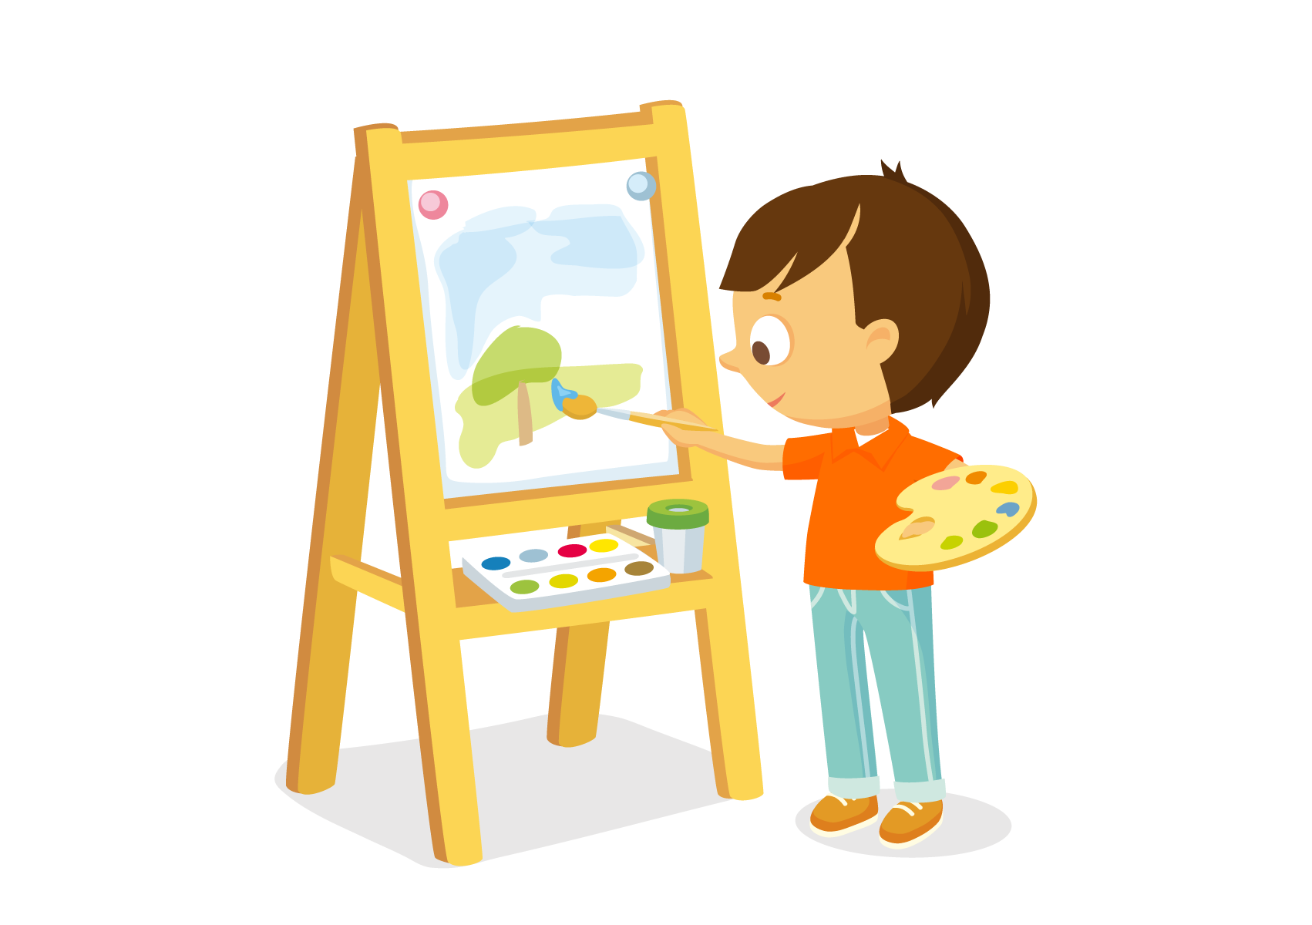
7:00 p.m.
It’s 7:00 p.m. I’m drawing.

Slide 7
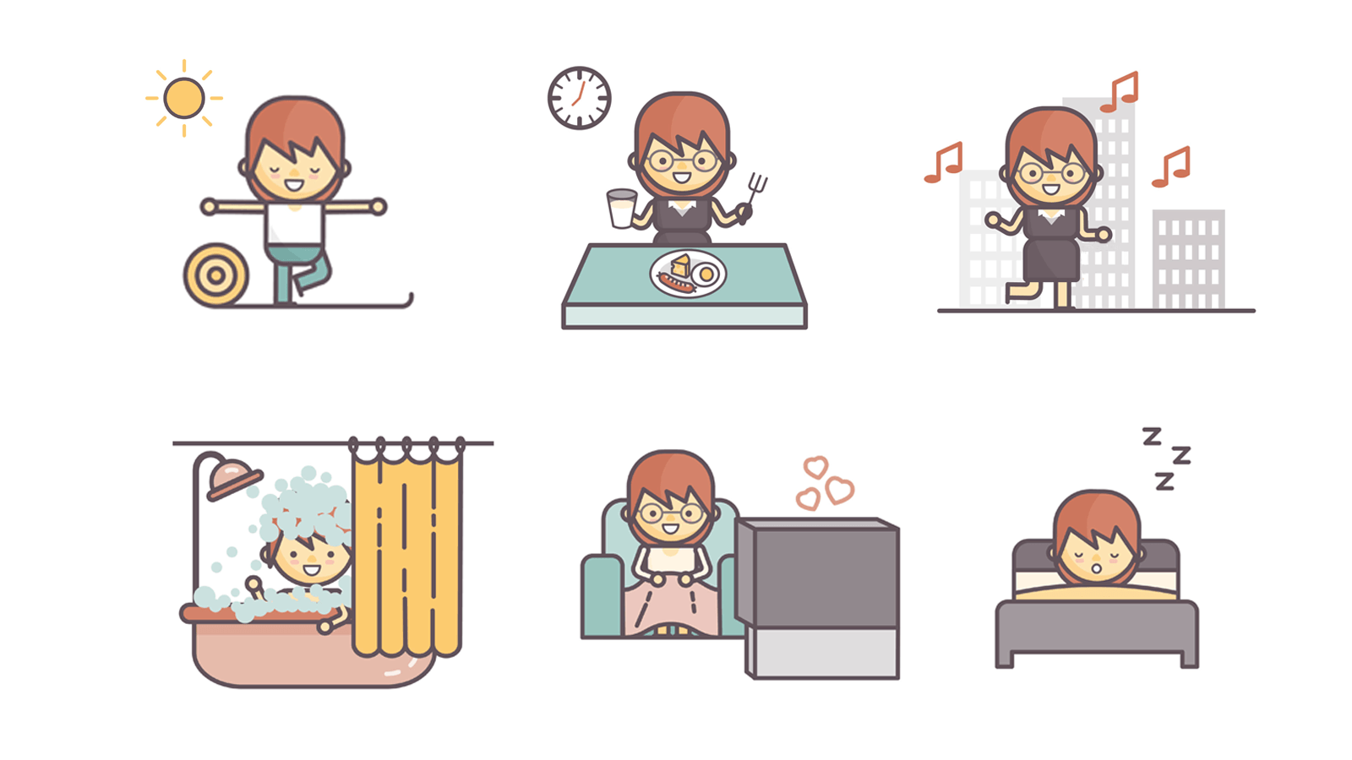
Let‘s see what people are doing!

Slide 8
Presentation
Talk about what they are doing.
Talk about what Chen Jie is doing.
Talk about what you are doing.
Talk about what people are doing.

Slide 9

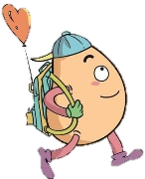
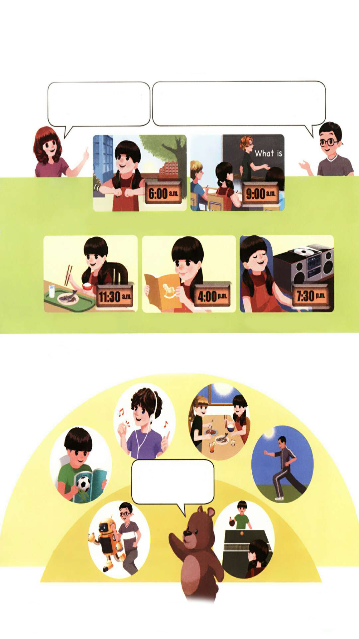

Let’s learn
Learn new words！
doing morning exercises
(正在)做早操
注：exercise在此处作可数名词，常用复数形式。
She is doing morning exercises.

Slide 10
having... class (正在)上......课
拓展：have Chinese class 上语文课
have English class 上英语课
We are having an English class.

Slide 11
eating lunch(正在)吃午饭
同义短语: have lunch
She is eating lunch.

Slide 12
reading a book(正在)看书
She is reading a book.

Slide 13
listening to music(正在)听音乐
She is listening to music.

Slide 14
Match the phrases and pictures！
doing morning exercises
reading a book
listening to music
having... class
eating lunch

Slide 15
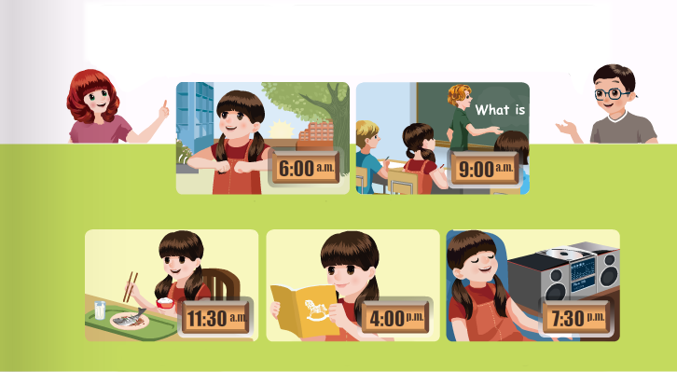
Listen to the tape.
It’s 7:30 p.m. What’s Chen Jie doing?
She’s listening to music. It’s 9 o’clock. What are the students doing?
doing morning exercises
having … class
eating lunch reading a book listening to music

Slide 16
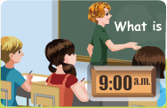
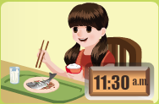
Let’s say.
They are having English class.It’s 11:30.What’s Chen Jie doing?
She’s . It’s 4 o’clock.
What ?
eating lunch
is Chen Jie doing

Slide 17
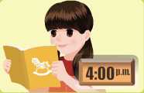
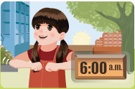
She’s . It’s 6 o’clock.What’s Chen Jie doing?
reading a book
She’s .
doing morning exercises

Slide 18

Play a game
What’s missing?
What’s Chen Jie doing?
She is….

Slide 19

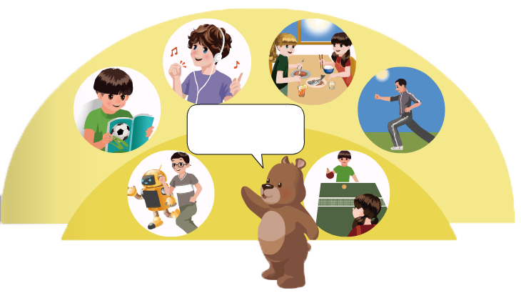
Look and say
Mike ie listening to music.

Slide 20
Wu Binbin and Robin are running.

Slide 21
Zhang Peng is reading a book.

Slide 22
Sarah and Chen Jie are eating lunch.

Slide 23
The man is doing morning exercises.

Slide 24
Zhang Peng and Chen Jie are playing ping-pong.

Slide 25
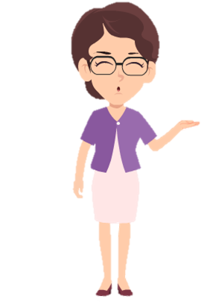
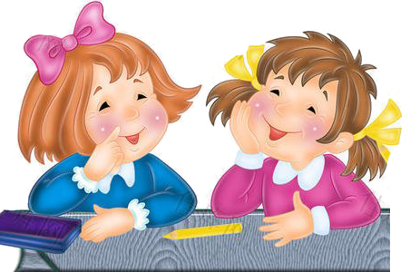
Make dialogues using the following phrases.
listening to music
doing morning exercises
eating breakfast
having … class
playing football
playing sports
eating dinner
reading a book
What is he/ she doing?
He/She is ____.

Slide 26
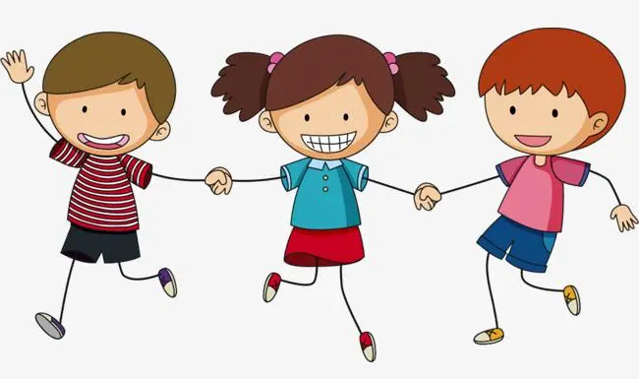
Play a game
接力表演
学生三个人一组进行表演，第一个人表演(做早操)动作，第二个人说单词(doing morning exercises)，第三个人说出句子。如: I’m doing morning exercises.

Slide 27
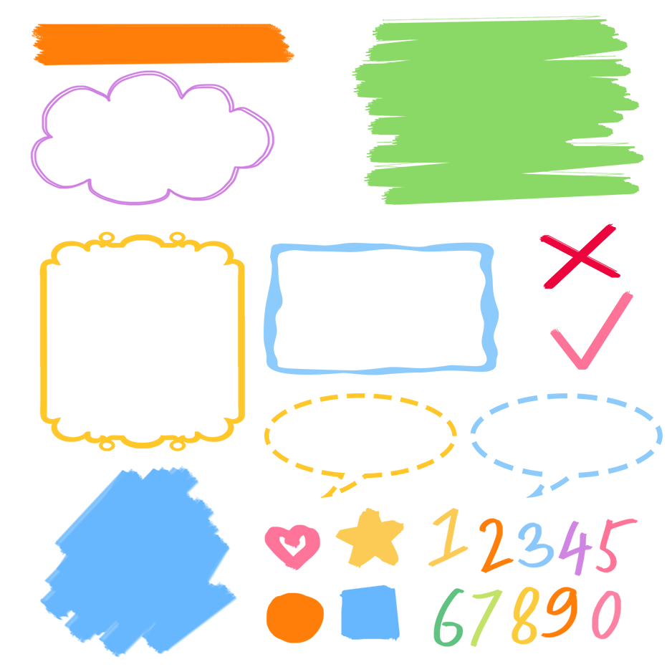
了解描述人物活动的词组
记忆描述人物活动的词组
熟练运用词组表达人物正在做什么

Slide 28
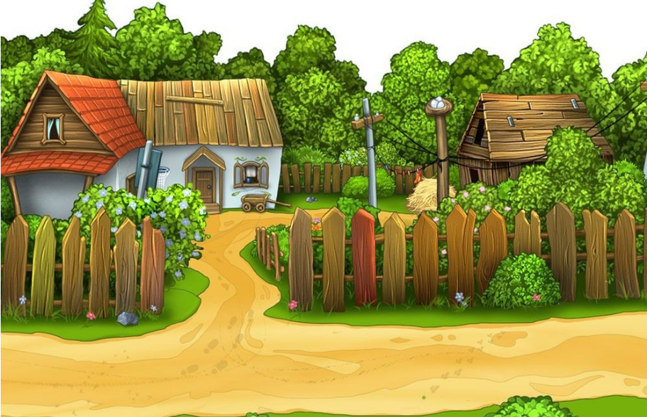
Good to know
At the right time, do the right thing. If you don't give up one second, there's hope the next.
在对的时间,做对的事。这一秒不放弃，下一秒就会有希望。

Slide 29

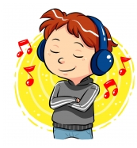
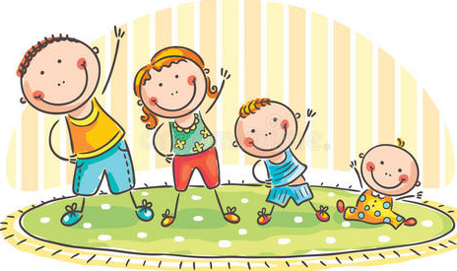
Exercises
一、看图写短语。(用v-ing形式)
1. _________________2.___________________3._________________________
reading a book
listening to music
doing morning exercises

Slide 30
二、单项选择。
( )1. What _______ the students doing?
A. am B. is C. are
( )2.—_______ is listening to music?
—Chen Jie.
A. What B. Who C. Where
( )3. It’s 9:00. We are _______ English class.
A. haveing B. having C. have
C
B
B

Slide 31

Summary
1.学习了下列短语： doing morning exercises, having ... class, eating lunch,
reading a book, listening to music等。
2.学习了询问某人正在做某事的句型：
—What is ... doing?
—She’s /He’s ...

Slide 32
Homework
ONE
TWO
Say and do the actions in pairs.
Make a short dialogue using the sentences we have learnt.
Ask your dad what he is doing.

Slide 33







