Slide 1









人 教 PEP 版 英 语 五 年 级 下 册
Unit 6
Work quietly!
Part A
Let’s learn & Look and say

Slide 2

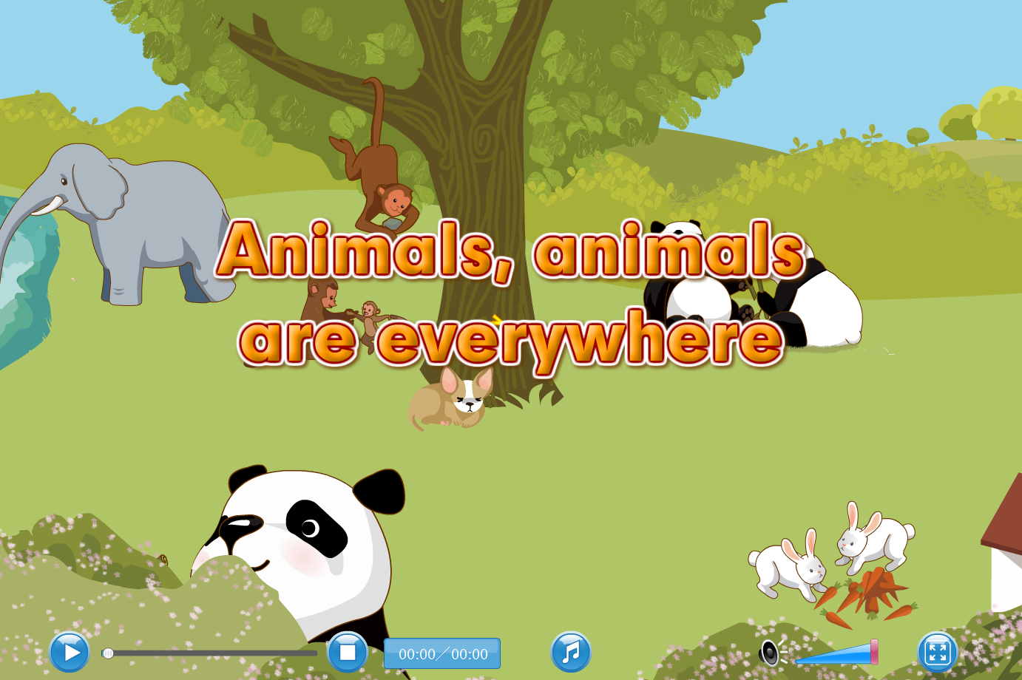
Warm up
Let’s sing.
点击画面 播放视频

Slide 3

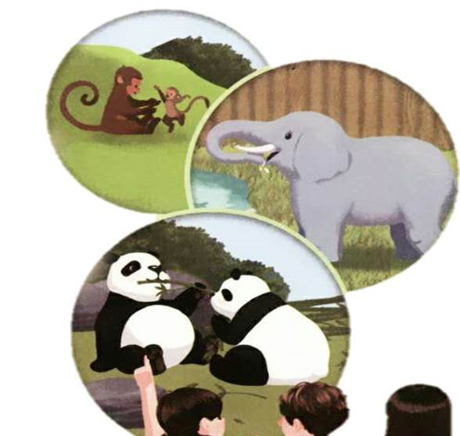
Lead in
Who is she?
She is Chen Jie.
What’s Chen Jie doing?
She’s watching TV/the video with her friends.
Chen Jie does many things every day. Let’s have a look.

Slide 4
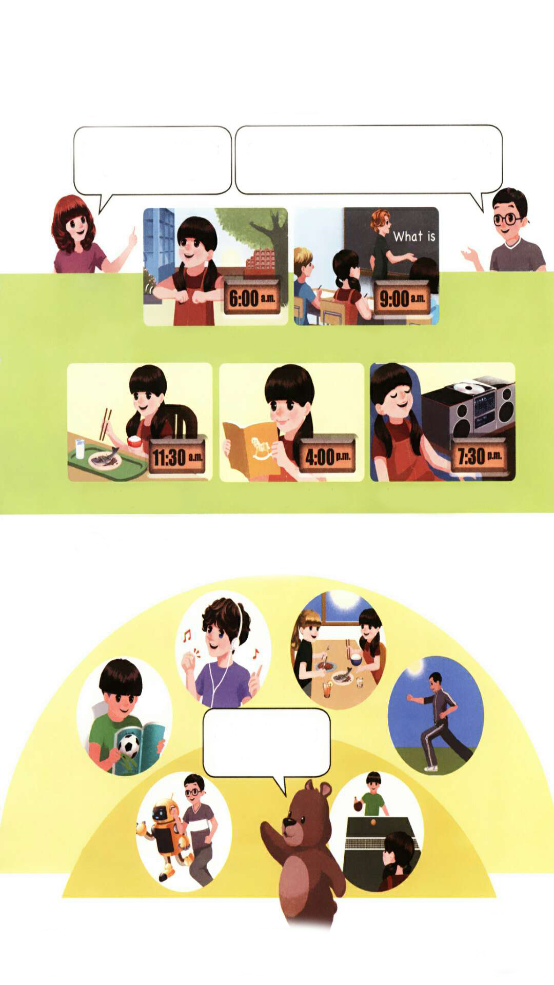
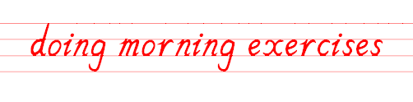

Presentation
What time is it? What’s Chen Jie doing?
It’s 6 o’clock.
She’s doing morning exercises.
do+ving
（正在）做早操

Slide 5

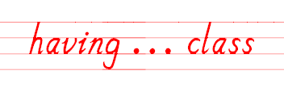
What time is it? What’s Chen Jie doing?
It’s 9 o’clock.
She’s having an English class.
have+ving
（正在）上……课

Slide 6
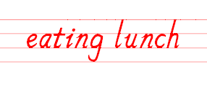
What time is it? What’s Chen Jie doing?
It’s 11:30 a.m.
She’s eating lunch.
eat+ving
（正在）吃午饭

Slide 7

What time is it? What’s Chen Jie doing?
It’s 4:00 p.m.
She’s reading a book.
read+ving
（正在）读书

Slide 8
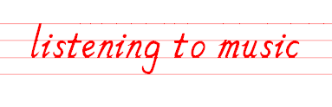
What time is it? What’s Chen Jie doing?
It’s 7:30 p.m.
She’s listening to music.
listen+ving
（正在）听音乐

Slide 9
Let’s learn
Read after the video.
It’s 7:30 p.m. What’s Chen Jie doing?
She’s listening to music. It’s 9 o’clock. What are the students doing?
doing morning exercises
having … class
eating lunch reading a book listening to music

Slide 10
What’s missing?
What’s Chen Jie doing?
She is….

Slide 11
Today is Monday. Tell me what you are doing?
Today is Monday. I have a busy day. It’s 6:00. I’m running.
It’s 10:00. I’m having a lesson.
It’s 11:30. I’m having lunch.
It’s 2:00 p.m. I’m reading a book.
It’s 4:00 p.m. I’m listening to music.

Slide 12
Practice
Look and say
Mike is listening to music.

Slide 13
Mike is ….

Slide 14
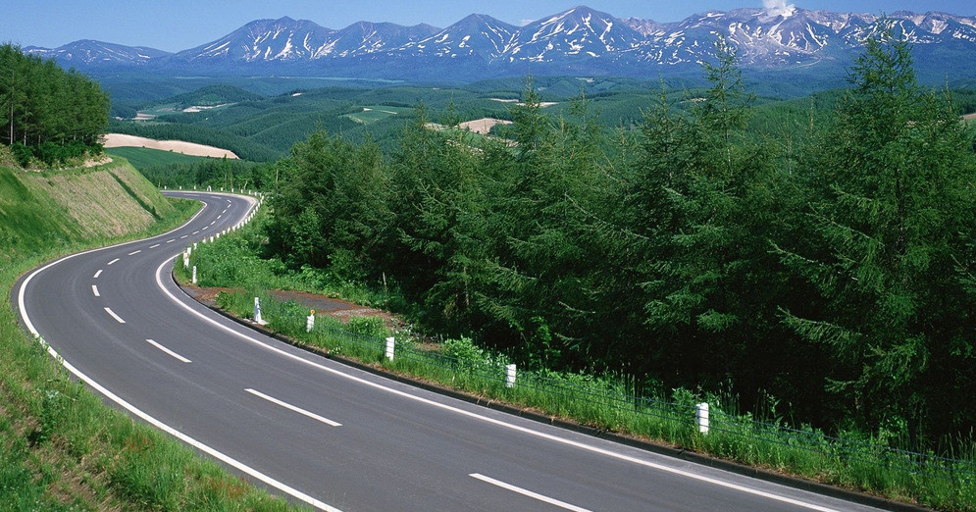
I want to know
在对的时间。做对的事。这一秒不放弃，下一秒就会有希望。
At the right time. Do the right thing. If you don't give up one second, there's hope the next.

Slide 15

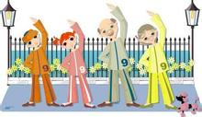
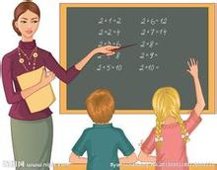
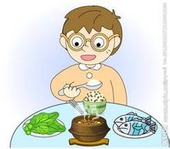
Exercises
一、看图写短语。（用v-ing形式）
1. 2. 3.
___________ ___________ ___________
11:30 a.m.
doing morning exercises
eating lunch
having … class

Slide 16
二、单项选择。
( )1. What _______ the students doing?
A. am B. is C. are
( )2.—_______ is listening to music?
—Chen Jie.
A. What B. Who C. Where
( )3. It’s 9:00. We are _______ English class.
A. haveing B. having C. have
C
B
B

Slide 17


三、看图回答问题。
1. What is Lily doing?
__________________________
2. What is Tom doing?
___________________________
She is reading a book.
He is listening to music.

Slide 18


Summary
学习了下列短语： doing morning exercises, having ... class, eating lunch,
reading a book, listening to music等。
2.学习了询问某人正在做某事的句型：
—What is ... doing?
—She’s /He’s ...
七彩课堂
伴你成长

Slide 19

Homework
ONE
TWO
Say and do the actions in pairs.
Make a short dialogue using the sentences we have learnt.
七彩课堂
伴你成长
Ask your dad what is he doing?

Slide 20








