Slide 1









人 教 PEP 版 英 语 五年 级 下 册
Unit 6
Work quietly!
Part A
Let’s spell

Slide 2

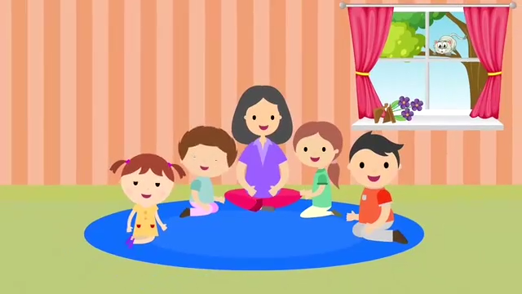
Warm up

Slide 3
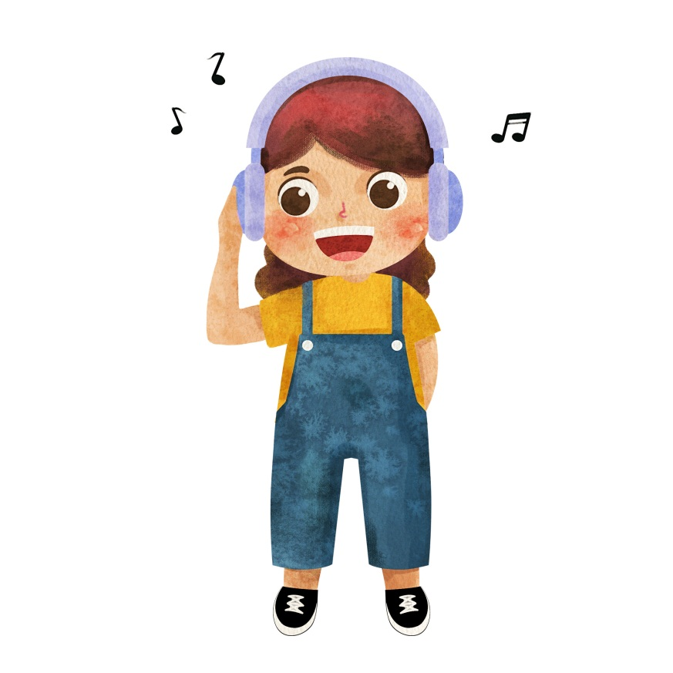
Review
What’s she doing?
She’s listening to music.

Slide 4

What’s he doing?
He’s writing.

Slide 5

What are they doing?
They are playing football.

Slide 6
Lead in
观察这些句子，分别指出带有wh的单词有哪些。
What
Which
When
Whose
Who
What do you do on the weekend?
Which season do you like best?
When is the summer vacation?
Whose dog is it?
Who is she?

Slide 7
Presentation
How to spell wh?
学习wh在单词中的发音 /w/
学习wh在单词中的发音 /h/
学习wh的发音要领

Slide 8



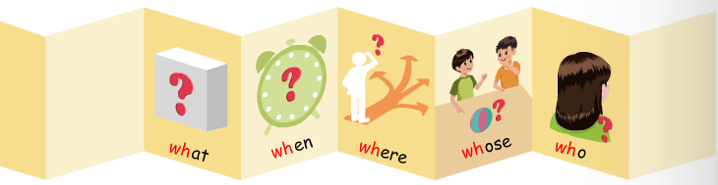
Let’s spell
Read and listen.
/w/
/h/

Slide 9

Read the new words.
what /wɒt/
What’s this?

Slide 10

when /wen/
When is the English test?

Slide 11

where /weə(r)/
Where are you?

Slide 12
what
when
where
wh
/w/

Slide 13
Let’s read！
what
when
which
whether
while
why
white
where

Slide 14
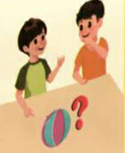
Read the words.
whose /huːz/
Whose ball it is?

Slide 15
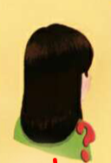
who /huː/
Who is she?

Slide 16
whose
who
wh
/h/

Slide 17
Let’s read！
whole
whoever
whomever
who
whose
whom

Slide 18
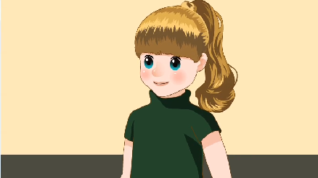
Let’s chant.

Slide 19
Where is my cat?
Where is she?
Who can find her?
One, two, three.
What does she drink?
What does she eat?
Where is she hiding?
Under my seat.
听到wh发/w/时坐正，
听到wh发/h/时拍下手。

Slide 20

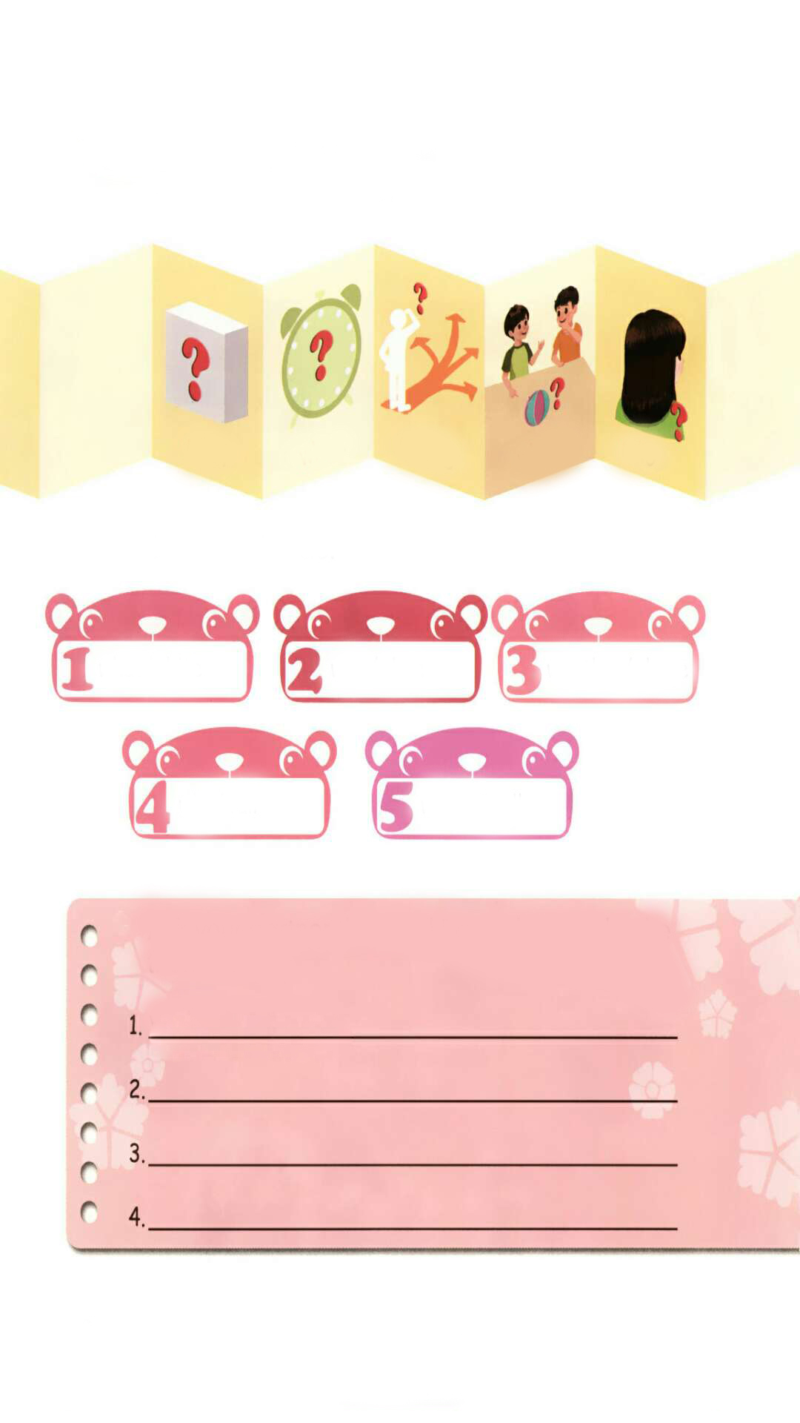
Listen and circle.
what/white
wait/when
weather/whose
who/wall
where/well

Slide 21
Ask your partner three “wh” questions and write them down.
What colour is it?
Where is the cat?
Who are they?
Whose book is it?

Slide 22



Let’s read！
who
whose
what
where
when
whoever
white
while
why
whale
whole
wheat
which

Slide 23
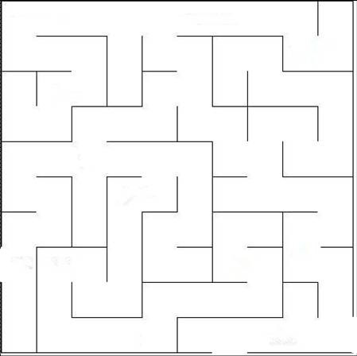
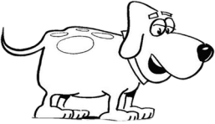
Play a game！
why
whose
where
which
what
who
white
while
when
whole
whoever
whether
whom

Slide 24

了解wh的发音规则
记忆wh的发音规则
根据发音规则读出生词

Slide 25
Exercises
一、英译汉。
什么时候
哪里
1. when___________ 2. where___________
3. what___________ 4. whose __________
5. who ___________ 6. which_____________
什么
谁的
谁
哪一个

Slide 26
二、判断下列每组单词画线部分发音是（T）否（F）相同。
what
where
who
when
wait
white
whose
why
T
F
T
  F

Slide 27
三、写三个带有wh的问题。
______________________
2. ______________________
3. ______________________
When is your birthday?
What time is it?
Who is he?

Slide 28

Summary
字母/字母组合
发音
词语
wh
/w/
what when
where
/h/
wh
whose who

Slide 29
Homework
ONE
TWO
Read the words.
Make sentences using the words we have learnt.
Collect the words with “/h/” and
“/w/”.

Slide 30







