Slide 1









人 教 PEP 版 英 语 五 年 级 下 册
Unit 6
Work quietly!
Part A
Let’s spell

Slide 2


Warm up
Let’s chant.
Where is my cat?
Where is she?
Who can find her?
One, two, three.
What does she drink? What does she eat? Where is she hiding? Under my seat.
点击画面 播放视频

Slide 3

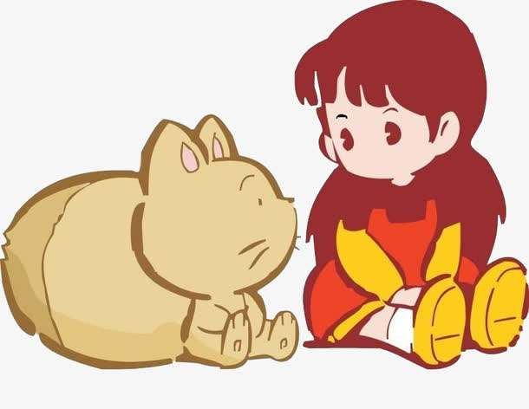
Lead in
I have a cute cat. We often play together.

Slide 4






Presentation
Where is my cat? Where is she?
Who can find her?
Is she in/on/under…?

Slide 5

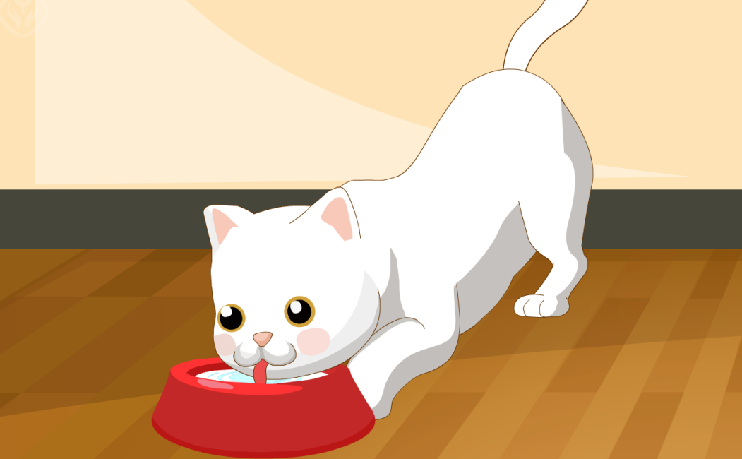
She is in the kitchen. What does she drink? What does she eat?
Maybe she is drink/eating…

Slide 6
Can you circle the words with “wh”?
Where is my cat?
Where is she?
Who can find her?
She is in the kitchen. What does she drink?
What does she eat?
where
wh
/w/
who
wh
/h/
what

Slide 7
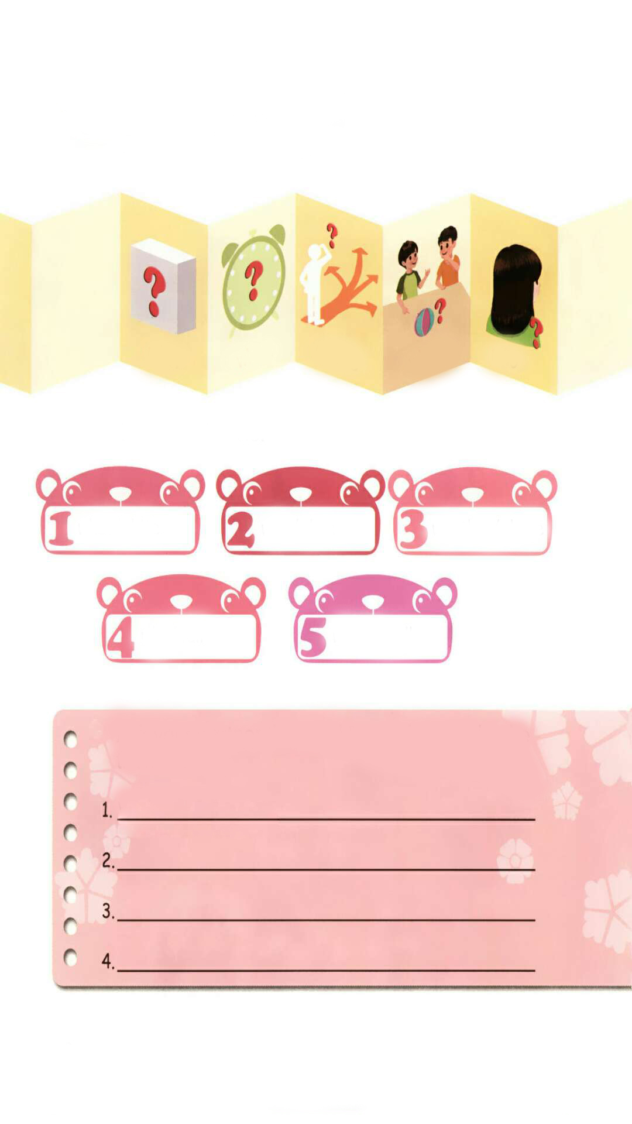
Listen and read.
点击画面 播放视频
where
whose
who
what
when
/w/
/h/

Slide 8
Listen and circle.
what/white
wait/when
weather/whose
who/wall
where/well

Slide 9
Ask your partner three “wh” questions and write them down.
What colour is it?

Slide 10
Practice
Can you read more?
whale whoever whole
white which whom
whether while why

Slide 11




Game: Find the right tree.
whomever
whoever
where
weather
why
whom
white
who
when
whose
/w/
/h/

Slide 12

Exercises
一、英译汉。
什么时候
哪里
1. when___________ 2. where___________
3. what___________ 4. whose __________
5. who ___________ 6. wall_____________
什么
谁的
谁
墙

Slide 13
二、连词成句
is it what colour (?)
_________________________
2. what the doing students are (.)
_________________________
3. music she’s to listening (?)
_________________________
What colour is it?
What are the students doing?
She’s listening to music.

Slide 14
三、判断下列每组单词画线部分发音是“T”否“F”相同。
what
where
who
when
wait
white
whose
why
T
F
T
  F

Slide 15


Summary
字母/字母组合
发音
词语
七彩课堂
伴你成长
wh
/ w /
what when
where
/ h /
wh
whose who

Slide 16

Homework
ONE
TWO
Read the words.
Make sentences using the words we have learnt.
七彩课堂
伴你成长
Collect the words with “/ h /” and “/ w/”.

Slide 17








