Slide 1


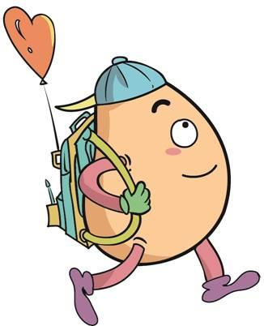

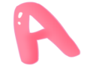



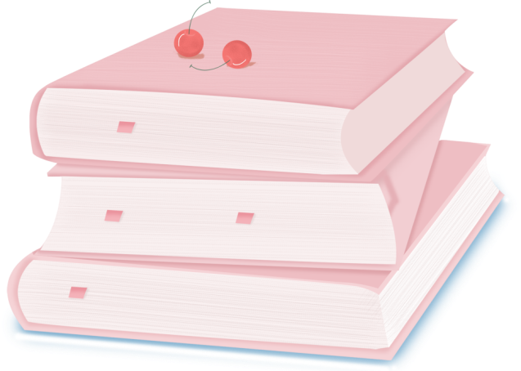
人 教 PEP 版 英 语 五年 级 下 册
Unit 6
Work quietly!
Part A
Let’s try & Let’s talk

Slide 2

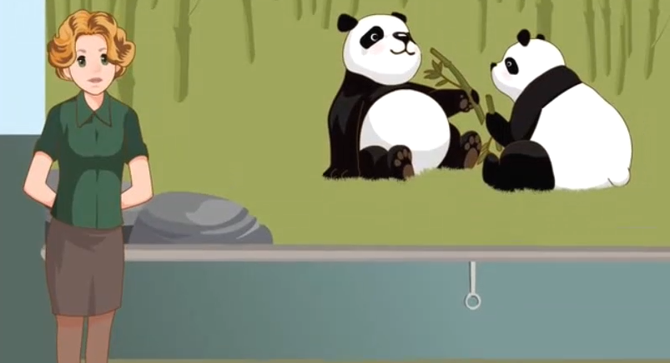
Warm up

Slide 3
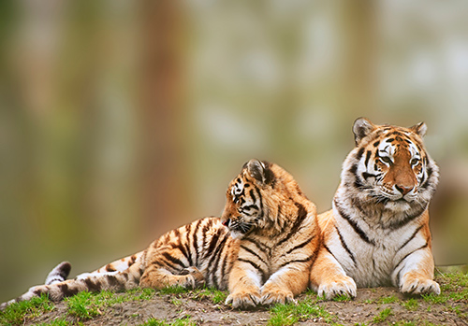
Lead in
What animals do you like in the zoo?
I like tigers.

Slide 4
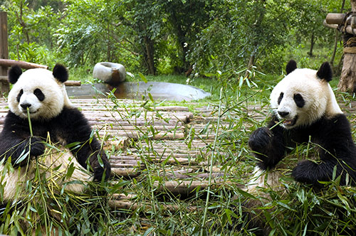
What animals do you like in the zoo?
I like pandas.

Slide 5
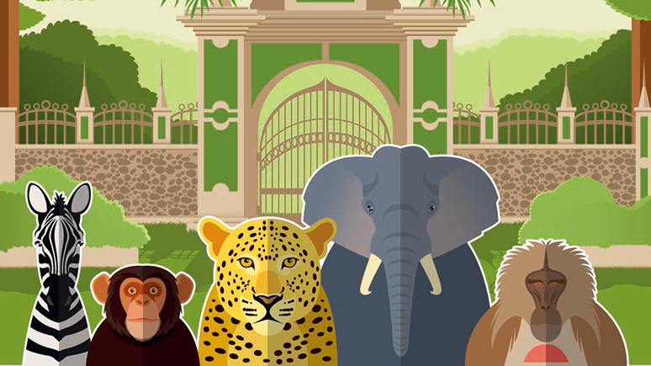
What animals do you like?

Slide 6
Presentation
Talk about what they are doing.
Talk about what the bird and the tiger are doing.
Talk about what the pandas, little monkey and the elephant are doing.
Talk about what people are doing.

Slide 7

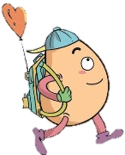

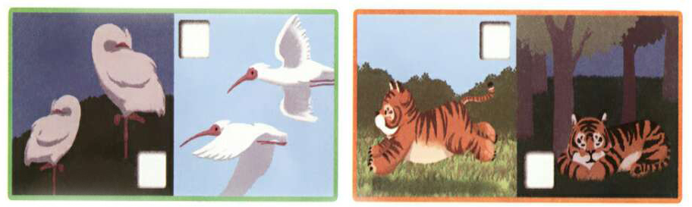
Let’s try
Listen and tick.
There are many other animals in the zoo.
What are they doing? Let’s listen and tick.
√
√

Slide 8
Let’s check！
Mike:
Chen Jie:
Mike:
Chen Jie:
Wow! There are so many animals in the zoo.
Yes. I love them. Look! The birds are flying.
And there is a yellow tiger, too.
Yes. It is running very fast!

Slide 9

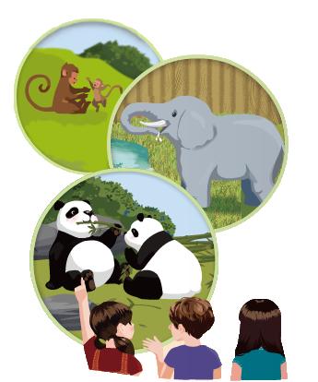
Let’s talk
Watch and answer！
What are the pandas doing?
2. What do the pandas like?
3. What is the little monkey doing?
4. What is the elephant doing?

Slide 10
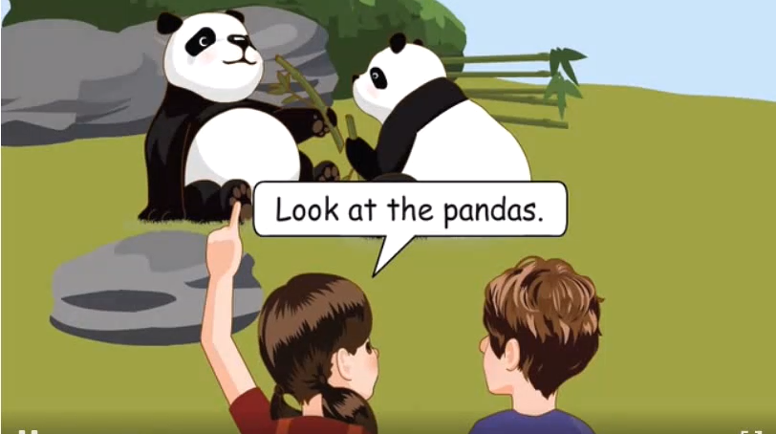

Slide 11
What are the pandas doing?
2. What do the pandas like?
3. What is the little monkey doing?
4. What is the elephant doing?
They are eating lunch.
They like bamboo.
It is playing with its mother.
The elephant is drinking water.

Slide 12
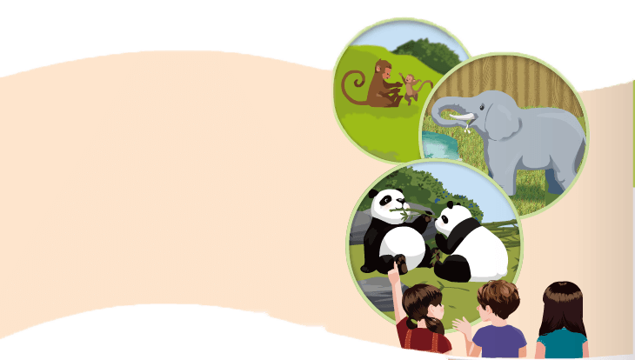
Read in roles.
Chen Jie:Look at the pandas.
Mike:What are they doing?
Chen Jie:Haha. They’re eating lunch!
They’re so cute.
Mike:Oh, yes! They like bamboo.
Chen Jie:What’s the little monkey doing?
Mike:It’s playing with its mother!
Chen Jie:Do you see any elephants?
Mike:Yes! Look there! The
elephant is drinking water.

Slide 13
Read in roles.
Chen Jie:
Mike:
Chen Jie:
Mike:
Chen Jie:
Mike:
Chen Jie:
Mike:
Look at the pandas.
What are they doing?
Haha. They’re eating lunch!
They’re so cute.
Oh, yes! They like bamboo.
What’s the little monkey doing?
It’s playing with its mother!
Do you see any elephants?
Yes! Look there! The
elephant is drinking water.

Slide 14

Read and act.
1.Read it together.
2.Each student
reads a sentence.
Tip: Choose one to read in two. 选择一种两人练习。
3. Read in roles.
自己分配角色。

Slide 15
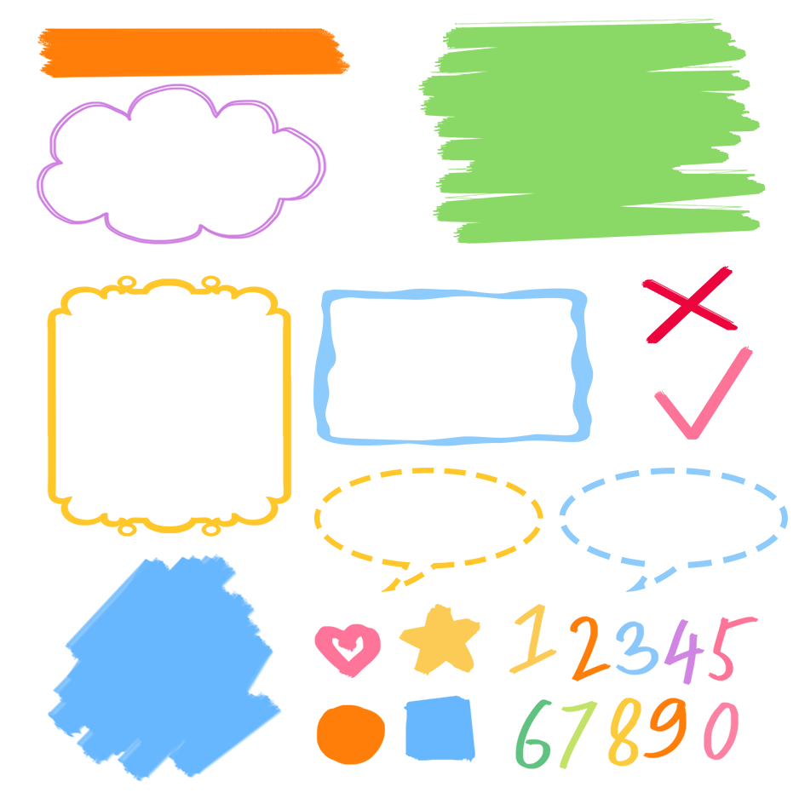
流利地朗读
流利地表演
有感情地表演

Slide 16
Listen and repeat.
Chen Jie:Look at the pandas.
Mike:What are they doing?
Chen Jie:Haha. They’re eating lunch!
They’re so cute.
Mike:Oh, yes! They like bamboo.
Chen Jie:What’s the little monkey doing?
Mike:It’s playing with its mother!
Chen Jie:Do you see any elephants?
Mike:Yes! Look there! The
elephant is drinking water.
询问某人正在做什么事情
竹子
any用于疑问句和否定句中，肯定句用some.

Slide 17
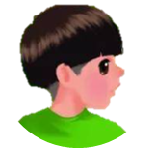
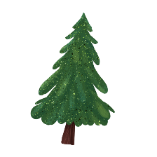


Language point.
— What is the little monkey doing?
— It’s playing with its mother.
现在进行时态的用法
句型：
What + be 动词 + 主语 + doing?
回答:主语 + be 动词 + 动词-ing(+其他).
— What is the boy doing?
— He is playing football.

Slide 18
现在分词变化规则
规则 | 原形 | -ing形式
一般在动词原形末尾加-ing | listen | listening
以不发音字母e结尾的动词,先去掉e,再加-ing | ride | riding
以重读闭音节结尾的动词,如果末尾只有一个辅音字母,应先双写这个字母,再加-ing | get | getting
注:die的-ing 形式为dying, lie的-ing形式为lying,
picnic的-ing 形式为picnicking

Slide 19
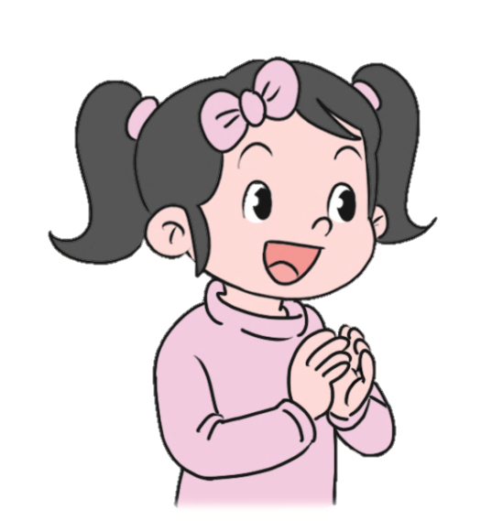
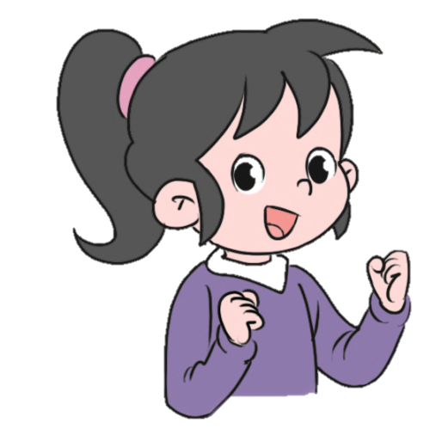
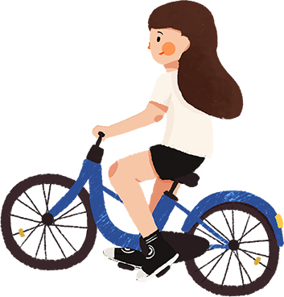
Let’s practice.
What’s she doing?
She’s riding a bike.

Slide 20
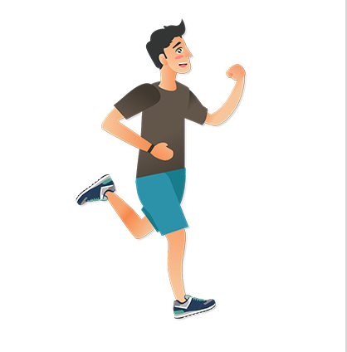
What’s he doing?
He’s running.

Slide 21
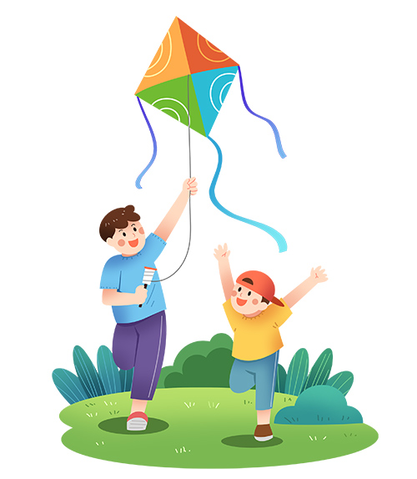
They’re flying a kite.
What are they doing?

Slide 22
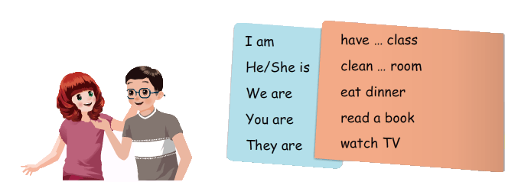
Choose and tell.
We’re having an English class.
I’m eating dinner.

Slide 23
Let’s practice.
You are reading a book.
He’s cleaning his room.

Slide 24
They are watching TV.
She’s having a Chinese class.

Slide 25
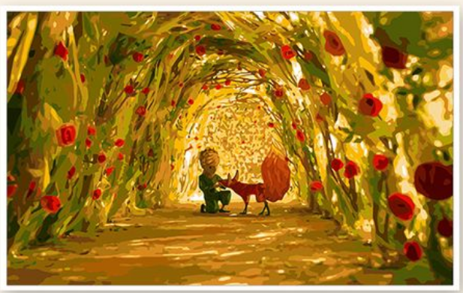
Good to know
Sometimes your plans don’t work out because God has better ones.
有时候，你的计划不奏效，是因为上天有更好的安排。

Slide 26
Exercises
一、根据要求写出相应的单词。
1. drink(现在分词)________ 2. dance(现在分词)________
3.一头大象(英语)____________ 4.have(现在分词)_________
5. it (形容词性物主代词)_______ 6. 听音乐(英语)____________
7. take(现在分词)_________ 8. I(名词性物主代词)_______
drinking
dancing
an elephant
having
its
listen to music
taking
mine

Slide 27
二、按照要求完成句子。
1.She is listening to music in the classroom.(对划线部分提问)
____________________________________
2.elephant, water, the, drinking, is (.)(连词成句)
___________________________________
3.I see some elephants. (变为一般疑问句)
_____________________________
What is she doing in the classroom?
The elephant is drinking water.
Do you see any elephants?

Slide 28

Summary
1.学习了以下单词：bamboo, its
2.学习了下列句型：
What are they doing?
They are eating lunch.
What’s the little monkey doing?
It’s playing with its mother.

Slide 29
Homework
ONE
TWO
Act the dialogue out with your friends.
Make a short dialogue using the sentences we have learnt.
Introduce pandas to your parents.

Slide 30







