Slide 1




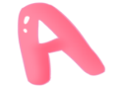

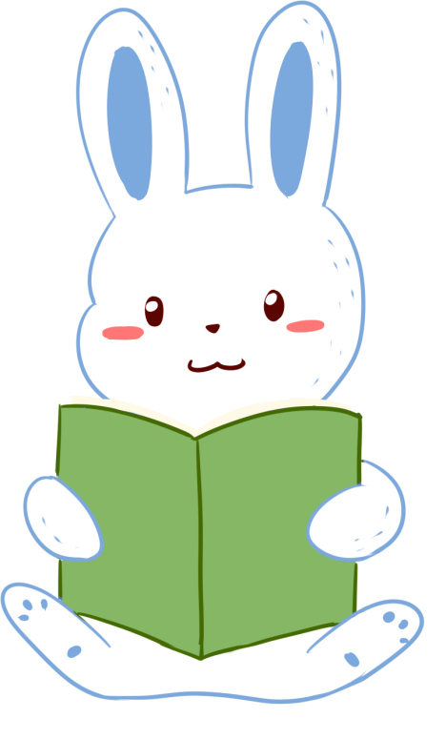
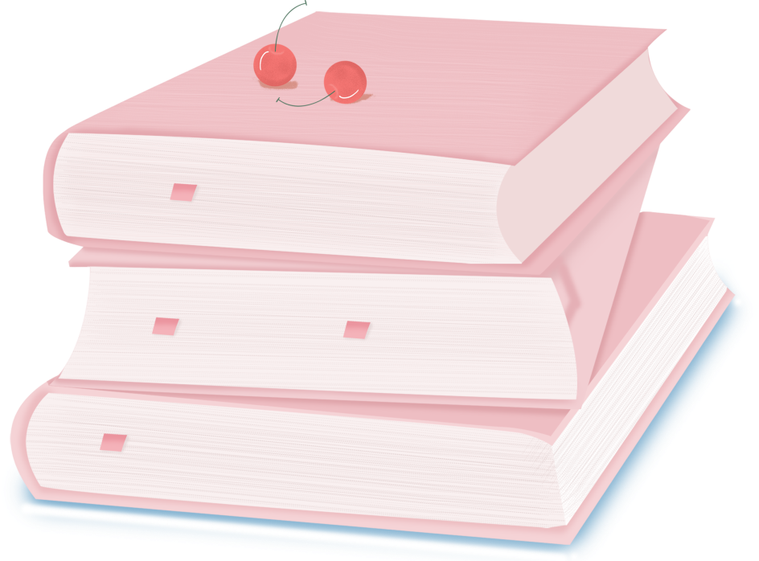

人 教 PEP 版 英 语 五 年 级 下 册
Unit 6
Work quietly!
Part A
Let’s try & Let’s talk

Slide 2

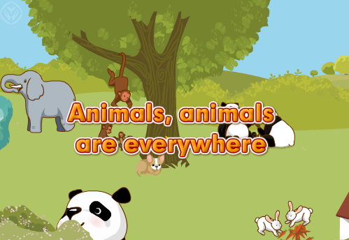
Warm up
Let’s sing!
点击画面 播放视频

Slide 3


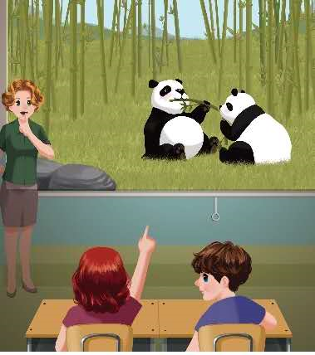
Lead in

Slide 4
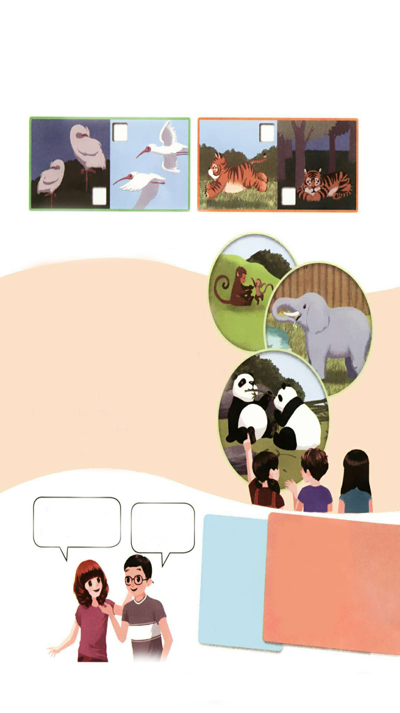
Presentation
Let’s try
There are many other animals in the zoo, too.
What are they doing? Let’s listen and tick.
√
√

Slide 5

听力材料：
Mike:
Chen Jie:
Mike:
Chen Jie:
Wow! There are so many animals in the zoo.
Yes. I love them. Look! The birds are flying.
And there is a yellow tiger, too.
Yes. It is running very fast!

Slide 6
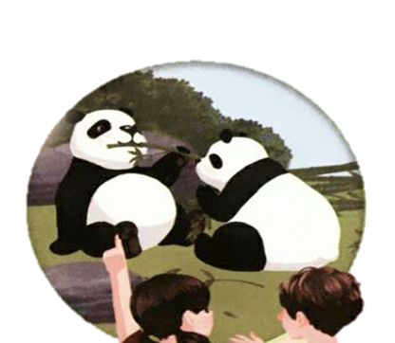
Do you see the pandas? What are they doing?
They are eating bamboo.
…
It’s 12:00. They are eating ?
lunch
bamboo
竹子

Slide 7
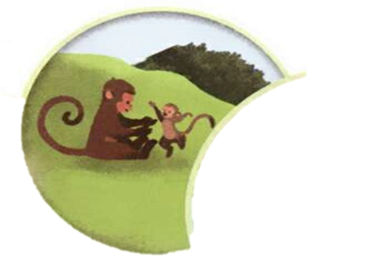
What are the little monkey doing?
It’s playing with its mother!
its
它的

Slide 8
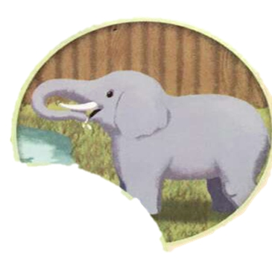
Do you see any elephants?
Look there!
What is the elephant doing?
It’s drinking water.

Slide 9
Let’s talk
Chen Jie and Mike are watching a video about animals. What animals do they see? Listen and answer.
They see pandas, monkeys and elephants.

Slide 10
What are they doing? Listen again and answer.
The monkeys are playing with each other.
The elephant is drinking water.
The pandas are eating lunch.

Slide 11
Listen and read.
Chen Jie:
Mike:
Chen Jie:
Mike:
Chen Jie:
Mike:
Chen Jie:
Mike:
Look at the pandas.
What are they doing?
Haha. They’re eating lunch!
They’re so cute.
Oh, yes! They like bamboo.
What’s the little monkey doing?
It’s playing with its mother！
Do you see any elephants?
Yes! Look there! The
elephant is drinking water.

Slide 12
Read and fill in the blanks.
Chen Jie:
Mike:
Chen Jie:
Mike:
Chen Jie:
Mike:
Chen Jie:
Mike:
pandas
Look at the_______.
What are they doing?
Haha. They’re eating lunch!
They’re so cute.
Oh, yes! They like bamboo.
What’s the ___________doing?
It’s playing with its mother！
Do you see any________?
Yes! Look there! The
elephant is drinking water.
little monkey
elephants

Slide 13
Read again and fill in the blanks.
pandas
Chen Jie:
Mike:
Chen Jie:
Mike:
Chen Jie:
Mike:
Chen Jie:
Mike:
Look at the_______.
What are___________?
Haha. They’re____________!
They’re so_______.
Oh, yes! They like_______.
What is___________________?
It’s _____________________！
Do you see any________?
Yes! Look there! The
elephant is_____________.
they doing
eating lunch
cute
bamboo
the little monkey doing
playing with its mother
elephants
drinking water

Slide 14
Language point
— What's the little monkey doing?
— It's playing with its mother!
【详解】这组对话是现在进行时。表示现阶段正在进行的动作。
句型结构:What + be 动词 + 主语 + doing?
回答:主语 + be 动词 + 动词-ing(+其他).
e.g.— What is Amy doing?
— She's doing an experiment.

Slide 15
(1)现在分词变化规则
规则 | 原形 | -ing形式
一般在动词原形末尾加-ing | listen | listening
以不发音字母e结尾的动词,先去掉e,再加-ing | ride | riding
以重读闭音节结尾的动词,如果末尾只有一个辅音字母,应先双写这个字母,再加-ing | get | getting
注:die的-ing 形式为 dying, lie的-ing 形式为lying, picnic的-ing 形式为 picnicking

Slide 16
(2)现在进行时时间状语
现在进行时的时间状语常用now,或者告诉你一个准确的现在时间,或者用look、 listen(常用于句子的开头,表示提醒听者注意正在发生的事情)。
e.g. They are playing basketball now.
Listen! She is singing.
Look! He is reading.

Slide 17
Act it out group by group. Find the best group.
Chen Jie:
Mike:
Chen Jie:
Mike:
Chen Jie:
Mike:
Chen Jie:
Mike:
Look at the ….
What are … doing?
Haha. They’re ….!
They’re …..
Oh, yes! They like …..
What’s ……doing?
It’s ……..！
Do you see any ……?
Yes! Look there! The
elephant is ….

Slide 18
Now you are at the zoo. Make dialogue and act it out.
S1: （举起望远镜）I see a __________.
S2: What is it doing?
S1: It’s __________. Here you are. Take a look.
S2: Thank you.
S1: Do you see any ________?
S2: Yes! Look there! _____________________.
S1: Wow!

Slide 19
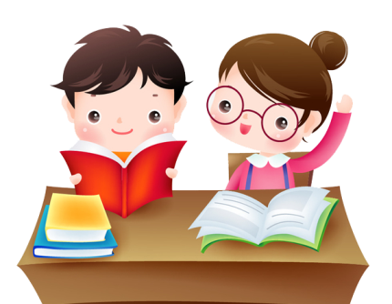
Practice
Choose and tell.
We’re having an English class.
I’m eating dinner.
I am
He/She is
We are
You are
They are
have… class
clean… room
eat dinner
read a book
watch TV

Slide 20

Exercises
一、单选题。
( )1.—What are the birds doing?
—________
A. They are at school. B. They are monkeys.
C. They are flying.
( )2.—Do you see ________ elephants?
—Yes.
A. some B. any C. an
( )3. The cat is playing with _____ mother.
A. it’s B. its C. it
C
B
B

Slide 21
二、翻译下列句子。
1. 我正在吃中午饭。
I am _______ ________.
2. 看那！大象在喝水。
Look there! The elephant _______ _______water.
eating lunch
is drinking

Slide 22
三、连词成句。
is, the what, little, monkey, doing(?)
_______________________________
2. reading, she, books, is(.)
_______________________________
3. English an are we having class(.)
_______________________________
What is the little monkey doing?
She is reading books.
We are having an English class.

Slide 23
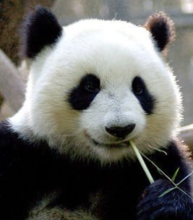
I want to know
中国的国宝
大熊猫属于食肉目、熊科、大熊猫亚科和大熊猫属唯一的哺乳动物，体色为黑白两色，它有着圆圆的脸颊，大大的黑眼圈，胖嘟嘟的身体，标志性的内八字的行走方式，也有解剖刀般锋利的爪子。是世界上最可爱的动物之一。

Slide 24
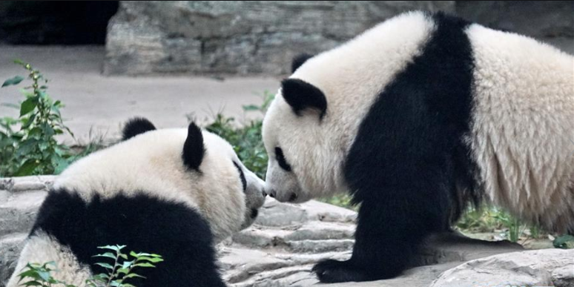
Do you like pandas?

Slide 25


Summary
1.学习了以下单词：bamboo, its
2.学习了下列句型：
What are they doing?
They are eating lunch.
What’s the little monkey doing?
It’s playing with its mother.
七彩课堂
伴你成长

Slide 26

Homework
ONE
TWO
Act the dialogue out with your friends.
Make a short dialogue using the sentences we have learnt.
七彩课堂
伴你成长
Introduce pandas to your parents.

Slide 27





