Slide 1


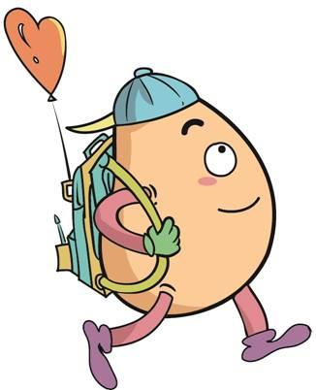






人 教 PEP 版 英 语 五年 级 下 册
Unit 5
Whose dog is it?
Part B
Let’s learn & Let’s play

Slide 2

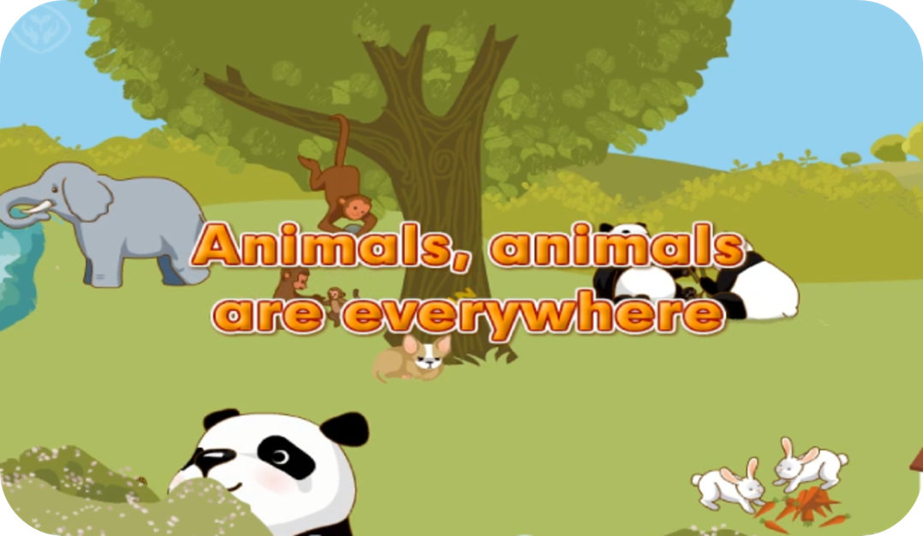
Warm up

Slide 3
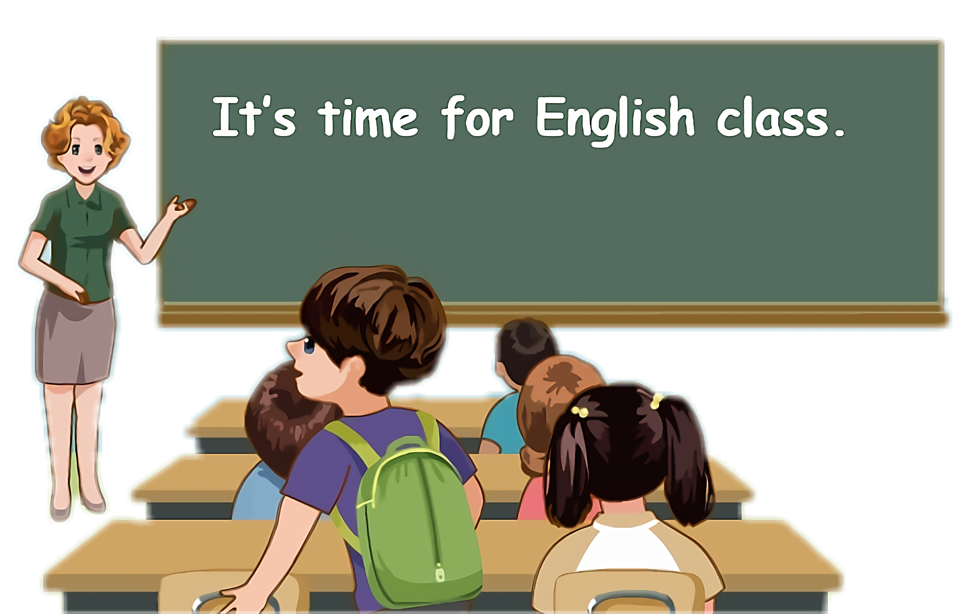
Lead in
Children, which animal do you like best?

Slide 4






Let’s introduce what they are doing.

Slide 5
Presentation
Talk about what they are doing.
Talk about what the dog is doing.
Talk about what the rabbits are doing.
Talk about what my partners are doing.

Slide 6

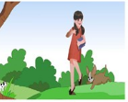
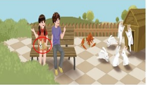
Let’s learn
Chen Jie is taking Fido to the farm. Fido is so excited.
Where is Fido?
He is sleeping on Chen jie’s legs.

Slide 7

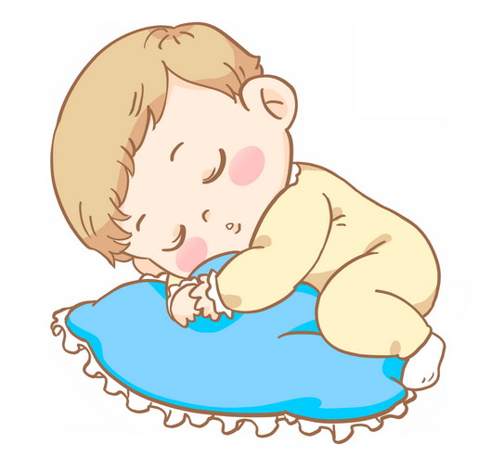

Learn new words！
sleeping /ˈsliːpɪŋ/
sleep
原形
go to sleep
短语
The baby is sleeping.

Slide 8
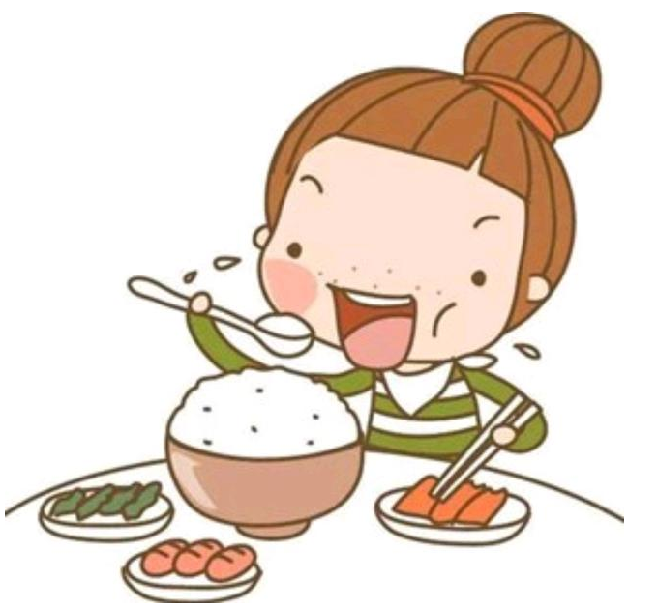
eating /ˈiːtɪŋ/
eat
原形
eat breakfast
eat lunch
短语
She is eating breakfast.

Slide 9
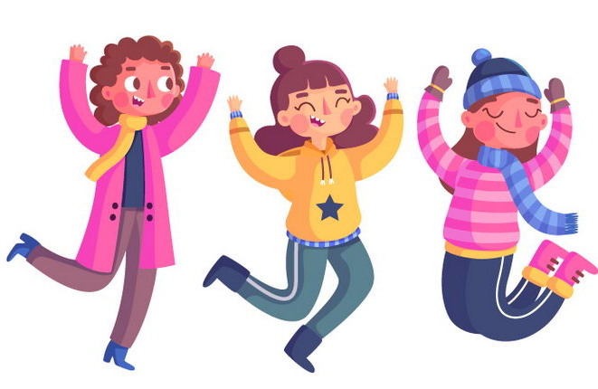
jumping /ˈdʒʌmpɪŋ/
jump
原形
jump into...
jump off
短语
They are jumping now.

Slide 10
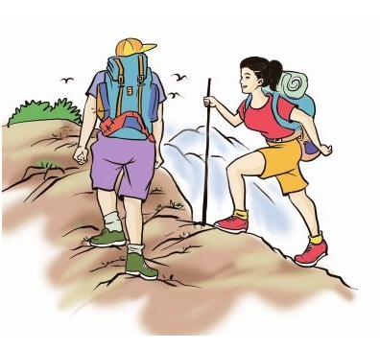
climbing /ˈklaɪmɪŋ/
climb
原形
climb mountains
短语
They are climbing mountains.

Slide 11
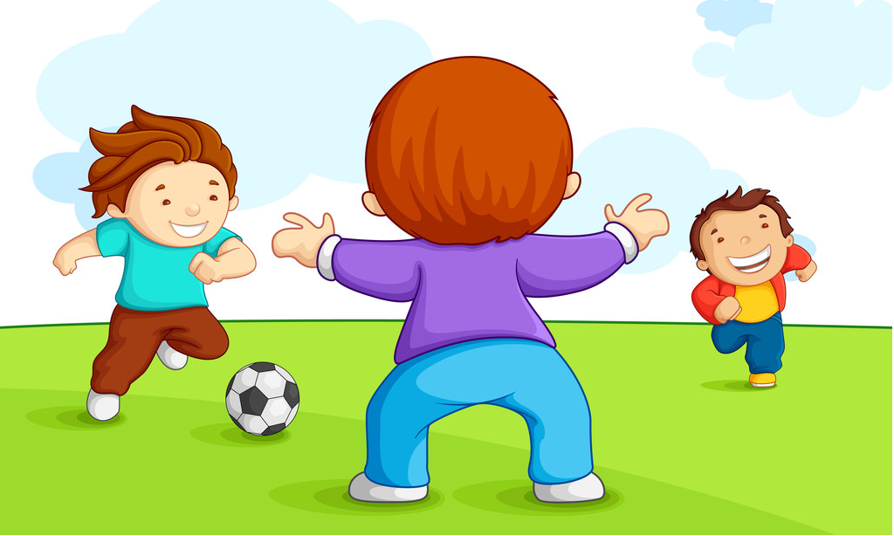
playing /ˈpleɪɪŋ/
play
原形
play football
play the piano
短语
They are playing football on the playground.

Slide 12
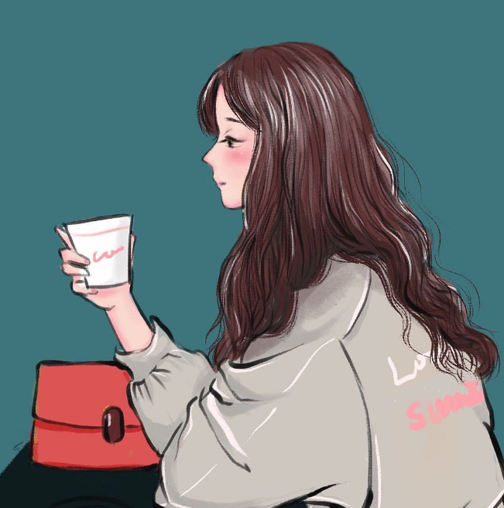
drinking /ˈdrɪŋkɪŋ/
drink
原形
drink water
drink coffee
短语
She is drinking coffee.

Slide 13

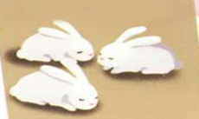
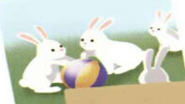
Read quickly

Slide 14




Play a game.
drinking
sleeping
playing
talking
running
eating
thinking
climbing
watching
reading
cooking
drawing
seeing
dancing

Slide 15

eating
drinking
climbing
jumping
sleeping
playing

Slide 16
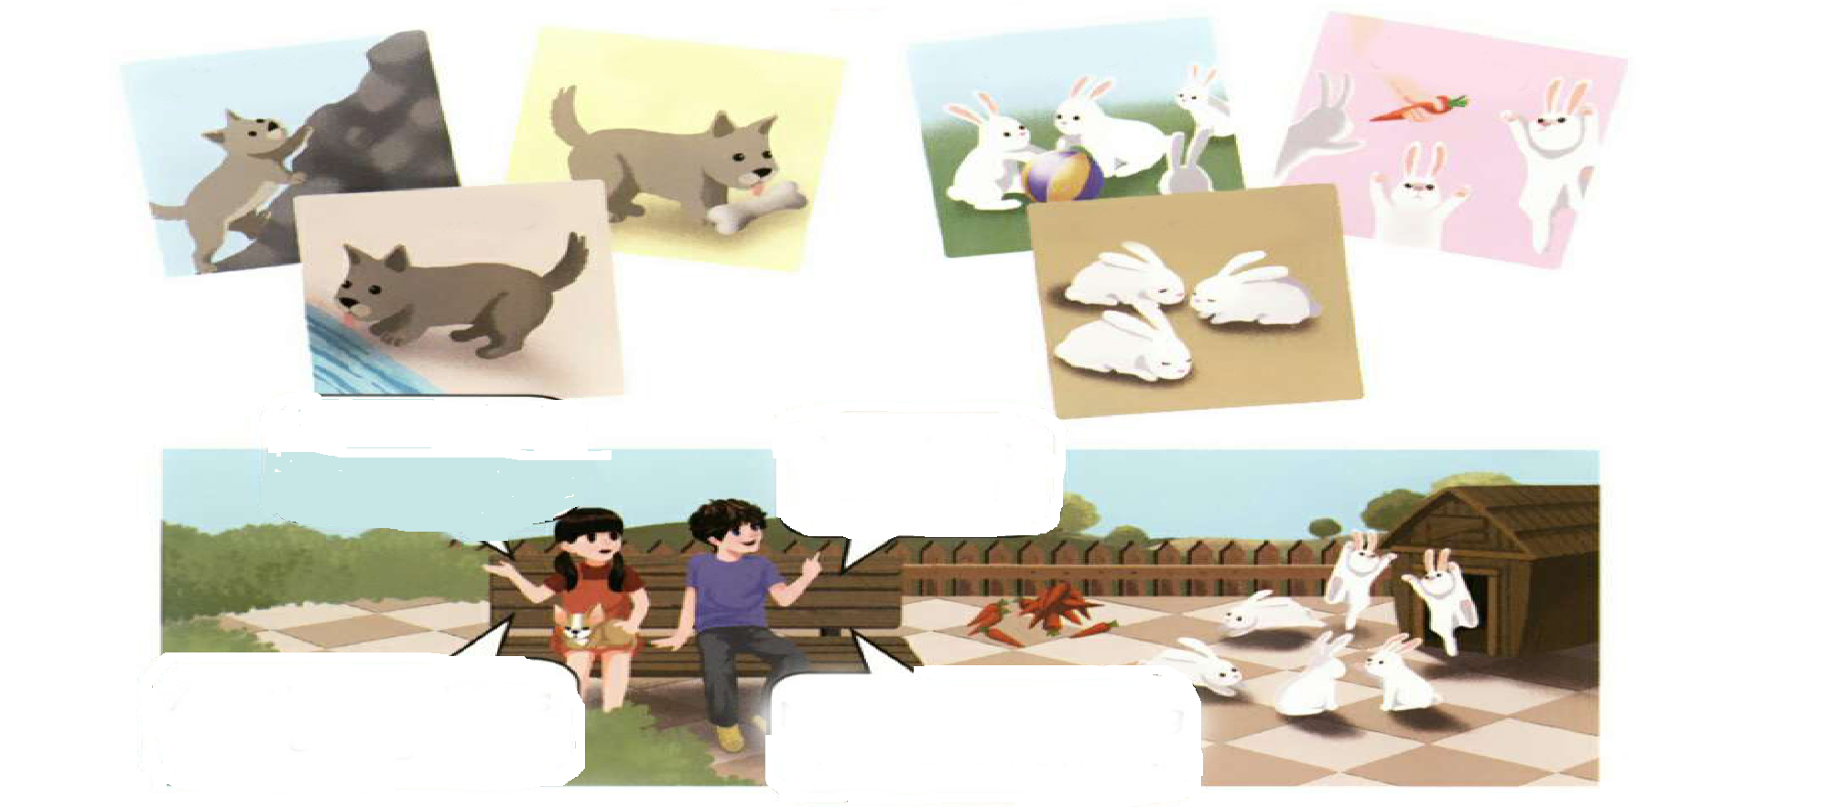
Let’s Learn
climbing
eating
playing
jumping
drinking
sleeping
Oh, Fido is sleeping.
Yes. He is so cute.
可爱的
Are these rabbits eating?
No. They’re playing with each other.
彼此,相互

Slide 17
Look and say！
climbing
eating
playing
jumping
drinking
sleeping
Oh, Fido is ...
Yes. He is ...
Are these rabbits ...?
No. They’re ...

Slide 18

Language point.
现在进行时的动词ing形式变化规则
1、一般动词，加+ing；
例子: wash--washing，read--reading
2、以不发音字母e结尾的动词，去掉e，再加+ing；
例子: make—making write—writing use--using
3、以重读闭音节结尾的动词且末尾只有一个辅音字母，双写最后的辅音字母，再加+ing；
例子:run--running，swim--swimming，put--putting
4、以ie结尾的动词，改ie为y，再加+ing。
例子: lie—lying， die--dying，tie--tying

Slide 19

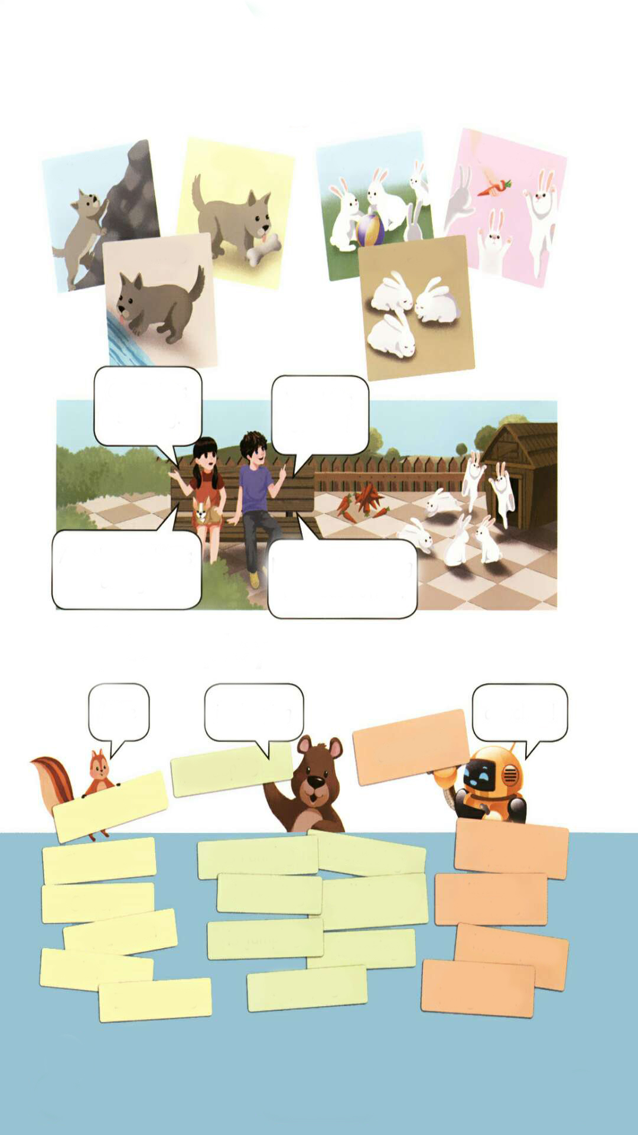
Let’s play
1.小组成员分工做卡片，一人做人名卡片，一人做动作卡片，一人做地点卡片。
2.三组卡片里各抽一张，连起来说句子，看看谁抽出的句子最合理，看看谁抽出的句子最好笑！
Mike
is sleeping
at school!
at school!
is sleeping
Mike
with my father
is running
is climbing
Chen Jie
is reading
is listening to music
under the tree
Oliver
Wu Binbin
is jumping
is eating
in the park
John
in the living room
is playing
Zhang Peng

Slide 20
Try to say.
eat eating Fido is eating.
drink drinking I am drinking.
play playing They’re playing.
jump jumping He is jumping.
climb climbing She is climbing.
sleep sleeping The baby is sleeping.

Slide 21
Let’s find out.
1.试着翻译下列句子并找出共同点.
I am eating.
Fido is sleeping.
They are playing.
2.小组讨论并试着总结出规律.
现在进行时的陈述句: 主语+ be + v-ing.
现在进行时的一般疑问句:
Be+主语+ 现在分词(v-ing)

Slide 22
Let’s chant
Eating, eating. Is Zoom eating?
Jumping, jumping. Is John jumping?
Drinking, drinking. Is Zip drinking?
Singing, singing. Is Sarah singing?
Is... +v-ing?

Slide 23
Let’s chant
Climbing, climbing, the dog is climbing.
Eating, eating, the dog is eating.
Drinking, drinking, the dog is drinking.
Playing, paying, are the rabbits playing?
Jumping, jumping, are the rabbits jumping?
Sleeping, sleeping, are they sleeping?

Slide 24
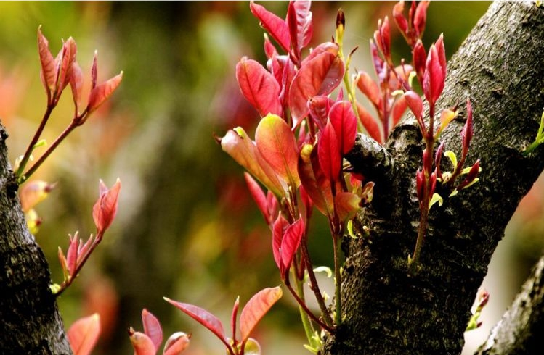
Good to know
Life is like flowers, because everyone blooms at different times.
生命就像一朵朵花，每个人都在不同的时间绽放。

Slide 25
Exercises
一、单项选择。
( ) 1. Sarah _____ reading a book in the library.
A. am B. is C. are
( ) 2. Can I ____ with the dog?
A. playing B. plays C. play
( ) 3.--Is he ____ water now? ---No, he isn’t.
A. drink B. drinking C. drinks
B
C
B

Slide 26
二、按照要求完成句子。
1.The monkey is climbing the tree.(改为一般疑问句)
____________________________________
2.tree, running, cat, under, the, is, the (.)(连词成句)
_________________________________________
3.listening, the, Mike, to, in, music, is, park,(.) (连词成句)
____________________________________
Is the monkey climbing the tree?
The cat is running under the tree.
Mike is listening to music in the park.

Slide 27

Summary
1. 学习了下列单词： climbing, eating, playing, jumping, drinking, sleeping等。
2.学习了下列句型：
— Are these…?
— Yes, ….

Slide 28
Homework
ONE
TWO
Act the dialogue out and show it to your parents.
Talk about your dog and write a short passage.
Do “Let’s play” with your friends.

Slide 29







