Slide 1







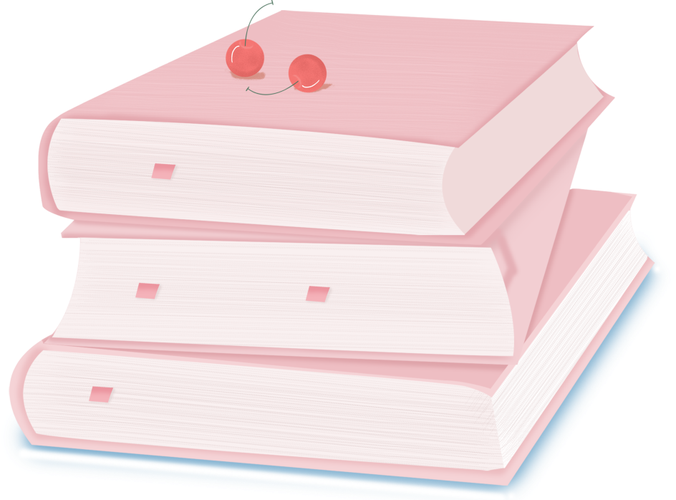

人 教 PEP 版 英 语 五 年 级 下 册
Unit 5
Whose dog is it?
Part B
Let’s learn & let’s play

Slide 2

Warm up
Can you read the words?
mine
theirs
ours
you
yours
his
hers
their
my
May
April
yours

Slide 3
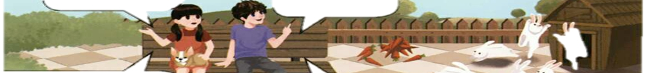
Lead in
Now, Chen Jie and Mike are in the park with Fido.
But where is Fido?

Slide 4
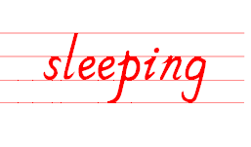

Presentation
Where is Fido?
He’s sleeping on Chen Jie’s legs.
sleep的ing形式
（正在）睡觉

Slide 5

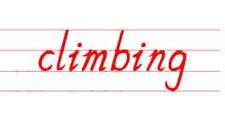
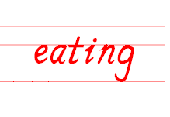
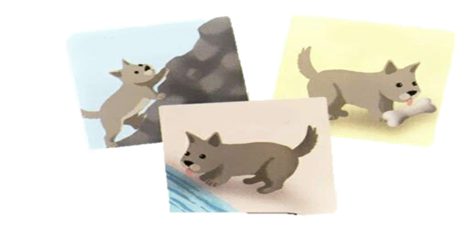
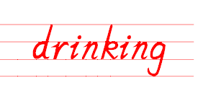
Look at some of Fido’s pictures in the park.
He is climbing.
He is eating.
He is drinking.

Slide 6
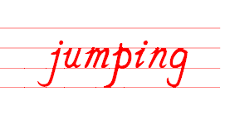
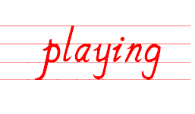
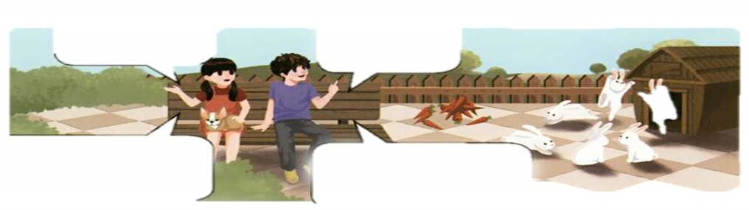
Chen Jie and Mike see some rabbits in the park, too.
What are they doing?
They’re jumping.
They’re playing.

Slide 7
Language points
现在进行时的动词ing形式变化规则：
1、一般动词，变化:加+ing，
例子: wash--washing，read--reading
2、以不发音字母e结尾的动词，变化:去掉e，再加+ing，
例子: make—making write—writing use--using
3、以重读闭音节结尾的动词且末尾只有一个辅音字母 ，变化:双写最后的辅音字母，再加+ing，
例子:run--running，swim--swimming，put--putting
4、以ie结尾的动词，变化:改ie为y，再加+ing，
例子: lie—lying, die--dying，tie--tying

Slide 8
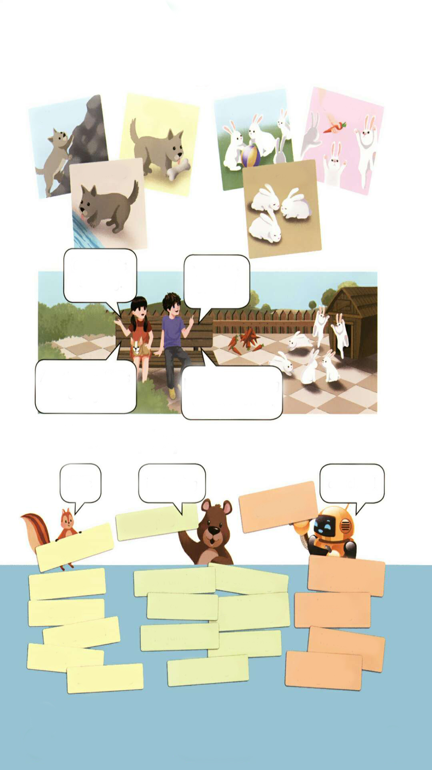
Listen and read.
climbing
jumping
eating
playing
drinking
sleeping
相互
Oh, Fido is sleeping.
Yes. He’s so cute!
each
每一
Are these rabbits eating?
No. They’re playing with each other.

Slide 9
What’s missing?
eating
climbing
jumping
playing
drinking
sleeping

Slide 10
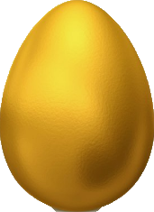
Play a game.
drinking
sleeping
playing
playing
reading
cooking
eating
playing
playing
reading
cooking
drinking
sleeping
playing

Slide 11
Look for the right pictures based on phrases.
eating
drinking
playing
climbing
jumping

Slide 12
Act the dialogue.
climbing
jumping
eating
playing
drinking
sleeping
Oh, Fido is ……….
Yes. He’s ……!
Are these rabbits ……?
No. They’re …….

Slide 13
Practice
Look and write
Mike
is sleeping
at school!
at school!
is sleeping
Mike
with my father
is running
is climbing
Chen Jie
is reading
is listening to music
under the tree
Oliver
Wu Binbin
is jumping
is eating
in the park
John
in the living room
is playing
Zhang Peng

Slide 14
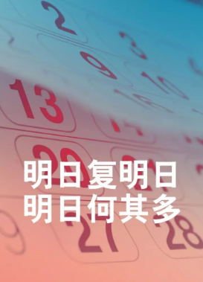
I want to know
明日复明日，明日何其多!
Tomorrow after tomorrow, How many tomorrows!
请珍惜现在的时间！
Please cherish the present time!

Slide 15

Exercises
一、汉译英。
sleeping
攀登 睡觉
玩耍 相互
喝水 吃
climbing
playing
each
drinking
eating

Slide 16

二、单项选择。
( )1. She is_______ breakfast.
A. eatting B. eating C. eat
( )2. —_______ the dogs sleeping?
—Yes, they are.
A. Is B. Are C. Am
( )3. They are playing _______ each other.
A. with B. to C. in
B
B
A

Slide 17
三、连词成句。
Olive, at home, is reading (.)
_____________________________
2. cat, the, is running, under the tree(.)
_____________________________
3. is playing, John, in the park(.)
_____________________________
Olive is reading at home.
The cat is running under the tree.
John is playing in the park.

Slide 18


Summary
1. 学习了下列单词： climbing, eating, playing, jumping, drinking, sleeping等。
2.学习了下列句型：
— Are these…?
— Yes, ….
七彩课堂
伴你成长

Slide 19

Homework
ONE
TWO
七彩课堂
伴你成长
Talk about your dog and write a short passage.
Act the dialogue out and show it to your parents.
Do “Let’s play” with your friends.

Slide 20








