Slide 1


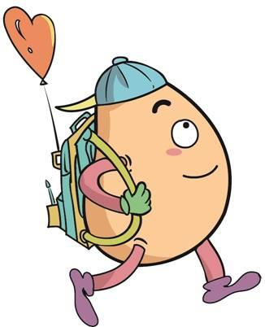






人 教 PEP 版 英 语 五年 级 下 册
Unit 5
Whose dog is it?
Part B & Part C
Read and write—Story Time

Slide 2

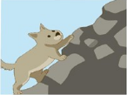
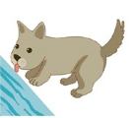

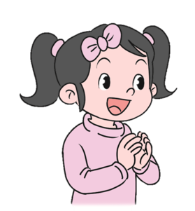

Lead in
Is the dog ...?
No, he isn’t. He is ...
eating, drinking, sleeping, climbing, running, playing

Slide 3



Are these rabbits ...?
No, they aren’t. They are ...
eating, drinking, sleeping, climbing, running, playing

Slide 4
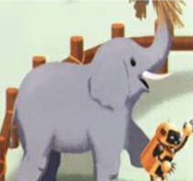
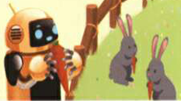
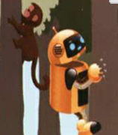
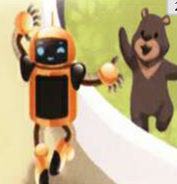
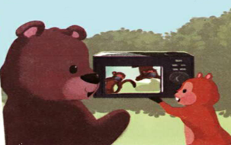
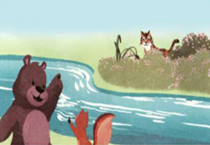
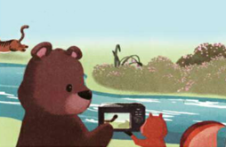
Let’s introduce the stories.

Slide 5
Talk about the stories.
Talk about Robin’s story.
Talk about Zoom and Zip’s story.
Talk about the story in groups.

Slide 6

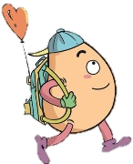
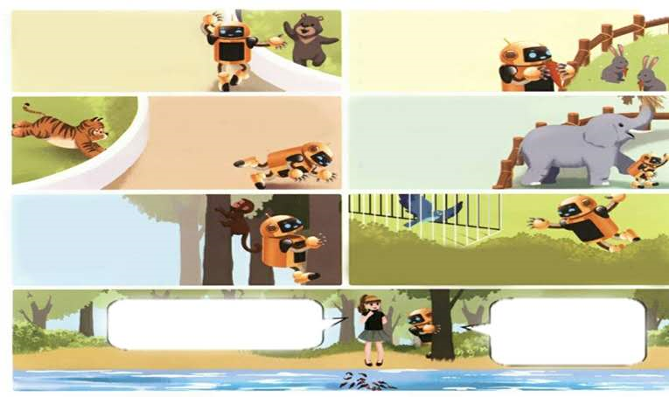
Read and write
Circle the animals that Robin is looking at.
The bear is dancing.
The rabbits are eating.
The tiger is running.
The elephant is walking.
The monkey is climbing.
The bird is flying.
The fish is swimming.

Slide 7


Listen and read！
Robin at the zoo.
Sarah and Robin are at the zoo. Robin is excited!
What are you doing here, Robin?

Slide 8

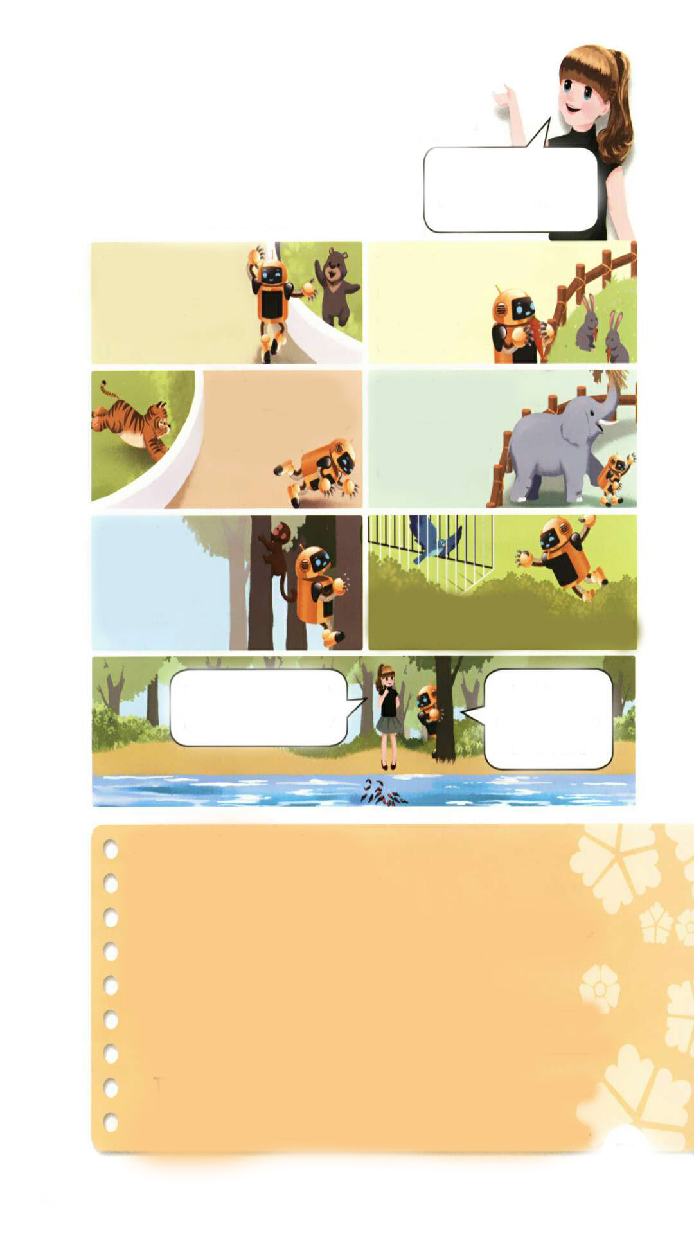
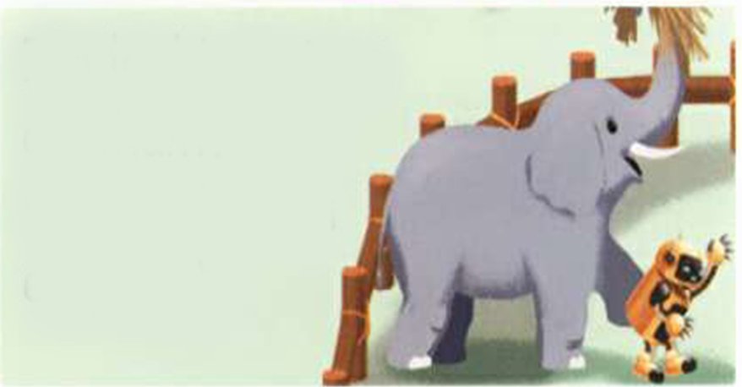
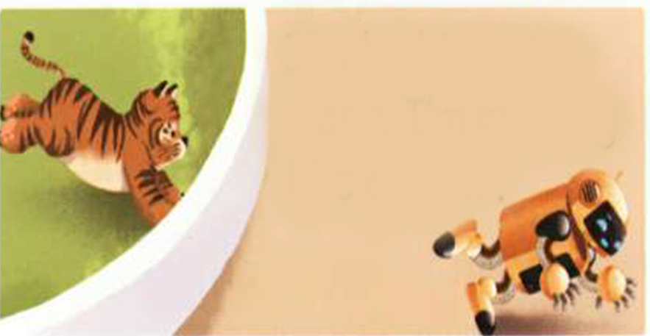

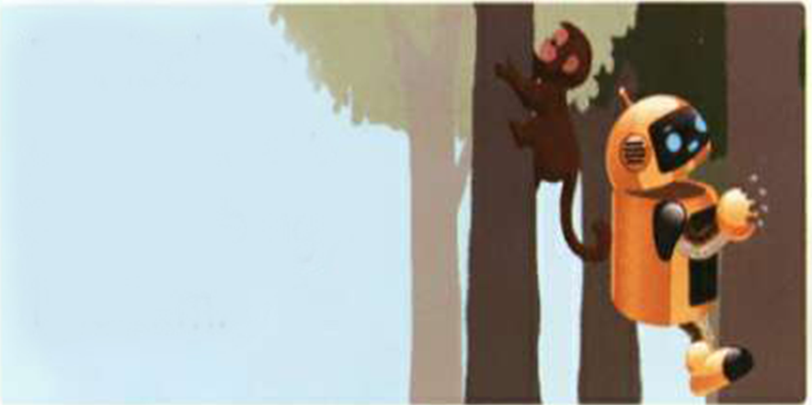
I’m looking at a bear. I’m dancing like a bear.
I’m looking at the rabbits. I’m eating like a rabbit.
I’m looking at a tiger. I’m running like a tiger.
I’m looking at an elephant. I’m walking like an elephant.
I’m looking at a monkey. I’m climbing like a monkey.
I’m looking at a bird. I like flying. I want to be a bird!

Slide 9

Robin, do you want to swim like a fish?
No! No! I don’t want to be a fish!

Slide 10

Read after the tape.
像……一样
look like看起来像
sound like听起来像
Sarah: What are you doing here, Robin?
Robin:I’m looking at a bear. I’m dancing like a bear.
I’m looking at the rabbits. I’m eating like a rabbit.
I’m looking at a tiger. I’m running like a tiger.
I’m looking at an elephant. I’m walking like an elephant.
I’m looking at a monkey. I’m climbing like him.
I’m looking at a bird. I like flying. I want to be a bird!
Sarah: Robin, do you want to swim like a fish?
Robin: No! No! I don’t want to be a fish!
第一个字母是元音音素，所以前面用an.
want to do sth.想要做某事

Slide 11
Answer the questions.
1. Where are Sarah and Robin? They are at _________.
2. What are the animals doing in the story?
The bear is _________. The rabbits are ___________.
The tiger is _________. The elephant is ___________.
the zoo
dancing
eating
running
walking

Slide 12

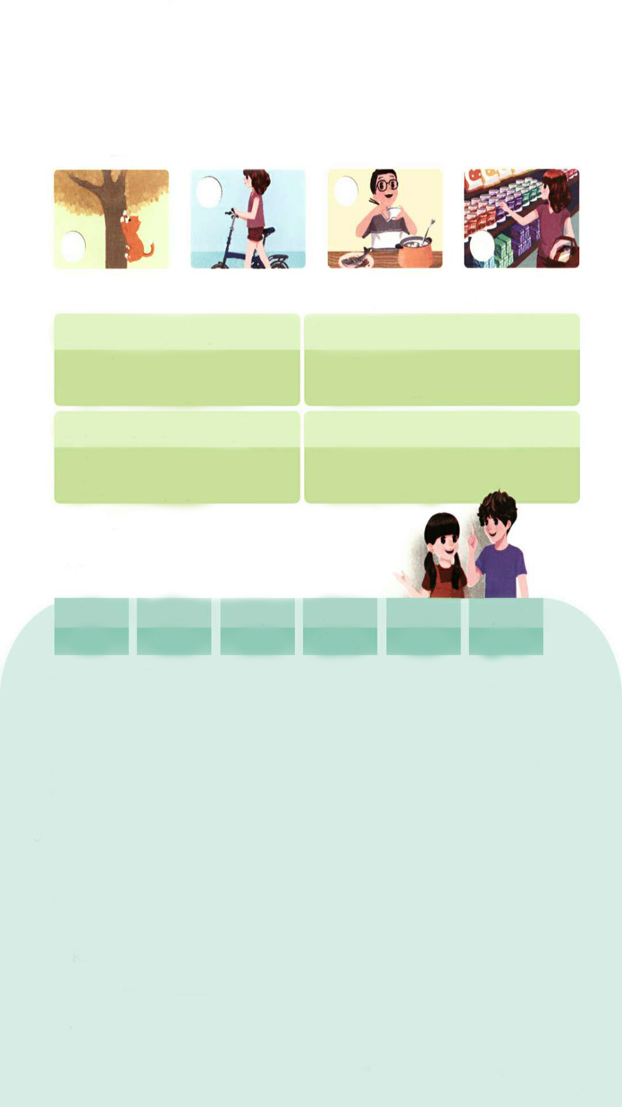
Let’s check
Listen and number.
3
4
2
1

Slide 13
听力材料：
1. Mrs Smith: Hi, Mrs Green!
Mrs Green: Hi, Mrs Smith!
Mrs Smith: Where is Amy now?
Mrs Green: She is shopping for us.
Mrs Smith: I see. What a good girl!
Mrs Green: Yes, she is.

Slide 14
2. Chen Jie: Look at the cat.
Mike: Oh, yes. Haha!
Chen Jie: It's climbing!
3. Boy: Hey, whose bike is that?
Girl: It's mine. Do you like it?
Boy: Yes. Very much!
4. Robin: Binbin. What are you doing?
Wu Binbin: I am eating.
Robin: Let's play a game.
Wu Binbin: OK, Robin.

Slide 15

Listen again and choose the right answers.
1. What is Amy doing?
2. Whose bike is it?
√
She is shopping.
She is eating lunch.
It is his.
It is hers.
√
3. What is the cat doing?
4. What is Wu Binbin doing now?
√
It is climbing.
It is sleeping.
He is playing.
He is eating.
√

Slide 16

Let’s wrap it up
Complete the sentences.
his
his
her
hers
my
mine
their
theirs
our
ours
your
yours
Amy: Whose English book is that?
John: It's ______________.
It's _______ .
Amy: Whose storybook is this?
John: It's__________. It's ____ .
my
2. Wu Binbin: Where is ____pen?
I can't find it.
Sarah: Here's one.
Is this _____ pen?
Wu Binbin: Yes, it's ______ .Thank you.
Miss White's book.
hers
your
Mr Zhang's
his
mine
my
3.Grandpa: Whose rabbits are these? Robin: These are_________.
Grandpa: Oh, these are ____ rabbits.
Sarah: Look! The rabbits are eating ___________carrots now.
4. Mike: Mum, ______dog is so cute.
I love him so much.
Mum: My dear, it's not only
_____dog. It's also ______.
Mike: Yes, Mum. He's ______ dog.
Binbin’s
his
your
mine
their
our

Slide 17




Language point.
英语物主代词用法口诀
物主代词分两种，形容词性名词性。
形容词性能力差，自己不能来当家。
句子当中作定语，身后定把名词加。
物主代词名词性，相当名词可单用。
句中充当主宾表，身后没有名词影。
两种代词形不同，添个“s”形变名。
his, its不用变， my变mine要记清。

Slide 18

Story time
Listen and answer.
1.Where are Zoom and Zip today?
At the zoo.
2.What is Zip doing?
She’s taking pictures.
3.What does Zip take pictures of?
She takes pictures of a tiger and two monkeys.

Slide 19
4.There is only the tiger’s tail. Why?
Because it’s running so fast.
5.What are the monkeys doing?
They’re looking at Zoom and Zip. They’re taking pictures like them. They’re copying them.

Slide 20
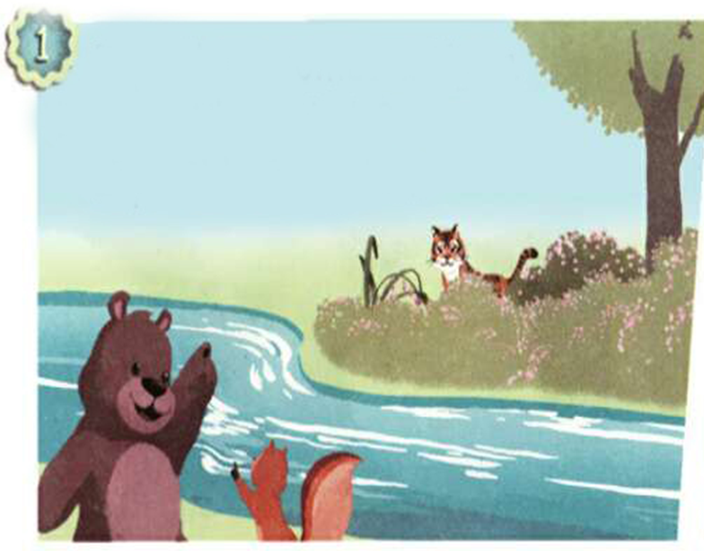
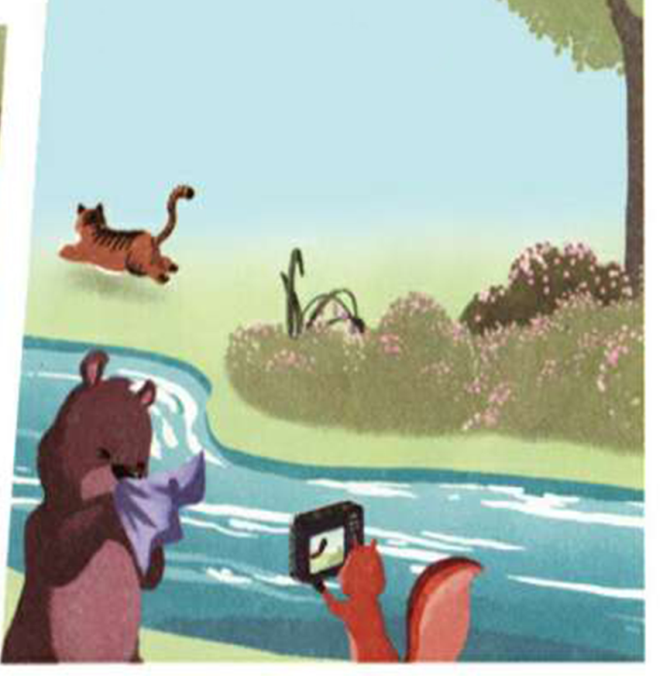
Listen to the tape.
.
Zoom: Ah-choo!
Zip: Here comes a tiger.
Zoom: Where is it?
Zip: Shh. Be quiet.

Slide 21
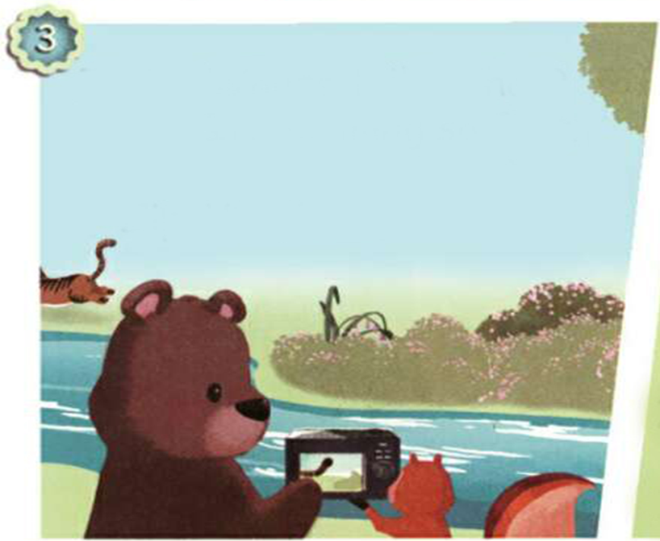
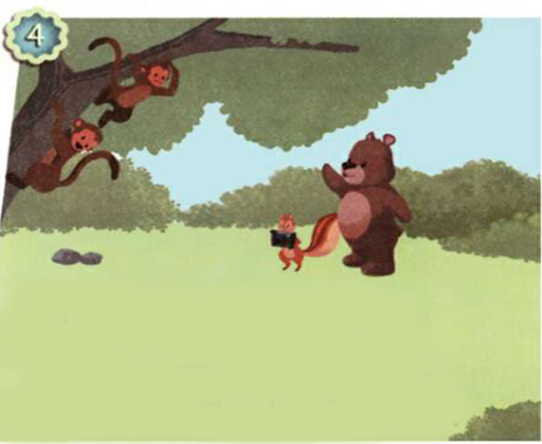
Zoom: Whose tail is that?
It’s running so fast.
Is it the tiger’s?
Zip: Yes, it is.
Zip: I see two monkeys.
Zoom: Where are they?
Zip: Shh. They’re climbing.
Zoom: Wow! They’re fast, too.

Slide 22
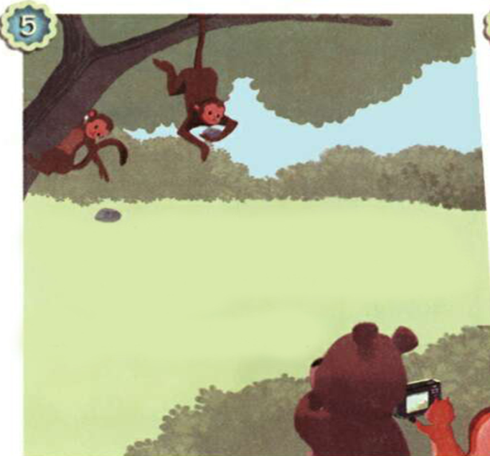
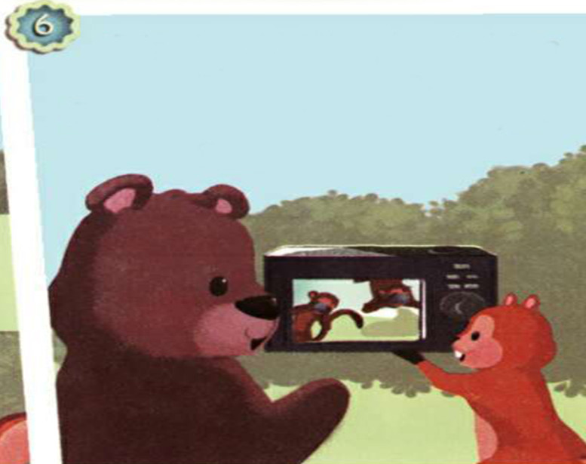
Zip: Look! They’re taking pictures, too.
Zoom: That’s cute. They’re copying us!
Zoom: What are they doing?
Zip: Why are they looking at us?
Zoom: I don’t know.

Slide 23
Listen and repeat.
Zip:Here comes a tiger.
Zoom:Where is it?
Zip:Shh. Be quiet.
Zoom:Ah-choo!
Zoom:Whose tail is that?
It's running so fast.
Is it the tiger's?
Zip:Yes, it is.
Zip:I see two monkeys.
Zoom:Where are they?
Zip:Shh. They're climbing.
Zoom:Wow! They’re fast, too.
Zoom:What are they doing?
Zip:Why are they looking at us?
Zoom:I don't know.
Zip:Look! They’re taking pictures, too.
Zoom:That’s cute. They’re copying us!
安静
快的，反义词slow慢的
看……
take pictures拍照
=take photos
名词所有格，意为老虎的(尾巴)
我不知道
v.模仿，复制

Slide 24




Number the pictures.
④
②
⑥
③
⑤
①

Slide 25
Read and judge(T or F).
F
( )1. Zoom and Zip are at the park.
( )2. The tiger and the monkeys are fast.
( )3. The tiger is climbing trees.
( )4. The monkeys are copying Zoom and Zip.
T
F
T

Slide 26

Act the story out in groups.

Slide 27

流利地朗读
流利地表演
有感情地表演

Slide 28
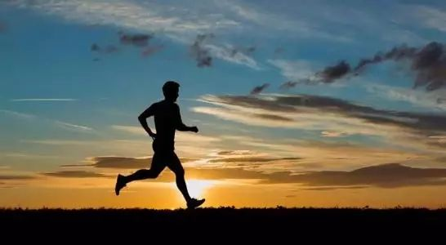
Good to know
Start where you are. Use what you have. Do what you can.
就地开始，用你所有的，做你所能做的。

Slide 29
Exercises
一、按要求填空。
1.写出下列单词的名词性物主代词。
you--_____ his --_______
our--______ they--________
2.写出下列动词的-ing形式。
eat--_______ dance--_______
drink--________ climb--________
run--_______ copy--_______
yours
his
ours
theirs
eating
dancing
drinking
climbing
running
copying

Slide 30
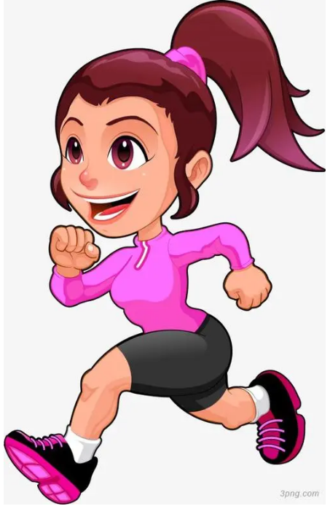
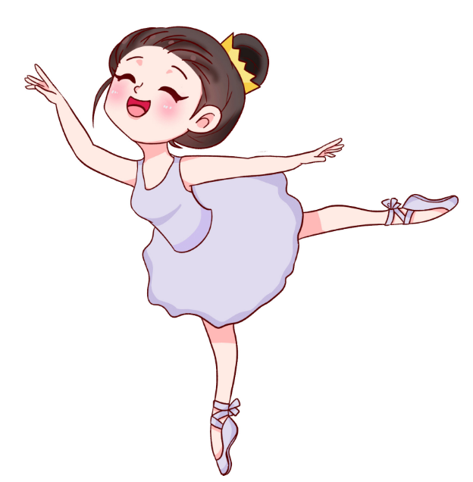
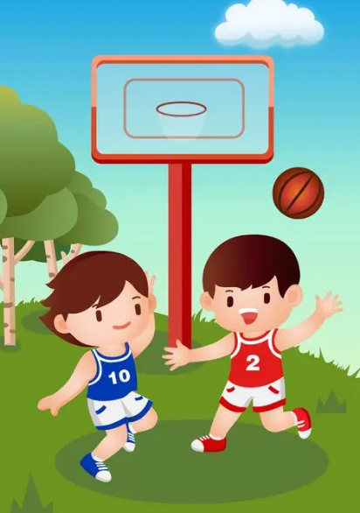
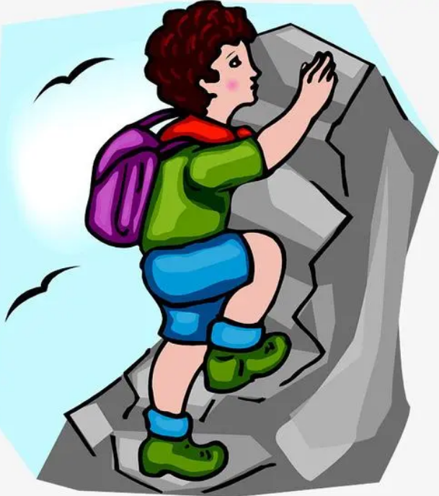
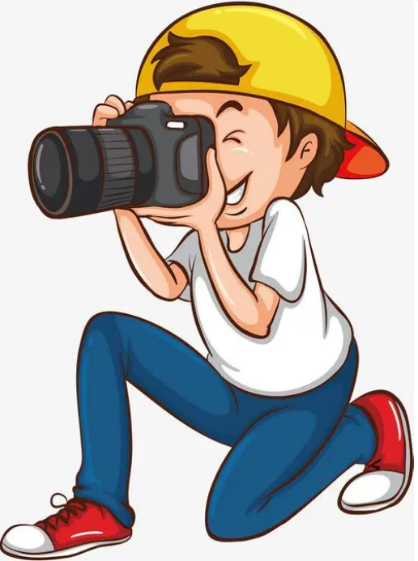
二、根据图片提示，完成句子。
running
The girl is ________.
2. The girl is _________ .
3. They are _______________.
4. He is _________________
5. He is ___________________.
dancing
playing basketball
climbing mountains
taking pictures

Slide 31
三、按照要求完成句子。
1.It’s the tiger’s tail.(对划线部分提问)
_______________________________
2.elephant, I’m, like, an, walking (.)(连词成句)
________________________________
3.They are taking photos. (划线部分提问)
________________________________
Whose tail is it?
I’m walking like an elephant.
What are they doing?

Slide 32

Summary
1.复习下列单词：eating, drinking, sleeping, climbing, running, playing等。
2.复习下列句型：
Whose… is that?
What are they doing?
They are +ving…
3.复习物主代词的用法。

Slide 33
Homework
ONE
TWO
Make sentences like Read and Write.
Read the story to your parents.
Act the story out in groups.

Slide 34







