Slide 1






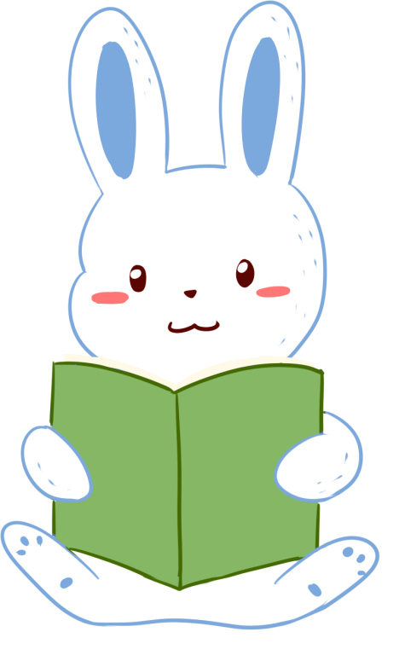


人 教 PEP 版 英 语 五 年 级 下 册
Unit 5
Whose dog is it?
Part B & Part C
Read and write—Story time

Slide 2

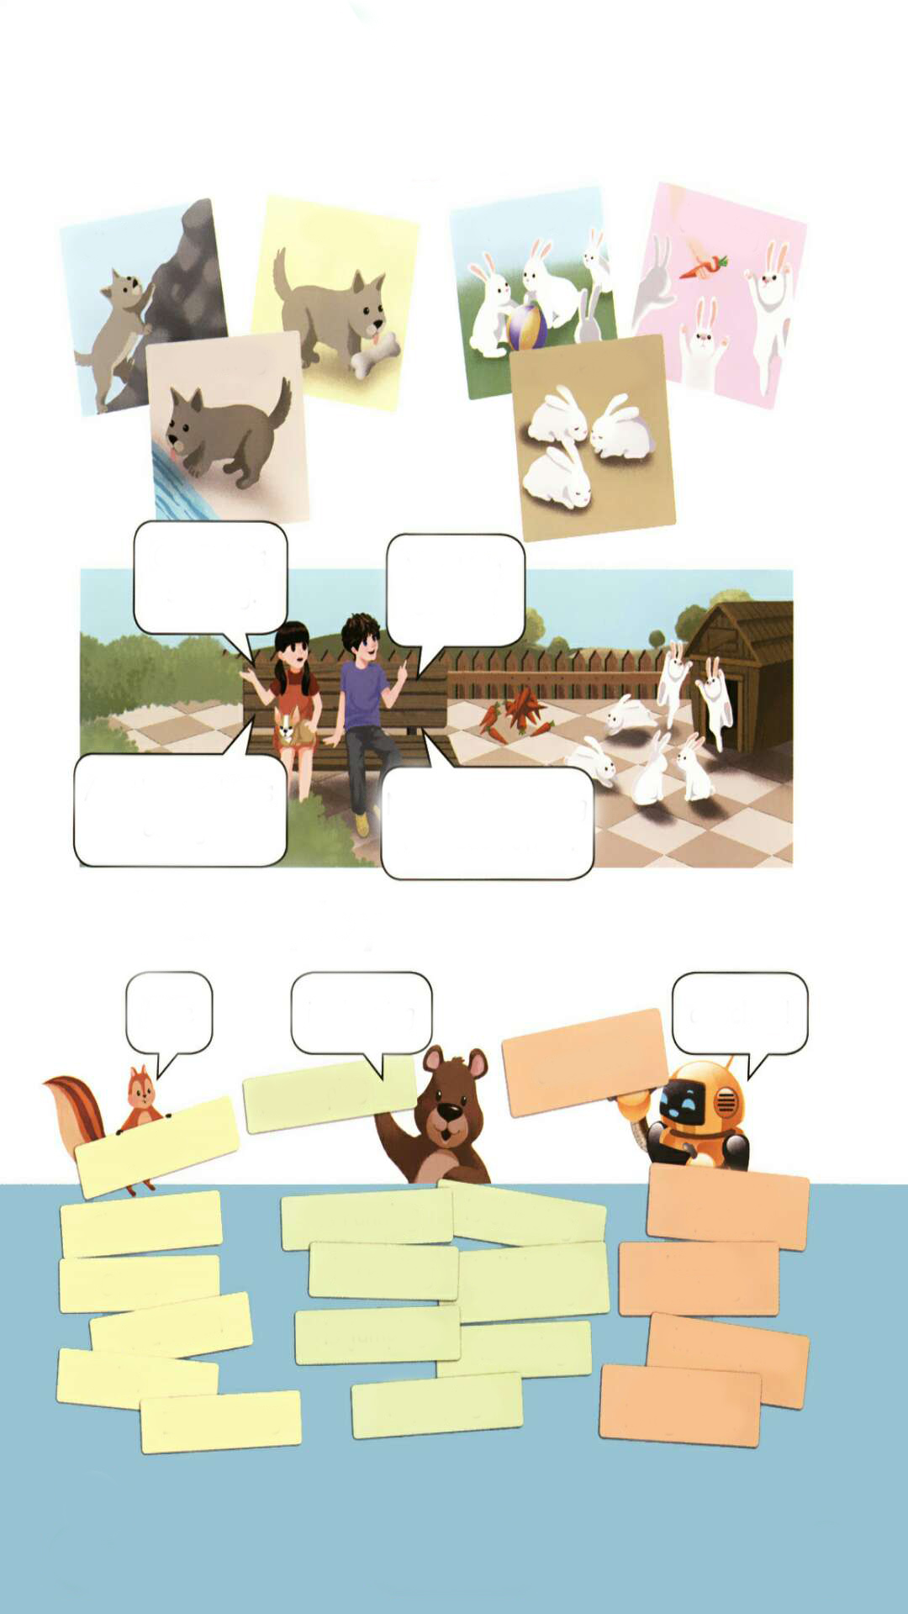
Warm up
Let’s match!
eating
drinking
playing
climbing
jumping

Slide 3
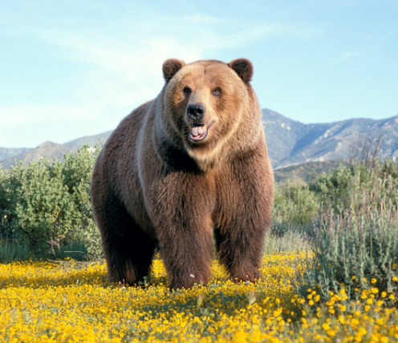
Lead in
Guess. What animal is it?
It’s a bear.

Slide 4

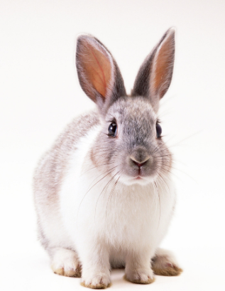
What’s this?
It’s a rabbit.
Notes:
点击字母后面的空白，会出现字母，点击图片后面的空白，导线会变短，三次变短后，点击炸弹，炸弹会爆炸。

Slide 5
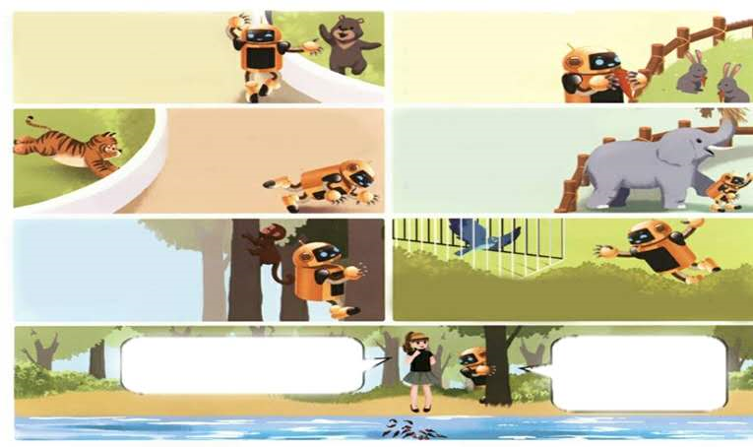
Presentation
Read and write
兴奋的
Sarah and Robin are at the zoo. Robin is excited!
Robin is looking at the animals. What animals does he see?
What are the animals doing?
The bear is dancing.
The rabbits are eating.
The tiger is running.
The elephant is walking.
The monkey is climbing.
The bird is flying.
The fish is swimming.

Slide 6
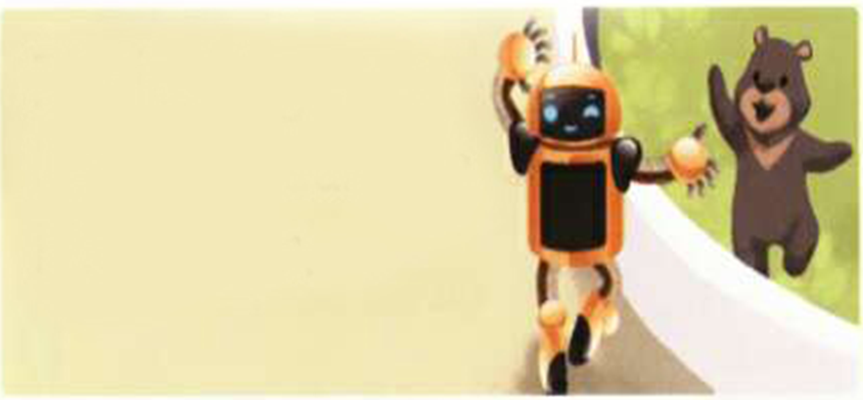
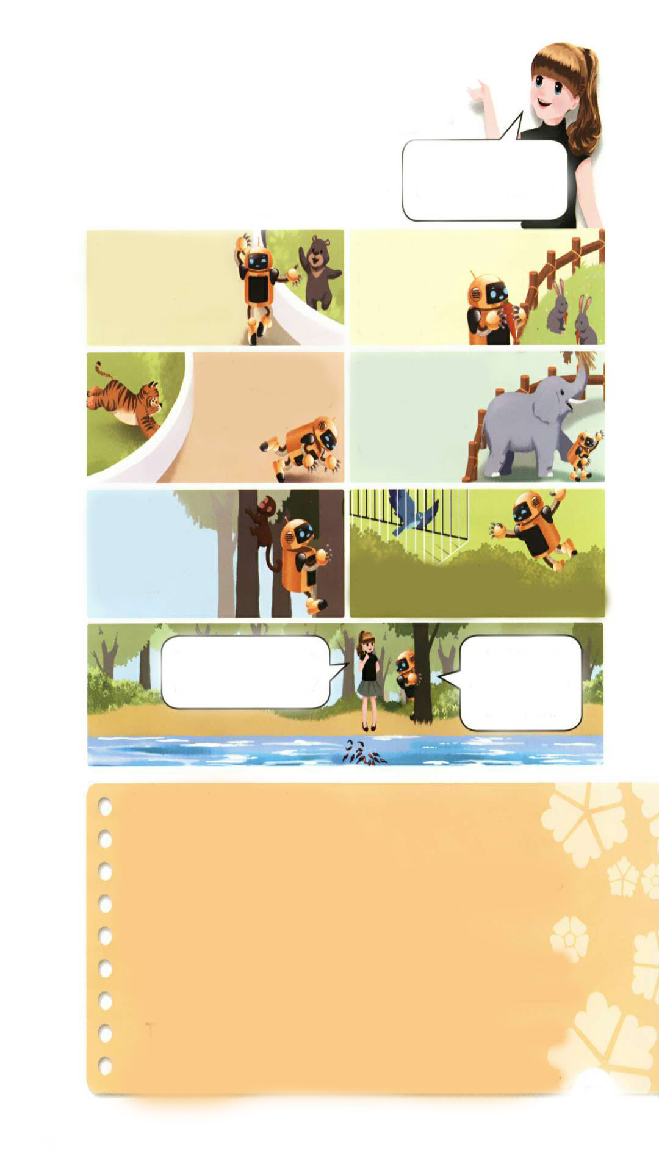
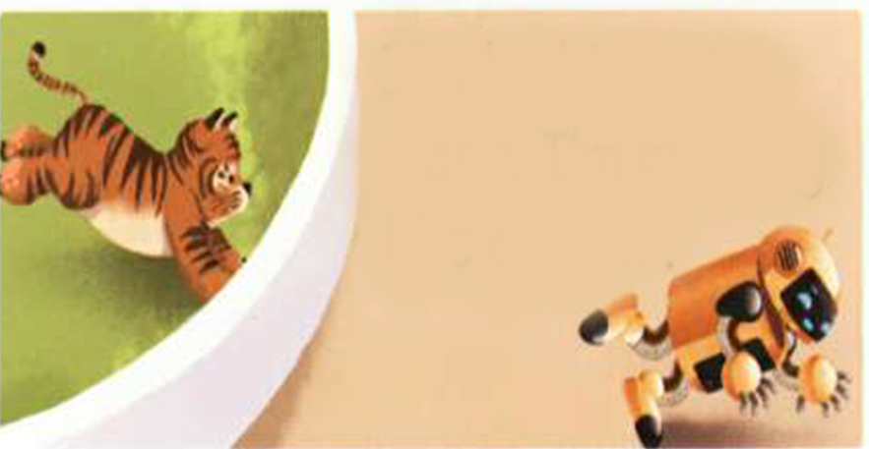
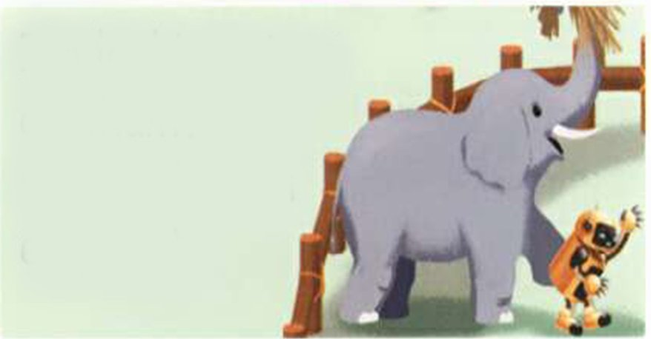
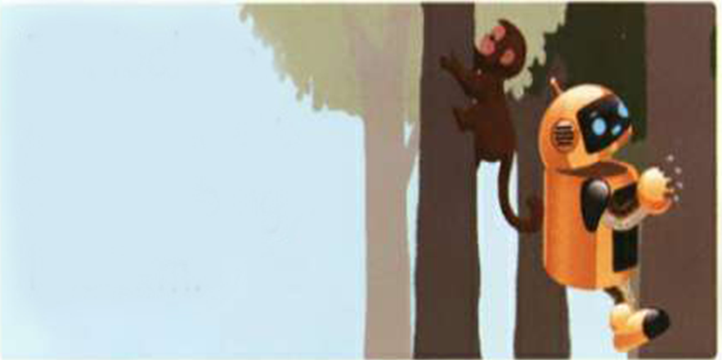
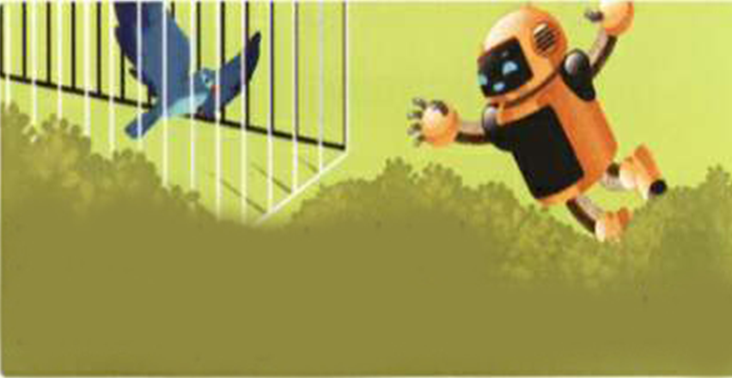
Then what is Robin doing?
Robin is dancing like a bear.
Robin is eating like a rabbit.
like
像……那样
Robin is running like a tiger.
Robin is walking like an elephant.
Robin is climbing like a monkey.
Robin is flying like a bird.

Slide 7

Read after the tape.
Sarah:
Robin:
What are you doing here, Robin?
I’m looking at a bear. I’m dancing like a bear.
I’m looking at the rabbits. I’m eating like a rabbit.
I’m looking at a tiger. I’m running like a tiger.
I’m looking at an elephant. I’m walking like an elephant.
I’m looking at a monkey. I’m climbing like him.

Slide 8
Robin:
Sarah:
Robin:
I’m looking at a bird.
I like flying. I want to be a bird!
Robin, do you want to swim like a fish?
No! No! I don’t want to be a fish!

Slide 9
Language points
1. Robin is excited!
【详解】该句为主系表结构。excited在句中作表语,意思是“兴奋的”。
e.g. Are you excited about going to Beijing?

Slide 10
2. I like flying.
【详解】这个句子用来表达某人喜欢做某事。like在句中是动词,意思是“喜欢”。 Like doing sth.喜欢做某事。
句型结构:主语 +like(s) doing sth.
e.g.I like swimming.

Slide 11
Act out.

Slide 12
Answer the questions.
Where are Sarah and Robin?
They are at .
2. What are the animals doing in the story?
The bear is .
The rabbits are .
The tiger is .
The elephant is .
the zoo
dancing
eating
running
walking

Slide 13
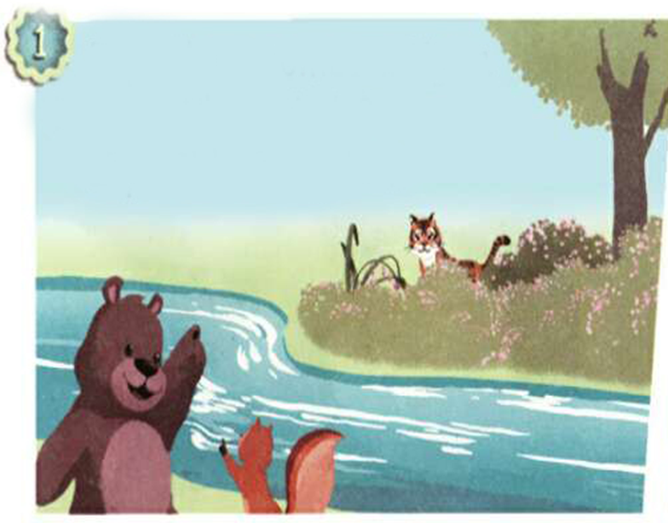
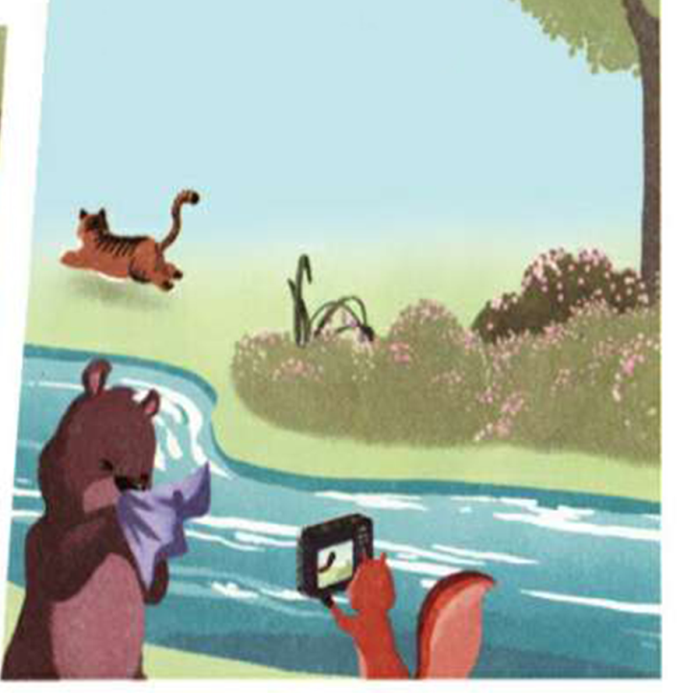
Story time
Let’s watch and find out.
Where are Zoom and Zip today?
At the zoo.
What is Zip doing?
She’s taking pictures.
What does Zip take pictures of?
She takes pictures of a tiger and two monkeys.

Slide 14
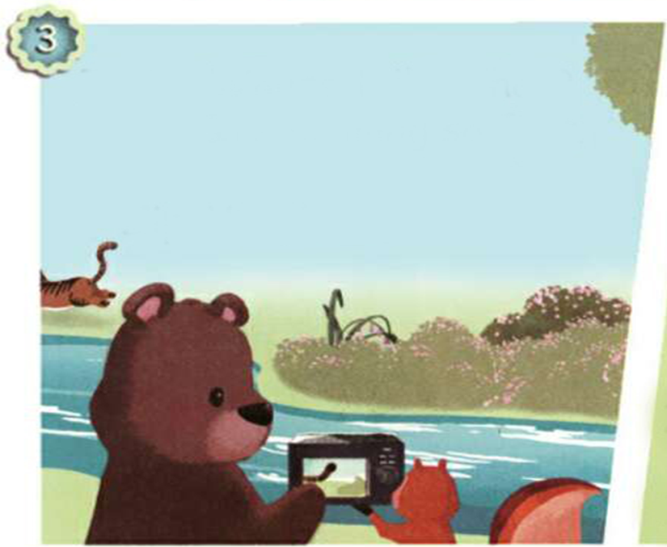
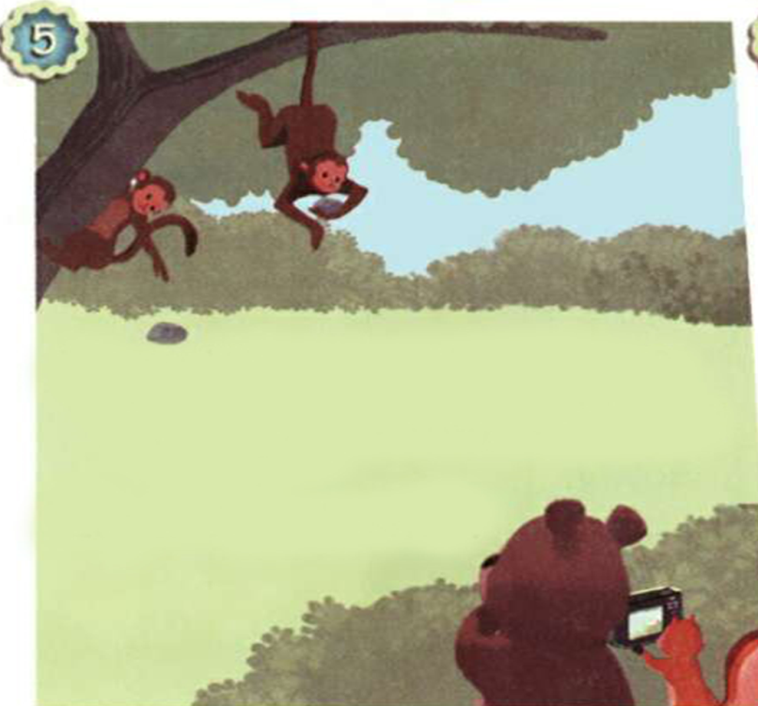
Look! There is only the tiger’s tail. Why?
Listen again and find the answer.
Because it’s running so fast.
What are the monkeys doing?
Yes. They’re looking at Zoom and Zip. They’re taking pictures like them. They’re copying them.

Slide 15
Listen and read.
Zip:
Zoom:
Zip:
Zoom:
Zoom:
Zip:
Here comes a tiger.
Where is it?
Shh. Be quiet.
Ah-choo!
Whose tail is that? It's running so fast. Is it the tiger's?
Yes, it is

Slide 16
Zip:
Zoom:
Zip:
Zoom:
Zoom:
Zip:
Zoom:
Zip:
Zoom:
I see two monkeys.
Where are they?
Shh. They're climbing.
Wow! They’re fast, too.
What are they doing?
Why are they looking at us?
I don't know.
Look! They’re taking pictures, too.
That’s cute. They’re copying us!

Slide 17

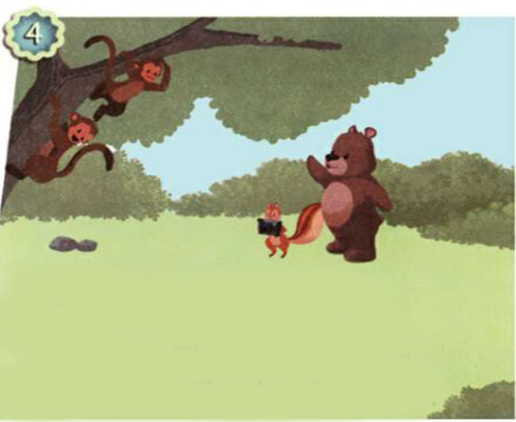

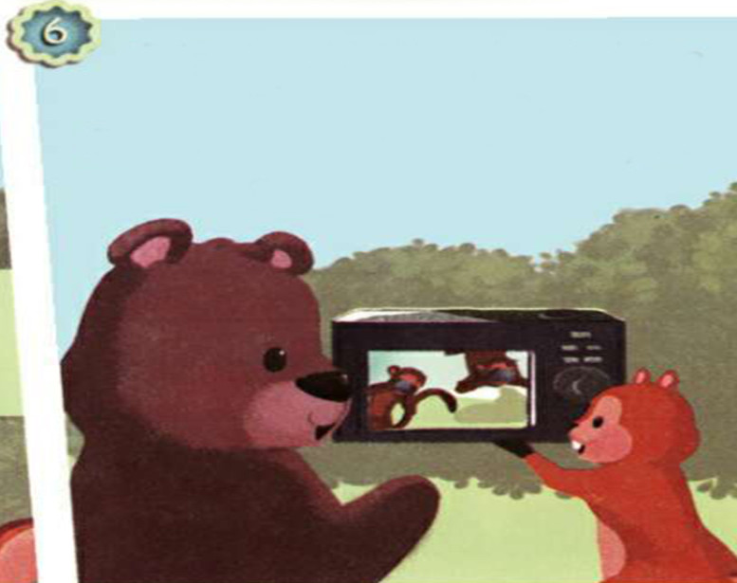



Number the pictures.
④
②
⑥
③
⑤
①

Slide 18

Act the story out in groups.

Slide 19
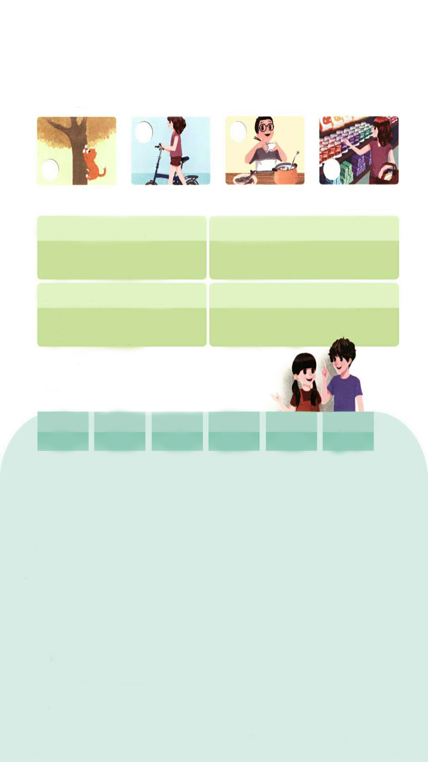
Practice
Let’s check
Listen and number.
3
4
2
1

Slide 20
Listen again and choose the right answers.
1. What is Amy doing?
2. Whose bike is it?
√
She is shopping.
She is eating lunch.
It is his.
It is hers.
√
3. What is the cat doing?
4. What is Wu Binbin doing now?
√
It is climbing.
It is sleeping.
He is playing.
He is eating.
√

Slide 21
听力材料：
1. Mrs Smith: Hi, Mrs Green!
Mrs Green: Hi, Mrs Smith!
Mrs Smith: Where is Amy now?
Mrs Green: She is shopping for us.
Mrs Smith: I see. What a good girl!
Mrs Green: Yes, she is.

Slide 22
2. Chen Jie: Look at the cat.
Mike: Oh, yes. Haha!
Chen Jie: It's climbing!
3. Boy: Hey, whose bike is that?
Girl: It's mine. Do you like it?
Boy: Yes. Very much!
4. Robin: Binbin. What are you doing?
Wu Binbin: I am eating.
Robin: Let's play a game.
Wu Binbin: OK, Robin.

Slide 23
Let’s wrap it up
Complete the sentences.
his
his
her
hers
my
mine
their
theirs
our
ours
your
yours
Amy: Whose English book is that?
John: It's ______________.
It's _______ .
Amy: Whose storybook is this?
John: It's__________. It's ____ .
my
2. Wu Binbin: Where is ____pen?
I can't find it.
Sarah: Here's one.
Is this _____ pen?
Wu Binbin: Yes, it's ______ .Thank you.
hers
Miss White's book
your
Mr Zhang's
his
mine
my
3.Grandpa: Whose rabbits are these? Robin: These are_________.
Grandpa: Oh, these are ____ rabbits.
Sarah: Look! The rabbits are eating ___________carrots now.
4. Mike: Mum, ______dog is so cute.
I love him so much.
Mum: My dear, it's not only
_____dog. It's also ______.
Mike: Yes, Mum. He's ______ dog.
Binbin’s
his
your
mine
their
our

Slide 24

Exercises
一、写出下列动词的现在分词。
1. walk________ 2. look ________
3. fly ________ 4. run________
5. climb ________ 6. dance________
walking
looking
flying
running
climbing
dancing

Slide 25
二、单项选择。
( )1. Amy is ________ in the music room.
A. dancing B. danceing C. dance
( )2. ________ elephant is drinking water.
A. A B. An C. Some
( )3. Two monkeys ________ climbing the tree.
A. am B. is C. are
A
B
C

Slide 26
三、问答连线。
1. Where are Sarah and Mike? A. It’s flying.
2. What is the bird doing? B. They are at the zoo.
3 Are these rabbits eating? C. They are walking.
4. What are the bears doing? D. No, they are sleeping.

Slide 27


Summary
1.能够正确听、说、认读单词：excited, dancing, walking, flying, running, like等。
2.能用The … is v+ing…句型简单介绍某动物正在干什么。
3.能够掌握人称代词的用法。
七彩课堂
伴你成长

Slide 28

Homework
ONE
TWO
Make sentences like Read and Write.
Read the story to your parents.
七彩课堂
伴你成长
Act the story out in groups.

Slide 29








