Slide 1


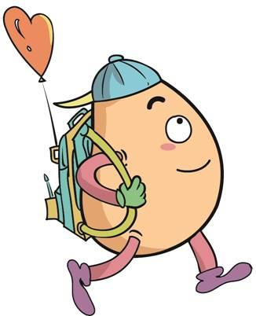






人 教 PEP 版 英 语 五年 级 下 册
Unit 5
Whose dog is it?
Part B
Let’s try & Let’s talk

Slide 2


Warm up

Slide 3

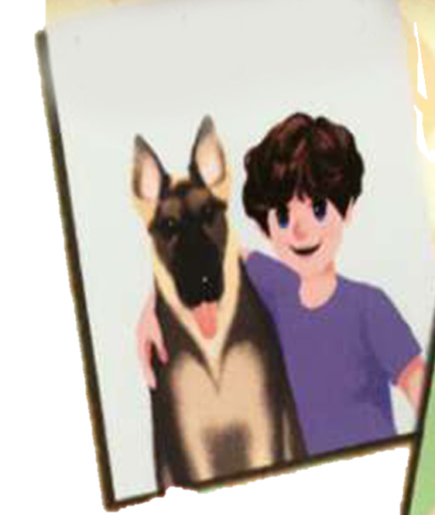
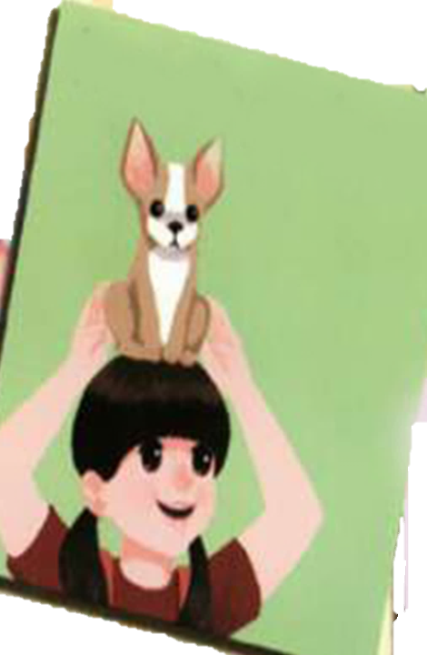
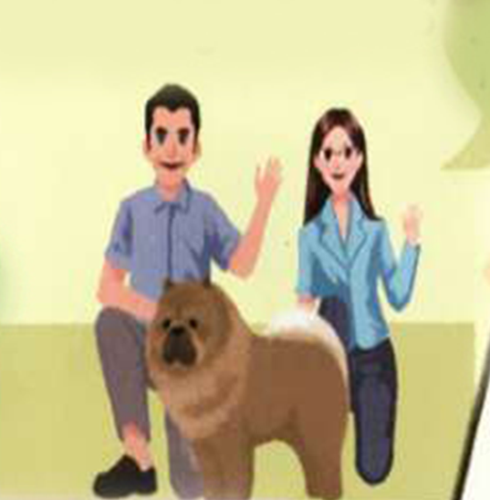

Play a game
What’s missing?
his dog-his
her dog- hers
their dog-theirs
my dog-mine

Slide 4



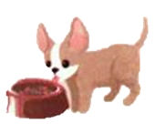
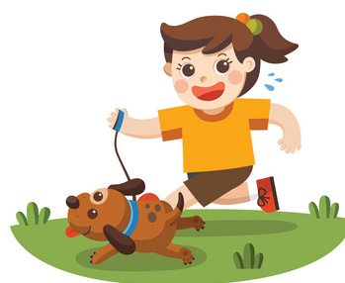
Let’s introduce my dog.

Slide 5
Presentation
Talk about what the dog is doing.
Talk about where the dog is.
Talk about what the dog is doing.
Talk about what your partners are doing.

Slide 6


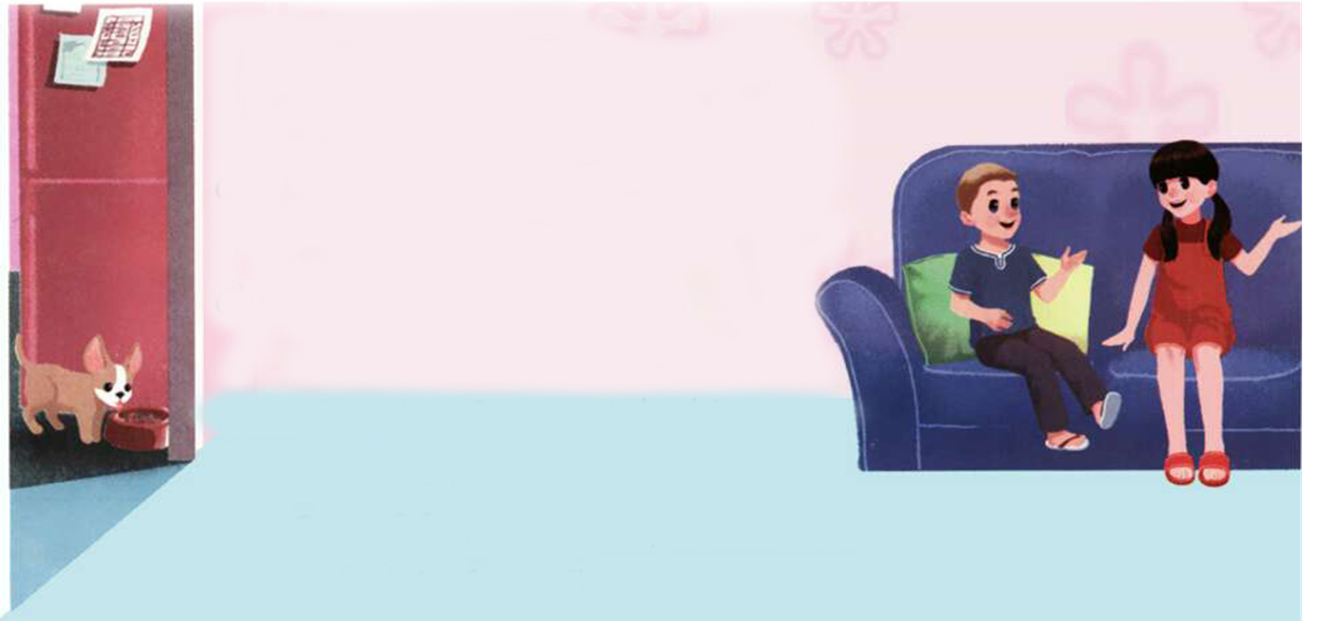
Let’s try
Today Sam is at Chen Jie’s home. He wants to play with her dog Fido.
Where is the dog?
Fido

Slide 7
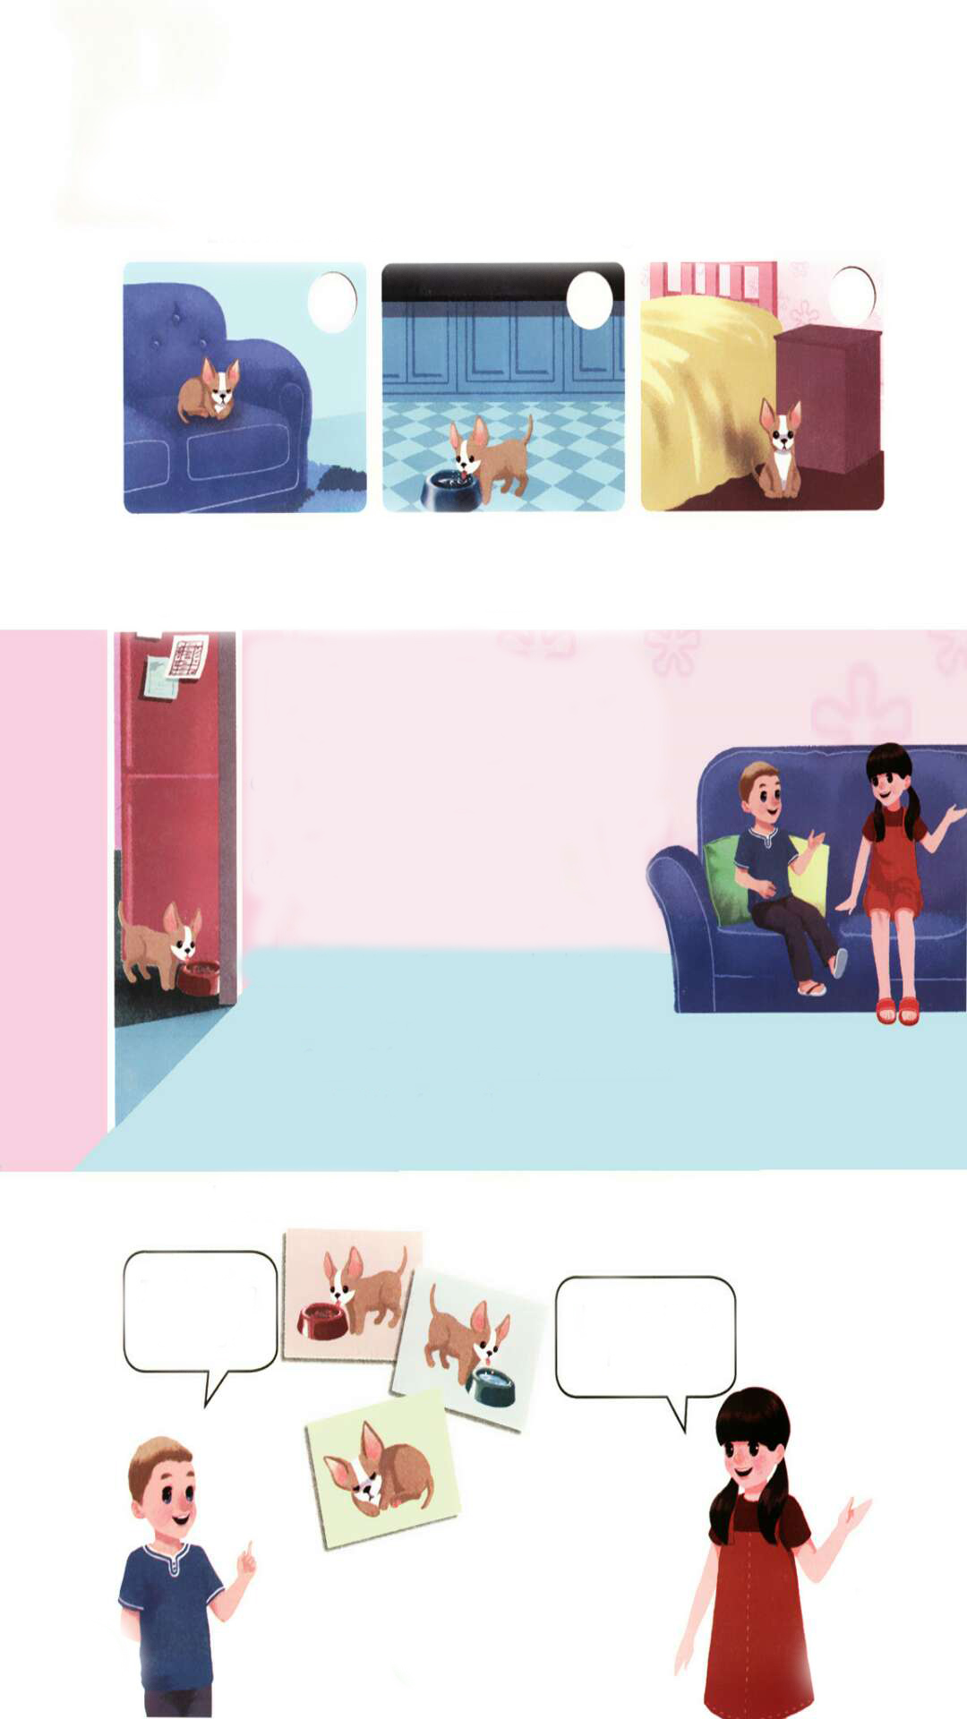
Listen and tick.
Where is the dog?
√

Slide 8
Let’s check！
听力材料：
Sam: Chen Jie, where is Fido?
Chen Jie: He's in the living room.
Sam: What is he doing?
Chen Jie: He's sleeping.
Sam: Again?! Oh, I want to play with him.
Chen Jie: You can play with him later!

Slide 9
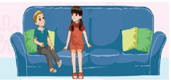
Try to talk.
Sam is at Chen Jie’s home.
Sam and Chen Jie are talking about Fido.

Slide 10

Let’s talk
Watch and answer！
Where is Fido now?
2.What is Fido doing?
3.Can Sam take Fido to the park?

Slide 11
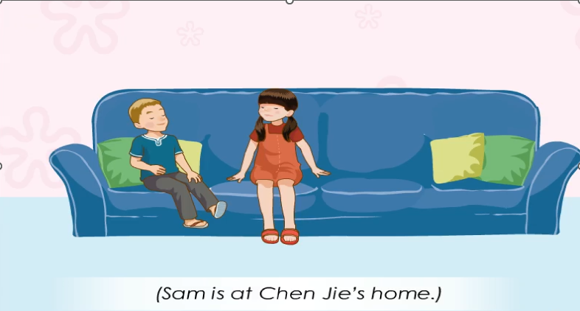

Slide 12
Watch and answer！
1.Where is Fido now?
2.What is Fido doing?
3.Can Sam take Fido to the park?
He is in the kitchen.
He is eating.
Yes, he can.

Slide 13

Listen and judge.
1. Sam is looking for Fido. ( )
2. Fido is drinking water. ( )
3. Fido is Sam’s dog. ( )
4. Sam can take Fido to the park. ( )
5. Sam, Sarah, Fido will go to the park. ( )
T
F
F
T
F

Slide 14
Listen and follow.
(Sam is at Chen Jie’s home.)
Sam: Where is Fido now?
Chen Jie: He’s in the kitchen.
Sam: Is he drinking water?
Chen Jie: No, he isn’t. He’s eating.
Sam: Can I play with him now?
Chen Jie: Yes. Can you take him to the park?
Sam: Of course! Fido, come here!
Fido: Woof, woof!

Slide 15

Read and act.
1.Read it together.
2.Each student
reads a sentence.
Tip: Choose one to read in two. 选择一种两人练习。
3. Read in roles.
自己分配角色。

Slide 16

流利地朗读
流利地表演
有感情地表演

Slide 17
Listen and repeat.
(Sam is at Chen Jie’s home.)
Sam: Where is Fido now?
Chen Jie: He’s in the kitchen.
Sam: Is he drinking water?
Chen Jie: No, he isn’t. He’s eating.
Sam: Can I play with him now?
Chen Jie: Yes. Can you take him to the park?
Sam: Of course! Fido, come here!
Fido: Woof, woof!
在厨房
现在进行时态, be+v-ing构成
和……一起玩
带某人去某地

Slide 18
Listen and follow.
(Sam is at Chen Jie’s home.)
Sam: Where is Fido now?
Chen Jie: He’s in the kitchen.
Sam: Is he drinking water?
Chen Jie: No, he isn’t. He’s eating.
Sam: Can I play with him now?
Chen Jie: Yes. Can you take him to the park?
Sam: Of course! Fido, come here!
Fido: Woof, woof!

Slide 19




Language point.
现在进行时的一般疑问句
课文原句: ---Is he drinking water?
---No, he isn’t.
句型结构：Be动词+主语+动词ing形式+其他？
肯定回答: Yes, 主语+be动词.
否定回答: No, 主语+ be动词+ not.
eg. ---Are you singing? --Yes, I am.
---Is he listening to music? --No, he isn’t.

Slide 20
Language point.
如何描述某人正在做某事
课文原句: He is eating.
句型结构:主语+be动词+动词ing形式+其他.
此句型用于表示此刻或目前这段时间内正在进行的动作，be动词随主语人称和数的变化而变化。句型结构还可这样记：
be动词跟在后，动词ing形式跟着走，其他成分不可丢。

Slide 21
Language point.
动词ing形式的构成
1.大多数动词可在动词后直接加-ing。 carry-carrying
2.如果动词以-e结尾，则去掉e，再加-ing。 dance-dancing
3.如果动词只有一个元音字母，而其后跟有一个辅音字母时，将此辅音字母双写，再加ing。 run-running swim-swimming

Slide 22
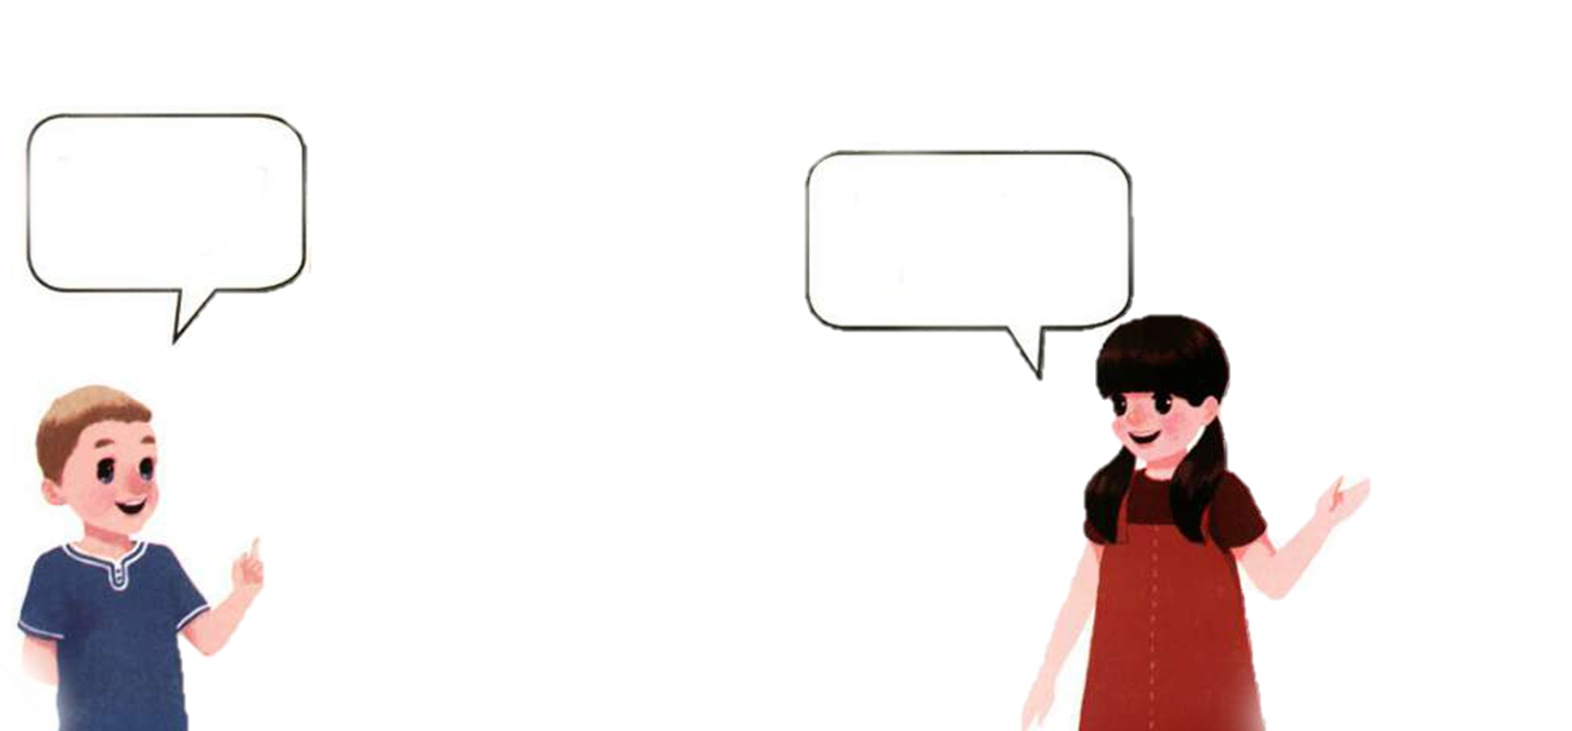
Look and say.
Is the dog jumping?
No, he isn’t.
He is sleeping.

Slide 23
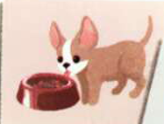
Look and say.
Is the dog eating?
Yes, he is.

Slide 24
Look and say.
Is the dog running?
No, he isn’t.
He is drinking
water.

Slide 25
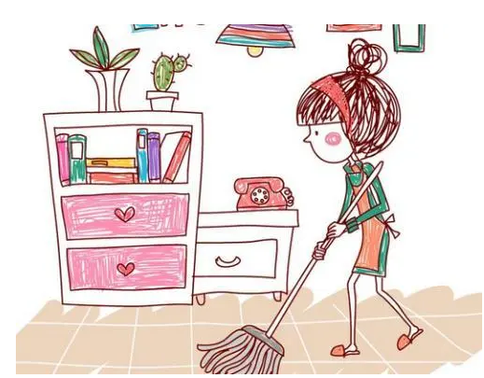


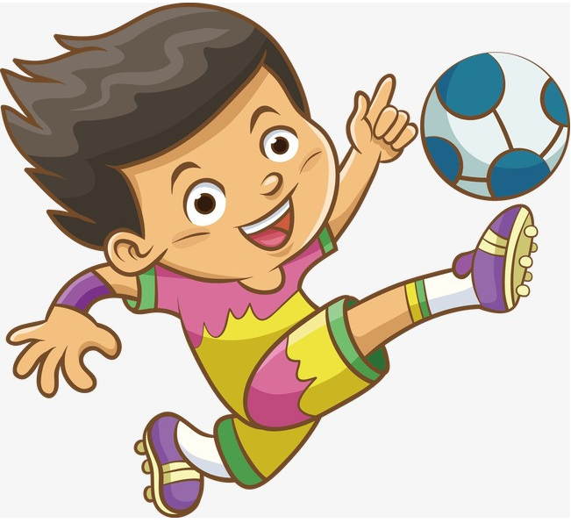
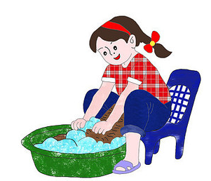
Ask and answer.
--Is he/she ...?
--Yes, he/she is./ No, he/she isn’t.

Slide 26

Good to know
Write it on your heart that every day is the best.
铭记在心，每一天都是一年中最好的日子。

Slide 27



Exercises
一、图句连连看。
A. --Is she shopping?
--Yes, she is.
B. --Is he jumping?
--No, he isn’t. He is reading.
C. --Are they singing?
--No, they are dancing.

Slide 28
二、选择填空。
( ) 1.—Is Sarah ___ water?
—Yes, she is.
A. drink B. drinking C. drinks
( ) 2. —Can you take ____ to the park?
—Sure.
A. he B. him C. his
( ) 3. —_____ is Tom?
—He’s at home.
A. Where B. Whose C. Who
B
B
A

Slide 29
三、照例子，改写句子并回答。
例：John is eating an apple. →
Is John eating an apple?
Yes, he is. / No, he isn’t.

Slide 30
1. Chen Jie is playing the piano.→
__________________________________
__________________________________
2. Fido is drinking water. →
_______________________________
________________________________
Is Chen Jie playing the piano?
Yes, she is./ No, she isn’t.
Is Fido drinking water?
Yes, he is./ No, he isn’t.

Slide 31

Summary
学习了下列句型：
— Where is …?
— He is ….
— Is he …?
— No,….

Slide 32
Homework
ONE
TWO
Act the dialogue out with your friends.
Make a short dialogue using the sentences we have learnt.
Ask your father some questions.

Slide 33







