Slide 1









人 教 PEP 版 英 语 五 年 级 下 册
Unit 5
Whose dog is it?
Part B
Let’s try & Let’s talk

Slide 2

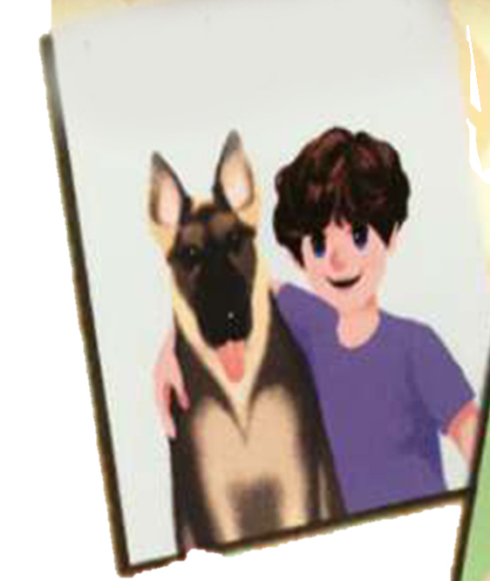
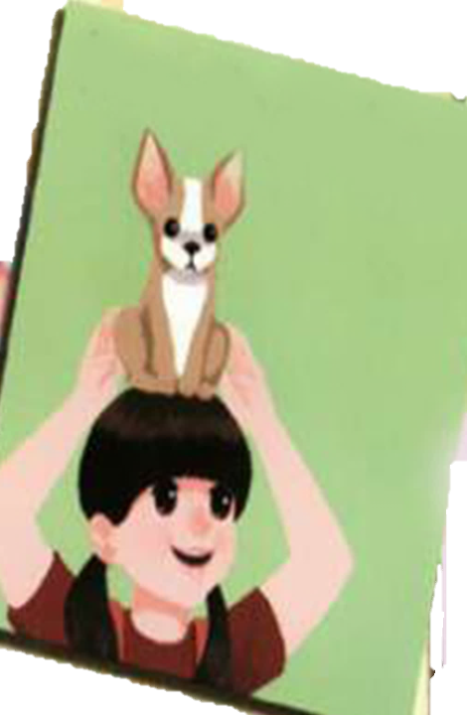
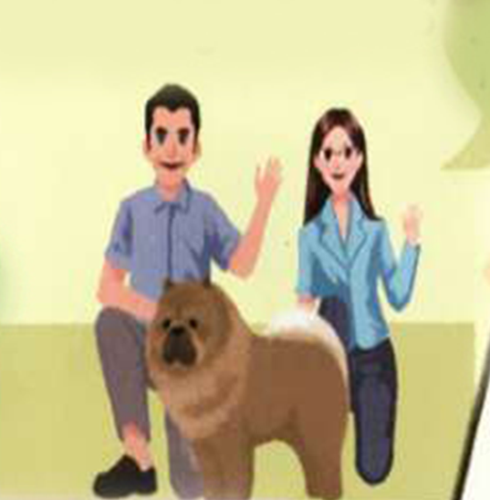

Warm up
What’s missing?
his dog-his
her dog- hers
their dog-theirs
my dog-mine

Slide 3
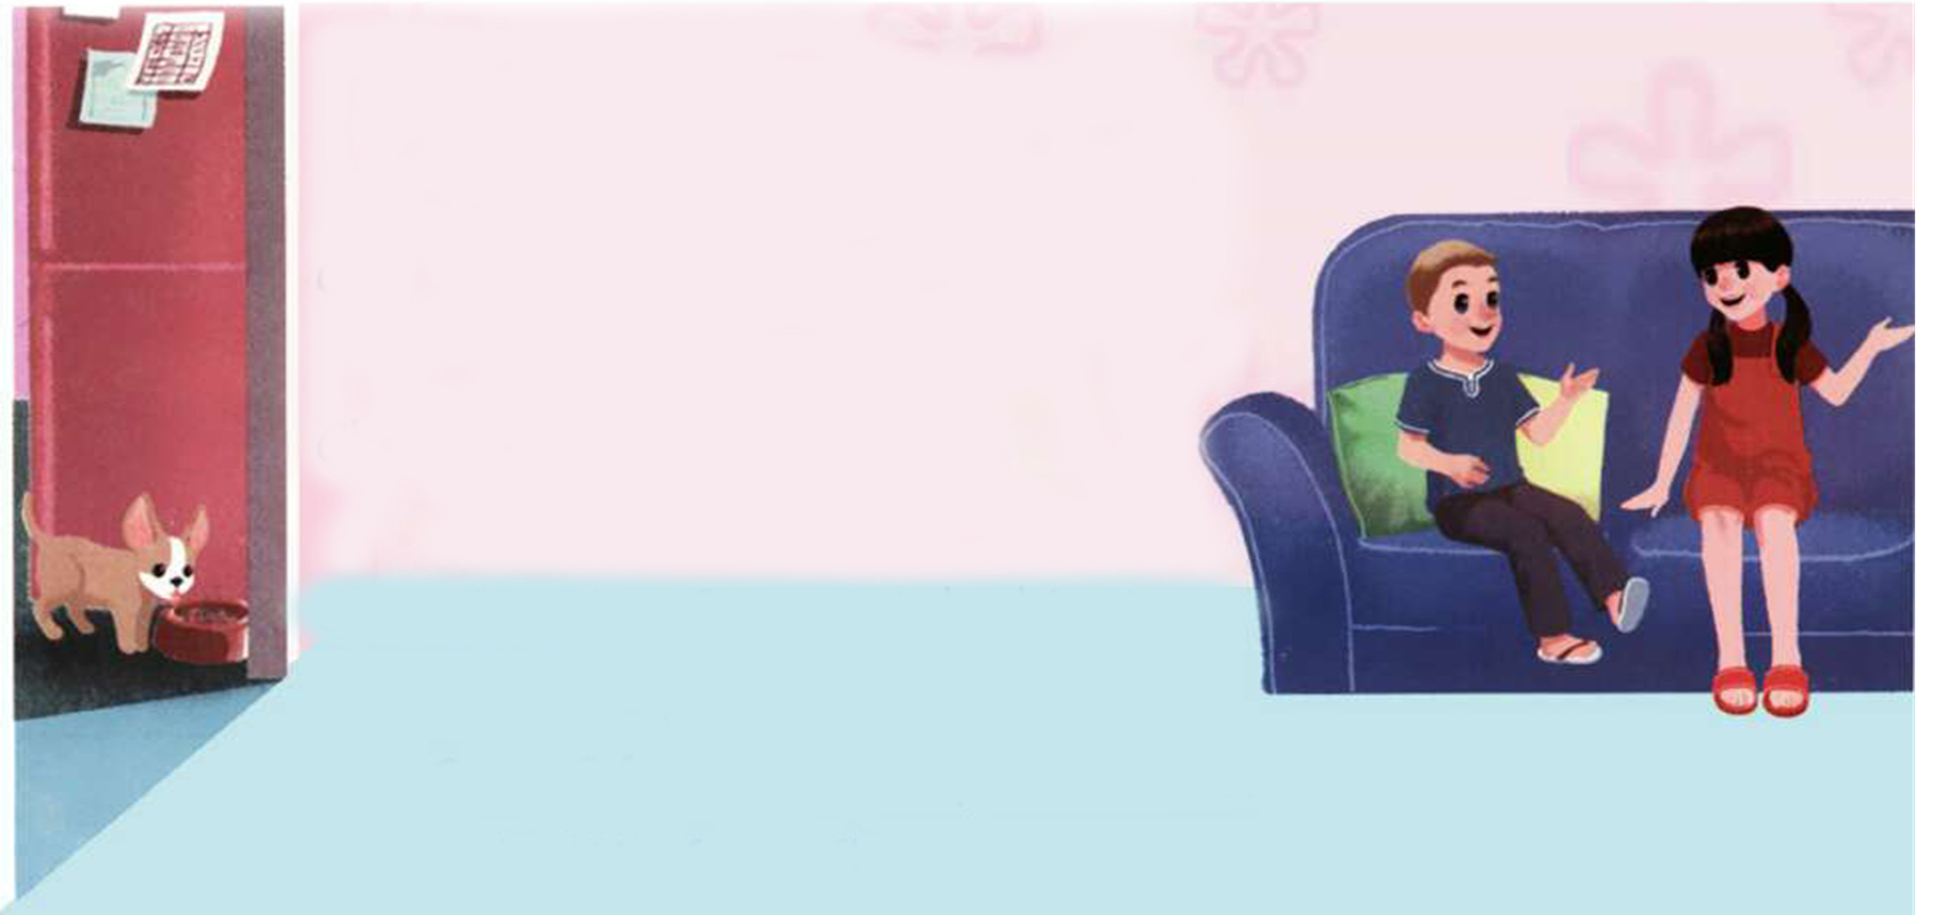
Lead in
Today Sam is at Chen Jie’s home. He wants to play with her dog Fido.
Where is the dog?
Fido

Slide 4

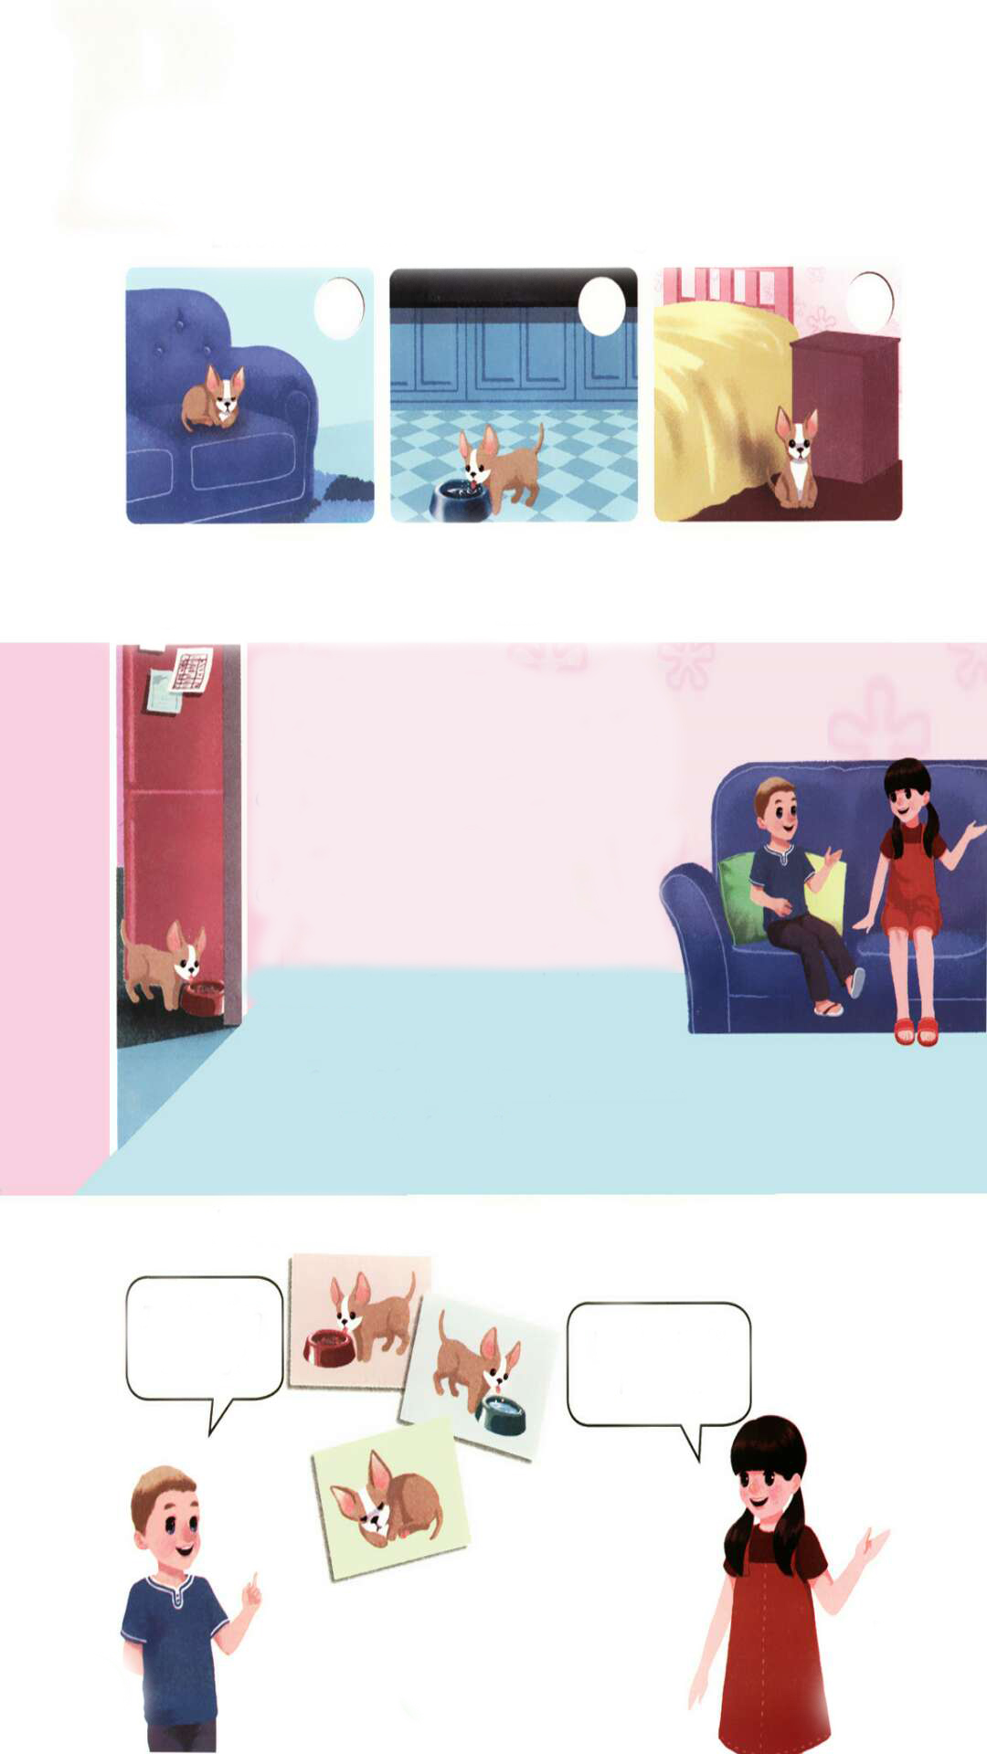
Presentation
Let’s try
Listen and tick. Where is the dog?
√

Slide 5

听力材料：
Sam:
Chen Jie:
Sam:
Chen Jie:
Sam:
Chen Jie:
Chen Jie, where is Fido?
He's in the livingroom .
What is he doing?
He's sleeping.
Again?! Oh, I want to play with him .
You can play with him later!

Slide 6


Today Sam is at Chen Jie’s home. They are talking in the living room.
What are they talking about? Can you guess?
They’re talking about Chen Jie’s dog.

Slide 7


Let’s enjoy some pictures of Fido.
He’s sitting in the bedroom.
He’s sleeping in the living room.
He’s eating in the kitchen.

Slide 8

Fido is so cute. Sam wants to play with him.
Where is he? What is he doing? Can you guess?
Is he v-ing?
Let’s listen to the tape and find out the answers.

Slide 9

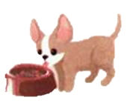
Where is he? What is he doing?
He’s in the kitchen. He’s eating.

Slide 10
Let’s talk
Listen and read.
(Sam is at Chen Jie’s home.)
Sam:
Chen Jie:
Sam:
Chen Jie:
Sam:
Chen Jie:
Sam:
Fido:
Where is Fido now?
He’s in the kitchen.
Is he drinking water?
No, he isn’t. He’s eating.
Can I play with him now?
Yes. Can you take him to the park?
Of course! Fido, come here!
Woof, woof!

Slide 11
Language point
—Is he drinking water?
— No, he isn't.
【详解】这组对话用来询问和回答某人是否正在做某事。因为主语是he,所以此句型的be动词应用is,其肯定回答是“Yes, he is.”,否定回答是“No, he isn't.”。
句型结构:Is+ 主语 + 动词-ing+ 其他?
回答:Yes,主语 +is./No,主语 +isn't.
e.g. — Is he playing games?
— Yes, he is.

Slide 12
Read and find out the missing words.
(Sam is at Chen Jie’s home.)
Sam:
Chen Jie:
Sam:
Chen Jie:
Sam:
Chen Jie:
Sam:
Fido:
Where is Fido now?
He’s in the kitchen.
Is he drinking water?
No, he isn’t. He’s eating.
Can I play with him now?
Yes. Can you take him to the park?
Of course! Fido, come here!
Woof, woof!

Slide 13
Read and act out.
(Sam is at Chen Jie’s home.)
Sam:
Chen Jie:
Sam:
Chen Jie:
Sam:
Chen Jie:
Sam:
Fido:
Where is Fido now?
He’s in the kitchen.
Is he drinking water?
No, he isn’t. He’s eating.
Can I play with him now?
Yes. Can you take him to the park?
Of course! Fido, come here!
Woof, woof!

Slide 14
Practice
Look and say
Is the dog eating?
No, he isn’t.
He is …
Yes!

Slide 15
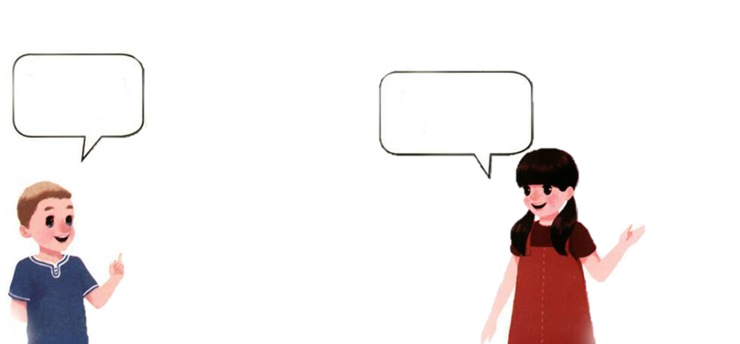
Is the dog …?
No, he isn’t.
He is …

Slide 16

Is the dog …?
No, he isn’t.
He is …

Slide 17

Exercises
一、按要求写单词。
1.play with A. 和……玩
2.come here B. 喝茶
3.drink tea C. 当然可以
4.of course D. 过来

Slide 18
二、选择填空。
( ) 1.—Is Sarah ________ water?
—Yes, she is.
A. drink B. drinking C. Drinks
( ) 2. —Can you take ________ to the park?
—Sure.
A. he B. him C. his
( ) 3. —________is Tom?
—He’s at home.
A. Where B. Whose C. Who
B
B
A

Slide 19

三、连词成句。
is in kitchen the he (.)
__________________________
2. I play with now can him (?)
__________________________
3. Fido is where now (?)
__________________________
He is in the kitchen.
Can I play with him now?
Where is Fido now?

Slide 20


Summary
学习了下列句型：
— Where is …?
— He is ….
— Is he …?
— No,….
七彩课堂
伴你成长

Slide 21

Homework
ONE
TWO
Act the dialogue out with your friends.
Make a short dialogue using the sentences we have learnt.
七彩课堂
伴你成长
Ask your father some questions.

Slide 22








