Slide 1









人 教 PEP 版 英 语 五年 级 下 册
Unit 5
Whose dog is it?
Part A
Let’s learn & Look, say and complete

Slide 2


Warm up

Slide 3

Lead in
Children, today we are going to see a dog show.

Slide 4
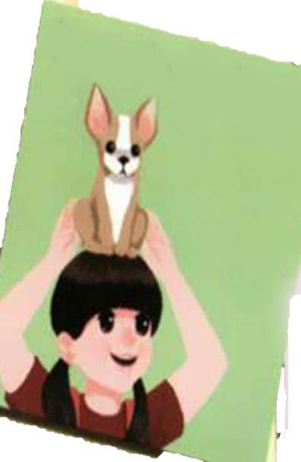
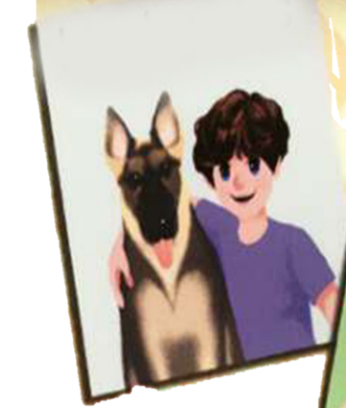
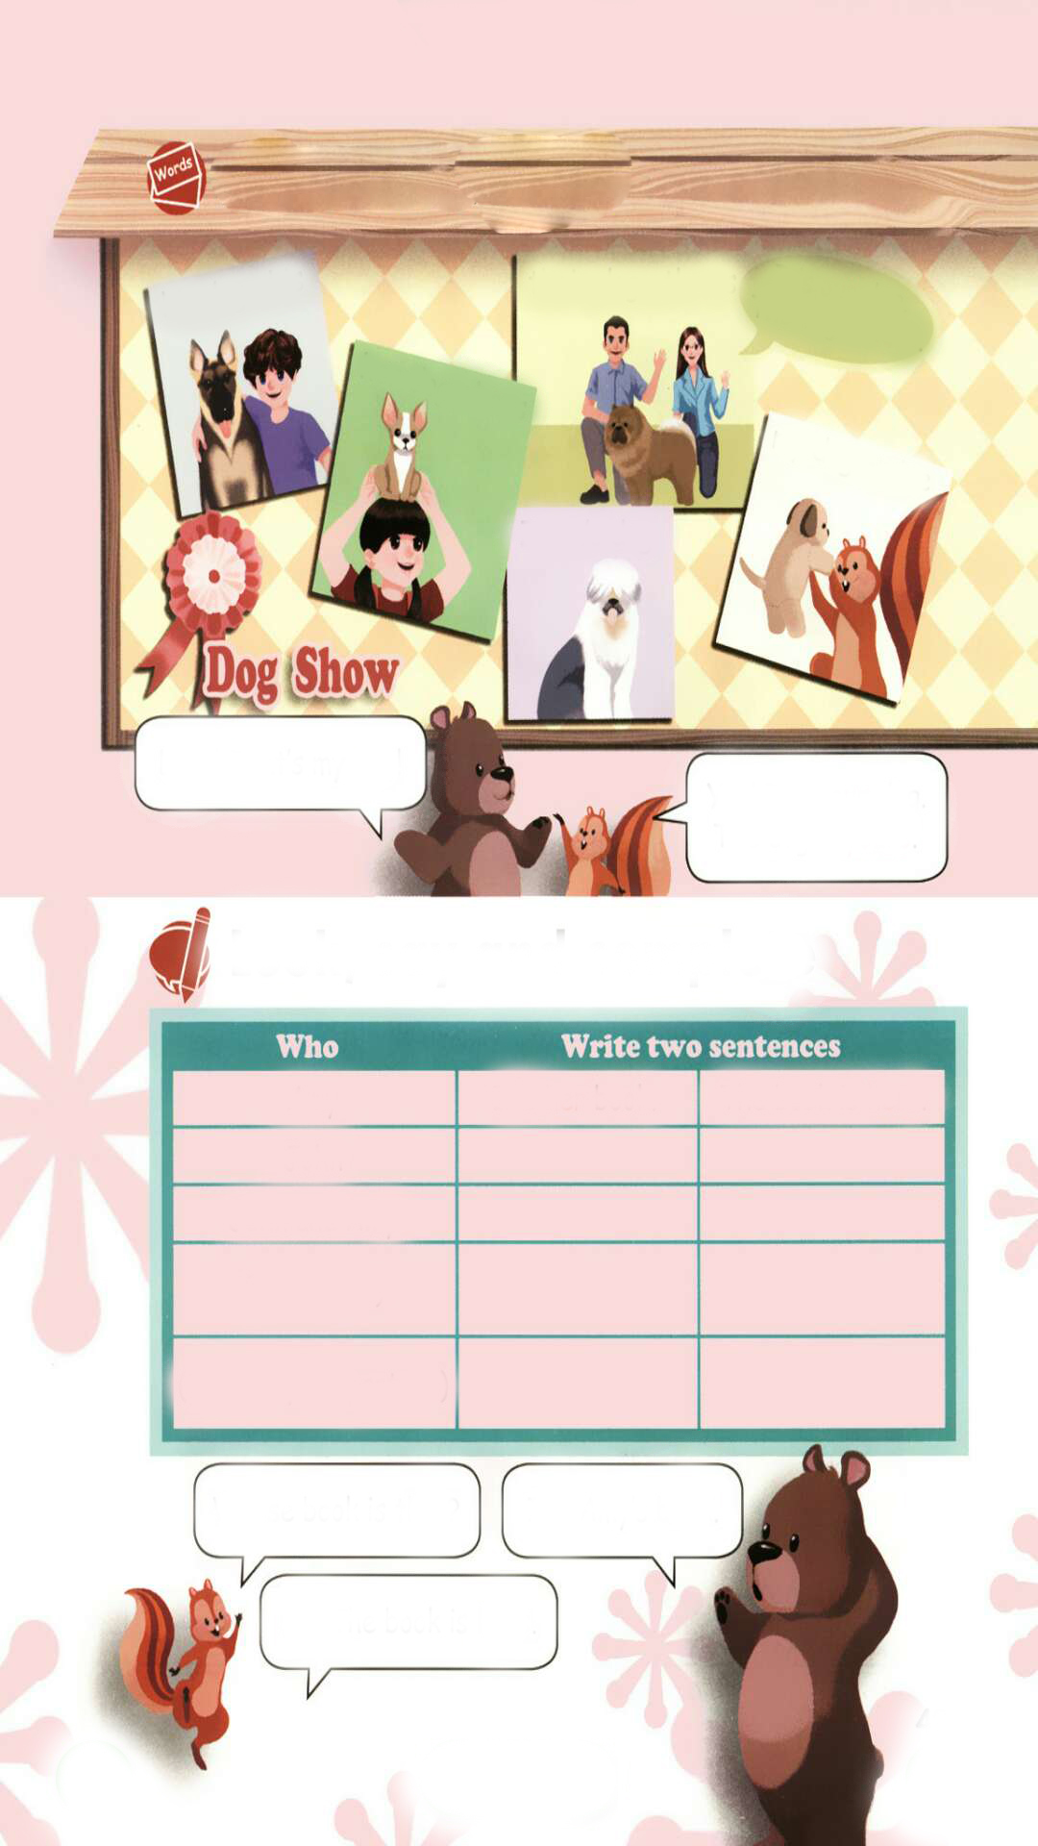

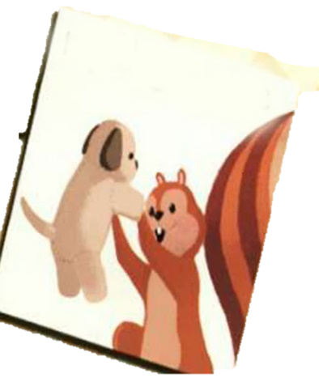

Let’s introduce the dogs.

Slide 5
Presentation
Talk about whose...
Talk about whose dogs they are.
Talk about whose dog is mine.
Talk about whose things they are.

Slide 6




Let’s learn
Learn new words
Zoom: Look! That’s my dog!
Zip: Yes! It’s your dog. The dog is yours.
your dog = yours
yours
你(们)的

Slide 7
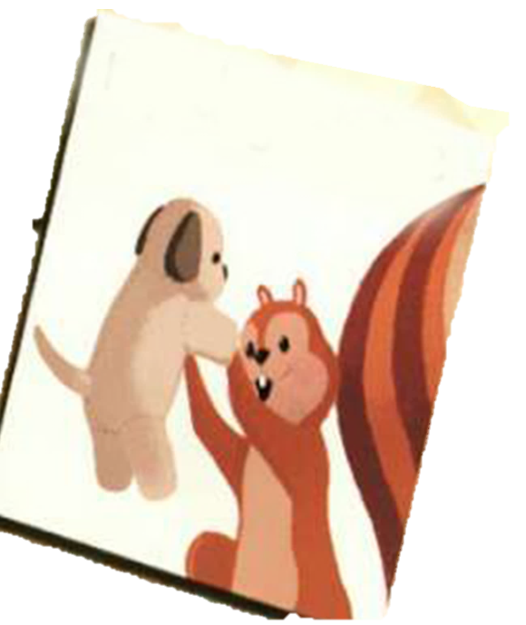
Zoom: Zip, is this your dog?
Zip: Yes! It’s my dog. The dog is mine.
Zoom: It’s so cute.
my dog =
mine
mine
我的

Slide 8
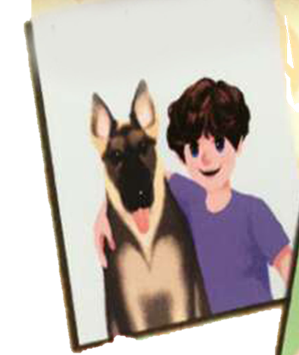
Zoom: Look! That’s______ dog.
Zip: Yes! It’s his dog. The dog is ____.
Zoom: It’s so big.
Mike’s
his
his dog =
his
his
他的

Slide 9
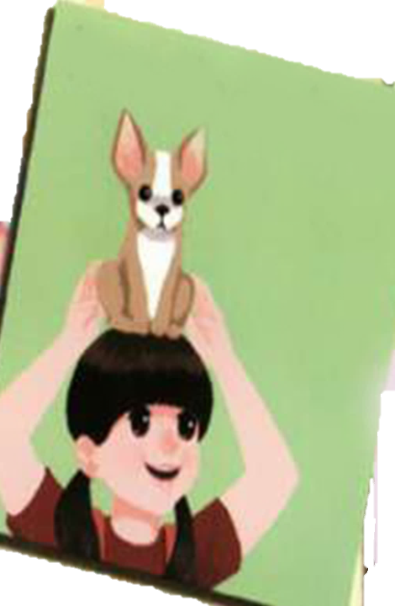
Zoom: Look! That’s_________ dog.
Zip: Yes! It’s her dog. The dog is ____.
Zoom: It’s so cute.
Chen Jie’s
hers
her dog =
hers
hers
她的

Slide 10
It’s our dog.
The dog is ours.
our dog =
ours
ours
我们的
their dog =
theirs
their
It’s _____dog.
The dog is_______.
theirs
theirs
她/他/它们的

Slide 11
Language point
物主代词也有人称和数的变化,见下表:
 | 单数 |  | 复数
 | 形容词性物主代词 | 名词性物主代词 | 形容词性物主代词 | 名词性物主代词
第一人称 | my | mine | our | ours
第二人称 | your | yours | your | yours
第三人称 | his | his | their | theirs
 | her | hers
 | its | its

Slide 12
Read after the tape.
his dog - his
their dog - theirs
It’s our dog.
The dog is ours.
her dog - hers
my dog - mine
Zoom’s dog
Look! That’s my dog!
Yes! It’s your dog. The dog is yours.

Slide 13

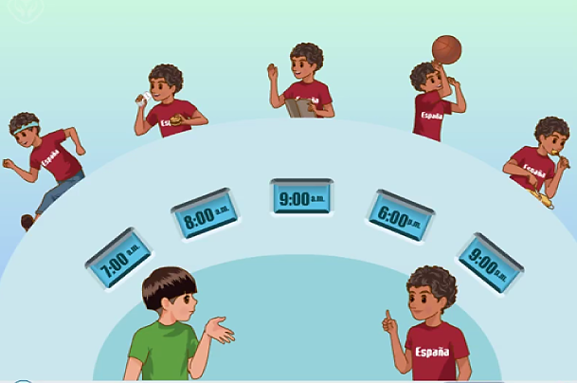
Play in roles.
Whose book is that?
It’s Sarah’s. It’s hers.

Slide 14

Play in roles.
Whose schoolbag is that?
It’s Mike’s. It’s his.

Slide 15

Play in roles.
Whose ruler is that?
It’s my ruler. It’s mine.

Slide 16
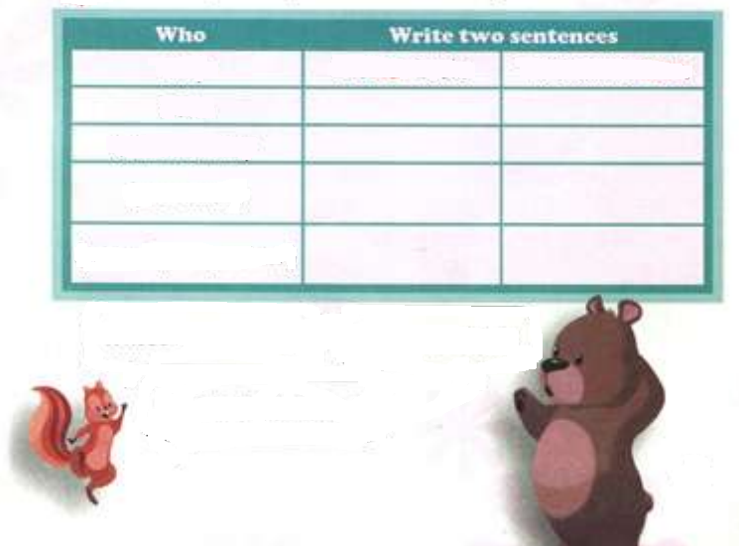
Look, say and complete
Amy
John
John and Amy
(your name)
(you and your partner)
It’s her book.
The book is hers.
It’s his bike.
The bike is his.
It’s their bag.
The bag is theirs.
It’s my pen.
The pen is mine.
It’s our desk.
The desk is ours.
Whose book is that?
It’s Amy’s book.
Ah! The book is hers.

Slide 17
Discuss the difference
形容词性物主代词
my pen
her bag
his eraser
your ruler
their dogs
our desks
名词性物主代词
mine
hers
his
yours
theirs
ours

Slide 18
形容词性物主代词
起形容词的作用，用在名词前。
名词性物主代词
起名词的作用，后面无名词。

Slide 19
Look, say and complete
It’s her book. =
The book is hers.
It’s his book. =
The book is his.
It’s their book.=
The book is theirs.
It’s my book. =
The book is mine.
It’s our book. =
The book is ours.

Slide 20


Make dialogues using the following phrases.
picture
maths book
story book
glasses
pencil
pencil box
skirt
schoolbag
Whose _____ is that?
It’s ____’s.
It’s _____.

Slide 21

Play a game
接力表演
学生三个人一组进行表演，第一个人拿着实物(pen)，第二个人说(Whose pen is that?)，第三个人作出回答。如: It’s John’s pen. It’s his.

Slide 22

Good to know
Every new day is another chance to change your life.
每天都会是改变命运的机会。

Slide 23
Exercises
一、英汉互译。
1. my(名词性物主代词)__________
2. he(名词性物主代词)._________
3. she(名词性物主代词)._________
4. we(名词性物主代词)__________
5. their(名词性物主代词)________
6. we(形容词性物主代词)________
mine
his
hers
ours
theirs
our

Slide 24
二、用所给单词的正确形式填空。
1.This storybook is ______(she).
2. It’s ______(you) dog. The dog is ______(you).
3. ________(Mike) dog is yellow. The dog is ______(John).
4. The bag is not ______(my). ____(I) bag is over there.
hers
your
yours
Mike’s
John’s
mine
My

Slide 25
三、照例子，仿写句子
例：It’s my schoolbag. → The schoolbag is mine.
1. It’s his pencil. → _______________.
2. It’s your bed. → _________________
3. They are our keys. →______________.
4. They are their storybooks.→ ___________________ .
The pencil is his.
The bed is yours.
The keys are ours.
The storybooks are theirs.

Slide 26

Summary
1.学习了下列单词： mine, yours, his, hers, theirs, ours等。
2.学习了下列句型：
—Whose book is …?
—It’s …

Slide 27
Homework
ONE
TWO
Say and do the actions in pairs.
Make a short dialogue using the sentences we have learnt.
Ask your dad whose desk is that?

Slide 28







