Slide 1









人 教 PEP 版 英 语 五 年 级 下 册
Unit 5
Whose dog is it?
Part A
Let’s learn & Look, say and complete

Slide 2


Warm up
Let’s sing.
点击画面 播放视频

Slide 3

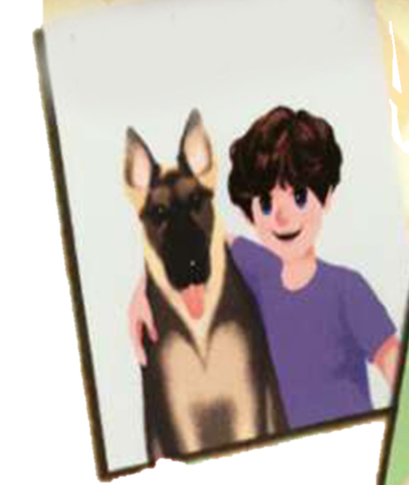




Lead in
That’s Mike’s dog.
That’s Chen Jie’s dog.
That’s their dog.
That’s Zip’s dog.
Today Zoom and Zip are at the dog show.
Whose dog are on show?
Whose dog is it?

Slide 4


Presentation
Let’s learn
Listen and answer the question.
Whose is it?
It’s Zoom’s.
Whose dogs do you like best? Why?

Slide 5


Listen and read.
Zoom:
Zip:
Look! That’s my dog!
Yes! It’s your dog. The dog is yours.
your dog = yours
你（们）的

Slide 6

Let’s act Zoom and Zip.
Zoom: Zip, is this your dog?
Zip: Yes! It’s my dog. The dog is mine.
Zoom: It’s so cute.
my dog =
mine
我的

Slide 7
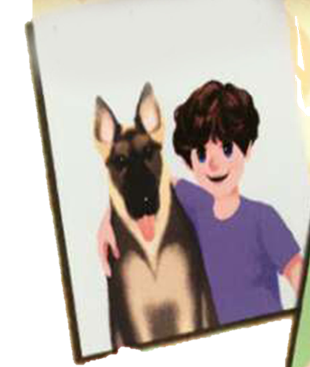

Zoom: Look! That’s______ dog.
Zip: Yes! It’s his dog. The dog is ____.
Zoom: It’s so big.
Mike’s
his
his dog =
his
他的

Slide 8

Zoom: Look! That’s_________ dog.
Zip: Yes! It’s her dog. The dog is ____.
Zoom: It’s so cute.
Chen Jie’s
hers
her dog =
hers
她的

Slide 9
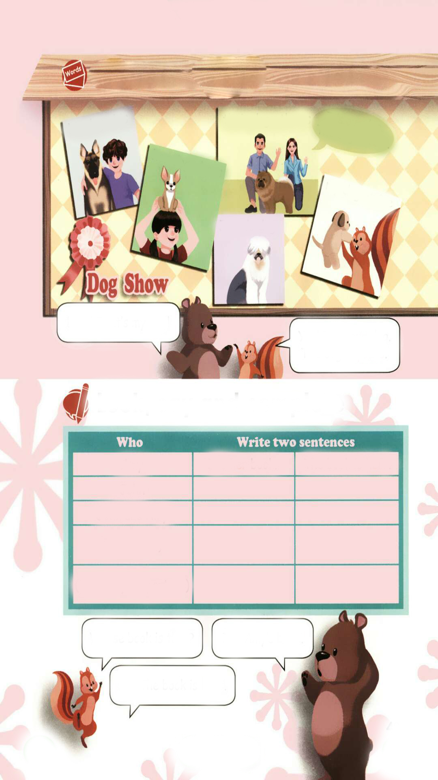


It’s our dog.
The dog is ours.
our dog =
ours
我们的
their
It’s _____dog. The dog is_______.
theirs
她/他/它们的

Slide 10
物主代词也有人称和数的变化,见下表:
 | 单数 |  | 复数
 | 形容词性 | 名词性 | 形容词性 | 名词性
第一人称 | my | mine | our | ours
第二人称 | your | yours | your | yours
第三人称 | his | his | their | theirs
 | her | hers
 | its | its

Slide 11
Read after the tape.
his dog - his
their dog - theirs
It’s our dog.
The dog is ours.
her dog - her
my dog - mine
Zoom’s dog
Look! That’s my dog!
Yes! It’s your dog. The dog is yours.

Slide 12
Practice
Look, say and complete
Amy
John
John and Amy
(your name)
(you and your partner)
It’s her book.
The book is hers.
Whose book is that?
It’s Amy’s book.
Ah! The book is hers.

Slide 13
Pair work.
Amy
John
John and Amy
(your name)
(you and your partner)
It’s her book.
The book is hers.
Whose book is that?
It’s … book.
Ah! The book is ….

Slide 14
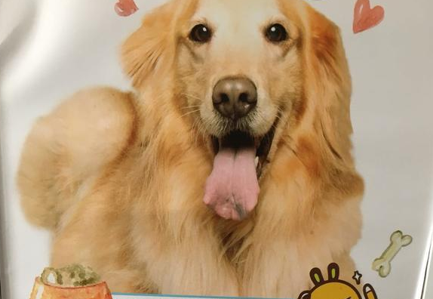
I want to know
常见狗狗的名称：
1、金毛巡回犬-Golden Retriever
2、哈士奇-Husky
3、阿拉斯加犬-Alaskan Malamute
4、柯基犬-Corgi
5、比熊犬-Bichon Frise

Slide 15

Exercises
一、译成汉语。
1. mine__________ 2. theirs_________
3. hers _________ 4. ours___________
5. his __________ 6. yours__________
我的
他/她/它们的
她的
我们的
他的
你/你们的

Slide 16
二、选词填空。
1. hers her
This is _______ jacket.
The jacket is _________.
2. ours our
These are _______ books.
The books are_______.
3. my mine
Look! It isn’t ________ picture.
________ is yellow.
her
hers
our
ours
my
Mine

Slide 17
三、连词成句。
is dog yours the (.)
______________________
2. my dog that’s(.)
______________________
3. book is that whose (?)
______________________
The dog is yours.
That’s my dog.
Whose book is that?

Slide 18


Summary
学习了下列单词： mine, yours, his, hers, theirs, ours等。
2.学习了下列句型：
—Whose book is …?
—It’s …
七彩课堂
伴你成长

Slide 19

Homework
ONE
TWO
Say and do the actions in pairs.
Make a short dialogue using the sentences we have learnt.
七彩课堂
伴你成长
Ask your dad whose desk is that?

Slide 20








