Slide 1


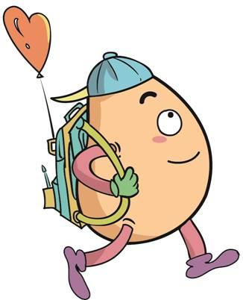






人 教 PEP 版 英 语 五年 级 下 册
Unit 5
Whose dog is it?
Part A
Let’s spell

Slide 2

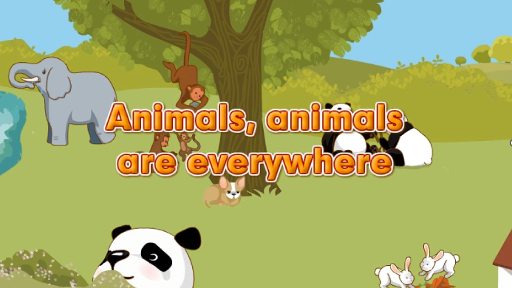
Warm up

Slide 3
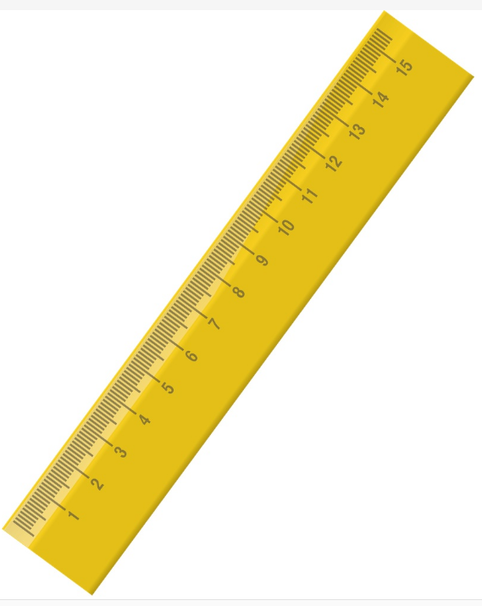

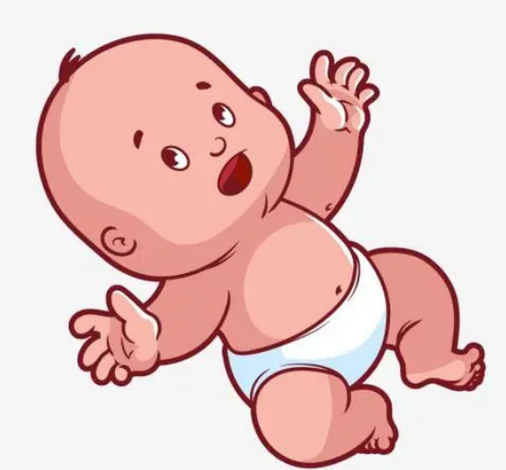




Let’s introduce the pronunciations of ng and nk.

Slide 4
Presentation
How to spell?
学习ng 在单词中的发音规则。
学习nk在单词中的发音规则。
学习ng, nk的发音要领。

Slide 5
sing /sɪŋ/
I can sing.

Slide 6
long /lɒŋ/
The ruler is long.

Slide 7
ring /rɪŋ/
I hear the ring.

Slide 8
young /jʌŋ/
The baby is young.

Slide 9
sing
long
ring
young
ng
/ŋ/

Slide 10
ng /ŋ/
单词闯关
sing
young
spring
thing
king
strong
ring
long

Slide 11
think /θɪŋk/
Let’s think.

Slide 12
ink /ɪŋk/
It’s a bottle of ink.

Slide 13
trunk /trʌŋk/
It’s an elephant’s trunk.

Slide 14

pink /pɪŋk/
I like pink.

Slide 15
think
ink
trunk
pink
nk
/ŋk/

Slide 16
nk /ŋk/
单词闯关
tank
trunk
link
think
bank
ink
thank
sink
pink

Slide 17

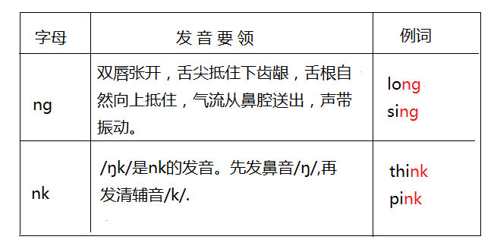
Let’s learn.

Slide 18


Let’s spell.
点击画面 播放视频
ring
long
sing
young
/ŋ/
think
trunk
pink
ink
/ŋk/

Slide 19
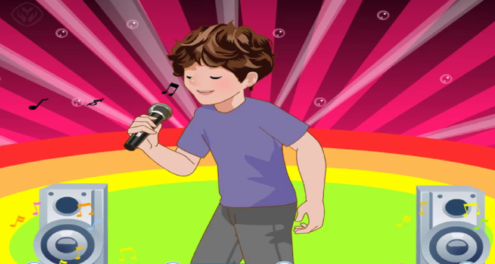
Let’s chant.

Slide 20

I think I can sing. I think I can sing.
I think I can sing a song.
I think I can sing. I think I can sing.
A song that is not too long.
听到nk时坐正，
听到ng时拍下手。

Slide 21

Read ,write and listen.
Read them by yourselves.
song
ring
think
sing
thing
trunk
pink
thank
morning
long
bank
drink

Slide 22

Read, write and listen.
song
ring
think
sing
thing
trunk
pink
thank
morning
long
bank
drink
song; ring; sing; thing; morning; long
trunk; think; drink; pink; thank; bank

Slide 23


Read, write and listen.
Look! Zoom is eating.
This girl is drinking.

Slide 24
Look, listen and write.
(eat)
(jump)
(drink)
(sing)
Zoom is eating.
Zip is drinking.
John is jumping.
Sarah is singing.

Slide 25
Play a game
Passing Words.
将全班分成八个人一组，排成一队，第一位学生选一个词，小声告诉下一位学生，如此这样，直到传到本队的最后一名学生时，请这位最后的学生说出他所听到的单词，然后请第一名学生也说出刚一开始传的单词，这样就可以判断出每个组员是否都传递了正确的读音。
trunk song ring think sing thing drink pink thank morning long bank

Slide 26
Read and group.
trunk song ring think sing thing drink pink thank morning long bank
/ŋ/
/ŋk/
song ring sing thing morning long
trunk think drink pink thank bank

Slide 27


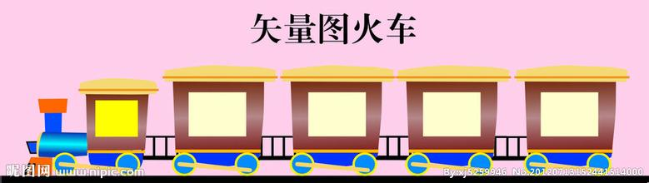
Let’s read！
sing
think
ink
long
thank
trunk
link
pink
thing
young
bank
strong
spring

Slide 28
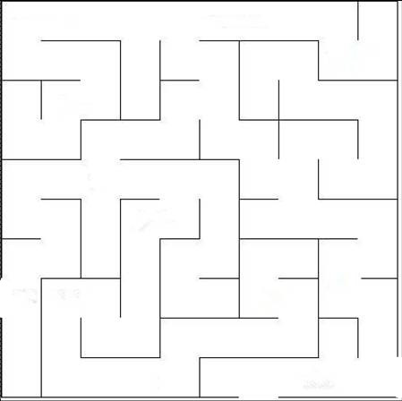
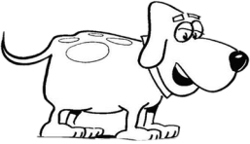
Play a game！
ring
thank
trunk
thing
sing
ink
think
spring
young
strong
king
tank
pink

Slide 29

Good to know
Labor is the law of life, also it is the most beautiful fruit.
劳动是生命的法则，也是它最美的果实。

Slide 30
Exercise
判断下列每组单词画线部分发音是“T”否“F”相同。
drink
thank
ring
long
sing
thing
song
bank
T
T
T
F

Slide 31

Summary
字母/字母组合
发音
词语
ng
/ŋ/
long sing
ring young
nk
/ŋk/
think ink
trunk pink

Slide 32
Homework
ONE
TWO
Read the words.
Make sentences using the words we have learnt.
Collect words with “/ŋ/” and “/ŋk/”.

Slide 33







