Slide 1









人 教 PEP 版 英 语 五 年 级 下 册
Unit 5
Whose dog is it?
Part A
Let’s spell

Slide 2

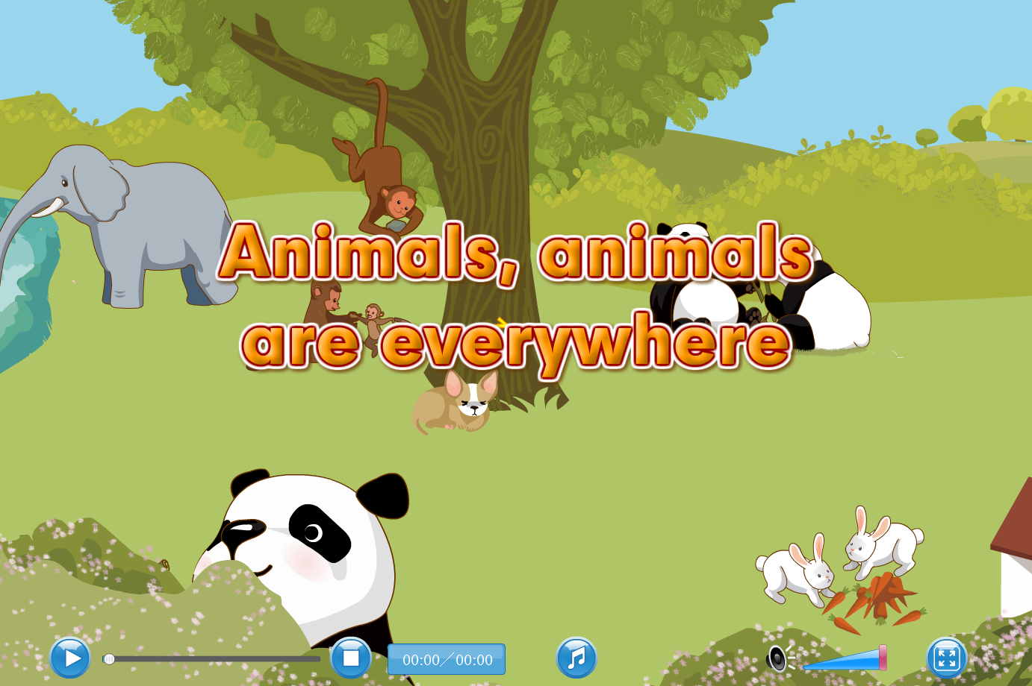
Warm up
Let’s sing.
点击画面 播放视频

Slide 3

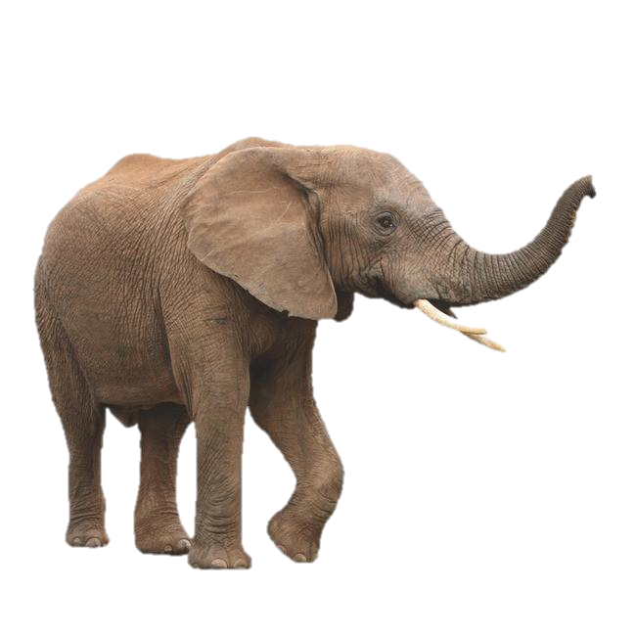

Lead in
What’s this?
Look! It’s a trunk of an elephant.
…
It’s
long and strong.
What can the trunk do?

Slide 4
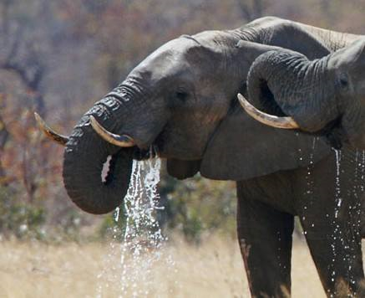
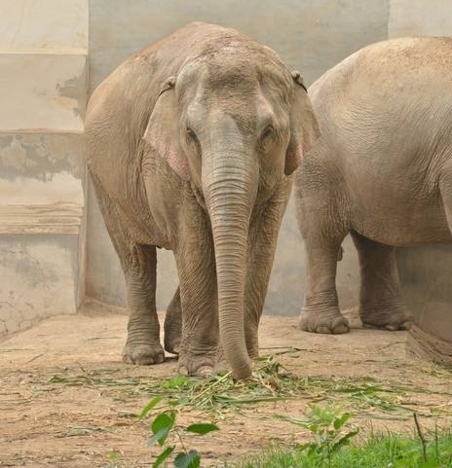
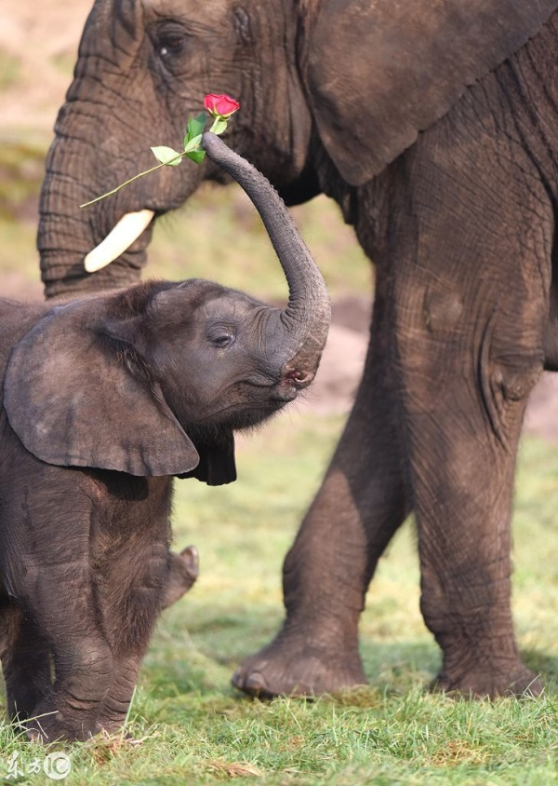
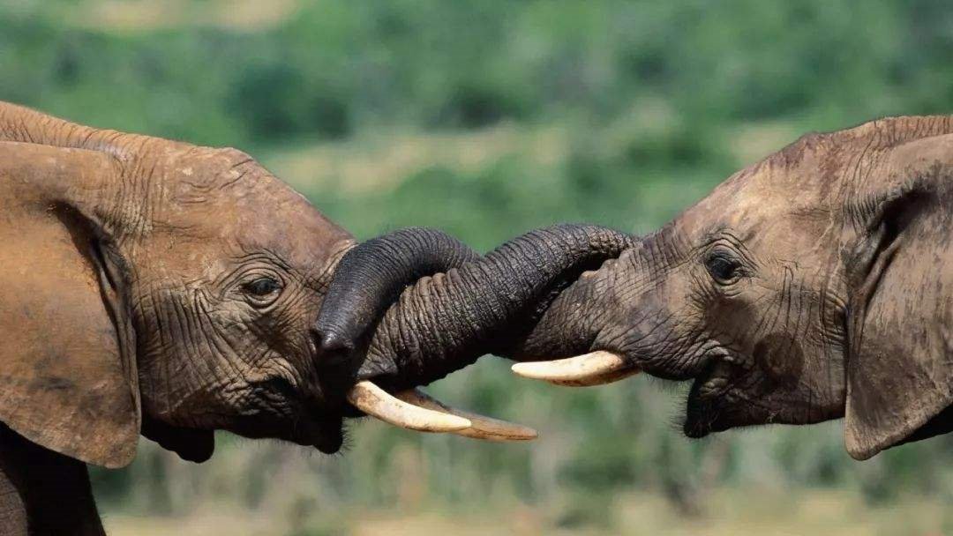
Presentation
I think it can help the elephant drink.
I think it can help the elephant eat.
I think it can help the elephant carry things.
I think it can help the elephant play with each other.
The trunk is so magic!

Slide 5
Let’s spell
Let’s enjoy a chant about the magic trunk and underline “ng” and circle “nk”.
The Magic Trunk
The trunk is long. The trunk is strong.
The trunk can do so many things.
Help to eat. Help to drink.
Help to play. Help to carry.
Wow. I think it’s a magic trunk!
long
strong
thing
ng
[ŋ]
trunk
drink
think
nk
[ŋk]

Slide 6
Language point
字母组合 ng 发/ŋ/的音。 音标特征:舌后软腭鼻的辅音。 发音要诀:舌位和/k/、/g/相同,但软腭下垂,堵住口腔通道,气流从鼻腔泄出。 属于浊辅音,发音时声带振动。
代表单词:sing song king thing
点击画面 播放视频

Slide 7

2. nk 常发/ ŋ k/的音,n后面的发音若为/k/、/ɡ/,这时 n 的发音也是/ ŋ /。
代表单词:think thank ink sink tank
点击画面 播放视频

Slide 8


Read, listen and chant
点击画面 播放视频
ring
long
sing
young
think
trunk
pink
ink

Slide 9

Read them by yourselves.
song
ring
think
sing
think
trunk
pink
thank
morning
long
bank
drink

Slide 10
Read, write and listen.
song
ring
think
sing
think
trunk
pink
thank
morning
long
bank
drink
song; ring; sing; thing; morning; long
trunk; think; drink; pink; thank; bank

Slide 11


Look! Zoom is eating.
This girl is drinking.

Slide 12
Look, listen and write
(eat)
(jump)
(drink)
(sing)
Zoom is eating.
John is jumping.
Zip is drinking.
Sarah is singing.

Slide 13
Practice
Passing Words.
将全班分成八个人一组，排成一队，第一位学生选一个词，小声告诉下一位学生，如此这样，直到传到本队的最后一名学生时，请这位最后的学生说出他所听到的单词，然后请第一名学生也说出刚一开始传的单词，这样就可以判断出每个组员是否都传递了正确的读音。
trunk song ring think sing thing drink pink thank morning long bank

Slide 14
Read and group.
trunk song ring think sing thing drink pink thank morning long bank
/ ŋ /
/ ŋ k /
song ring sing thing morning long
trunk think drink pink thank bank

Slide 15
Bingo.
给学生分发数张九格纸（横向三个格，竖向也三个格），在屏幕上显示所有要听写的单词，一旦有不会写的，就可以按照屏幕抄下所听到的单词，在听写的时候，学生可以随心所欲的把所听到的单词写在任意一个方格里，当你写出的单词无论是横向、竖向还是斜向，只要有一种情况的三个单词都含有nk，或都含有ng，你就可以喊出“Bingo!”，并且圈出这组单词。
每一次喊出“Bingo!”时，就给同桌看一眼，让同桌确认自己“Bingo!”是否正确。
trunk song ring think sing thing drink pink thank morning long bank

Slide 16

Exercises
一、英译汉。
长的
象鼻
1. long___________ 2. trunk___________
3. think_________ 4. sing ____________
5. pink __________ 6. ink_____________
想
唱歌
粉色
墨水

Slide 17
二、连词成句
is Zoom eating(.)
_________________
2. drinking Zip is(.)
_________________
3. ink is whose that(?)
_________________
Zoom is eating.
Zip is drinking.
Whose ink is that?

Slide 18

三、判断下列每组单词画线部分发音是“T”否“F”相同。
drink
thank
ring
long
sing
thing
song
bank
T
T
T
F

Slide 19


Summary
字母/字母组合
发音
词语
ng
七彩课堂
伴你成长
long sing
ring young
/ ŋ /
nk
/ ŋk /
think ink
trunk pink

Slide 20

Homework
ONE
TWO
Read the words.
Make sentences using the words we have learnt.
七彩课堂
伴你成长
Collect words with “/ ŋ /” and “/ ŋk /”.

Slide 21








