Slide 1


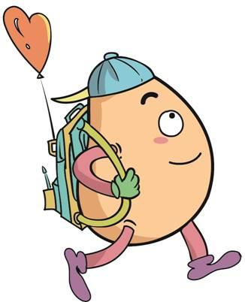






人 教 PEP 版 英 语 五年 级 下 册
Unit 5
Whose dog is it?
Part A
Let’s try & Let’s talk

Slide 2


Warm up

Slide 3
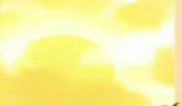

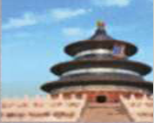
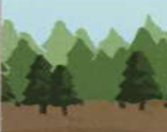
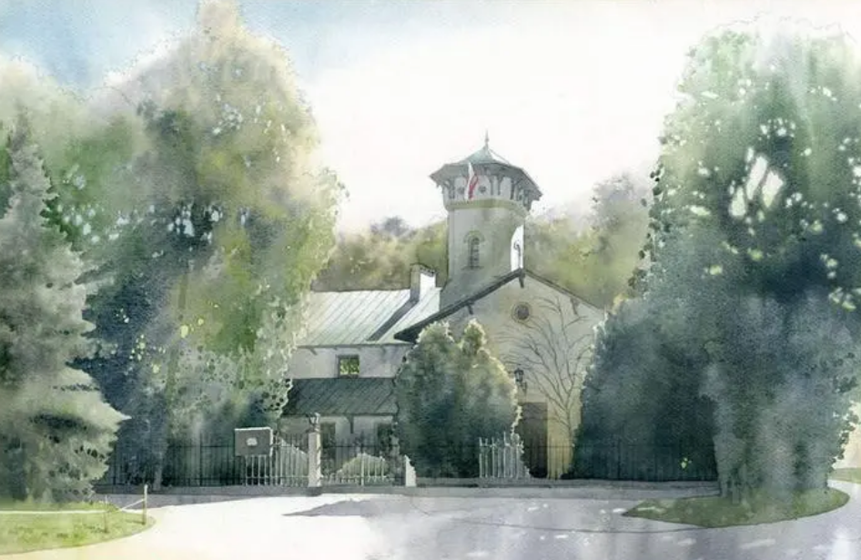
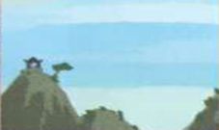
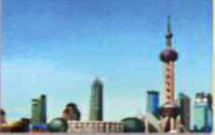
Let’s introduce our pictures.
Whose pictures are these?

Slide 4
Presentation
Talk about the owners of the things.
Talk about whose pictures they are.
Talk about my classmates’ pictures and mine.
Talk about whose books they are.

Slide 5

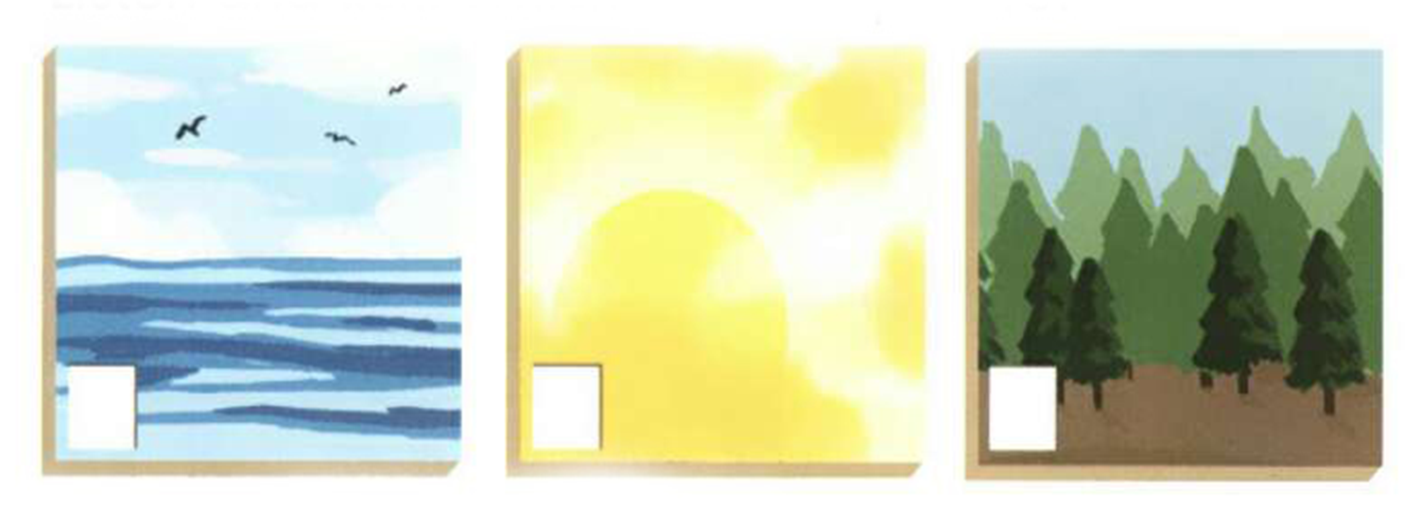
Let’s try
Look at the three pictures. They are pictures of the school art show.
Mike and Chen Jie are talking about them. Which is John’s picture?

Slide 6


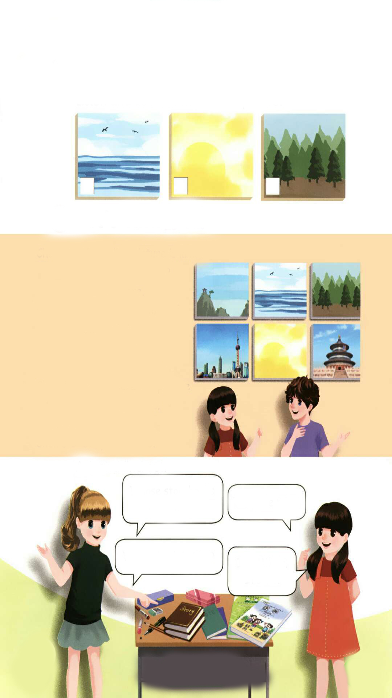
Listen and tick.
Which is John’s picture?
√

Slide 7
Let’s check！
听力材料：
Chen Jie: The school art show is great.
Mike: Yes. I like this picture. The trees are beautiful.
Chen Jie: Whose picture is it?
Mike: It's John's.
Chen Jie: What about the one over there? I like the blue colour.
Mike: That's mine.

Slide 8

Let’s discuss!
Let’s talk
Chen Jie and Mike are at the school art show.
Here are six pictures. Which is your favourite picture?

Slide 9
Watch and answer！
Which picture is Chen Jie’s?
2. Whose is the picture of Beijing?
3. Which picture is Binbin’s?

Slide 10
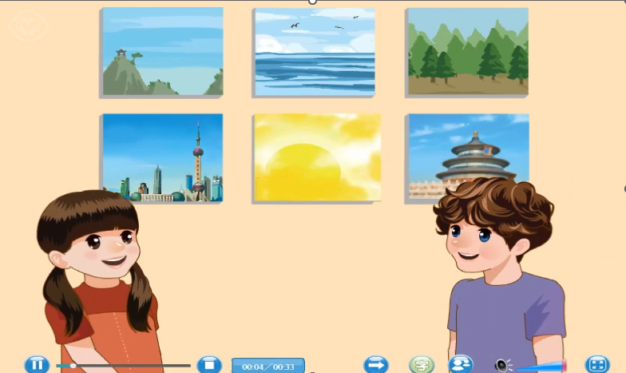

Slide 11
Watch and answer！
Which picture is Chen Jie’s?
2. Whose is the picture of Beijing?
3. Which picture is Binbin’s?
The yellow picture.
Zhang Peng’s.
The picture of Shanghai is his.

Slide 12

Read after the tape.
Chen Jie: The yellow picture is mine.Are these all ours?
Mike: Yes, they are.
Chen Jie: Wow! That picture of Beijing is beautiful. Whose is it?
Mike: It’s Zhang Peng’s.
Chen Jie: Look! There is a picture of Shanghai, too.
Mike: It’s Binbin’s.
Chen Jie:Oh, yes! It’s his.

Slide 13

Read and act.
1.Read it together.
2.Each student
reads a sentence.
Tip: Choose one to read in two. 选择一种两人练习。
3. Read in roles.
自己分配角色。

Slide 14

流利地朗读
流利地表演
有感情地表演

Slide 15
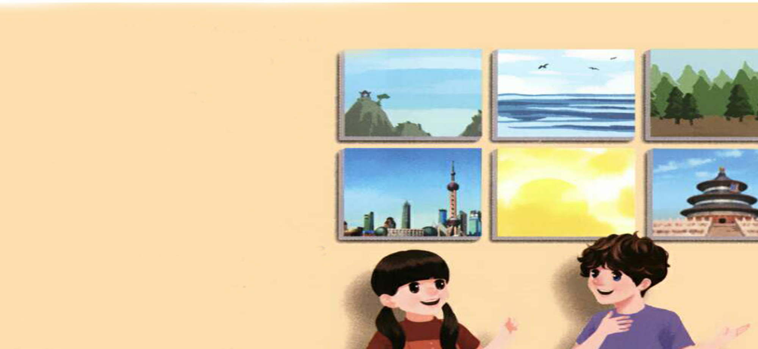
Read in roles.
Chen Jie: The yellow picture is mine.Are these all ours?
Mike: Yes, they are.
Chen Jie: Wow! That picture of Beijing is
beautiful. Whose is it?
Mike: It’s Zhang Peng’s.
Chen Jie: Look! There is a picture of
Shanghai, too.
Mike: It’s Binbin’s.
Chen Jie:Oh, yes! It’s his.

Slide 16
Listen and repeat
我的,名词性物主代词
我们的,名词性物主代词
Chen Jie: The yellow picture is mine.Are these all ours?
Mike: Yes, they are.
Chen Jie: Wow! That picture of Beijing
is beautiful. Whose is it?
Mike: It’s Zhang Peng’s.
Chen Jie: Look! There is a picture of
Shanghai, too.
Mike: It’s Binbin’s.
Chen Jie:Oh, yes! It’s his.
……的
谁的
名词所有格形式
There be结构
名词所有格形式
他的,名词性物主代词

Slide 17

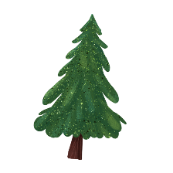


Language points.
The yellow picture is mine.
名词性物主代词的用法
【详解】 这个句子用来表达某物是某人的。句中的mine是名词性物主代词,起名词的作用。mine = my + 名词,意思是“我的”,它可以独立使用,也可以充当主语、宾语、表语。
句型结构:某物 + be 动词 + 名词性物主代词.
e.g. — That book is mine.
— Whose book is this?
— It's mine./Mine.

Slide 18
Language points.
Whose is it?
whose的用法
【详解】whose 作名词性物主代词就相当于一个名词,whose = whose picture。所以用”Whose is it? = Whose picture is it?”。
句型结构:Whose + 名词 + 一般疑问句?
e.g. Whose ruler is it ? = Whose is it?

Slide 19
Language points.
It's Zhang Peng’s.
名词所有格形式
【详解】名词所有格一般是在名词后面加上“'s”,表示“某人的……”,称为所属关系。
句型结构:主语 + be 动词 + 名词所有格形式.
e.g. The picture is Chen Jie’s.

Slide 20
Ask and find out
Whose storybooks are these?
They are mine.
Whose book is this?
It’s Mike’s.
It’s his.

Slide 21
Pair work.
Whose ... are these?
They are ….
Whose ... is this?
It’s ….
It’s ….

Slide 22
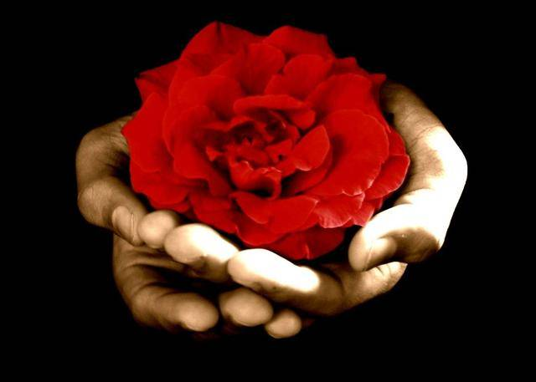
Good to know
Not he who has much is rich, but he who gives much.
拥有的多并不算富有，给予的多才算富有。

Slide 23
Exercises
一、按要求写出正确的单词。
his
1. he(名词性物主代词)______
2. we(名词性物主代词)________
3. Chen Jie(名词所有格形式)___________
4. my(名词性物主代词)_______
5. have(第三人称单数)________
ours
Chen Jie’s
mine
has

Slide 24
二、单选题。
( )1. _______ book is this?
A. Who B. Who’s C. Whose
( )2. The picture _______ Beijing is beautiful.
A. of B. in C. at
( )3. Look at the pen. It’s_______.
A. he’s B. his C. her
C
A
B

Slide 25
三、按照要求完成句子。
1.The yellow picture is mine. (对划线部分提问)
____________________________________
2.beautiful, of, is, Beijing, picture, the(.)(连词成句)
___________________________________
3.There is a picture of Shanghai. (改为一般疑问句)
_____________________________
Whose is the yellow picture?
The picture of Beijing is beautiful.
Is there a picture of Shanghai?

Slide 26

Summary
学习了下列句型：
The yellow picture is mine.
Are these all ours?
Whose is it?
It’s Zhang Peng’s.
It’s his.

Slide 27
Homework
ONE
TWO
Act the dialogue out with your friends.
Make a short dialogue using the sentences we have learnt.
Introduce your paintings to your friends!

Slide 28







