Slide 1









人 教 PEP 版 英 语 五 年 级 下 册
Unit 5
Whose dog is it?
Part A
Let’s try & Let’s talk

Slide 2


Warm up
Let’s sing.
点击画面 播放视频

Slide 3

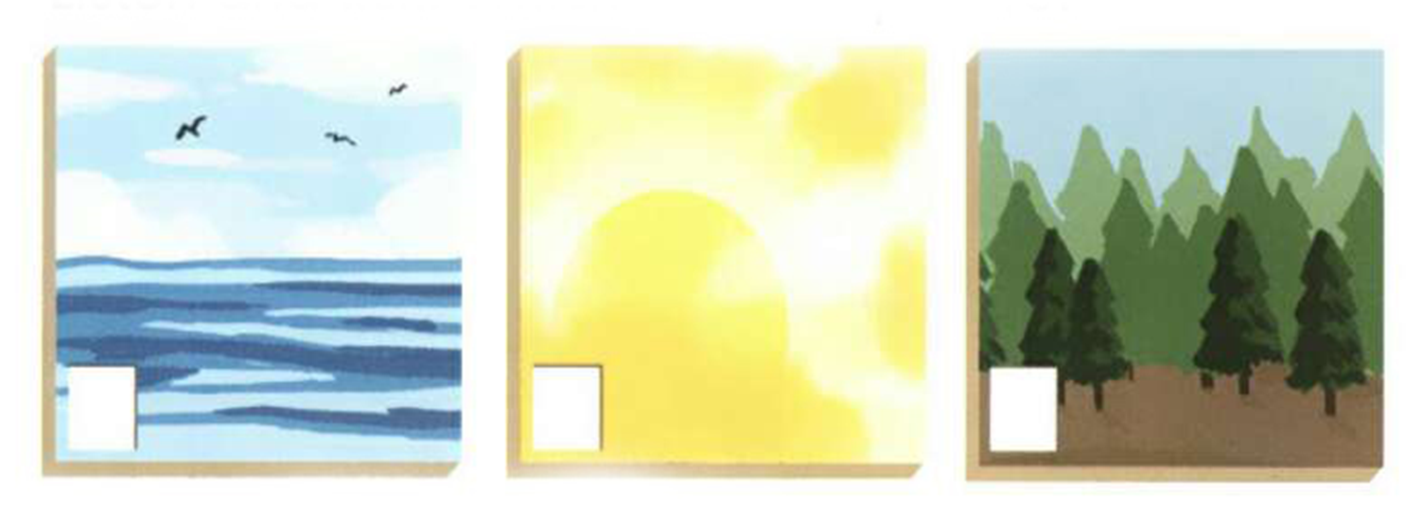
Lead in
Look at the three pictures. They are pictures of the school art show.
Mike and Chen Jie are talking about them. Which is John’s picture?

Slide 4

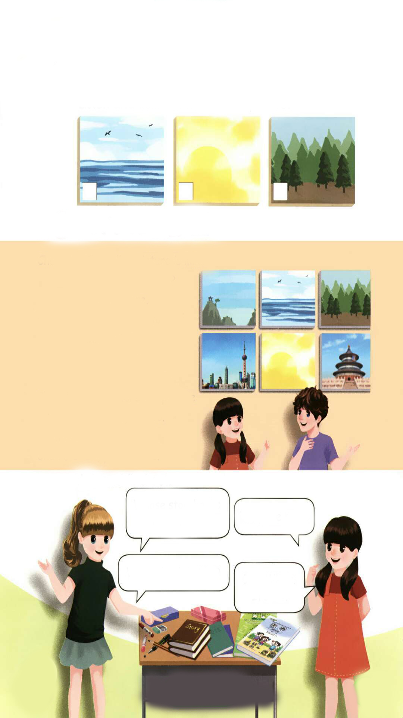
Presentation
Let’s try
Listen and tick. Which is John’s picture?
√

Slide 5

听力材料：
Chen Jie:
Mike:
Chen Jie:
Mike:
Chen Jie:
Mike:
The school art show is great.
Yes. I like this picture. The trees are beautiful. Whose picture is it?
It's John's.
What about the one over there? I like the blue colour.
That's mine.

Slide 6
Language points
1. The yellow picture is mine.
【详解】 这个句子用来表达某物是某人的。句中的 mine 是名词性物主代词,起名 词的作用。mine = my + 名词,意思是“我的”,它可以独立使用,也可以充当主语、宾语、表语。
句型结构:某物 + be 动词 + 名词性物主代词.
e.g. — That book is mine.
— Whose book is this?
— It's mine./Mine.

Slide 7
2. Whose is it?
【详解】whose 作名词性物主代词就相当于一个名词,whose = whose picture。所以用”Whose is it? = Whose picture is it?”。
句型结构:Whose + 名词 + 一般疑问句?

Slide 8
3. It's Zhang Peng’s.
【详解】名词所有格一般是在名词后面加上“'s”,表示“某人的……”,称为所属关系。
句型结构:主语 + be 动词 + 名词所有格形式.
e.g. The picture is Chen Jie’s.

Slide 9
Read and act out.
Chen Jie:
Mike:
Chen Jie:
Mike:
Chen Jie:
Mike:
The school art show is great.
Yes. I like this picture. The trees are beautiful. Whose picture is it?
It's John's.
What about the one over there? I like the blue colour.
That's mine.

Slide 10
Chen Jie and Mike are at the school art show.
Here are six pictures. Which is your favourite picture?

Slide 11
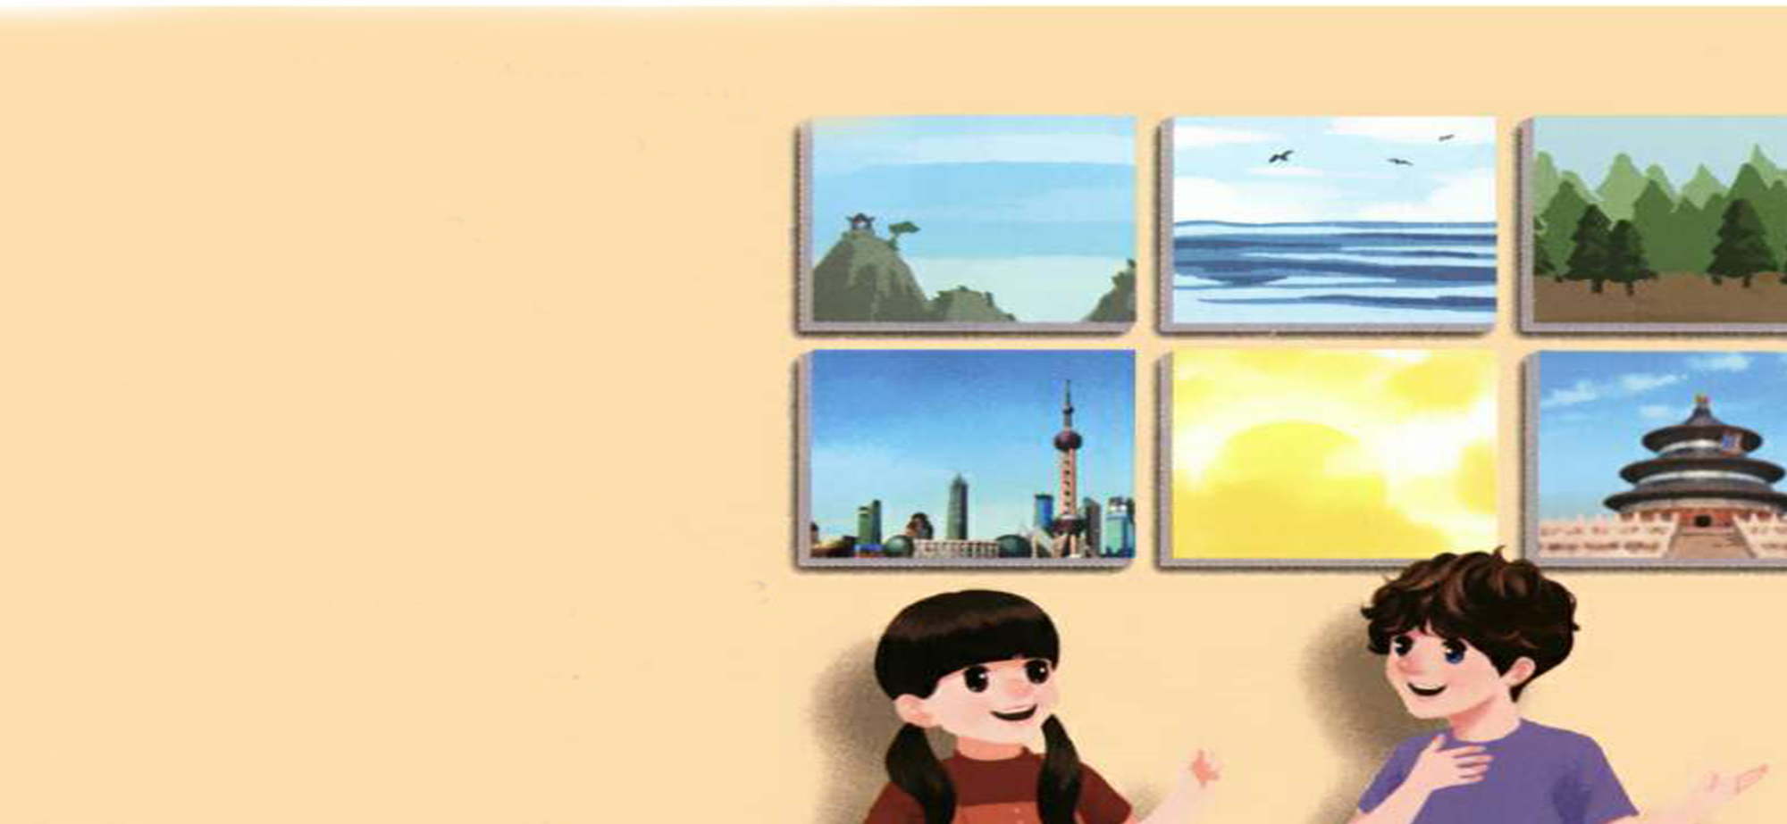
The picture of trees is John’s.
The picture of sea is Mike’s.
Which is John’s picture?
Which is Mike’s picture?
Do you remember?
Whose is that picture of Shanghai?

Slide 12

Let’s talk
Let’s listen and answer.
The picture of Beijing is Zhang Peng’s.
Whose is the picture of Shanghai?
It’s Binbin’s. It’s his.
Whose picture are the other pictures?
Let’s listen again.
The yellow picture of the sun is Chen Jie’s.

Slide 13
Read after the tape.
Chen Jie:
Mike:
Chen Jie:
Mike:
Chen Jie:
Mike:
Chen Jie:
The yellow picture is mine.
Are these all ours?
Yes, they are.
Wow! That picture of Beijing is beautiful. Whose is it?
It’s Zhang Peng’s.
Look! There is a picture of Shanghai, too.
It’s Binbin’s.
Oh, yes! It’s his.

Slide 14
Act it out group by group. Find the best group.
Chen Jie:
Mike:
Chen Jie:
Mike:
Chen Jie:
Mike:
Chen Jie:
The yellow picture ….
Are these …?
Yes, ….
Wow! That picture …. Whose is it?
It’s ….
Look! …, too.
It’s ….
Oh, yes! ….

Slide 15
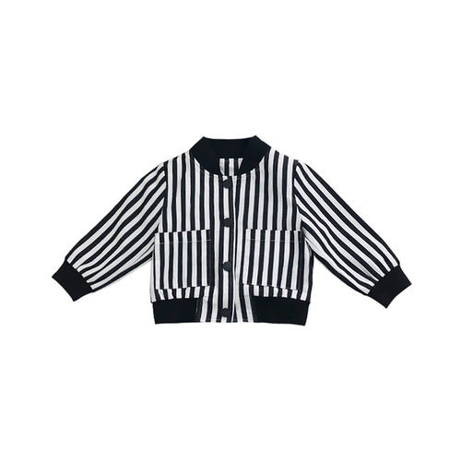


Practice
After visiting the art show, some students left something. Act out the dialogue in pairs.
S1: …, are these book yours?
S2: No, it isn’t.
S1: Whose are they?
S2: Let me see. They are …’s. They are his.
S1: What about these keys? Whose are they?
S2: They’re …’s. They’re hers.
S1: Is this jacket …’s?
S2:Oh, yes. It’s his/hers.
S1: Thank you.

Slide 16

Ask and find out
Whose storybooks are these?
They are mine.
Whose book is this?
It’s Mike’s.
It’s his.

Slide 17
Pair work.
Whose ... are these?
They are ….
Whose ... is this?
It’s ….
It’s ….

Slide 18

Exercises
一、将打乱的字母重新排列，组合成单词。
i, m, e, n
i, h, s
o, w, s, e, h
mine
his
whose

Slide 19

二、单选题。
( )1. _______ book is this?
A. Who B. Who’s C. Whose
( )2. The picture _______ Beijing is beautiful.
A. of B. in C. at
( )3. Look at the pen. It’s_______.
A. he’s B. his C. her
C
A
B

Slide 20
三、连词成句。
ours all are these(?)
_____________________________
2. picture that of is beautiful Beijing (.)
_____________________________
3. yellow is mine the picture(.)
_____________________________
Are these all ours?
That picture of Beijing is beautiful.
The yellow picture is mine.

Slide 21
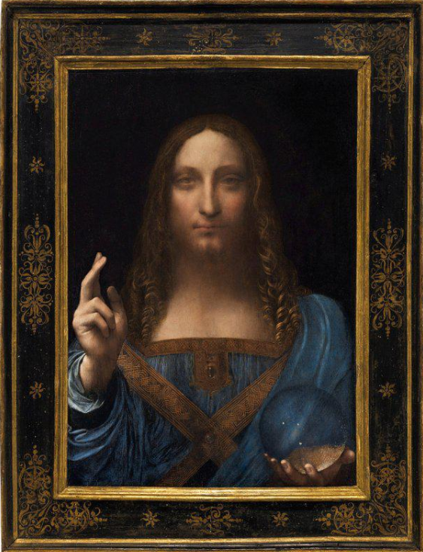
I want to know
世界上最贵的画
达芬奇 《救世主》 拍卖价格：4.5亿美元
It's called the world's most expensive painting.
被称为世界上最贵的画。

Slide 22
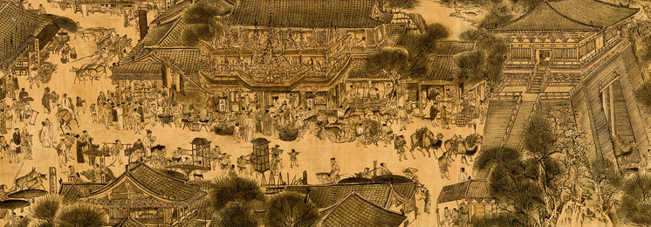
Do you like to draw?
你喜欢画画吗？

Slide 23


Summary
学习了下列句型：
The yellow picture is mine.
Are these all ours?
Whose is it?
It’s Zhang Peng’s.
It’s his.
七彩课堂
伴你成长

Slide 24

Homework
ONE
TWO
Act the dialogue out with your friends.
Make a short dialogue using the sentences we have learnt.
七彩课堂
伴你成长
Introduce your paintings to your friends!

Slide 25








