Slide 1


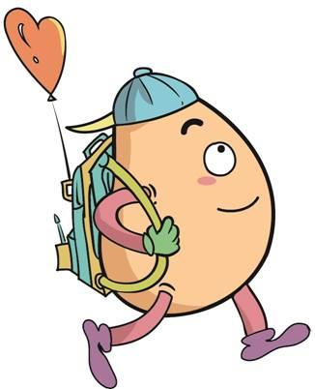






人 教 PEP 版 英 语 五年 级 下 册
Unit 4
When is the art show?
Part B
Let’s learn & Look and write

Slide 2
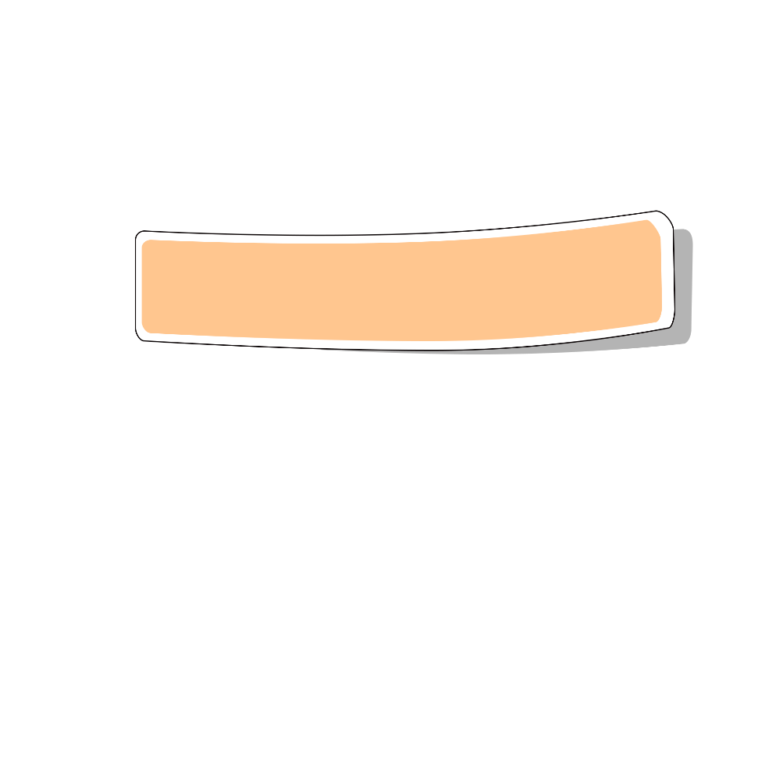
Review
Play a game
July
January
February
Which month is it?
December
August
March
It’s …
June
November
October
May
April
September

Slide 3
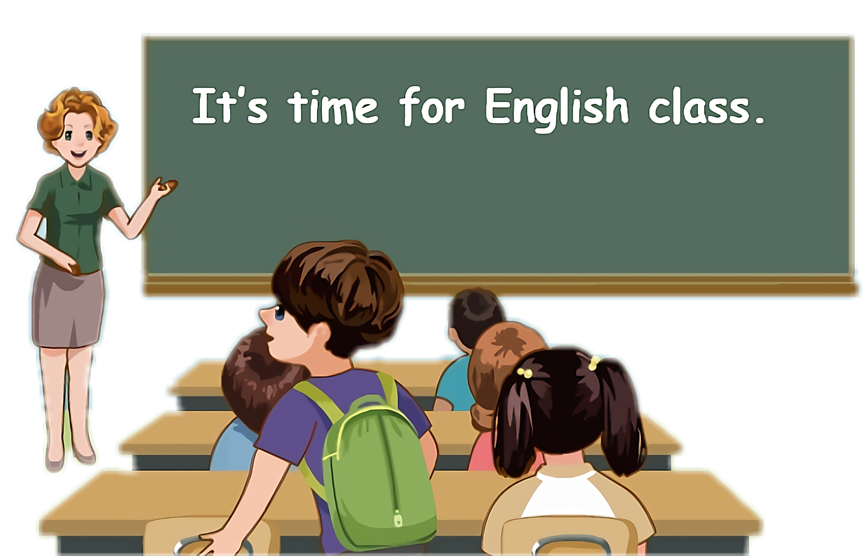
Lead in
Mike, when is your birthday?
My birthday is on July 3rd.

Slide 4
How many gifts do you get?
I get 23 gifts.

Slide 5
What are they?

Slide 6

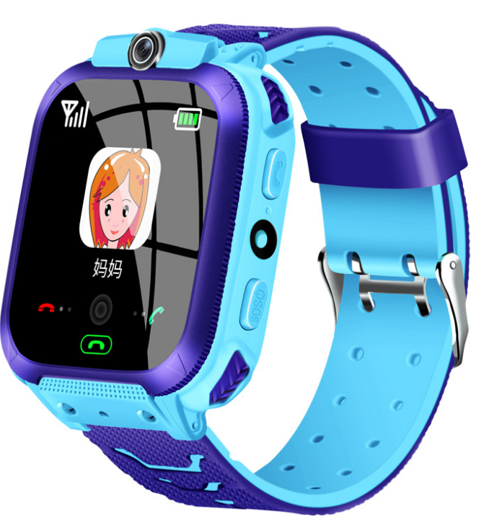
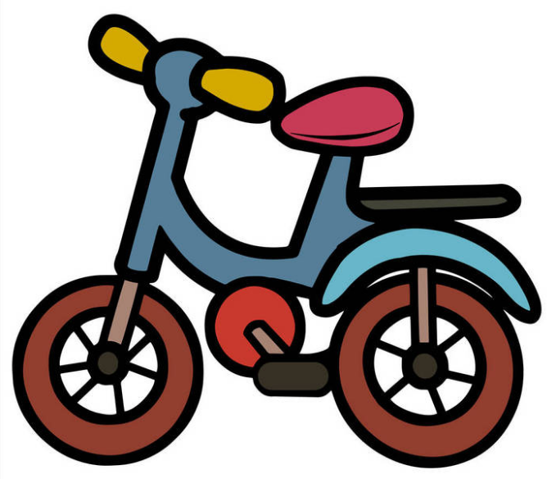
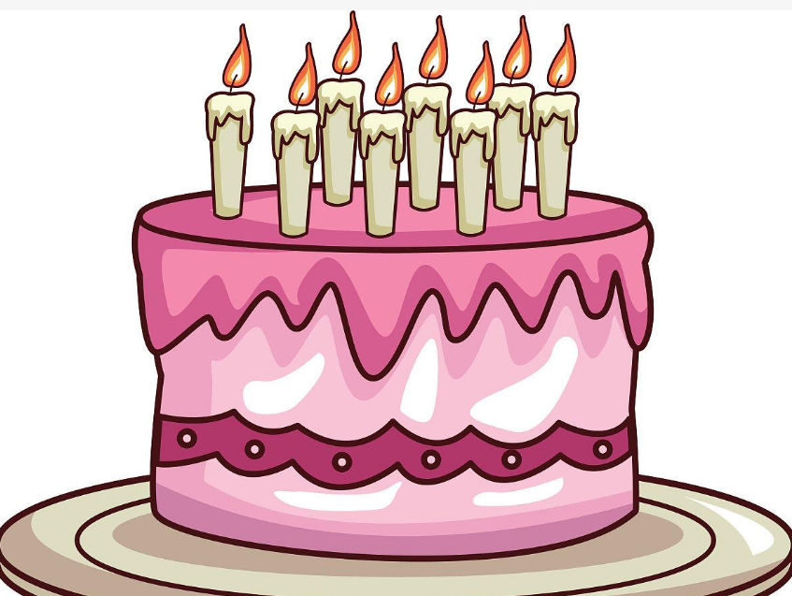


Let’s introduce the gifts!

Slide 7
Presentation
Talk about birthdays.
Learn five words.
Wu Binbin and Robin talk about family’s birthdays.
Wu Binbin and Amy talk about birthdays.

Slide 8

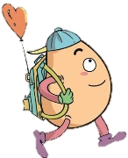


Let’s learn
Learn new words.
twelfth (12th)
第十二
This is my twelfth gift.

Slide 9
twentieth (20th)
第二十
This is my twentieth gift.

Slide 10
twenty-first (21st)
第二十一
This is my twenty-first gift.

Slide 11
twenty-third (23rd)
第二十三
This is my twenty-third gift.

Slide 12
thirtieth (30th)
第三十
This is my thirtieth gift.

Slide 13

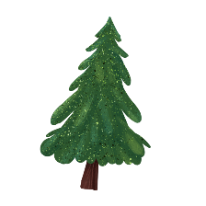


Language point.
基数词变序数词的规律
基数词：
twelve, twenty, twenty-one, twenty-three, thirty
序数词：
twelfth, twentieth, twenty-first, twenty-third, thirtieth
基变序，有规律，1、2、3特殊记，词尾各是t、 d、d。
th要从4加起，8加h, 9去e，ve要用f替。
ty变成tie，再加th莫迟疑；若是遇到几十几，只变个位就可以。

Slide 14
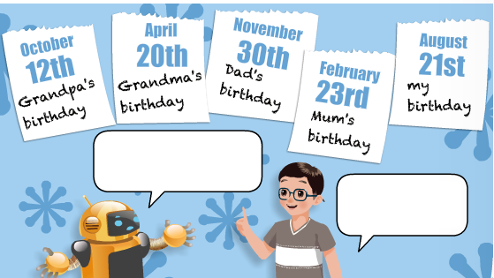
Listen and say！
When is Grandpa’s birthday?
It’s on
October 12th.

Slide 15
Listen and say！
When is Grandma’s birthday?
It’s on
April 20th.

Slide 16
Listen and say！
When is Dad’s
birthday?
It’s on
November 30th.

Slide 17
Listen and say！
When is Mum’s birthday?
It’s on
February 23rd.

Slide 18
Listen and say！
When is your birthday?
It’s on
August 21st.

Slide 19
Act out.
When is ...’s birthday?
It’s on ...

Slide 20

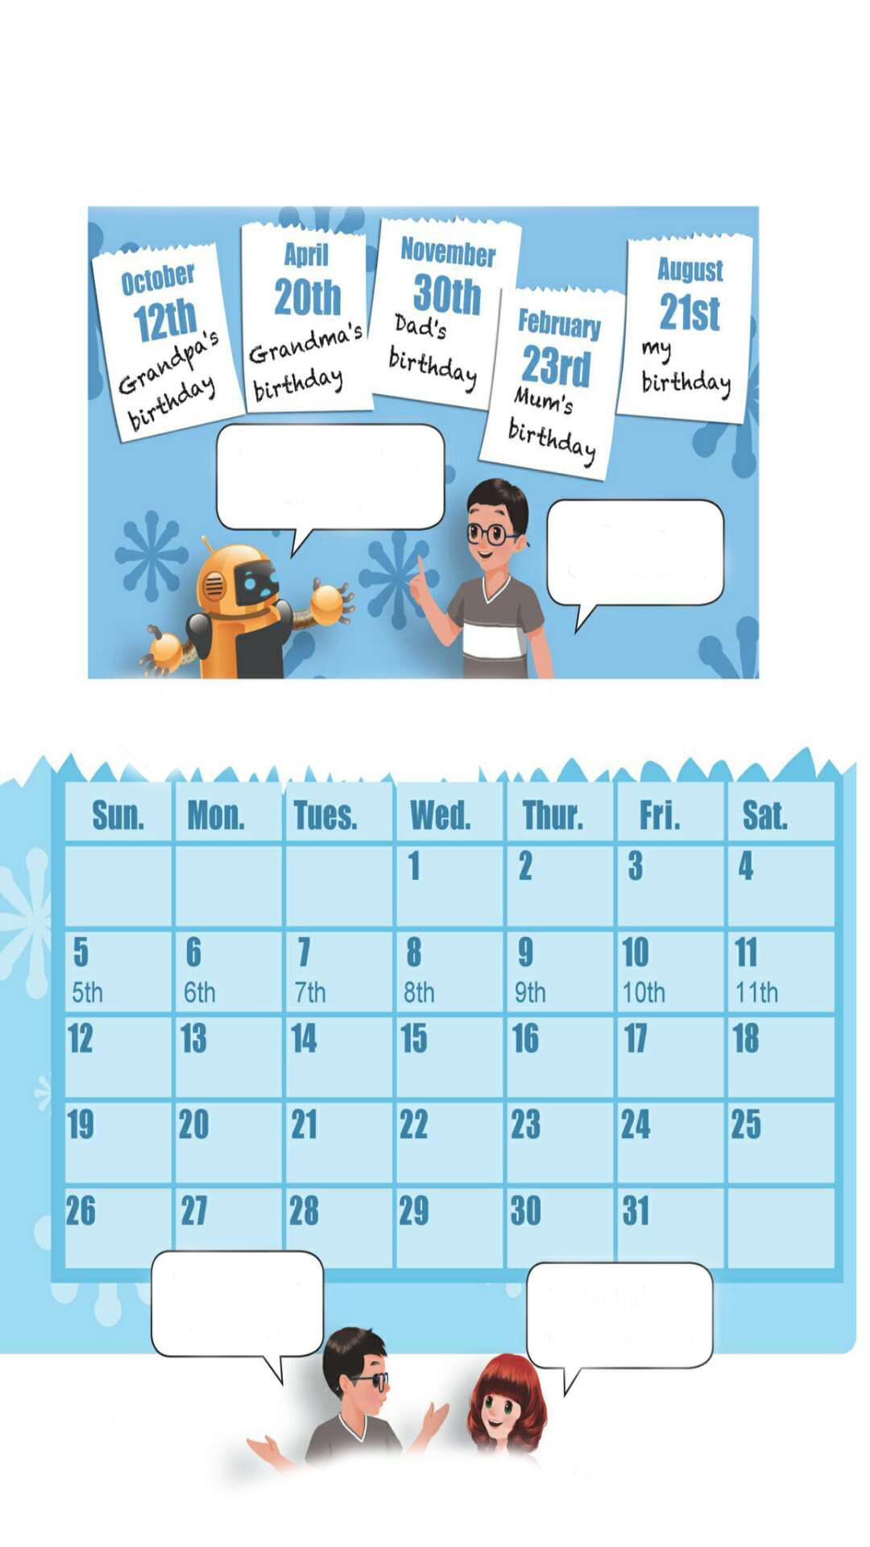
Look and write
When is your birthday?
My birthday is on March 21st.

Slide 21
1st
2nd
3rd
4th
12th
13th
14th
15th
16th
17th
18th
19th
20th
21st
22nd
23rd
24th
25th
27th
28th
31st
26th
29th
30th
When is ...?
... is on ...

Slide 22
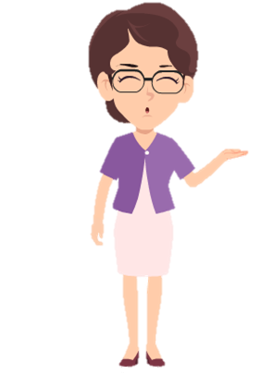
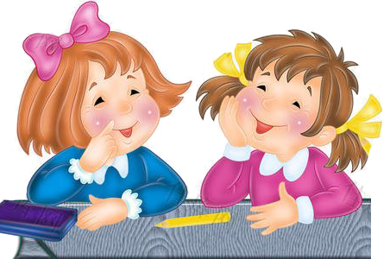
Make up dialogues in pairs.
Talk about your partner’s birthday.
April 12th
May 1st
June 3rd
September 9th
November 5th
January 22nd
October 16th
August 18th
When is your ...’s birthday?
...’s birthday is on ...

Slide 23
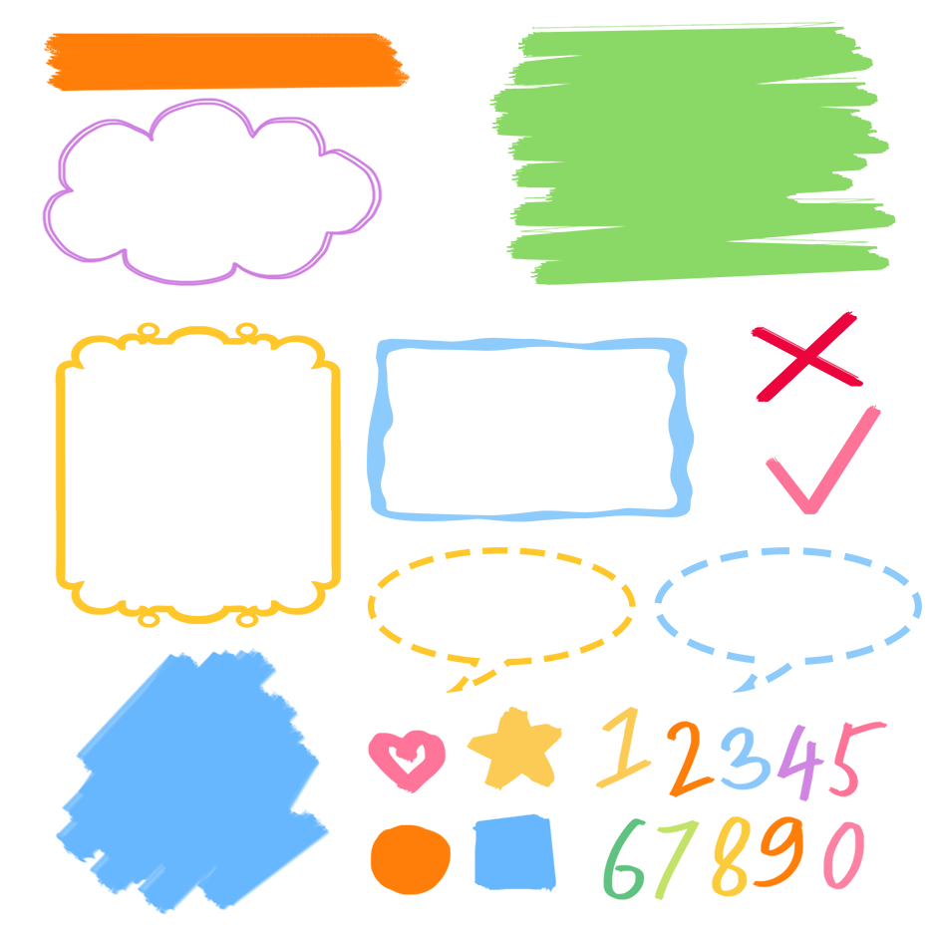
了解12、20、23等序数词形式
记忆12、20、23等序数词
熟练运用12、20、23等序数词表达

Slide 24

Good to know
Believe in yourself first, and then others will believe you.
先相信自己，然后别人才会相信你。

Slide 25
Exercises
一、汉译英。
twentieth
第二十三____________ 第二十__________
第五________________ 第十二__________
第二十一____________ 第三十__________
twenty-third
fifth
twelfth
twenty-first
thirtieth

Slide 26
二、用单词的适当形式填空。
1.—When is ________ birthday? —It’s in May. (Grandpa)
2. His birthday is on October _______. ( twenty-one)
3. ________ birthday is on March 12th. (Mike)
4. —_____ your birthday on August 3rd? —No, it isn’t. (be)
Grandpa’s
21st
Mike’s
Is

Slide 27
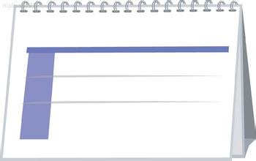
三、看图补全句子。
1. —When is your birthday?
—It is on ____ ____. 2. —When is _______ _______?
—It is on July 20th. 3. —____ ____ ____ ________?
—It’s ______ ______ _____.
April 13th
My birthday
April 13th
Mum’s birthday
July 20th
Mum’s birthday
When is Dad’s birthday
on November 1st
November 1st
Dad’s birthday

Slide 28

Summary
1. 学习了下列单词：twelfth, twentieth, twenty-first, twenty-third, thirtieth等
2.学习了询问和回答某人生日的句型：
—When is …’s birthday?
— It’s on ….

Slide 29
Homework
ONE
TWO
Act the dialogue out and show it to your parents.
Talk about your birthday and write a short passage.
Do “Look and write” with your friends.

Slide 30
