Slide 1







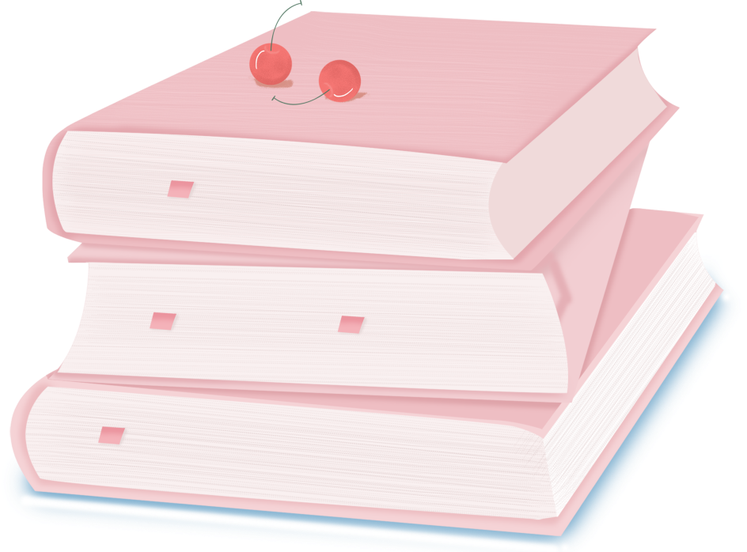

人 教 PEP 版 英 语 五 年 级 下 册
Unit 4
When is the art show?
Part B
Let’s learn & Look and write

Slide 2

Warm up
Which month is it?
July
January
February
December
August
March
June
November
October
April
It’s …
May
September

Slide 3


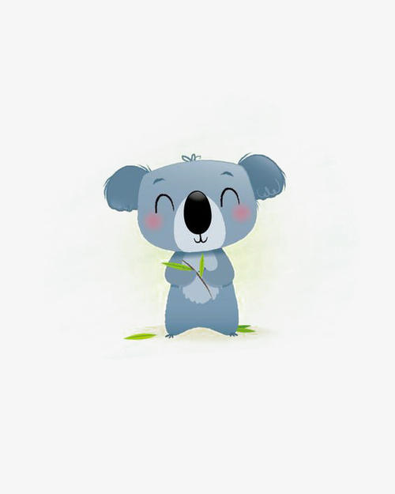
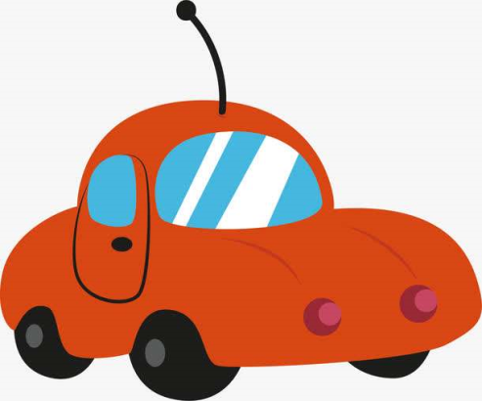

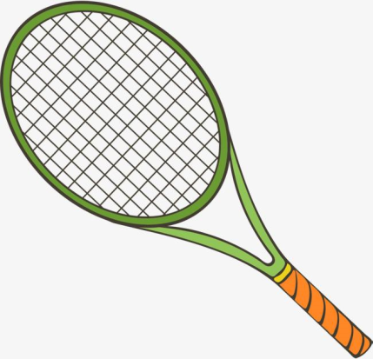
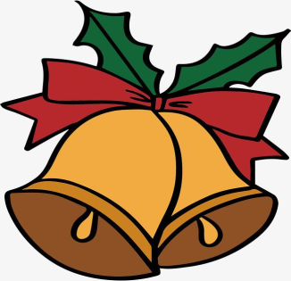
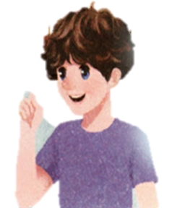
Lead in
Mike’s birthday
Today is May 5th. It’s Mike’s birthday. He gets six gifts.
As his first gift, he gets a toy bus.
As his second gift, he gets a ball.
As his third gift, he gets a bet.
As his fourth gift, he gets a storybook.
As his fifth gift, he gets a koala.
As his sixth gift, he gets a bell…for a bike!

Slide 4

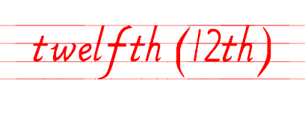


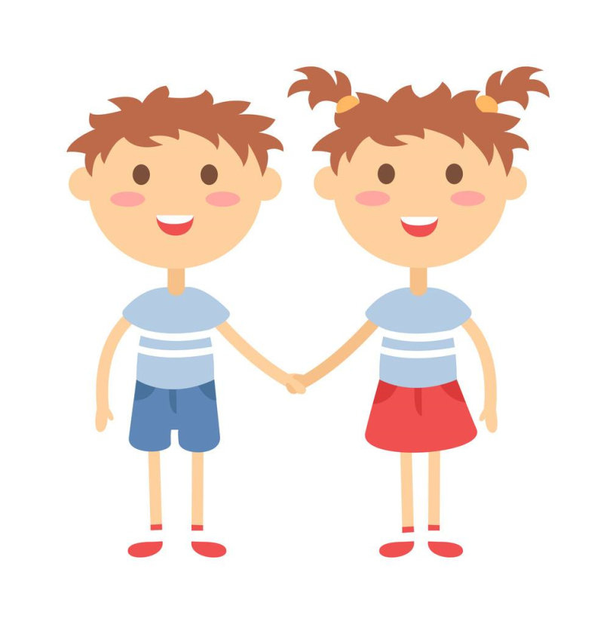
Presentation
Let’s learn
Mary and Ben are twins. Today is May 30th. It’s their birthday. They get 23 gifts!
第十二（的）
What’s the twelfth gift?
It’s a storybook.

Slide 5


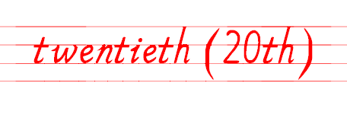
第二十（的）
What’s the twentieth gift?
It’s a bell.

Slide 6
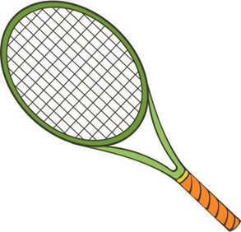
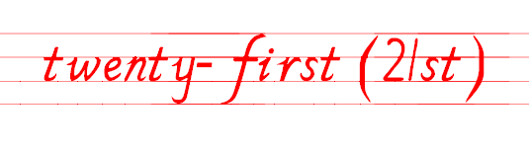
第二十一（的）
What’s the twenty-first gift?
It’s a bat.

Slide 7
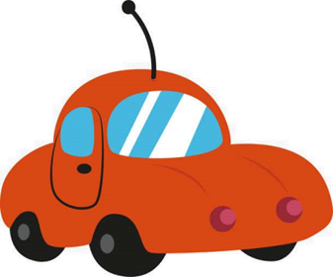
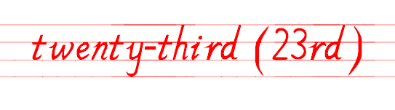
第二十三（的）
What’s the twenty-third gift?
It’s a toy car.

Slide 8

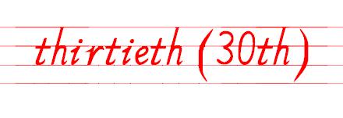
第三十（的）
What’s the thirtieth gift?
It’s a ball.

Slide 9
Language points
基数词：
twelve, twenty, twenty-one, twenty-three, thirty
序数词：
twelfth, twentieth, twenty-first, twenty-third, thirtieth
基变序，有规律，123特殊记，词尾各是t, d, d。
th，要从4加起，8加h, 9去e，ve要用f替。
ty变成tie，再加th莫迟疑；若是遇到几十几，只变个位就可以。

Slide 10
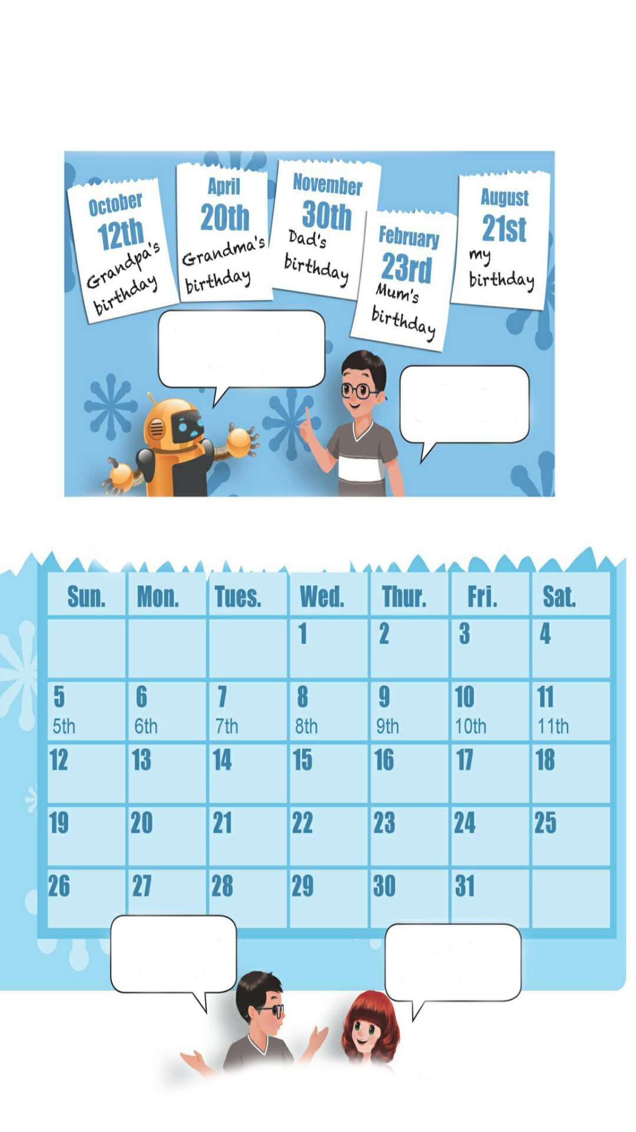
Read after the tape.
When is Grandpa’s birthday?
It’s on October 12th.

Slide 11
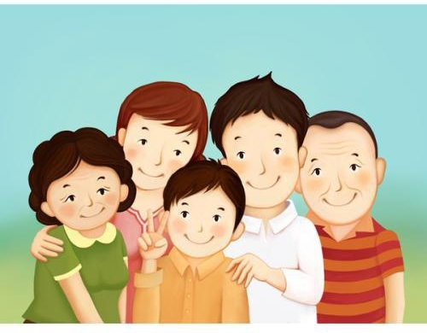
This is the photo of Wu Binbin’s family.
When is … birthday?
It’s on….

Slide 12
Act out
When is …’s birthday?
It’s on ….

Slide 13
Practice
Look and write
When is your birthday?
My birthday is on March 21st.

Slide 14
Group work
When is …?
…is on ….

Slide 15

Exercises
一、汉译英。
twentieth
第二十三____________ 第二十__________
第五________________ 第十二__________
第二十一____________ 第三十__________
twenty-third
fifth
twelfth
twenty-first
thirtieth

Slide 16
二、用单词的适当形式填空。
1.—When is ________ birthday?
—It’s in May. (Grandpa)
2. His birthday is on October ________. ( twenty-one)
3. ________ birthday is on March 12th. (Mike)
4. —________ your birthday on August 3rd?
—No, it isn’t. (be)
Grandpa’s
21st
Mike’s
Is

Slide 17
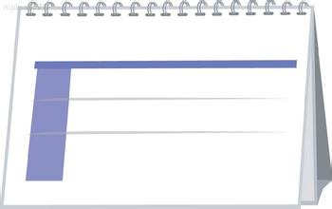
三、看图补全句子。
1. —When is your birthday?
—It is on ____ ____. 2. —When is _______ _______?
—It is on July 20th. 3. —____ ____ ____ ________?
—It’s ______ ______ _____.
April 13th
My birthday
April 13th
Mum’s birthday
July 20th
Mum’s birthday
When is Dad’s birthday
on November 1st
November 1st
Dad’s birthday

Slide 18


Summary
1. 学习了下列单词：twelfth, twentieth, twenty-first, twenty-third, thirtieth等。
2.学习了询问和回答某人生日的句型：
—When is …?
— It’s on ….
七彩课堂
伴你成长

Slide 19

Homework
ONE
TWO
七彩课堂
伴你成长
Talk about your birthday and write a short passage.
Act the dialogue out and show it to your parents.
Do “Look and write” with your friends.

Slide 20

