Slide 1


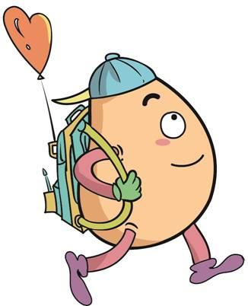

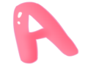



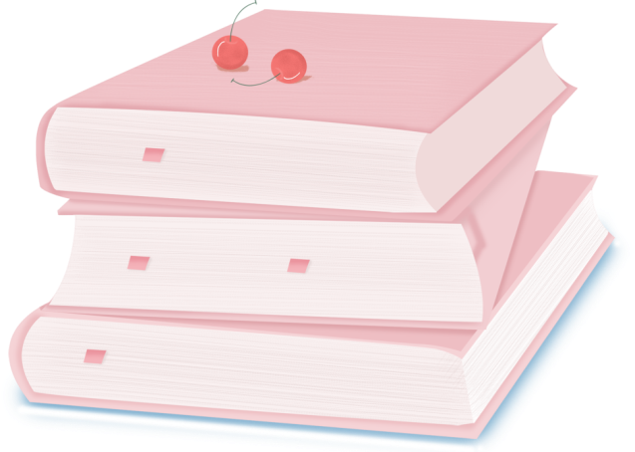
人 教 PEP 版 英 语 五年 级 下 册
Unit 4
When is the art show?
Part B & Part C
Read and write—Story Time

Slide 2

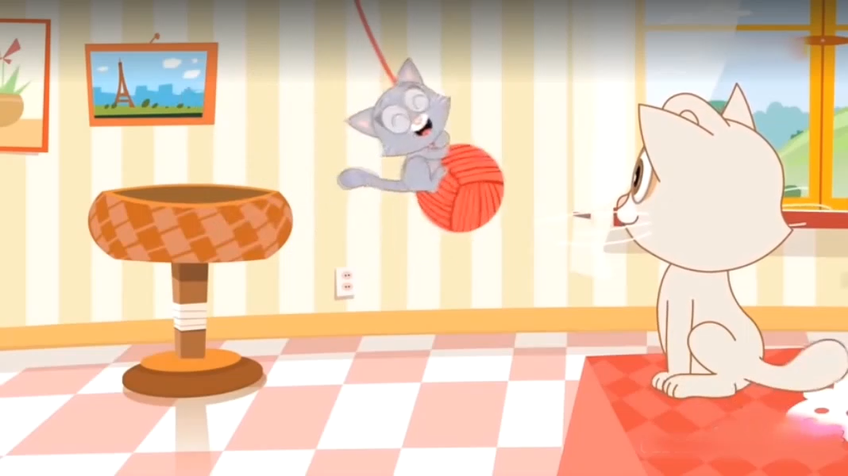
Warm up

Slide 3

Review
点击鼠标，气球飘来
twentieth
thirtieth
fourth
twelfth
second

Slide 4
Presentation
How to talk about the date?
Talk about Sarah’s new kittens.
Talk about people’s birthdays.
Talk about Zoom practicing singing.

Slide 5

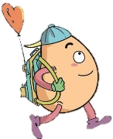

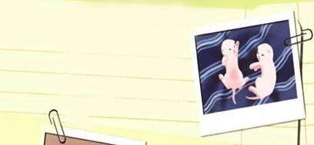
Read and write
Read and answer.
Two new kittens
Look! Sarah’s cat has two kittens. Read Sarah’s diary.
日记
have的第三人称单数
April 15th
My cat has two new kittens. They are pink because they are very young. They still can’t see.
仍然
When are the kitten’s birthdays?
What colour are they?
April 15th.
They are pink.

Slide 6
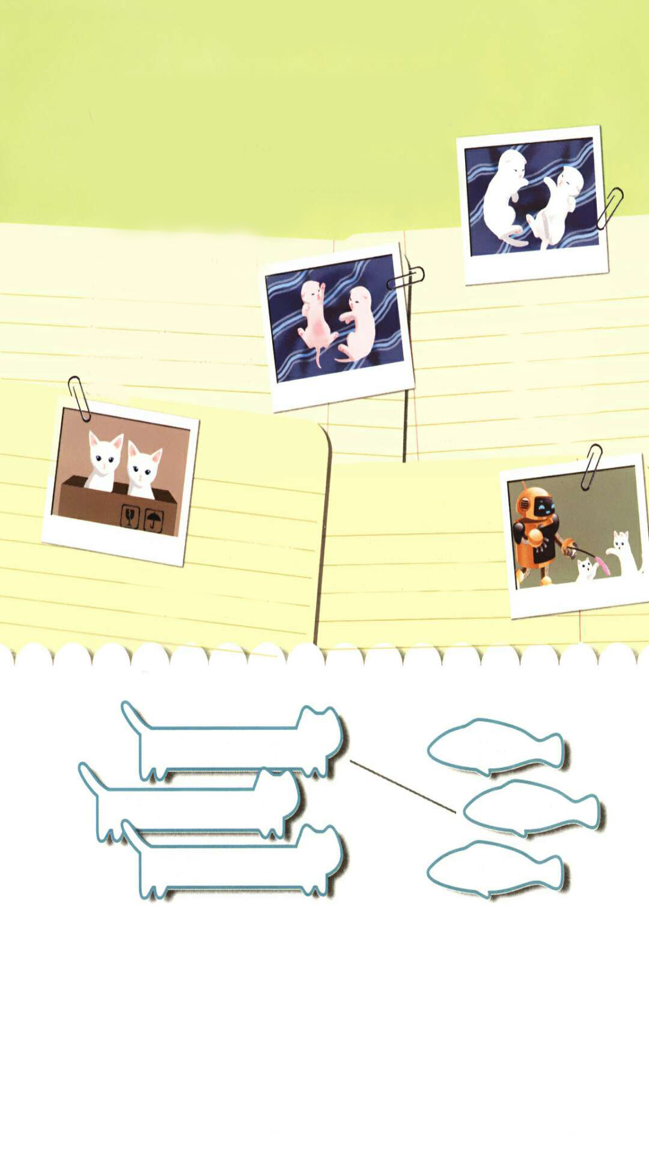
How old are the kittens?
The kittens are six days old.
制造噪音
April 21st
Are they pink?
The kittens are six days old. They make noises when they are hungry. They have white fur now. They are cute.
No, they aren’t.
They are white.
软毛
饿的

Slide 7
What colour are their eyes?
They are blue.
April 26th
Their eyes are open!
They are blue.
睁开的

Slide 8
May 3rd
走路
The kittens can walk now. They can play with Robin!
玩耍

Slide 9
Read after the tape.
Two new kittens
Sarah’s cat has two kittens. Read Sarah’s diary.
April 15th
My cat has two new kittens. They are pink because they are very young. They still can’t see.
April 21st
The kittens are six days old. They make noises when they are hungry. They have white fur now. They are cute.
April 26th
May 3rd
Their eyes are open!
They are blue.
The kittens can walk now. They can play with Robin!

Slide 10
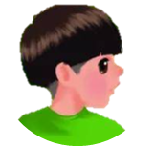
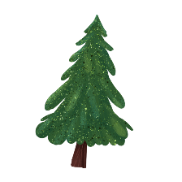


Language point.
My cat has two new kittens.
用来表达某人/某物拥有某物
句型：
主语 + have/has + 其他.
e.g. I have two big eyes.
The rabbit has two long ears.

Slide 11
Language point.
Their eyes are open!
主系表结构的句子
句型：
主语 + 系动词 + 表语.
e.g. They are excited.
I am really happy.

Slide 12
Language point.
The kittens can walk now.
情态动词can的用法
【详解】can 是一个情态动词,表示说话人的语气或情态,can没有人称和数的变化,在句子中不能单独作谓语,只能和紧挨着 can 的动词原形一起构成谓语。can 的基本意思是“能;会”。
e.g. I can speak English.
The monkey can climb the tree.

Slide 13
Read and match.
Their eyes are open.
May 3rd
They have white fur.
April 26th
They can walk.
April 21st

Slide 14
Now write two sentences about the kittens.
Their eyes are open on April 26th.
________________________________
________________________________
They have white fur on April 21st.
The kittens can walk on May 3rd.

Slide 15


Let’s check
Listen and number.
4
3
2
1

Slide 16

Listen again and tick or cross.
√
1. ( ) The girl’s birthday is on July 7th.
2. ( ) The boy’s birthday is on May 10th.
3. ( ) The woman’s birthday is on October 2nd.
4. ( ) The man’s birthday is on December 13th.
√
×
×

Slide 17
Boy: What's your name, please?
Girl: My name is Summer.
Boy: Is your birthday in summer?
Girl: Yes. My birthday is on July 7th.
Boy: Can you come to my birthday party this Saturday?
Girl: Let me think. It's May 10th. Yes, I'm free.
Boy: Great! See you then.

Slide 18
3.Woman: When is your birthday?
Man: My birthday is on October 2nd.
Woman: That's next Sunday.
Man: Yes.
4.Woman: It's my birthday soon.
Man: When is it?
Woman: It's on December 13th.
Man: It's this Friday.
Woman: Yes.

Slide 19

Let’s wrap it up
Fill in the table.
four
six
One two three five seven nine ten
eight
1st
3rd
5th
9th
4th 6th 8th
10th
2nd
7th

Slide 20
Finish the sentences.
I see horses in the picture.(ten)
2. My birthday is on July . (two)
3. Mother's Day is on the Sunday in May.(two)
4. It is o'clock.(three)
5. There are people in his family.(eight)
ten
2nd
second
three
eight

Slide 21

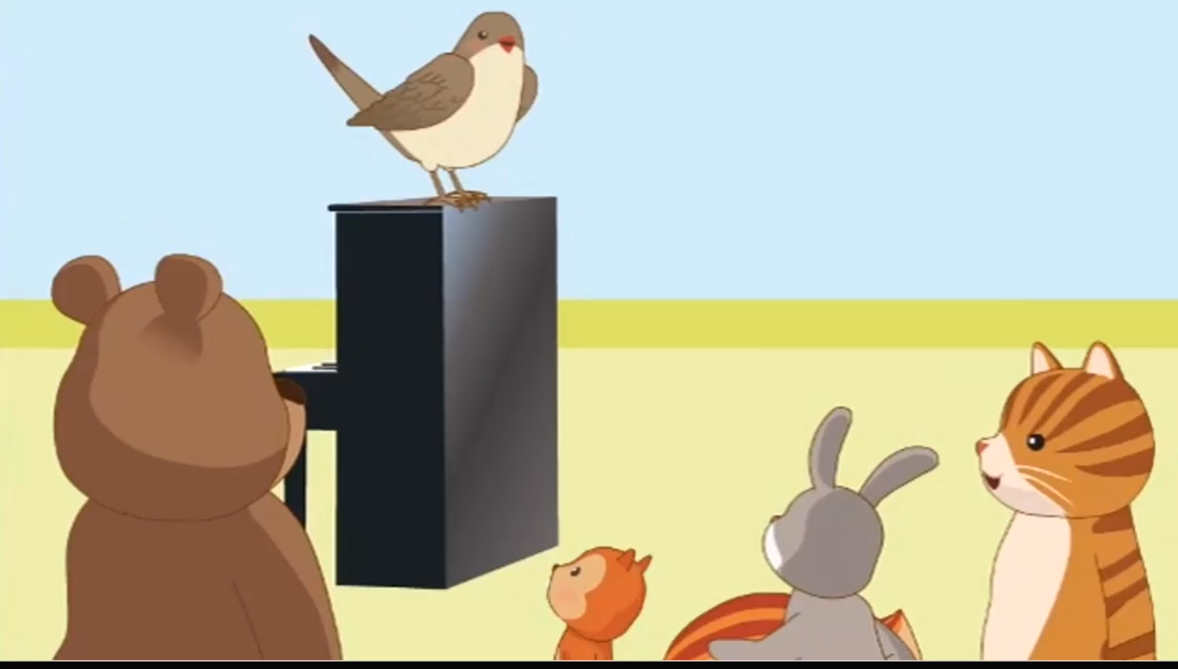
Story time
Watch the video.

Slide 22
Read and answer.
1.When will the singing test be?
2. Who wants to practise the song?
3. What will the cat do tonight?
The singing test will be on May 4th.
Zoom.
It will go swimming tonight.

Slide 23
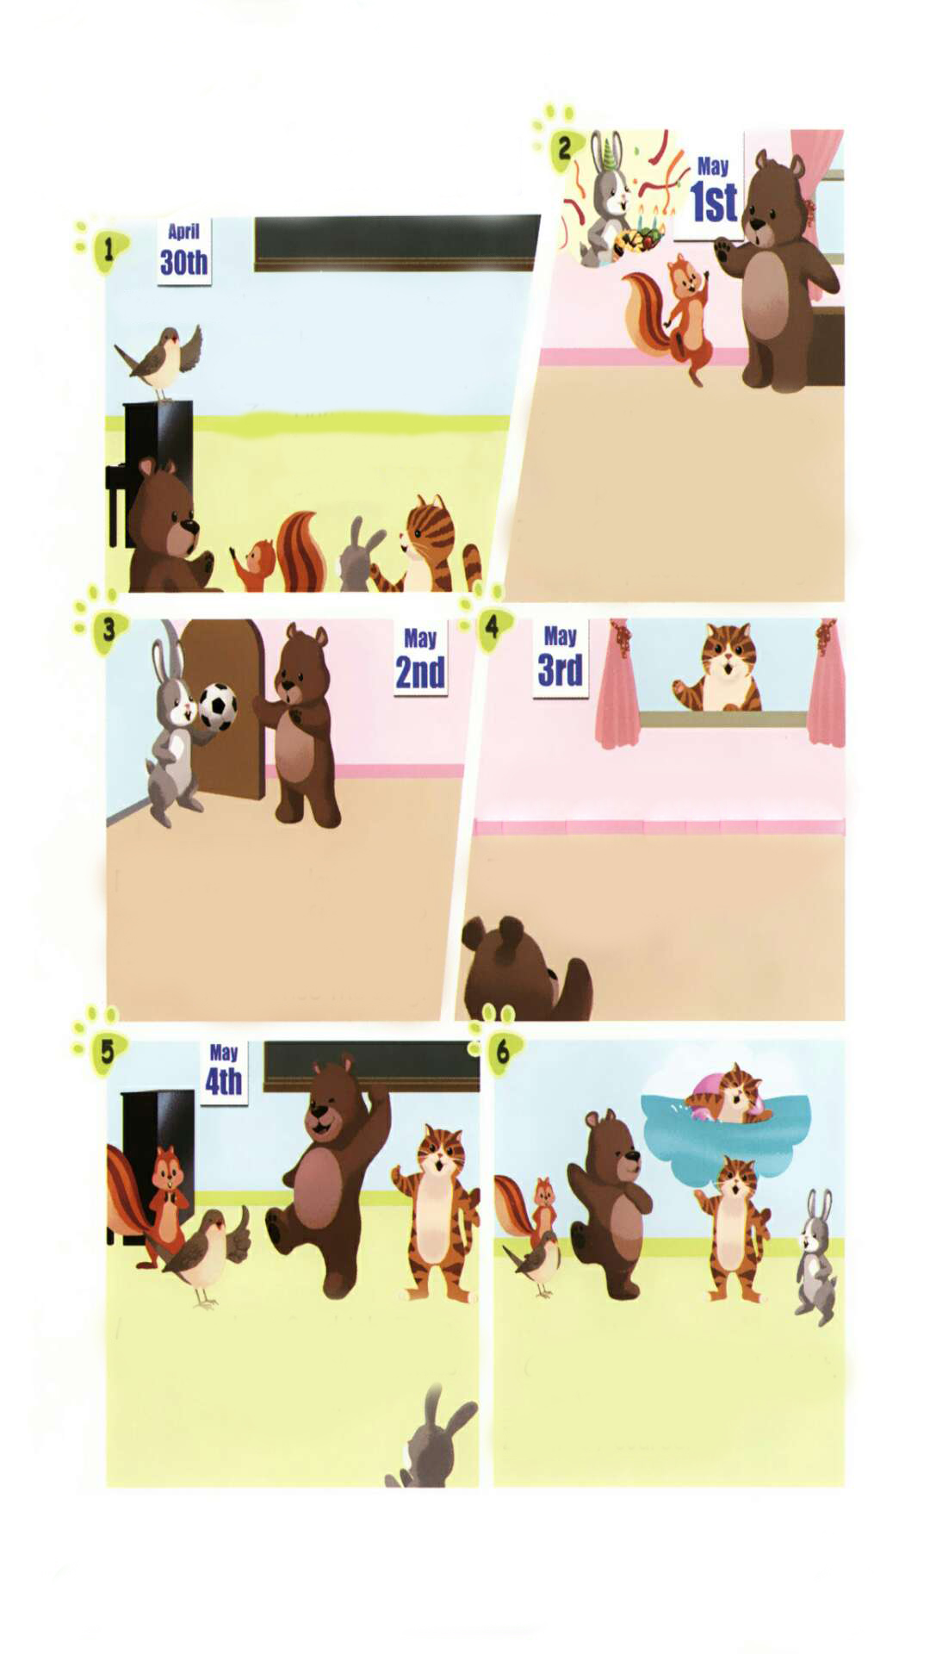
Listen to the tape.
Music teacher: The singing test will be on May 4th.
Zoom: I can't sing well.
Zip: Don't worry. Practice makes perfect.
Zip: Will you come to the party?Today is Rabbit’s birthday.
Zoom: Sorry, I can’t. I want to practise my song.
Rabbit: Will you play football with me after lunch?
Zoom: Sorry, I can’t. I want to practise the song.
Cat: Let’s watch TV together. The show is very funny!
Zoom: Sorry. I need more practice.
Music teacher: Good job, Zoom.
Zoom: Thank you, Miss Bird.
Cat: I’ll go swimming tonight. Will you go?
Zoom: Of course!

Slide 24
Play in roles.
不要担心
Music teacher: The singing test will be on May 4th.
Zoom: I can't sing well.
Zip: Don't worry. Practice makes perfect.
Zip: Will you come to the party?Today is Rabbit’s birthday.
Zoom: Sorry, I can’t. I want to practise my song.
Rabbit: Will you play football with me after lunch?
Zoom: Sorry, I can’t. I want to practise the song.
Cat: Let’s watch TV together. The show is very funny!
Zoom: Sorry. I need more practice.
Music teacher: Good job, Zoom.
Zoom: Thank you, Miss Bird.
Cat: I’ll go swimming tonight. Will you go?
Zoom: Of course!
v.练习
熟能生巧
后跟动词原形
有趣的
n.练习
当然

Slide 25
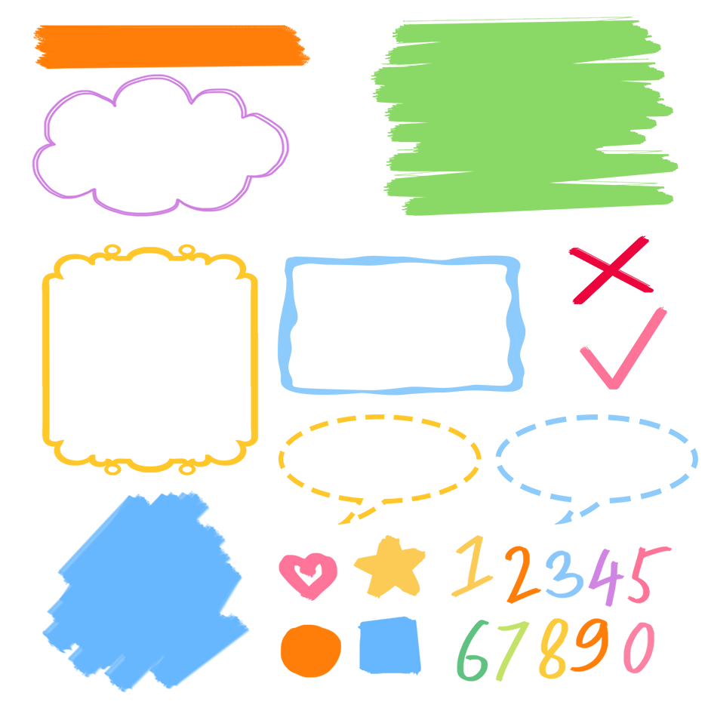
流利地朗读
流利地表演
有感情地表演

Slide 26
Language point.
I want to practise my song.
want to do sth.
want to do sth.的意思是“想要做某事”。
句型：
主语 + want(s) to do sth.
e.g. I want to have a look at your new watch.
He wants to go to school.

Slide 27
Language point.
The singing test will be on May 4th.
表示一般将来时的句子
【详解】这个句子用来表示一般将来时。singing test是指“歌唱比赛”,will是情态动词,意思是“将;要”。will在句中表示将来的动作或状态。
e.g. He will go to America tomorrow.
It will be sunny tomorrow.

Slide 28
Exercises
一、英汉互译。
1. kitten_______________
2. 不要担心_____________________
3. Practice makes perfect.___________
4. of course__________________
5. 踢足球 _______________
6. watch TV____________
7. go swimming ____________
小猫
Don’t worry
熟能生巧。
当然
play football
看电视
去游泳

Slide 29
二、用单词的适当形式填空。
eight
1. I see ________ pandas in the picture. ( eight)
2. My mom’s birthday is on June________. (three)
3.—What time is it now?
—It’s ________o’clock. (two)
4.There are ________people in Amy’s family. (six)
3rd
two
six

Slide 30
三、按照要求完成句子。
1.The singing test will be on May 4th.(对画线部分提问)
____________________________________
2.song, to, my, I, practice, want (.)(连词成句)
_________________________________________
3.I will play football after lunch. (改为一般疑问句)
____________________________________
When will the singing test be?
I want to practice my song.
Will you play football after lunch?

Slide 31

Summary
1.能够正确听、说、认、读单词：kitten, diary, still, noise, fur, open, walk等。
2.能用Sb’s birthday is…. 句型简单介绍某人的生日是哪一天。
3.能够掌握基数词和序数词的用法。

Slide 32
Homework
ONE
TWO
Make sentences like “Read and write”.
Read the story to your parents.
Act the story out in groups.

Slide 33







