Slide 1




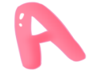

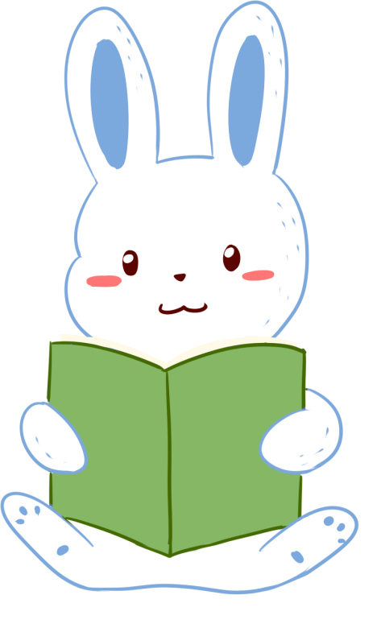


人 教 PEP 版 英 语 五 年 级 下 册
Unit 4
When is the art show?
Part B & Part C
Read and write—Story time

Slide 2


Warm up
twentieth
thirtieth
fourth
twelfth
second

Slide 3

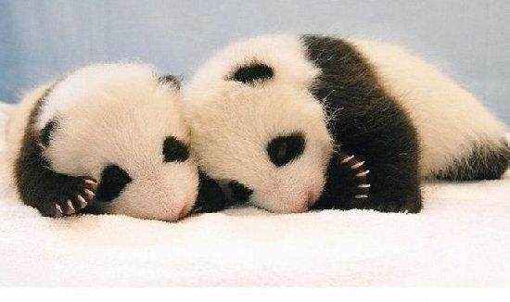
Lead in
Look! There are two baby pandas.
When are the baby pandas’ birthday?
April 4th

Slide 4

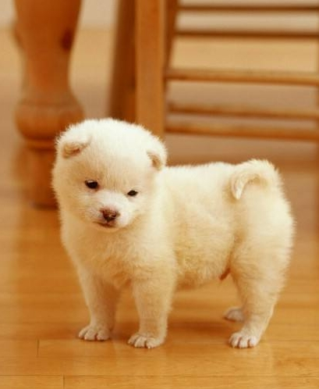
October 3rd
There is a cute baby dog.
When is his birthday?

Slide 5
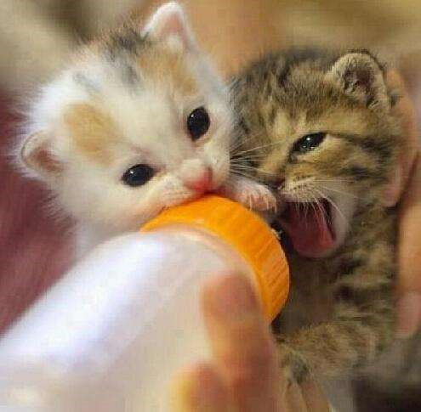
Look! Sarah’s cat has two kittens. Read Sarah’s diary, please.
kitten
小猫
diary
日记

Slide 6

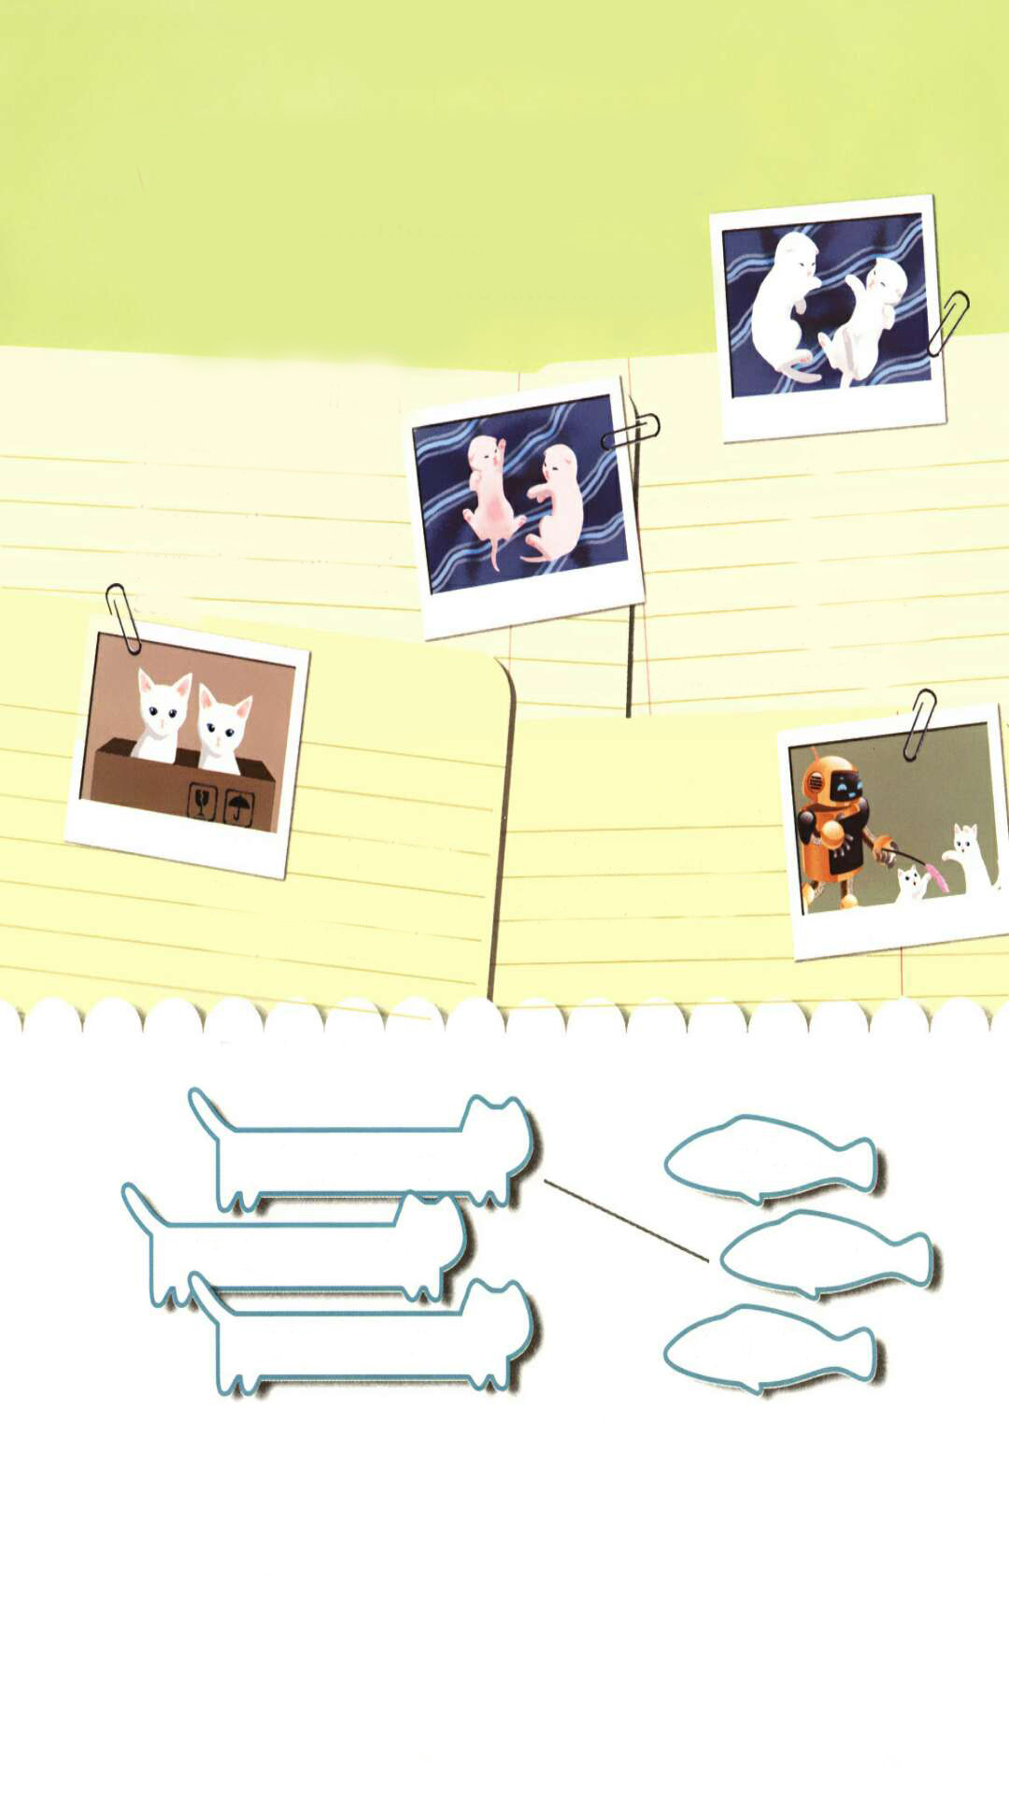
Presentation
Read and write
When are the kitten’s birthday?
April 15th
What colour are they?
Pink
April 15th
My cat has two new kittens. They are pink because they are very young. They still can’t see.
仍然

Slide 7
Read and answer.
How old are the kittens?
The kittens are six days old.
April 21st
Are they pink?
The kittens are six days old. They make noises when they are hungry. They have white fur now. they are cute.
No, they aren’t. They are white.
噪音
浓密的软毛

Slide 8
Listen, read and answer.
What colour are their eyes?
They are blue.
April 26th
Their eyes are open!
They are blue.
开着的

Slide 9
Say something about the kittens.
May 3rd
行走
The kittens can walk now. They can play with Robin!

Slide 10
Read after the tape.
Two new kittens
Sarah’s cat has two kittens. Read Sarah’s diary.
April 15th
My cat has two new kittens. They are pink because they are very young. They still can’t see.
April 21st
The kittens are six days old. They make noises when they are hungry. They have white fur now. they are cute.
April 26th
May 3rd
Their eyes are open!
They are blue.
The kittens can walk now. They can play with Robin!

Slide 11
Language points
【详解】这个句子用来表达某人/某物有某物。
句型结构:主语 + have/has + 其他.
e.g. I have two big eyes.
The rabbit has two long ears.
1. My cat has two new kittens.

Slide 12
【详解】这是一个主系表结构的句子。their eyes 是主语, are 是系动词, open 意思是“开着的”,作表语。
句型结构:主语 + 系动词 + 表语.
e.g. They are excited.
I am really happy.
2. Their eyes are open!

Slide 13
3. The kittens can walk now.
【详解】can 是一个情态动词,表示说话人的语气或情态,can没有人称和数的变化,在句子中不能单独作谓语,只能和紧挨着 can 的动词原形一起构成复合谓语。can 的基本意思是“能;会”。
e.g. I can speak English.
The monkey can climb the tree.

Slide 14
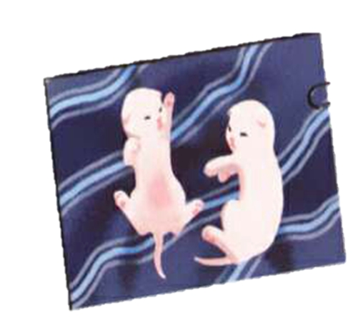
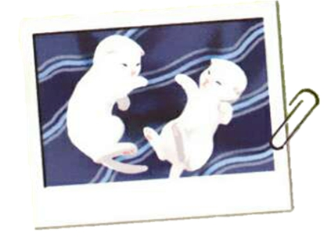
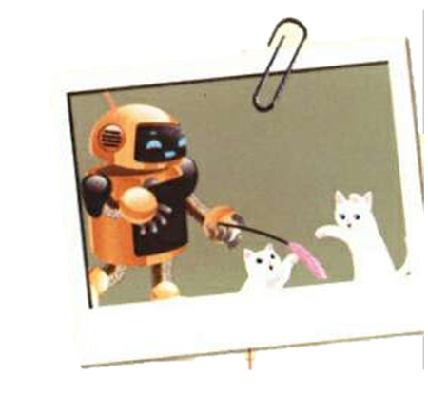
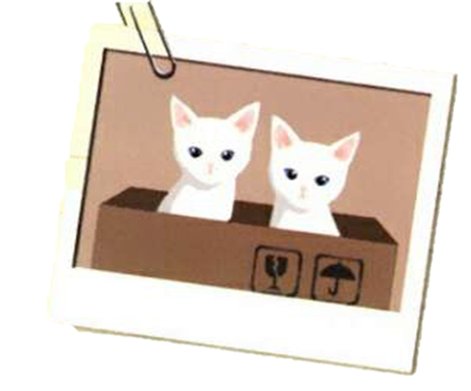
趣配音。

Slide 15
Read and match.
Their eyes are open.
May 3rd
They have white fur.
April 26th
They can walk.
April 21st

Slide 16
Now write two sentences about the kittens.
Their eyes are open on April 26th.
________________________________
________________________________

Slide 17
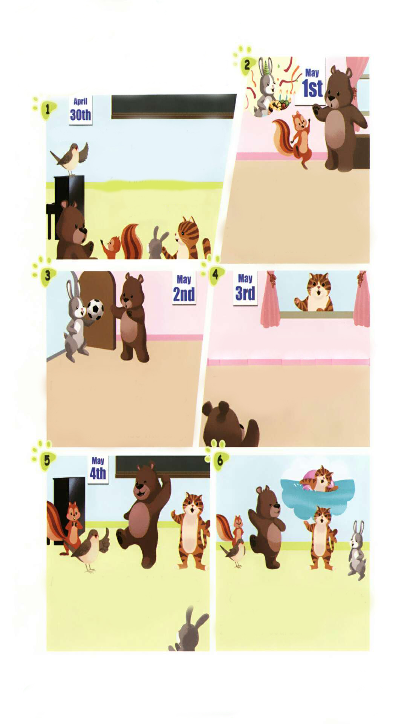

Guess! Who’s Zoom’s music teacher?
Miss Bird is Zoom’s music teacher.
Today is April 30th. The singing test will be on May 4th.
Can Zoom sing well?
No, he can’t.

Slide 18
Story time
点击画面 播放视频
What does Zip say? What happens? Let’s watch a cartoon.

Slide 19
At first, Zoom says, “I can’t sing well.”
He can’t come to Rabbit’s birthday party, because he wants to practise his song.
He can’t watch TV with Cat, because he wants to practise his song.
He can’t play football with Rabbit, because he wants to practise his song.
Finally, he sings well.

Slide 20
Listen and read.
Music teacher: The singing test will
be on May 4th.
Zoom: I can't sing well.
Zip: Don't worry.
Practice makes
perfect .
Zip: Will you come to the
party? Today is Rabbit‘s
birthday.
Zoom: Sorry, I can't. I want to
practise my song.

Slide 21
Rabbit：Will you play football with me after lunch?
Zoom: Sorry, I can't. I want to practise the song.
Cat: Let's watch TV together. The show is very funny!
Zoom：Sorry. I need more practice.
Music teacher：Good job, Zoom.
Zoom: Thank you, Miss Bird.
Cat：I'll go swimming tonight. Will you go?
Zoom：Of course!

Slide 22
What does “ Practice makes perfect.” mean?
Practice makes perfect.
熟能生巧

Slide 23
Language points
1.The singing test will be on May 4th.
【详解】这个句子用来表示一般将来时。Singing test是指“歌唱比赛”,will是情态动词,意思是“将;要”。will在句中表示将来的动作或状态。
e.g. He will go to America tomorrow.
Tomorrow will be Wednesday.

Slide 24
2. I can't sing well.
【详解】can't是can的否定形式,意思是“不能;不会”,后面接动词原形。can是情态动词,没有人称和数的变化。
e.g. I can't swim.
Tigers can't fly.

Slide 25
3. I want to practice my song.
【详解】want意思是“想”, “want to do sth.”意思是“想要做某事”。
句型结构:主语 + want(s) to do sth.
e.g. I want to have a look at your new watch.
I want to go to school.

Slide 26
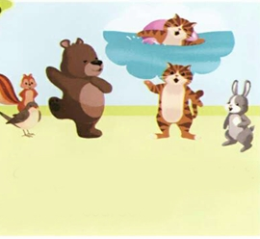
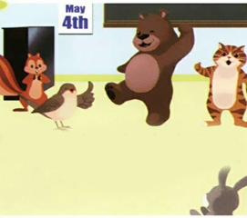
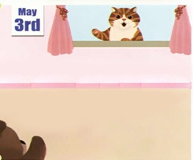

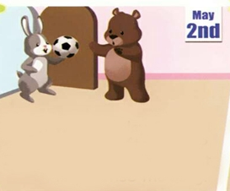
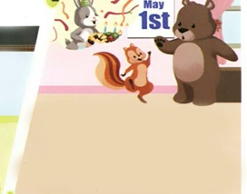
Number the pictures.
⑥
⑤
④
①
③
②

Slide 27
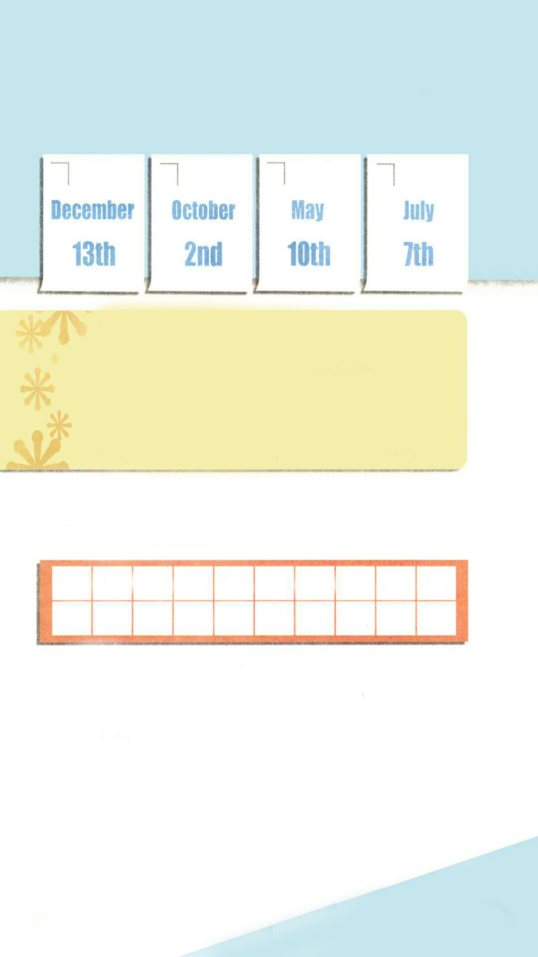
Practice
Let’s check
Listen and number.
4
3
2
1

Slide 28
Listen again and tick or cross.
√
1. ( ) The girl’s birthday is on July 7th.
2. ( ) The boy’s birthday is on May 10th.
3. ( ) The woman’s birthday is on October 2nd.
4. ( ) the man’s birthday is on December 13th.
√
×
×

Slide 29
听力材料：
Boy: What's your name, please?
Girl: My name is Summer.
Boy: Is your birthday in summer?
Girl: Yes. My birthday is on July7th.
Boy: Can you come to my birthday party this Saturday? Girl: Let me think. It's May 10th. Yes, I'm free.
Boy: Great! See you then.

Slide 30
3.Woman: When is your birthday?
Man: My birthday is on October 2nd.
Woman: That's next Sunday.
Man: Yes.
4.Woman: It's my birthday soon.
Man: When is it?
Woman: It's on December 13th.
Man: It's this Friday.
Woman: Yes.

Slide 31
Let’s wrap it up
Fill in the table.
four
six
One two three five seven nine ten
eight
1st
3rd
5th
9th
4th 6th 8th
10th
2nd
7th

Slide 32
Finish the sentences.
I see horses in the picture.(ten)
2. My birthday is on July . (two)
3. Mother's Day is on the Sunday in May.(two)
4. It is o'clock.(three)
5. There are people in his family.(eight)
ten
2nd
second
three
eight

Slide 33

Exercises
一、英译汉。
1. kitten_____________ 2. diary_____________
3. still_______________ 4. noise_____________
5. open______________ 6. walk________________
小猫
日记
仍然
噪音
开着的
行走

Slide 34
二、用单词的适当形式填空。
eight
1. I see ________ pandas in the picture. ( eight)
2. My mom’s birthday is on June________. (three)
3.—What time is it now?
—It’s ________o’clock. (two)
4.There are ________people in Amy’s family. (six)
3rd
two
six

Slide 35
三、问答连线。
1. When is your birthday? A. No, it isn’t. It’s on March 5th.
2. Is the sports meet on March 7th? B. I will make a birthday card.
3. When is April Fool’s Day? C. It’s on April 1st.
4. What will you do for your grandma? D. My birthday is on May 8th.

Slide 36


Summary
1.能够正确听、说、认、读单词：kitten, diary, still, noise, fur, open, walk等。
2.能用The girl’s birthday is….句型简单介绍某人的生日是哪一天。
3.能够掌握基数词和序数词的用法。
七彩课堂
伴你成长

Slide 37

Homework
ONE
TWO
Make sentences like “Read and write”.
Read the story to your parents.
七彩课堂
伴你成长
Act the story out in groups.

Slide 38








