Slide 1


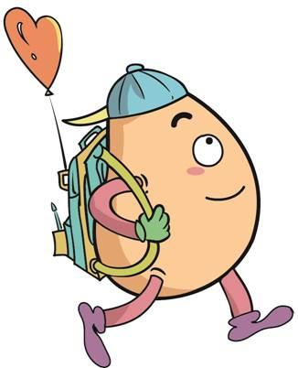






人 教 PEP 版 英 语 五年 级 下 册
Unit 4
When is the art show?
Part B
Let’s try & Let’s talk

Slide 2

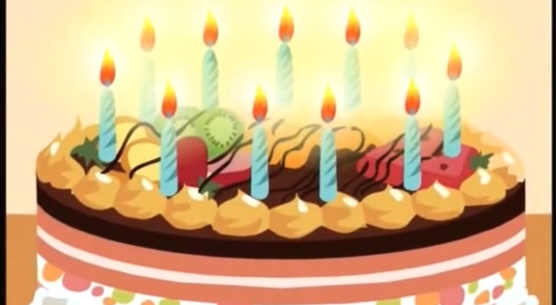
Warm up

Slide 3
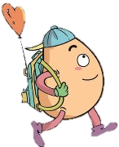
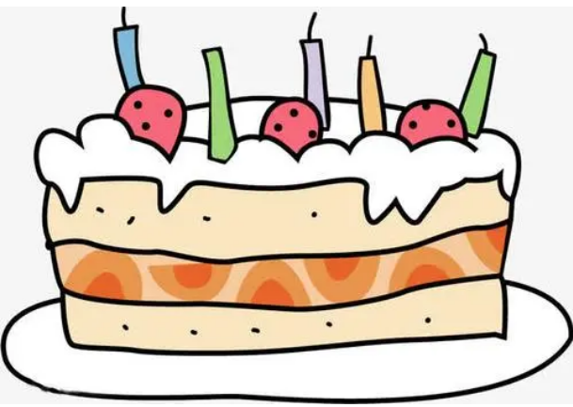
Lead in
Free talk！
—When is your birthday?
—It’s on ...

Slide 4

What will you do for your birthday?

Slide 5
Presentation
Talk about the birthdays.
Talk about Mike’s cousin’s birthday.
Chen Jie and Mike talk about birthdays.
Chen Jie and John talk about their classmates’ birthdays.

Slide 6


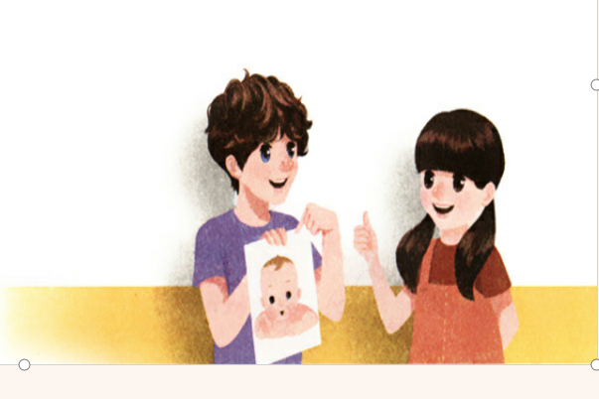
Let’s try
When is the baby’s birthday? Listen and tick.
March 1st.
√
March 2nd.
March 9th.

Slide 7
Let’s check！
Mike: I have a new cousin. Look at his photo.
Chen Jie: He's so cute! When is his birthday?
Mike: It's on March 2nd.
Chen Jie: How old is he now?
Mike: He's 15 days old.

Slide 8
Act it out.
Mike: I have a …. Look at … photo.
Chen Jie: He's …! When is …?
Mike: It's on ….
Chen Jie: How old is …?
Mike: He's … old.

Slide 9
Listen and choose.
根据对话内容选择正确答案。
1. The baby is Mike’s _____ .
A. cousin B. sister
2. The baby’s birthday is on ____.
A. March 3rd B. March 2nd
3. —How old is the baby? —He is only ___ days old.
A. fifteen B. fourteen

Slide 10

Let’s talk
Watch and answer！
1. When is Mike’s birthday?
2.When is Chen Jie’s mother’s birthday?
3.What will Chen Jie do for her mother?
4.Does Mike like Chinese noodles?

Slide 11
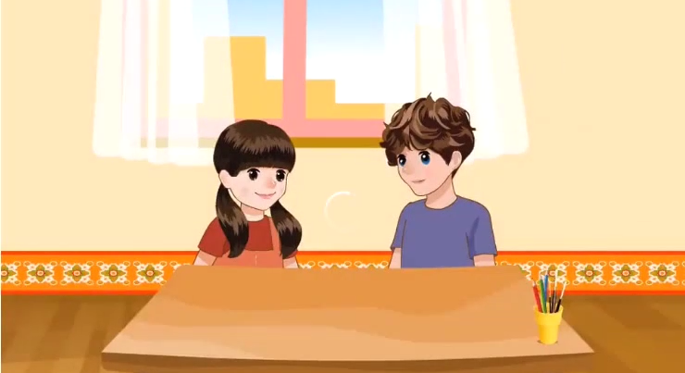

Slide 12
1. When is Mike’s birthday?
2.When is Chen Jie’s mother’s birthday?
3.What will Chen Jie do for her mother?
4.Does Mike like Chinese noodles?
Mike’s birthday is on Apirl 4th.
Chen Jie’s mother’s birthday is on Apirl 4th,too.
She will cook noodles for her mother.
Yes, he does.

Slide 13
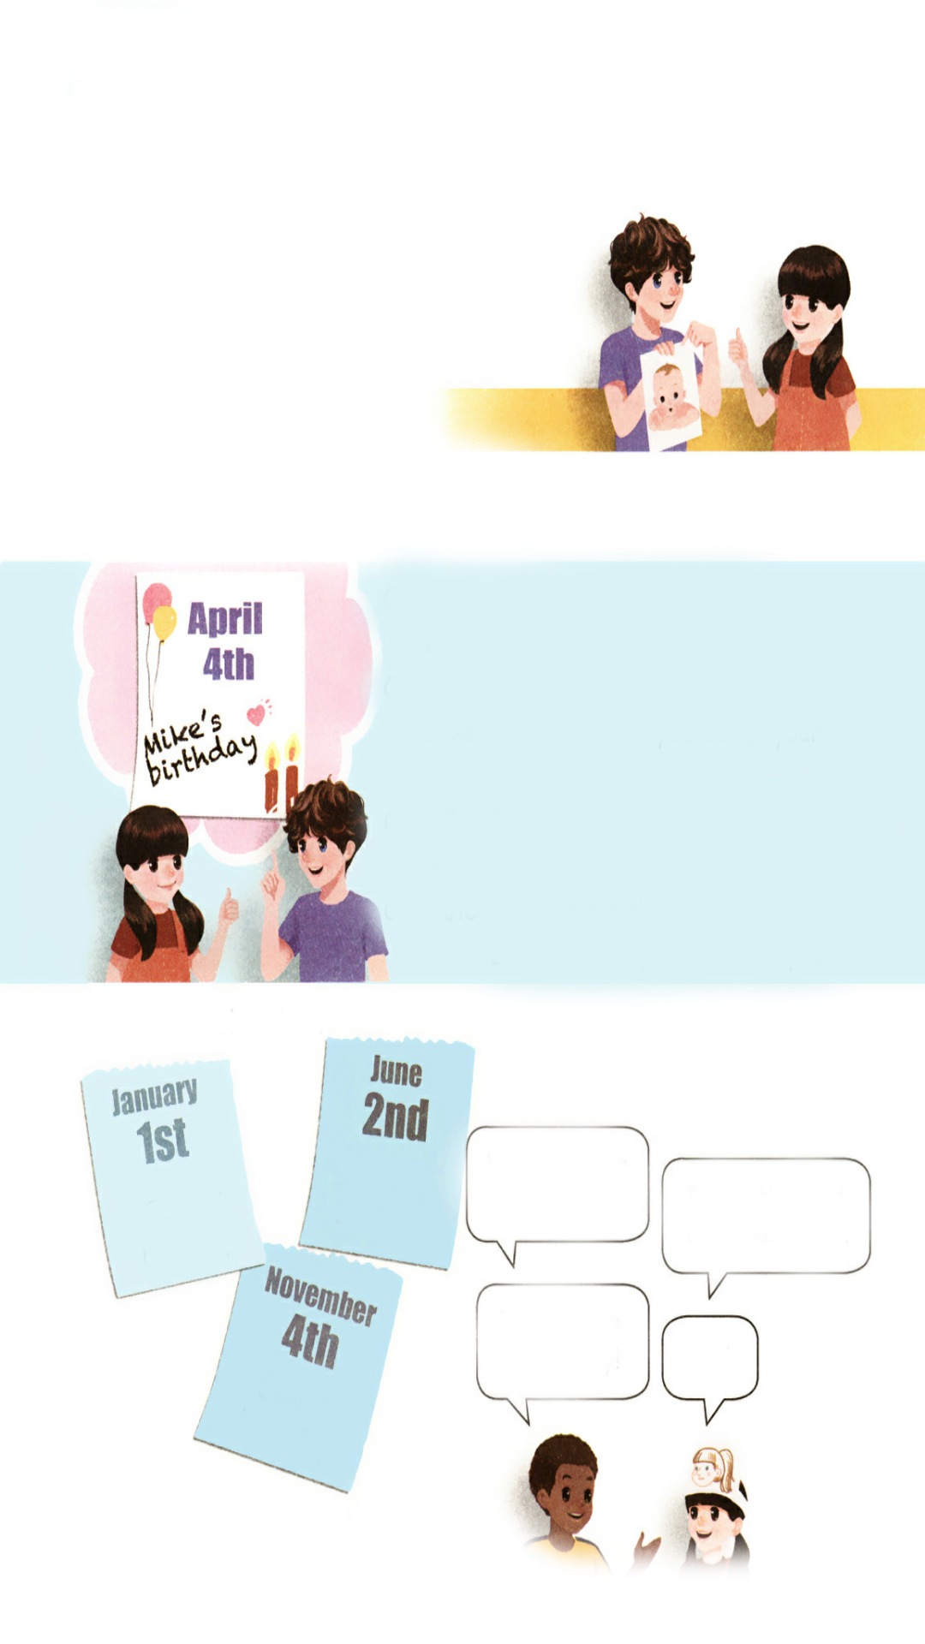
Listen to the tape.
Chen Jie:When is your birthday?
Mike:My birthday is on April 4th.
Chen Jie:That’s my mother’s birthday, too!
Mike:Cool! What will you do for your mum?
Chen Jie:I’ll cook noodles for her.
Mike:Chinese noodles are delicious!
Chen Jie:Please come then. We can have a
birthday party for both of you!

Slide 14

Read and act
1.Read it together.
2.Each student
reads a sentence.
Tip: Choose one to read in two. 选择一种两人练习。
3. Read in roles.
分角色朗读。

Slide 15
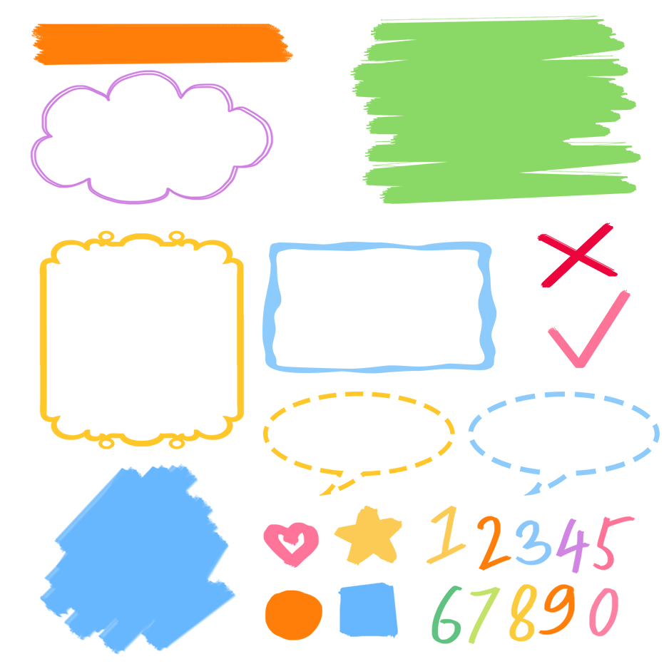
流利地朗读
流利地表演
有感情地表演

Slide 16
Listen and repeat
询问什么时间过生日
Chen Jie:When is your birthday?
Mike:My birthday is on April 4th.
Chen Jie:That’s my mother’s birthday, too!
Mike:Cool! What will you do for your mum?
Chen Jie:I’ll cook noodles for her.
Mike:Chinese noodles are delicious!
Chen Jie:Please come then. We can have a
birthday party for both of you!
四月四日，在具体某一天前面用介词on
煮面条
美味的
生日聚会
两个都

Slide 17
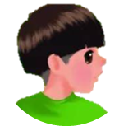
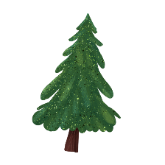


Language point.
— When is your birthday?
— My birthday is on April 4th.
询问和回答某人生日的时间
When is one's birthday?
回答:One's birthday is on + 具体年月日/in+ 月份.
句型：
E.g. — When is your birthday, Amy?
— My birthday is on June 1st.

Slide 18
Act it out.
Chen Jie:When is your birthday?
Mike:My birthday is on _________.
Chen Jie:That’s my _____’s birthday, too!
Mike:Cool! What will you do for your____?
Chen Jie:I’ll cook_______ for her.
Mike: _______ noodles are ______!
Chen Jie:Please come then. We can have a
birthday _____ for ____ of you!
April 4th
mother
mum
noodles
Chinese
delicious
party
both

Slide 19
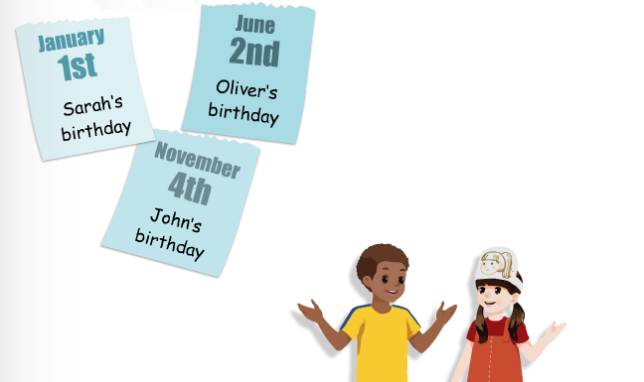
Role play.
When is your birthday?
My birthday is on January 1st.
That’s New Year’s Day!
Yes!

Slide 20
Role play.
When is ...birthday?
... birthday is on ...

Slide 21
Practice
Here are some birthdays of our classmates. Make up dialogues based on the information.
Zhang Lin
May 4th
Li Hui
October 9th
Lily
June 6th
Julia
July 1st

Slide 22
When is Zhang Lin’s birthday?
It’s on May 4th.

Slide 23
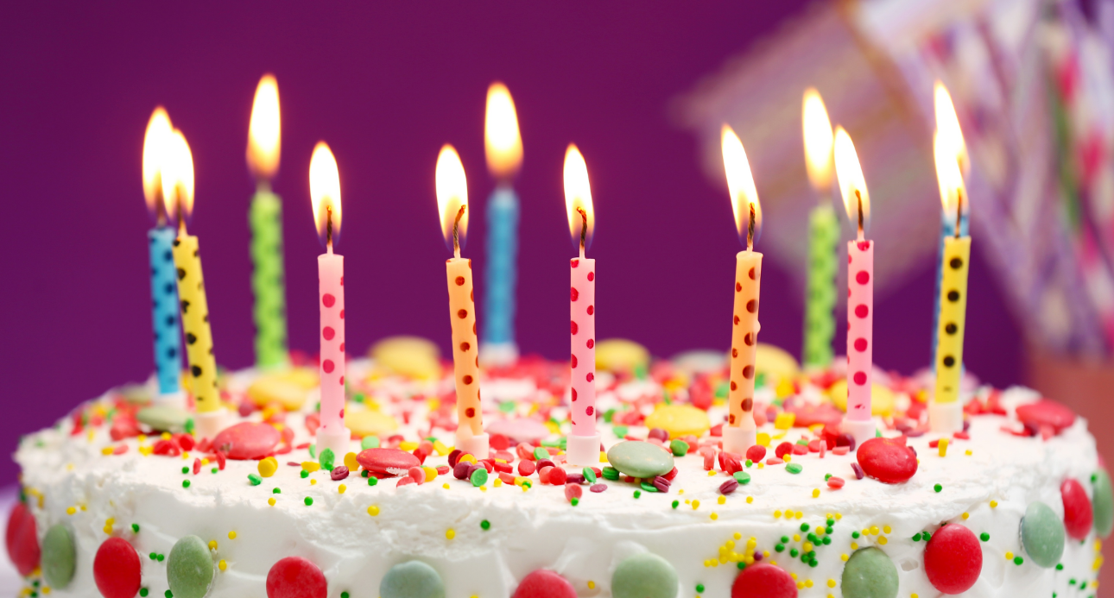
Good to know
生日（birthday），既指一个人出生的日子，也指一个人的出生日纪念日。传统上中国人以农历计算生日，小孩子一周岁的生日称为“周岁”，有各种习俗。老年人的生日称为寿日，在50岁以上逢十可称为大寿。在中国的传统中，生日吃长寿面(noodles)和鸡蛋(eggs)。

Slide 24
Exercises
一、按要求写单词。
1. two（序数词）_______
2. mother（所有格）_______
3. for（同音词）_______
4. third（缩写形式）_______
5. birthday party（英译汉）_______
second
mother’s
four
3rd
生日聚会

Slide 25
二、单项选择。
( ) 1. —________is your birthday?
—It’s on February 9th.
A. What B. When C. Where
( ) 2. I’ll cook noodles ________ her tomorrow.
A. to B. for C. at
( ) 3. June 5th is my ________birthday.
A. mother’s B. mothers C. mother
B
B
A

Slide 26
三、按照要求完成句子。
1.My birthday is on June 22.(对画线部分提问)
____________________________________
2.you, we, of, can, birthday, for, a, have, party, both(.)(连词成句)
_________________________________________
3.I’ll cook noodles for my mum. (对画线部分提问)
_____________________________
When is your birthday?
We can have a birthday party for both of you.
What will you do for your mum?

Slide 27

Summary
学习了下列句型：
— When is your birthday?
— My birthday is on April 4th.
— What will you do for your mum?
— I’ll cook noodles for her.

Slide 28
Homework
ONE
TWO
Act the dialogue out with your friends.
Make up a short dialogue using the sentences we have learnt.
Make a card for your mother.

Slide 29







