Slide 1









人 教 PEP 版 英 语 五 年 级 下 册
Unit 4
When is the art show?
Part B
Let’s try & Let’s talk

Slide 2

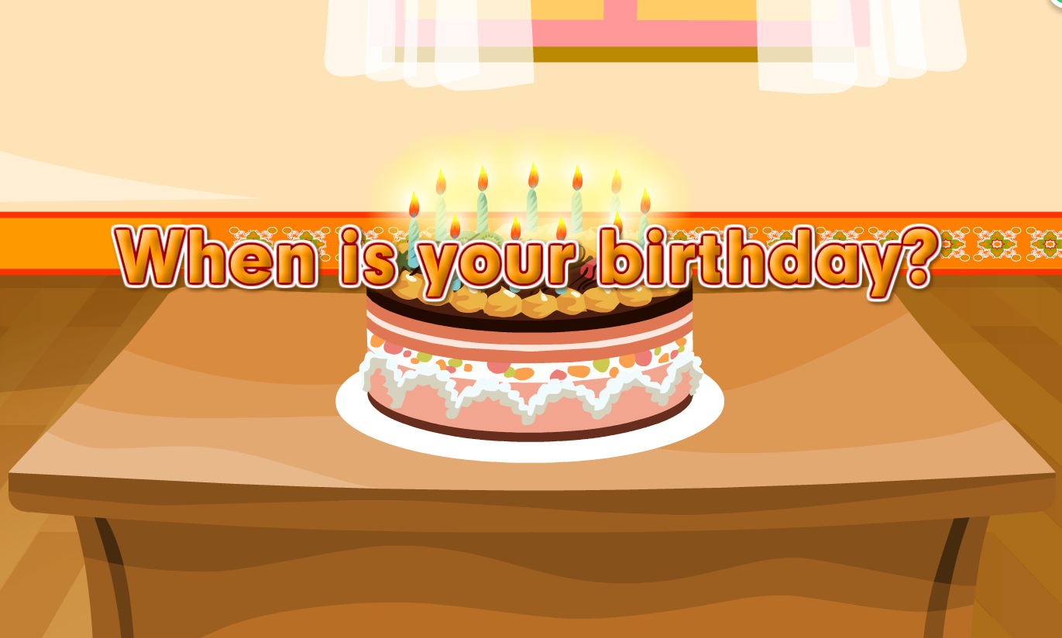

Warm up
Let’s sing.
点击画面 播放视频
My birthday is in January.
My birthday is in January.
My birthday is in January.
It’s on January 1st.
My birthday is in August.
My birthday is in August.
My birthday is in August.
It’s on August 5th.

Slide 3

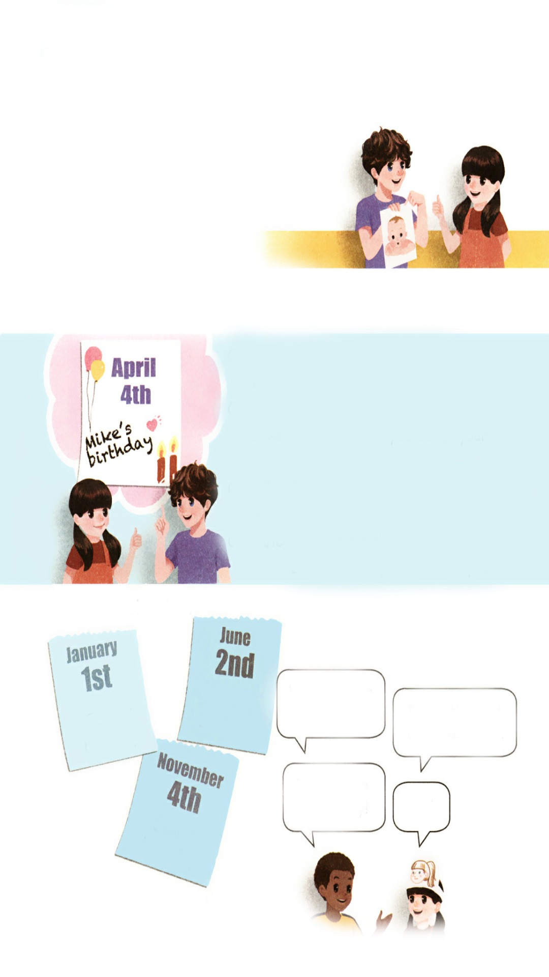
Lead in
Who’s this baby?
He’s Mike’s new cousin.
When is the baby’s birthday?
Swimming
contest
English
test
sports
test

Slide 4

Presentation
Let’s try
When is the baby’s birthday? Listen and tick.
March 1st.
√
March 2nd.
March 9th.

Slide 5

听力材料：
When is the baby’s birthday?
Mike: I have a new cousin. Look at his photo.
Chen Jie: He's so cute! When is his birthday?
Mike: It's on March 2nd.
Chen Jie: How old is he now?
Mike: He's 15 days old.

Slide 6
Act it out.
Mike: I have a …. Look at … photo.
Chen Jie: He's …! When is …?
Mike: It's on ….
Chen Jie: How old is …?
Mike: He's … old.

Slide 7
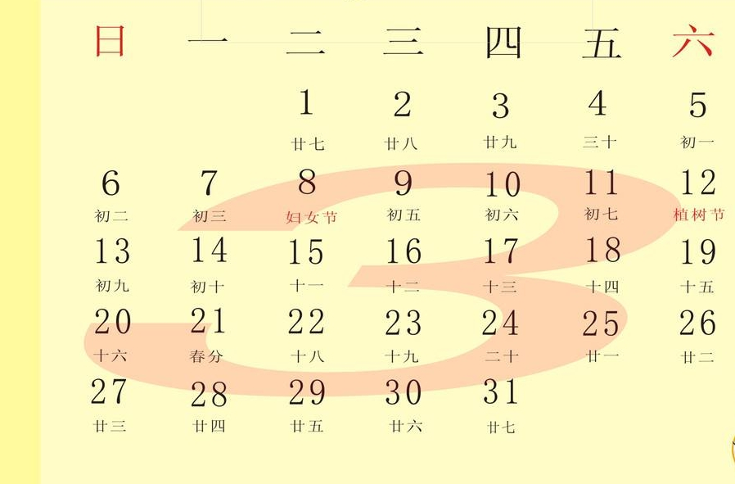
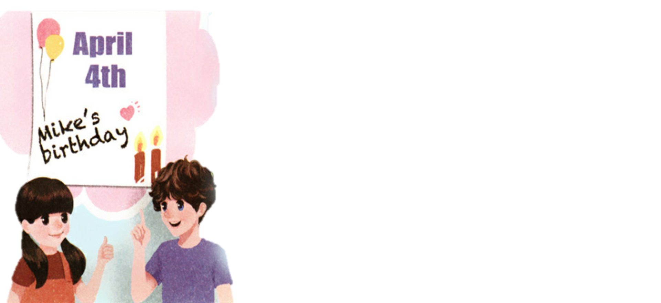
Let’s talk
Zoom’s birthday is on March 3rd.
Mike’s new cousin’s birthday is on March 2nd.
When is Mike’s birthday?
Mike’s birthday is on April 4th.

Slide 8
Here are some birthdays of our classmates.
Zhang Lin
May 4th
Li Hui
October 9th
Lily
June 6th
Julia
July 1st
A: When is … birthday?
B: … birthday is on….

Slide 9

When’s your mother’s birthday? Mum does many things for me. Let’s enjoy a poem.
Mum plays with me. Mum sings with me. Mum reads with me.
Mum buys toys with me. Mum cooks dinner for me. Mum washes my clothes for me.
Mum loves me!

Slide 10
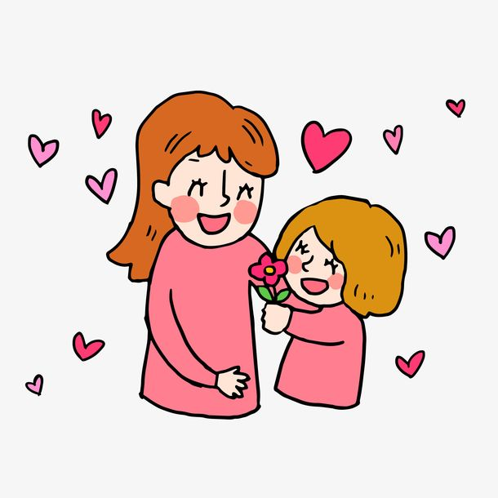
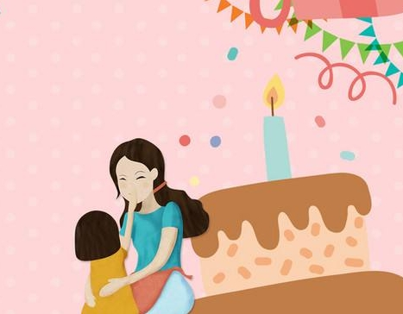
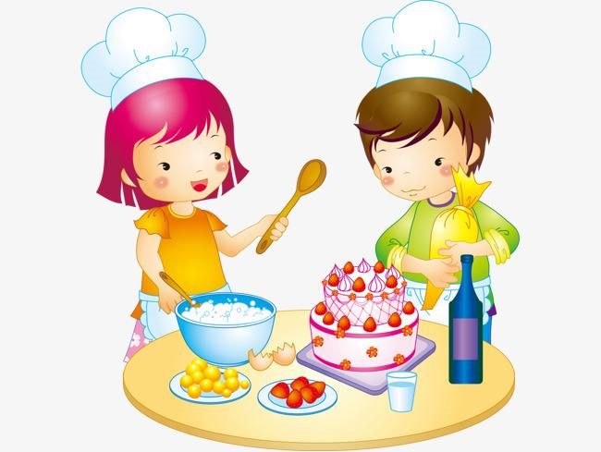
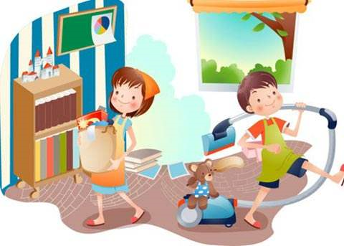
What will you do for your mum?
I will _____________.
give her a hug
clean our room
give Mum a flower
make a cake

Slide 11
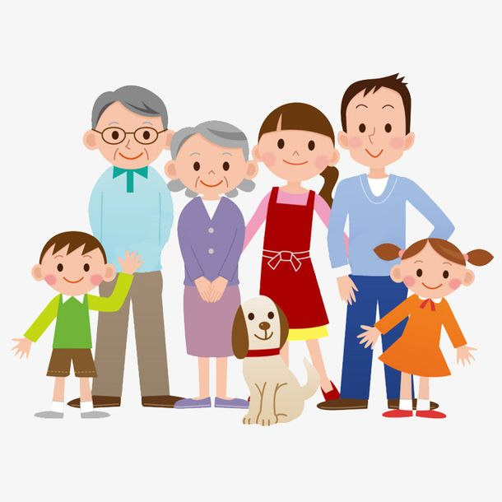
Talk about the birthdays of your family.
A: When is your…?
B: His/Her birthday is on….
A: What will you do for him/her?
B: I will….

Slide 12
Listen and answer the questions.
1. When is Mike’s birthday?
Mike’s birthday is on April 4th.
2. When is Chen Jie’s mother’s birthday?
Chen Jie’s mother’s birthday is on April 4th.
3. What will Chen Jie do for her mother ?
She will cook noodles for her.

Slide 13
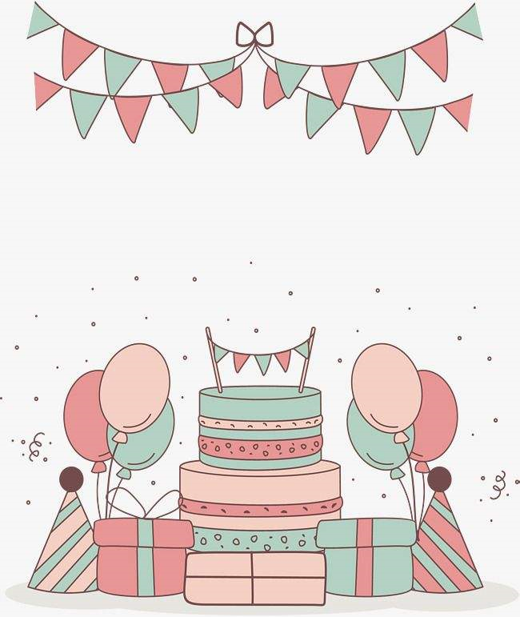

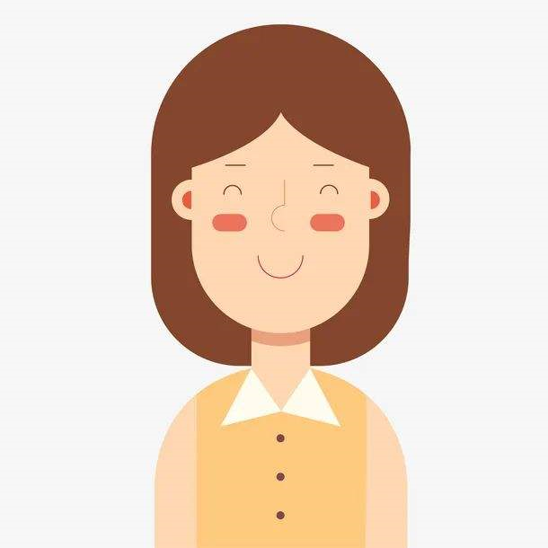
Mike’s birthday is on April 4th. Chen Jie’s mother’s birthday is on April 4th, too.
两者都
They can have a birthday party for both of them!
Chen Jie’s mother

Slide 14
Listen and read.
Chen Jie:
Mike:
Chen Jie:
Mike:
Chen Jie:
Mike:
Chen Jie:
When is your birthday?
My birthday is on April 4th.
That’s my mother’s birthday, too!
Cool! What will you do for your mum?
I’ll cook noodles for her.
Chinese noodles are delicious!
Please come then. We can have a birthday party for both of you!

Slide 15
Language point
— When is your birthday?
— My birthday is on April 4th.
【详解】这组对话用来询问和回答某人生日的时间。
句型结构:When is + one's birthday?
回答:One's birthday is on + 具体年月日/in+ 月份.
E.g. — When is your birthday, Amy?
— My birthday is on June 1st.

Slide 16
Act out
Chen Jie:
Mike:
Chen Jie:
Mike:
Chen Jie:
Mike:
Chen Jie:
When is your birthday?
My birthday is on ....
That’s my … ’s birthday, too!
Cool! What will you do for your …?
I’ll ….
…!
Please come then. We can … for both of you!

Slide 17
Practice
Role-play
Oliver’s
birthday
When is your birthday?
Sarah’s
birthday
My birthday is on January 1st.
That’s New Year’s Day!
Yes!
John’s
birthday

Slide 18
Pair work.
When is …?
Oliver’s
birthday
Sarah’s
birthday
… is on ….
…!
…!
John’s
birthday

Slide 19
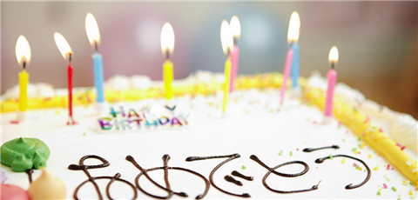
I want to know
生日（birthday），既指一个人出生的日子，也指一个人的出生日纪念日。传统中国人以农历计算生日，小孩子一周岁的生日称为“周岁”，有各种习俗。老年人的生日称为寿日，在50岁以上逢十可称为大寿。在中国的传统中，生日吃长寿面和鸡蛋。

Slide 20

Exercises
一、按要求写单词。
1. one（序数词）_______
2. you（形容词性物主代词）_______
3. for（同音词）_______
4. second（缩写形式）_______
5. birthday party（英译汉）_______
first
your
four
2nd
生日聚会

Slide 21
二、选择填空。
( ) 1. —________is your birthday?
—It’s on January 9th.
A. What B. When C. Where
( ) 2. I’ll cook noodles ________ her tomorrow.
A. to B. for C. at
( ) 3. June 5th is my ________birthday.
A. mother’s B. mothers C. mother
B
B
A

Slide 22
三、连词成句。
noodles I’ll for cook her (.)
___________________________
2. June birthday is My on 1st(.)
___________________________
3. is When birthday your(?)
____________________________
I’ll cook noodles for her.
My birthday is on June 1st.
When is your birthday?

Slide 23


Summary
学习了下列句型：
— When is your birthday?
— My birthday is on April 4th.
— What will you do for your mum?
— I’ll cook noodles for her.
七彩课堂
伴你成长

Slide 24

Homework
ONE
TWO
Act the dialogue out with your friends.
Make a short dialogue using the sentences we have learnt.
七彩课堂
伴你成长
Make a card for your mother.

Slide 25








