Slide 1


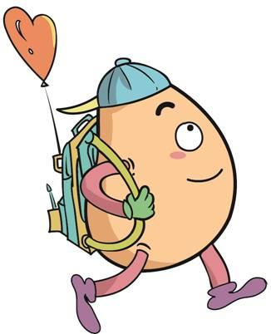





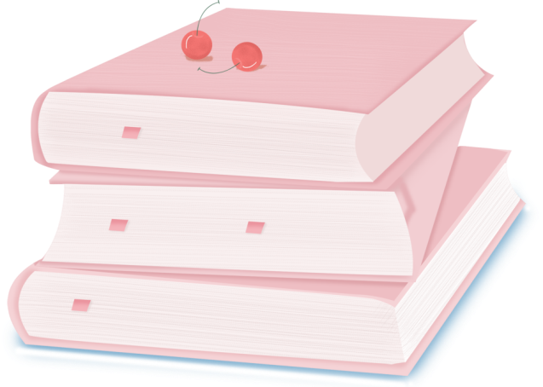
人 教 PEP 版 英 语 五年 级 下 册
Unit 4
When is the art show?
Part A
Let’s learn & Ask and answer

Slide 2

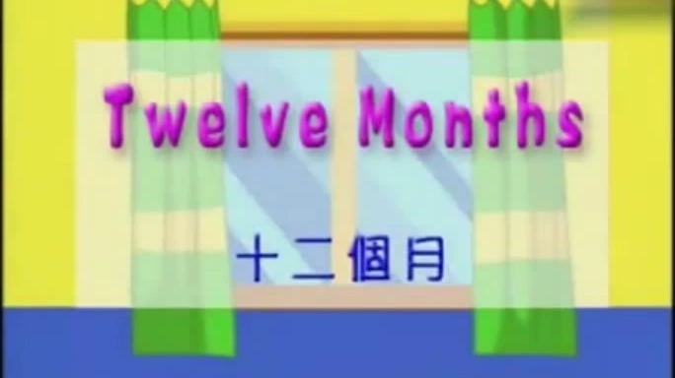
Warm up

Slide 3
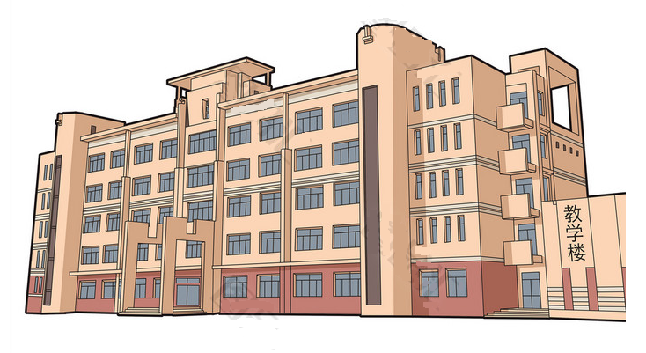
Lead in
This is our school. There are many rooms in the school.

Slide 4

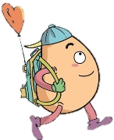


Let’s learn
Learn new words！
Where is the art room?
It’s on the first floor.
first (1st )
第一
art room
拓展：序数词前必须加the。

Slide 5
Where is the computer room?
It’s on the second floor.
second (2nd)
第二
computer room

Slide 6
Where is the teachers’ office?
It’s on the third floor.
third (3rd)
第三
teachers’ office

Slide 7
Where is the music room?
It’s on the fourth floor.
fourth (4th)
第四
music room

Slide 8
Where is the library?
It’s on the fifth floor.
fifth (5th)
第五
library

Slide 9
What can you find out?
six | seven | eight | nine | ten
六 | 七 | 八 | 九 | 十
sixth 6th | seventh 7th | eighth 8th | ninth 9th | tenth 10th
基变序，有规律，1、2、3特殊记，词尾各是t、 d,、d。th要从4加起，8加h, 9去e。

Slide 10

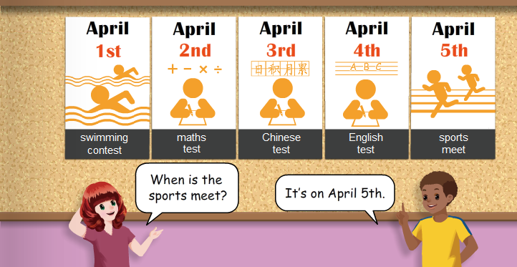
Listen to the tape.

Slide 11
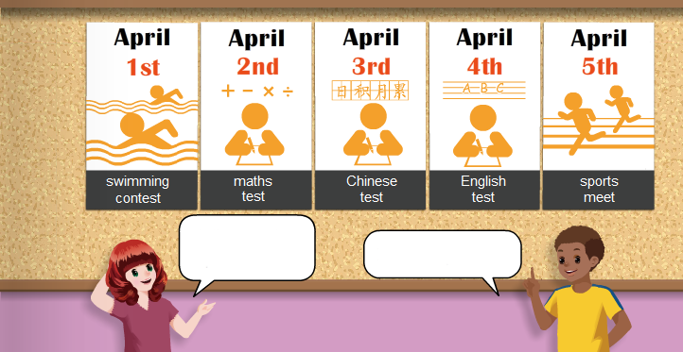
When is the swimming contest?
It’s on April 1st.

Slide 12
When is the maths test?
It’s on April 2nd.

Slide 13
When is the Chinese test?
It’s on April 3rd.

Slide 14
When is the English test?
It’s on April 4th.

Slide 15
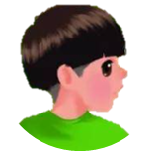



Language point.
基数词变序数词规律
one—first(1st) two—second(2nd)
three—third (3rd) four—fourth(4th)
five—fifth(5th) six—sixth(6th)
seven—seventh(7th) eight—eighth(8th)
nine—ninth(9th) ten—tenth(10th)
eleven—eleventh(11th) twelve—twelfth(12th)

Slide 16

Play a game！
May 1st
May 2nd
May 3rd
May 4th
reading festival
art show
sports meet
Chinese test

Slide 17

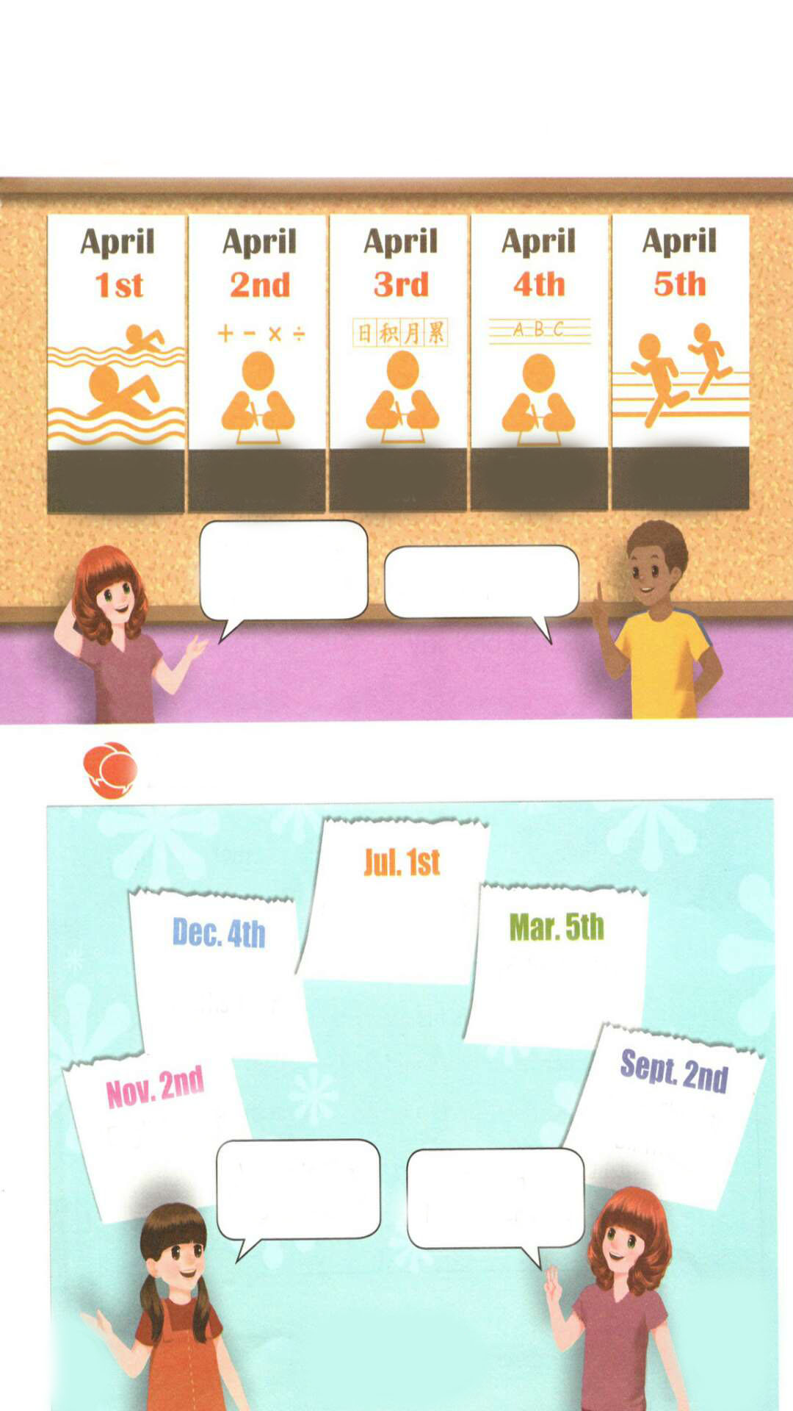
Ask and answer
singing contest
maths test
school trip
English test
Miss Chen’s
birthday
When is the English test?
It’s on November 2nd.

Slide 18
singing contest
maths test
school trip
English test
Miss Chen’s
birthday
When is the maths test?
It’s on December 4th.

Slide 19
singing contest
maths test
school trip
English test
Miss Chen’s
birthday
When is the singing contest?
It’s on July 1st.

Slide 20
singing contest
maths test
school trip
English test
Miss Chen’s
birthday
When is the school trip?
It’s on March 5th.

Slide 21
singing contest
maths test
school trip
English test
Miss Chen’s
birthday
When is the Miss Chen’s birthday?
It’s on September 2nd.

Slide 22

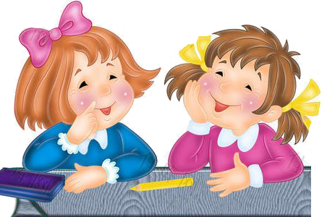
Make up dialogues using the following phrases.
Teachers’ Day
Labour Day
Spring Festival
Mid-Autumn Day
Children’s Day
China’s National Day
When is the_____?
It’s on ____.

Slide 23
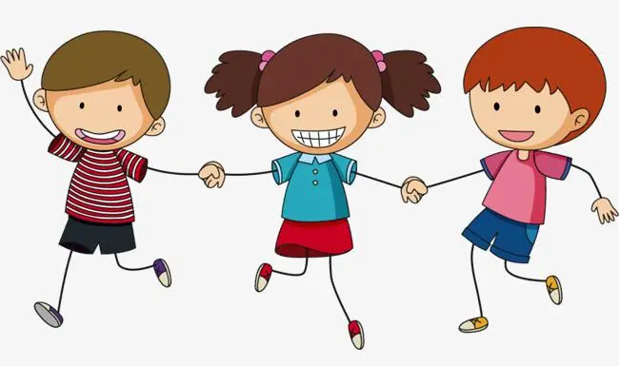
Play a game.
接力表演
三个人一组进行表演，第一个人说某项活动(school trip)，第二个人问”When is ...(the school trip)?”， 第三个人回答”It’s on...(March 5th).”。

Slide 24
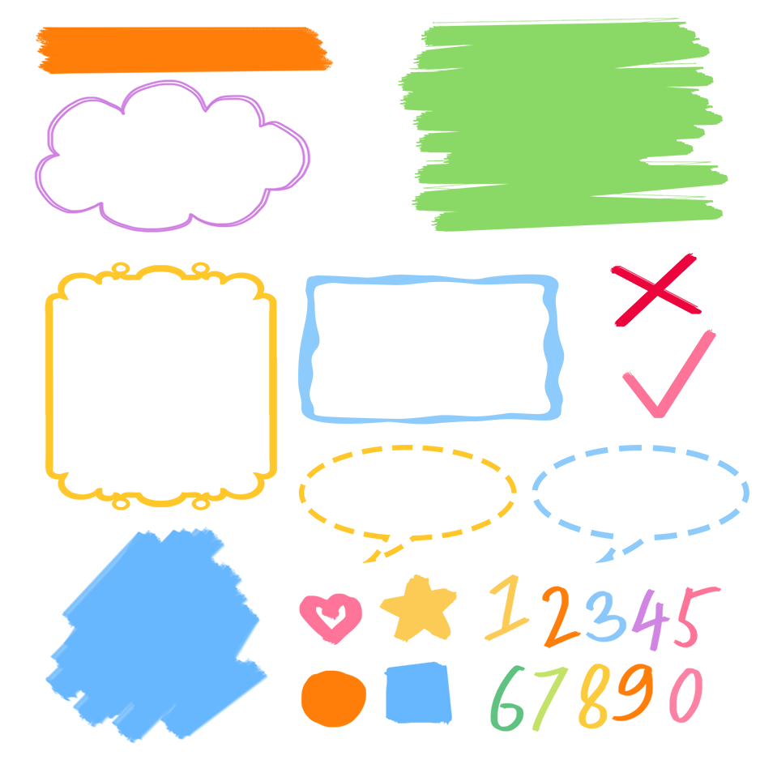
了解1—5序数词及其缩写形式
记忆1—5序数词及其缩写形式
熟练询问并回答活动的具体时间

Slide 25
Good to know
The world’s fastest while the slowest, the longest while the shortest, the most ordinary while the most valuable, the most easily overlooked and the most regrettable is time.
世界上最快而又最慢，最长而又最短，最平凡而又最珍贵，最易被忽视而又最令人后悔的就是时间。

Slide 26
Exercise
一、英汉互译。
1. second________ 2. third________
3. fourth _______ 4. fifth_________
5. first _________ 6. April________
第二
第三
第四
第五
第一
四月

Slide 27
二、单项选择。
( )1.The sports meet is ____ May 5th.
A. on B. in C. at
( )2. —When is Teachers’ Day?
—It’s on _______.
A. Sept. 10th B. Sept. ten C. Aug. 1st
( )3. Today is December _____.
A. 2rd B. 2nd C. 2th
A
A
B

Slide 28
三、按照要求完成句子。
1.China’s National Day is on October 1st.(对画线部分提问)
____________________________________
2.school, when, trip, the, is. (?)(连词成句)
___________________________________
3. Day, January, on, New Year’s, 1st, is.(.)(连词成句)
___________________________________
When is China’s National Day?
When is the school trip?
New Year’s Day is on January 1st.

Slide 29

Summary
学习了下列单词： first, second, third, fourth, fifth等
2.学习了以下句型：
—When is …?
—It’s on …

Slide 30
Homework
ONE
TWO
Say and do the actions in pairs.
Make up a short dialogue using the sentences we have learnt.

Slide 31







