Slide 1







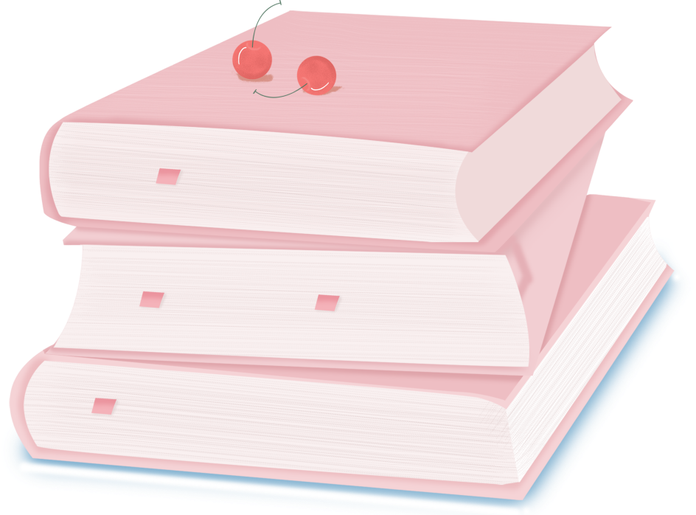

人 教 PEP 版 英 语 五 年 级 下 册
Unit 4
When is the art show?
Part A
Let’s learn & Ask and answer

Slide 2

Warm up
Let’s chant.
You have one, I have one
You have one, I have one. Two little children see the sun/say goodbye to mum.
You have two, I have two. Four little children go to school.
You have three, I have three. Six little children pick many apples.
You have four, I have four. Eight little children go swimming.
You have five, I have five. Ten little children go to the library.

Slide 3
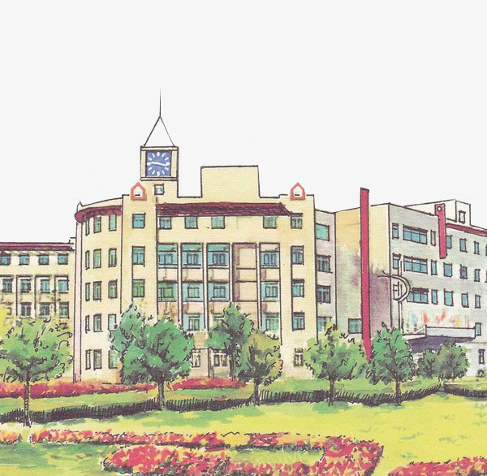

Lead in
Look at this school. It’s very nice. There are many rooms in the school.

Slide 4
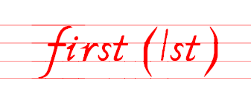

Presentation
Let’s learn
Where is the art room?
It’s on the first floor.
第一
art room

Slide 5

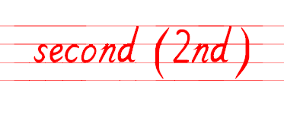
Where is the computer room?
It’s on the second floor.
第二
computer
room

Slide 6
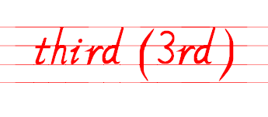
Where is the teachers’ office?
It’s on the third floor.
teachers’
office
第三

Slide 7
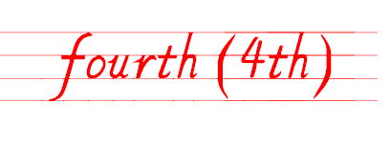
Where is the music room?
It’s on the fourth floor.
music room
第四

Slide 8
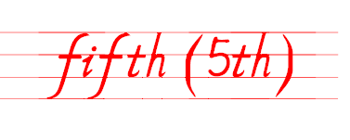
Where is the library?
It’s on the fifth floor.
library
第五

Slide 9
What can you find out?
six | seven | eight | nine | ten
六 | 七 | 八 | 九 | 十
sixth 6th | seventh 7th | eighth 8th | ninth 9th | tenth 10th
基变序，有规律，123特殊记，词尾各是t, d, d。
th，要从4加起，8加h, 9去e。

Slide 10
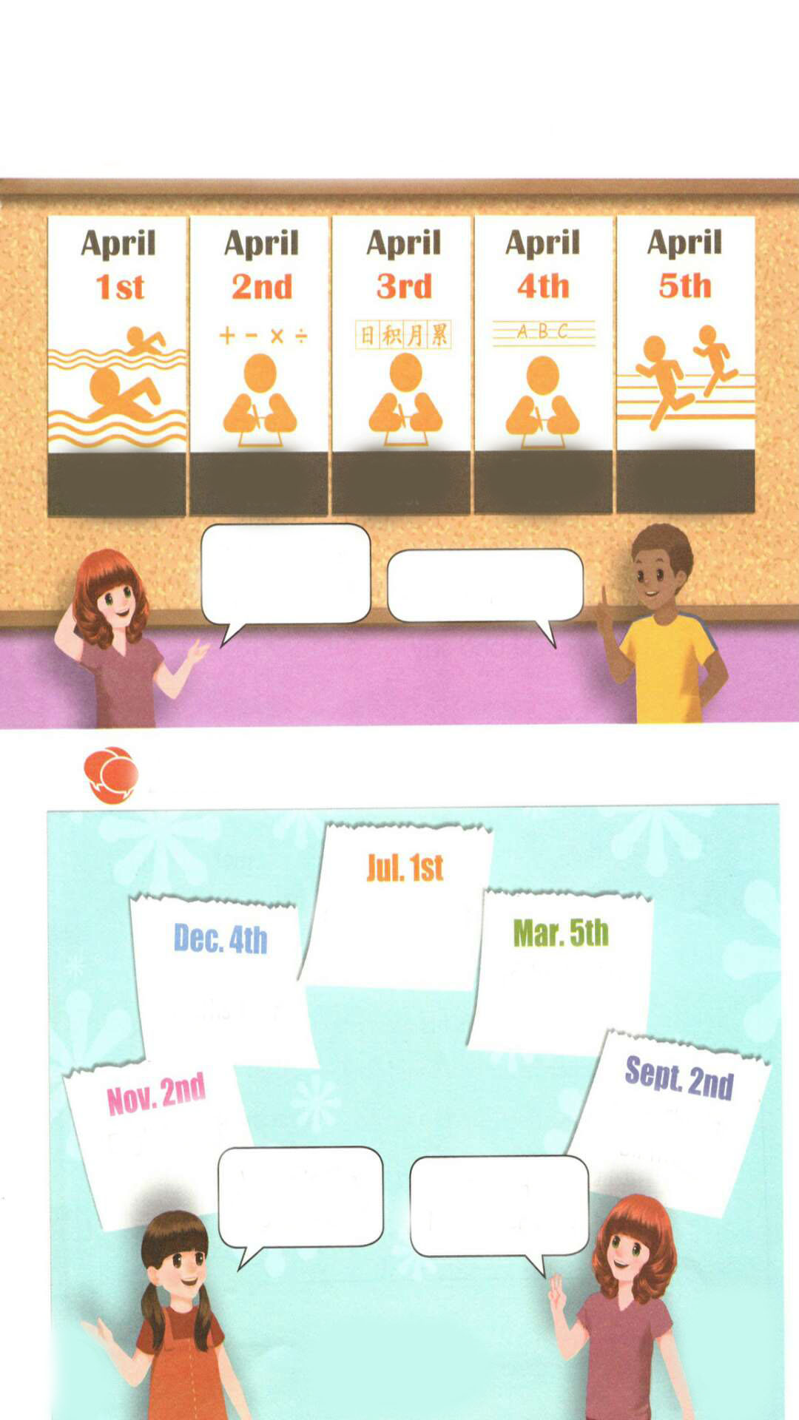
Read after the tape.
swimming
contest
maths
test
Chinese
test
English
test
sports
meet
When is the
sports meet?
It’s on April 5th.

Slide 11
Act out.
swimming
contest
maths
test
Chinese
test
English
test
sports
meet
When is the
…?
It’s on ….

Slide 12
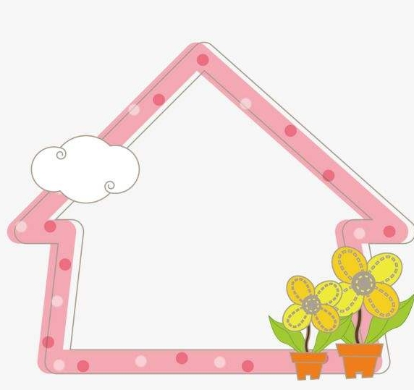
Play a game.
May 1st
May 2nd
May 3rd
May 4th
reading festival
art show
sports meet
Chinese test

Slide 13
Practice
Ask and answer
singing contest
maths test
school trip
English test
Miss Chen’s
birthday
When is the English test?
It’s on November 2nd.

Slide 14
I want to know
4月份的节日：
1.国际儿童图书日-International Children's Book Day
2.愚人节-April Fool's Day或April Fools' Day
3.清明节-Tomb-Sweeping Day
4.世界地球日-Earth Day
5.世界卫生日-World Health Day

Slide 15

Exercises
一、译成汉语。
1. second________ 2. third________
3. fourth _______ 4. fifth_________
5. first _________ 6. April________
第二
第三
第四
第五
第一
四月

Slide 16
二、单项选择。
( )1. Today is May_____.
A. 3rd B. 3th C. 1nd
( )2.—When is Teachers’ Day?
—___________
A. Sept. 10th B. Sept. ten C. Aug. 1st
( )3. The sports meet is _____ April 8th.
A. in B. on C. at
A
A
B

Slide 17
三、连词成句。
is When test the English ( ? )
__________________________
2. 5th on April It’s( . )
__________________________
3. season Which you do best like( ? )
__________________________
When is the English test?
It’s on April 5th.
Which season do you like best?

Slide 18


Summary
学习了下列单词： first, second, third, fourth, fifth等。
2.学习了以下句型：
—When is …?
—It’s on …
七彩课堂
伴你成长

Slide 19

Homework
ONE
TWO
Say and do the actions in pairs.
Make a short dialogue using the sentences we have learnt.
七彩课堂
伴你成长

Slide 20








