Slide 1


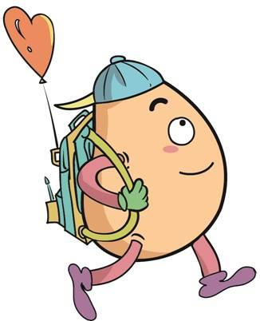





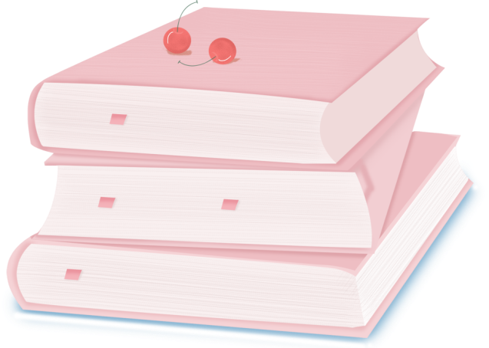
人 教 PEP 版 英 语 五年 级 下 册
Unit 4
When is the art show?
Part A
Let’s spell

Slide 2
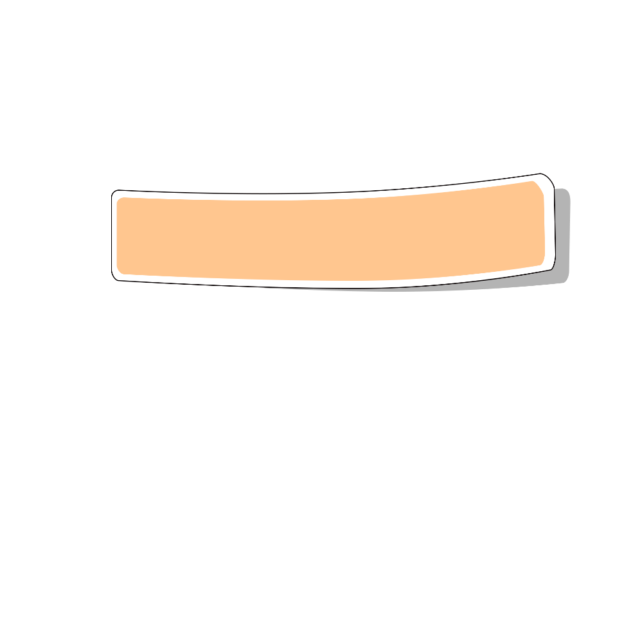
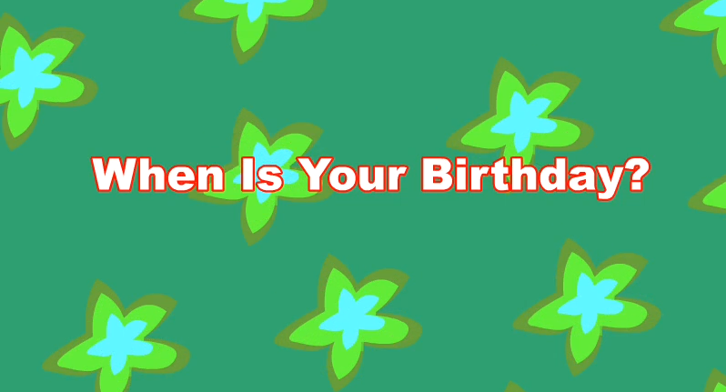
Warm up

Slide 3
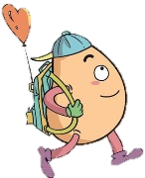
Lead in
Let’s read.
Beth, Beth. Go to the study. Beth likes to learn maths.
Beth, Beth. Go to the bathroom. Beth likes to take a bath.
Beth, Beth. Go to the kitchen. Beth likes to eat cake. Ah! A big mouth!

Slide 4
Presentation
How to spell th?
学习th 在单词中发/θ/的规则
学习 th在单词中发/ð/的规则
学习th /θ/ & /ð/的发音要领

Slide 5


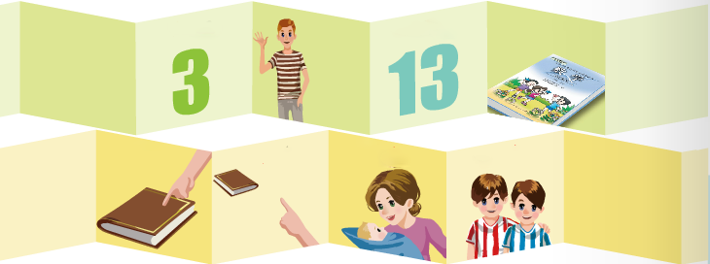
Let’s spell
Listen and read.
/θ/
three
thirteen
thin
maths
this
that
mother
brother
/ð/

Slide 6
Read the words.
three /θriː/

Slide 7
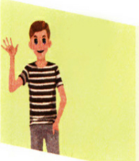
thin /θɪn/

Slide 8
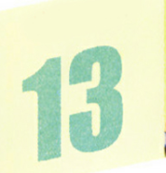
thirteen
/ˌθɜːˈtiːn/

Slide 9
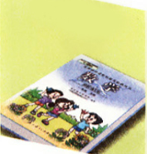
maths /mæθs/

Slide 10
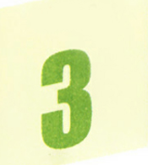
three
thin
thirteen
maths
th
/θ/

Slide 11
Let’s read！
fourth
thousand
Thursday
nothing
south
theatre
breath
both
worth

Slide 12
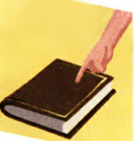
Read the words.
this /ðɪs/

Slide 13
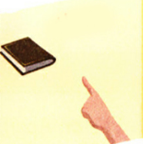
that /ðæt/

Slide 14
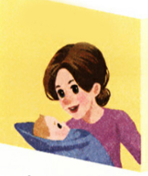
mother
/ˈmʌðə(r)/

Slide 15
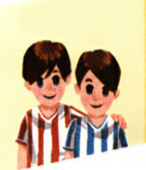
brother
/ˈbrʌðə(r)/

Slide 16
this
that
mother
brother
th
/ð/

Slide 17
Let’s read！
than
those
breathe
though
these
their
with
smooth
then

Slide 18
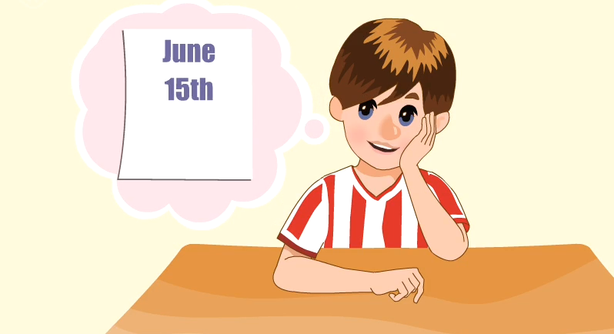
Let’s chant.

Slide 19
Let’s chant together.
My birthday is in three more days, three more days, three more days.
My birthday is in three more days. I will be thirteen.
My brother has a birthday, too, a birthday, too, a birthday, too.
He has a birthday on the 3rd of the month. What about you?

Slide 20
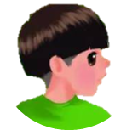
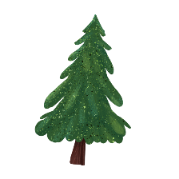


Language point.
th的发音规则
字母组合th发/ θ /的音
音标特征:舌尖齿背摩擦清辅音。发音要诀:舌尖轻触上齿背,气流由舌齿间窄缝泄出,摩擦成音。声带不振动,属于清辅音。代表单词:think, teeth, thin, thank。

Slide 21
Language point.
th的发音规则
字母组合th发/ ð /的音
音标特征:舌尖齿背摩擦浊辅音。发音要诀:舌尖轻触上齿背,气流由舌齿间窄缝泄出,摩擦成音。声带振动,属于浊辅音。代表单词:this, that, these, those。

Slide 22
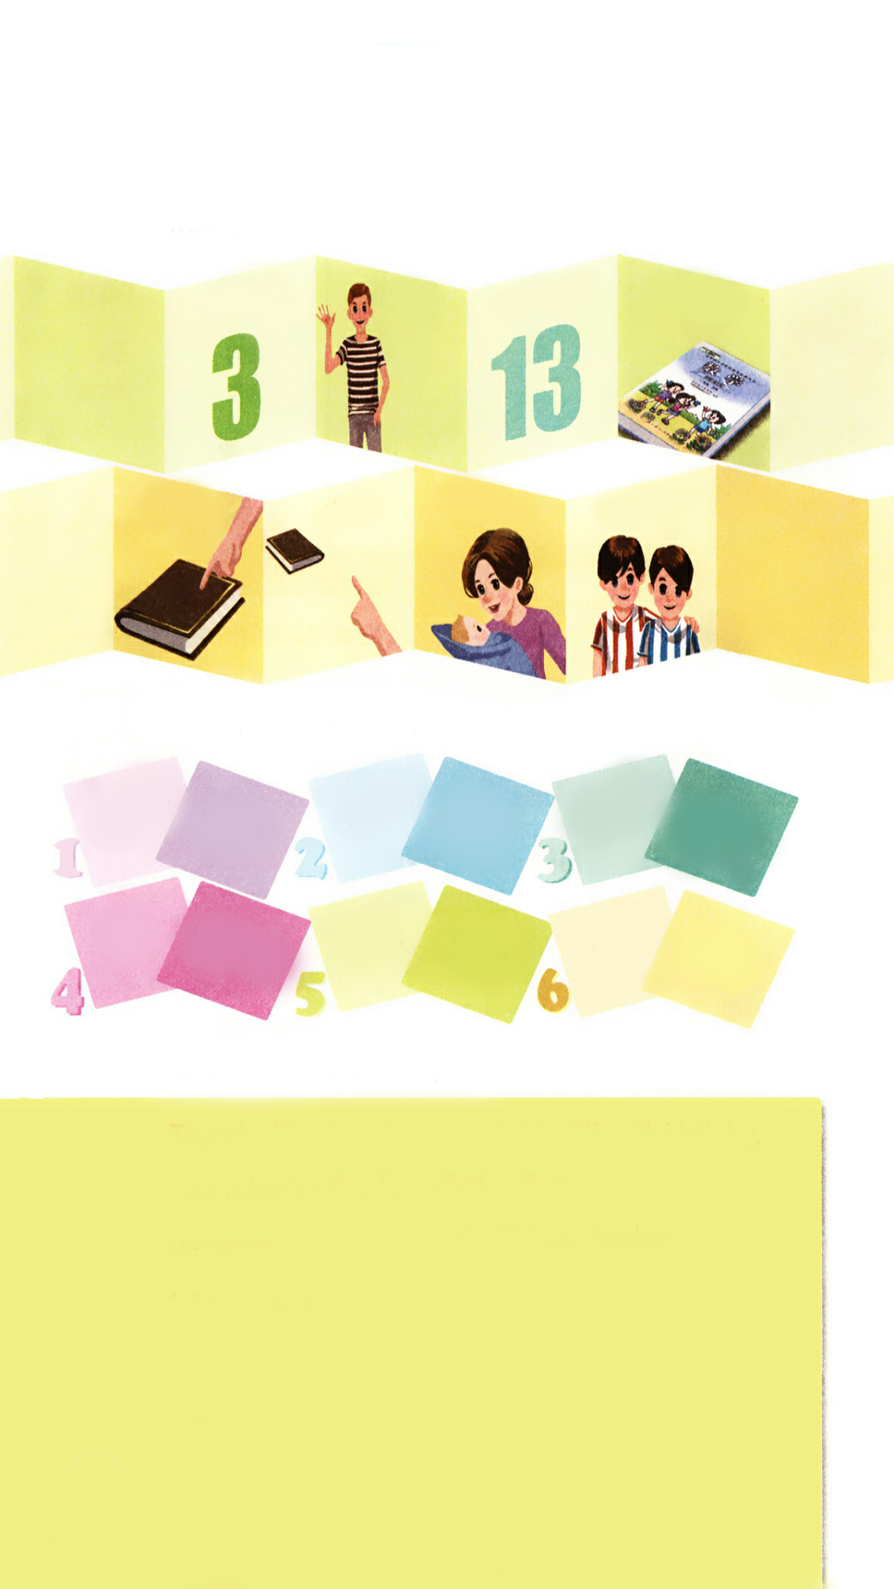
Listen, circle and say.
点击画面 播放视频
mother
brother
father
maths
thin
fifth
this
that
there
birthday
three
third

Slide 23
Choose, write and say.
Thursday/ Monday is his eleventh/ third/ fourth birthday.
That is her brother/ grandfather/ father.
His mother/ brother is a maths/ Chinese teacher.
Thursday is his eleventh birthday.
2.
3.
That is her brother.
His mother is a Chinese teacher.

Slide 24
Play a game.
Let’s make beautiful flowers.
the
this
that
thin
/ð/
mother
bath
/θ/
mouth
maths
path
father

Slide 25
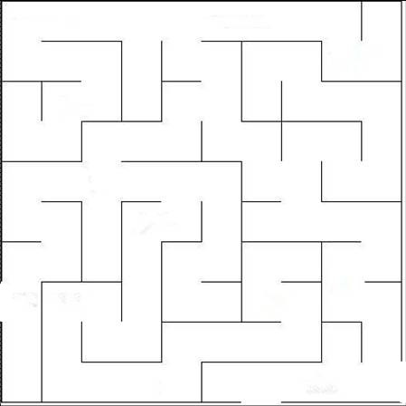
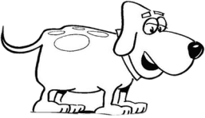
Play a game.
thousand
brother
mother
this
thirteen
thin
that
maths
three
these
Thursday
with
smooth

Slide 26
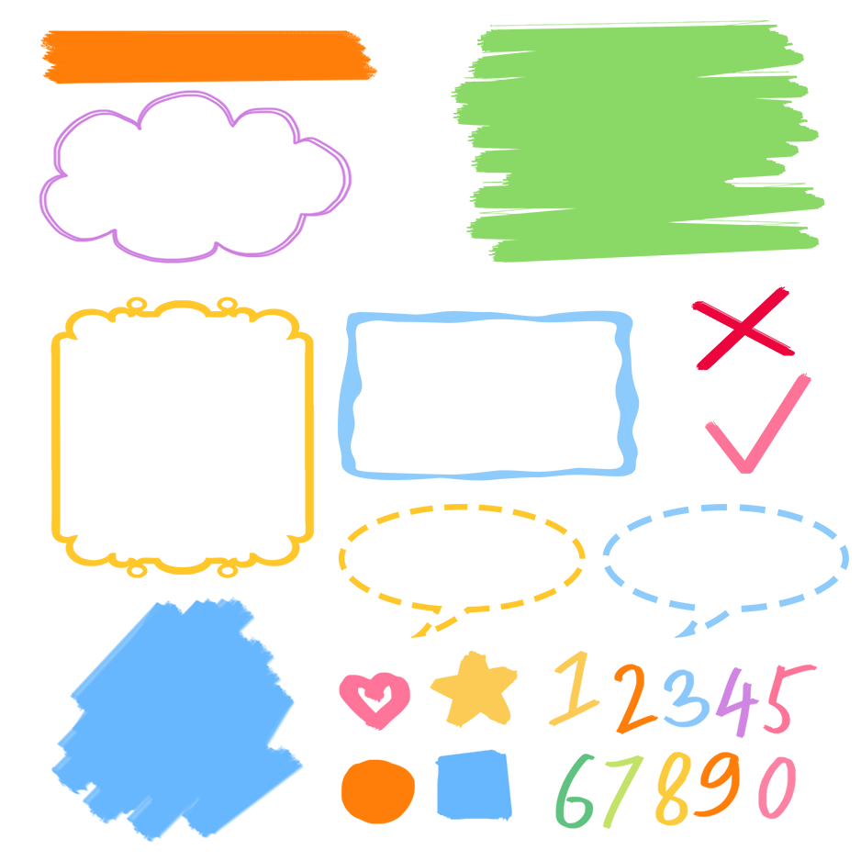
了解th的发音规则
记忆th的发音规则
根据发音规则读出生词

Slide 27
Exercises
一、英译汉。
三
妈妈
1. three___________ 2. mother___________
3. brother_________ 4. that ____________
5. father _________ 6. fifth_____________
兄弟
那个
爸爸
第五

Slide 28
二、找出下列单词中字母组合th发音不同的单词。
( )1. A. three B. thousand C. both D. these
( )2. A. breath B. breathe C. though D. thank
( )3. A. worth B. south C. fourth D. that
( )4. A. nothing B. with C. theatre D. thank
D
B
D
B

Slide 29

Summary
学习了字母组合th的发音规则。
字母/字母组合
发音
词语
three thin
thirteen maths
-th-
/θ/
-th-
/ð/
this that
mother brother

Slide 30
Homework
ONE
TWO
Read the words.
Make sentences using the words we have learnt.
Collect words with “/θ/” or “/ð/”.

Slide 31
