Slide 1







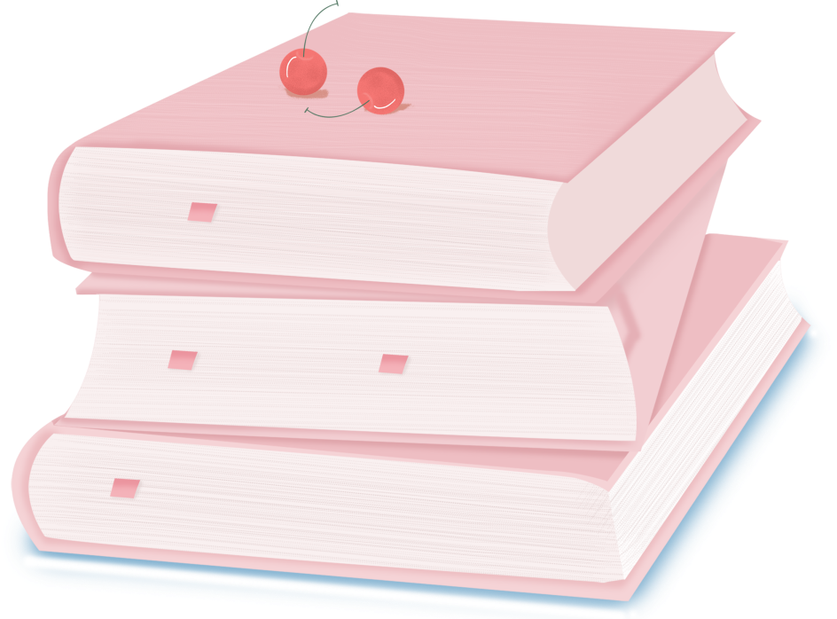

人 教 PEP 版 英 语 五 年 级 下 册
Unit 4
When is the art show?
Part A
Let’s spell

Slide 2

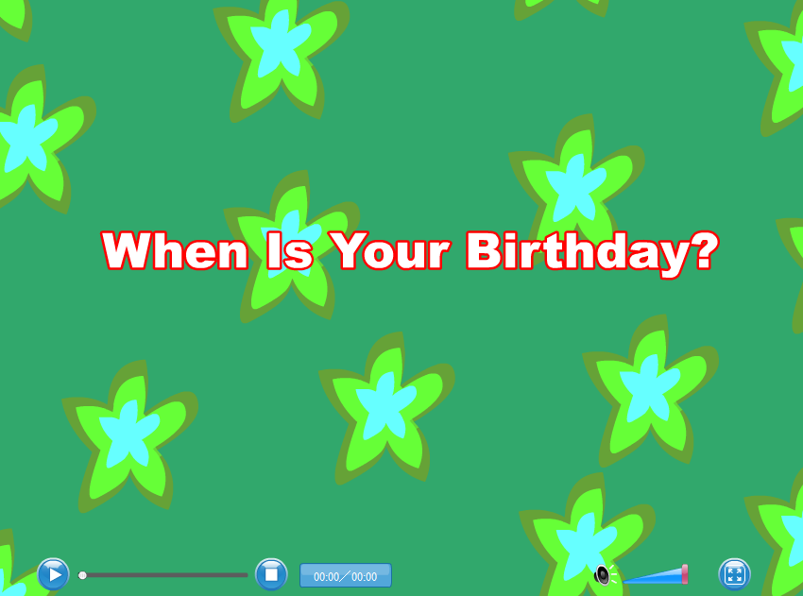
Warm up
Let’s sing.
点击画面 播放视频

Slide 3

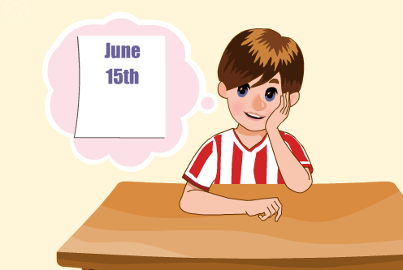
Lead in
Let’s chant.
点击画面 播放视频
点击画面 播放视频

Slide 4

Presentation
Listen again and answer the question.
When is my brother’s birthday?
His birthday is on the third of the month.
the
th
/ð/
brother

Slide 5

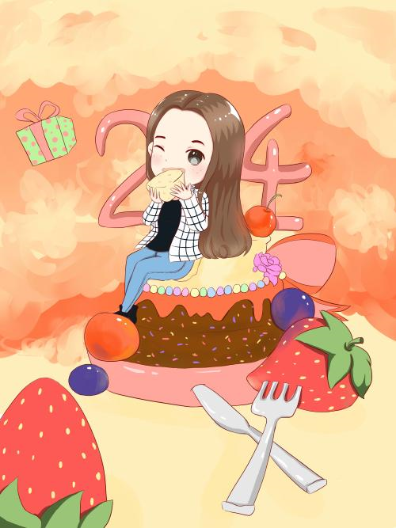
December 5th
Do you want to know my birthday?
My birthday is on December 5th. It’s in three more days.
birthday
th
/θ/
three

Slide 6
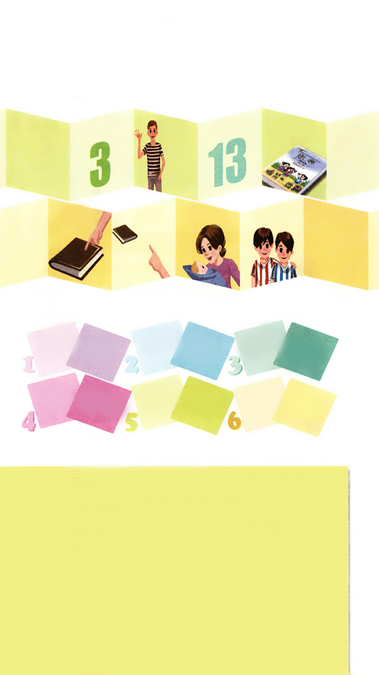
Listen and read.
点击画面 播放视频
thin
thirteen
maths
three
mother
brother
this
that

Slide 7
知识要点：
点击画面 播放视频
1. 发音组合 th 发/ θ /的音。 音标特征:舌尖齿背摩擦清辅音。发音要诀:舌尖轻触上齿背,气流由舌齿间窄缝泄出,摩擦成音。声带不振动,属于清辅音。代表单词:think, teeth, thin, thank。

Slide 8
2. 发音组合 th 发/ð/的音。 音标特征:舌尖齿背摩擦浊辅音。 发音要诀:舌尖轻触上齿背,气流由舌齿间窄缝泄出,摩擦成音。声带振动,属于浊辅音。代表单词:this, that, these, those,。
点击画面 播放视频

Slide 9
Can you read more?
sixth ninth path
thin thick leather
thumb weather feather
Beth moth fifth

Slide 10
Let’s chant together.
Beth, Beth. Go to the study. Beth likes to learn maths.
Beth, Beth. Go to the bathroom. Beth likes to take a bath.
Beth, Beth. Go to the kitchen. Beth likes to eat cake. Ah! A big moth!

Slide 11
Listen, circle and say.
点击画面 播放视频
mother
brother
father
maths
thin
fifth
this
birthday
there
that
three
third

Slide 12
Choose, write and say.
Thursday/ Monday is his eleventh/ third/ fourth birthday.
That is her brother/ grandfather/ father.
His mother/ brother is a maths/ Chinese teacher.
Thursday is his eleventh birthday.
2.
3.

Slide 13
Practice
Passing Words.
将全班分成八个人一组，每个小组排成一个长队，请第一位学生选其中一个词，小声告诉下一位学生，如此这样，直到小声传到本队的最后一名学生时，就请这位最后的学生大声说出他所听到的单词，然后请第一名学生也大声说出自己刚一开始传给第二名学生的单词，这样就可以判断出他们一组，每个组员是否都传递了正确的读音。
Three; thin; thirteen; maths; this; that;
mother; brother

Slide 14
Let’s make beautiful flowers.
that
thin
the
this
mother
bath
/ð/
/θ/
moth
maths
path
father

Slide 15

Exercises
一、英译汉。
三
妈妈
1. three___________ 2. mother___________
3. brother_________ 4. that ____________
5. father _________ 6. fifth_____________
兄弟
那个
爸爸
第五

Slide 16
二、连词成句
brother That her is (.)
______________________________
2. mother His maths a is teacher (.)
______________________________
3. English When the is test (?)
______________________________
That is her brother.
His mother is a maths teacher.
When is the English test?

Slide 17
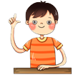
三、判断下列每组单词画线部分发音是“T”否“F”相同。
three
father
this
that
thin
third
brother
fifth
F
T
T
F

Slide 18


Summary
字母/字母组合
发音
词语
three thin
thirteen maths
-th-
[θ]
七彩课堂
伴你成长
-th-
[ð]
this that
mother brother

Slide 19

Homework
ONE
TWO
Read the words.
Make sentences using the words we have learnt.
七彩课堂
伴你成长
Collect words with “/θ/” and “/ð/”.

Slide 20

