Slide 1


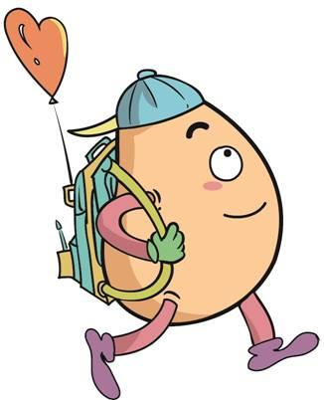

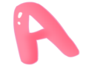




人 教 PEP 版 英 语 五年 级 下 册
Unit 4
When is the art show?
Part A
Let’s try & Let’s talk

Slide 2

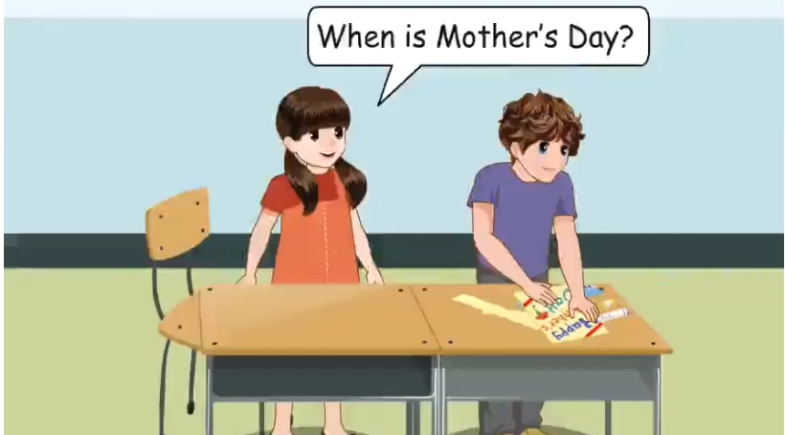
Warm up

Slide 3
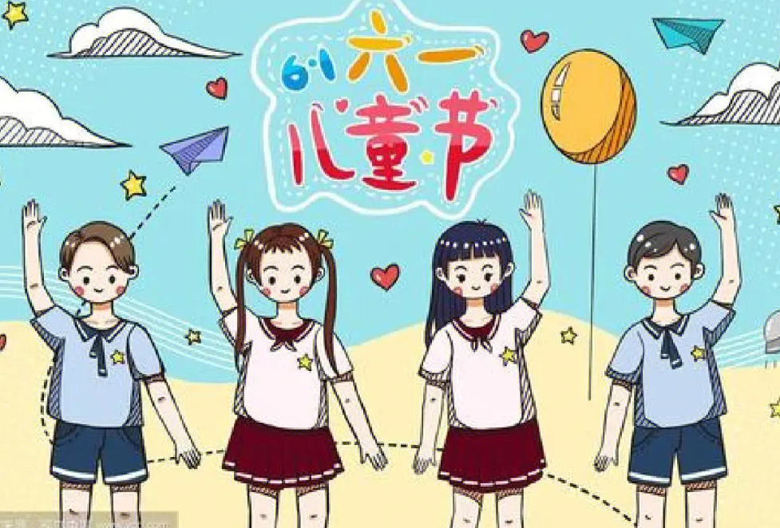
Lead in
What’s your favourite month?Why?
My favourite month is June.Because I like Children’s Day.

Slide 4
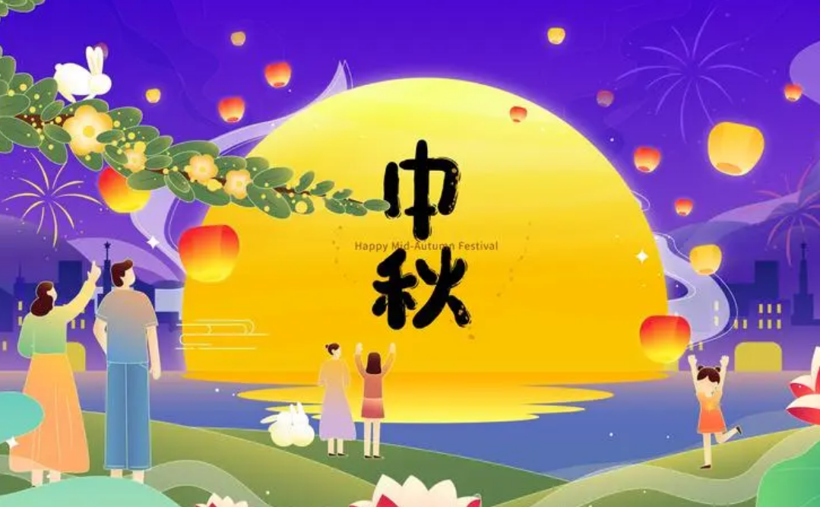
What’s your favourite month?Why?
My favourite month is August.Beacuse I like Mid-Autumn Festival.

Slide 5
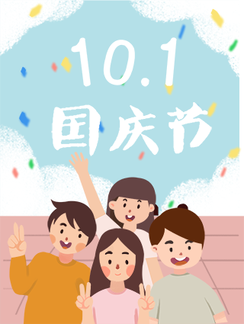
What’s your favourite month?
Why?
My favourite month is October.Because I like China’s National Day.

Slide 6
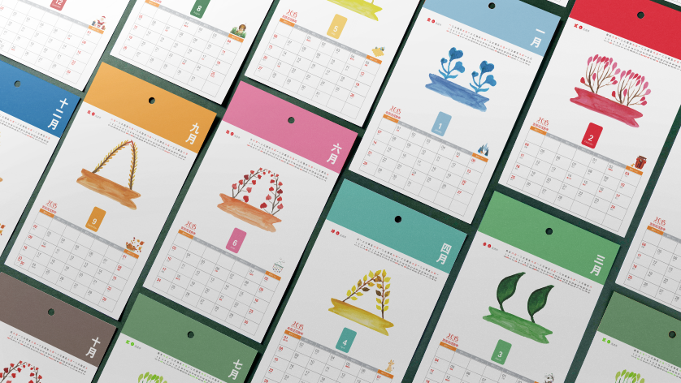
What’s your favourite month?

Slide 7
Presentation
Talk about the months.
Mr Jones and Zhang Peng talk about the months.
Mr Jones and Zhang Peng talk about the special days in May.
Chen Jie and Wu Binbin talk about the holidays.

Slide 8
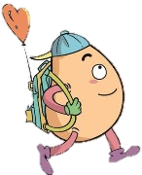


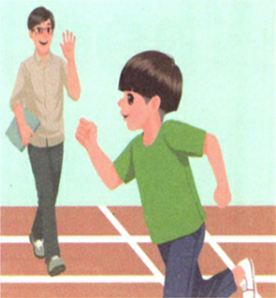
Listen and tick.
Let’s try
Which month are they talking about?
March.
√
April.
September.
February.

Slide 9
Let’s check！
Mr Jones: When is the sports meet, Zhang Peng?
Zhang Peng: It’s on April 4 th.
Mr Jones: It’s next Friday, then. Good luck.
Zhang Peng:Thanks!
They are talking about April.

Slide 10
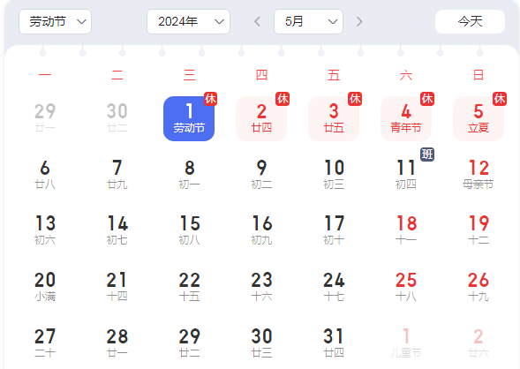
Ask and answer.
There are some special days in May. What are they?
Labour Day and Mother’s day.
When is Labour Day?
It is on May 1st.
When is Mother’s Day in 2024?
It is on May 12th.

Slide 11

Let’s talk
Watch and answer！
What are the special days in May?
2. When is the art show?
3. When is the reading festival?

Slide 12
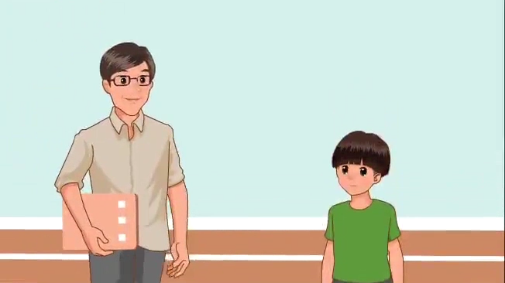

Slide 13
What are the special days in May?
2. When is the art show?
3. When is the reading festival?
The school art show and the reading festival.
It’s on May 1st.
It’s on May 5th.

Slide 14

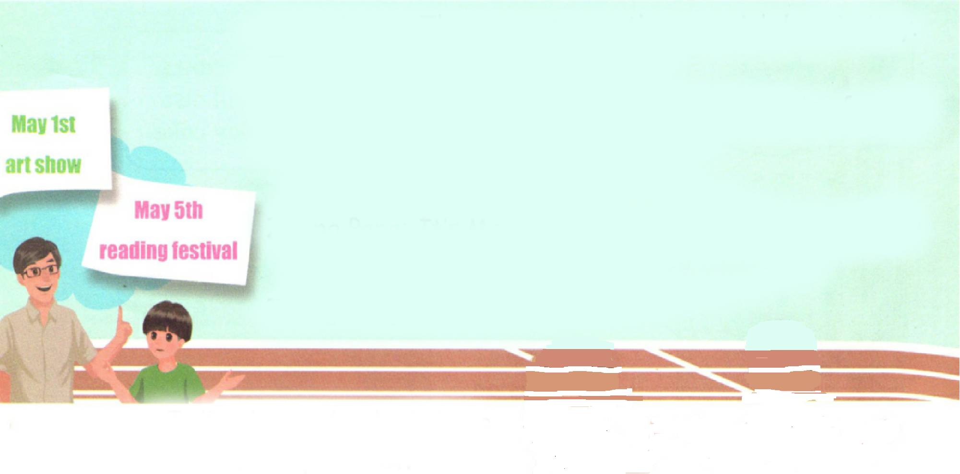
Listen to the tape and read after it.
Mr Jones: There are some other special days in May.
Zhang Peng: What are they?
Mr Jones: The school art show and the reading festival.
Zhang Peng: When is the art show?
Mr Jones: It’s on May 1st.
Zhang Peng: It’s Labour Day.When is the reading festival?
Mr Jones: It’s on May 5th.
Zhang Peng: Wow! May is fun!

Slide 15

Read and act.
1.Read it together.
2.Each student
reads a sentence.
Tip: Choose one to read in two. 选择一种两人练习。
3. Read in roles.
分角色朗读。

Slide 16
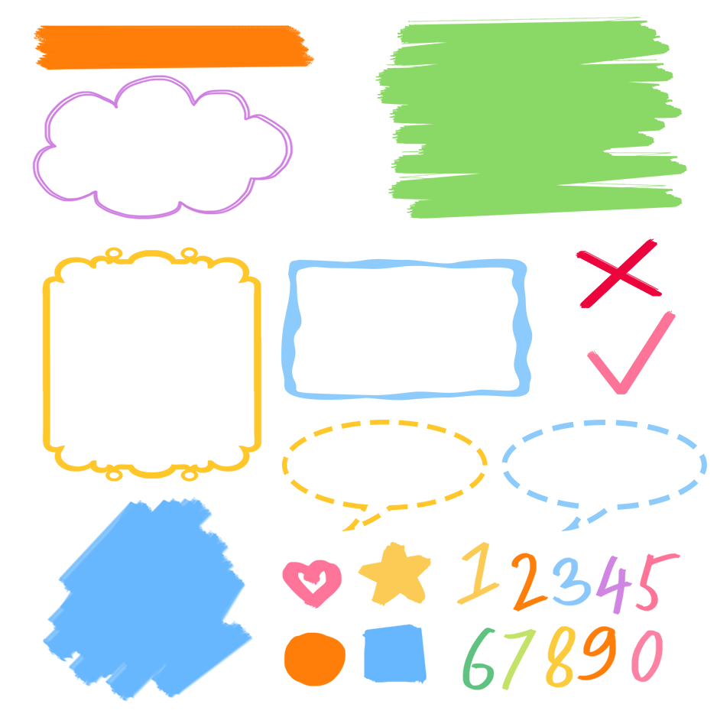
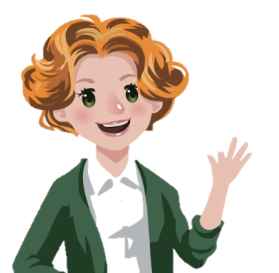
流利地朗读
流利地表演
有感情地表演

Slide 17
Listen and repeat.
其他
特殊的
Mr Jones: There are some other special days in May.
Zhang Peng: What are they?
Mr Jones: The school art show and the reading festival.
Zhang Peng: When is the art show?
Mr Jones: It’s on May 1st.
Zhang Peng: It’s Labour Day.When is the reading festival?
Mr Jones: It’s on May 5th.
Zhang Peng: Wow! May is fun!
展览
询问和回答某个活动的日期
五月一日。在具体某一天前用介词on

Slide 18
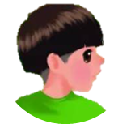



Language point.
什么时候
When
— When is the art show?
— It’s on May 1st.
询问及回答某个活动的日期
句型：
When + be动词 + 活动名称?
回答: It‘s on + 具体年月日.
—When is Children’s Day? —It’s on June 1st.
—When is New Year’s Day? —It’s on January 1st.

Slide 19
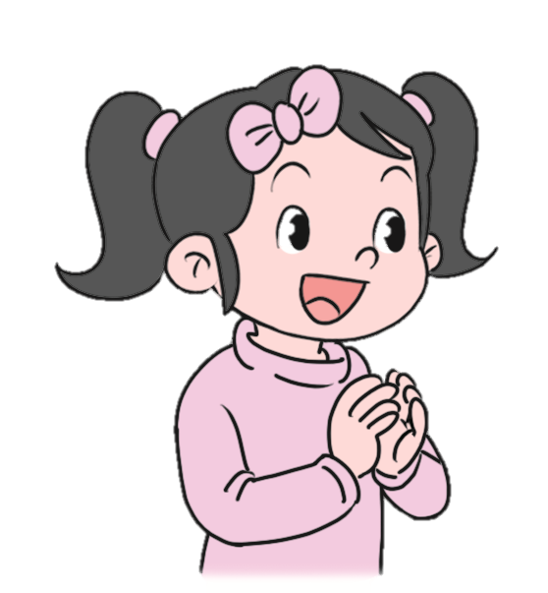
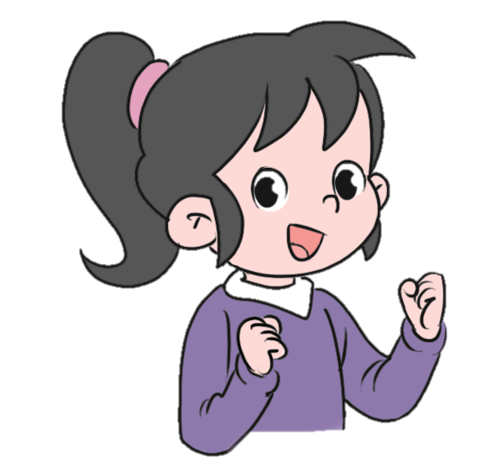
Let’s practice.
When is Children’s Day?
It’s on June 1st.
When is China’s National Day?
It’s on October 1st.

Slide 20
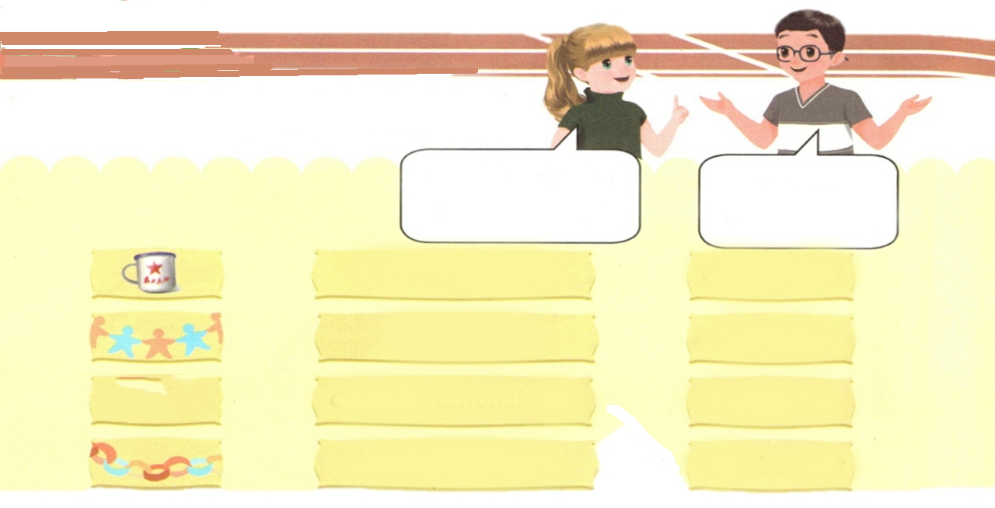
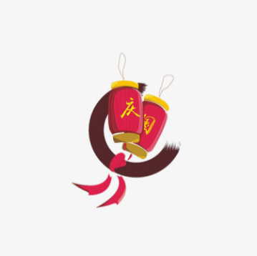
Role play.
Talk about the holidays with your partner.
When is China’s National Day?
It’s on October 1st.
Children’s Day
January 1st
Labour Day
May 1st
China’s National Day
June 1st
New Year’s Day
October 1st

Slide 21
Let’s think.
There are some special days in a year. Please talk about the holidays with your partner.
A: Which holiday do you like best?
B: I like Children’s Day.
A: When is Children’s Day?
B: It’s on June 1st.

Slide 22
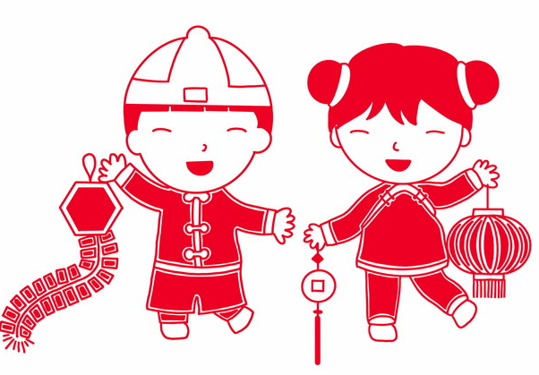
A: Which holiday do you like best?
B: I like _______.
A: When is ______?
B: It’s on ________.

Slide 23
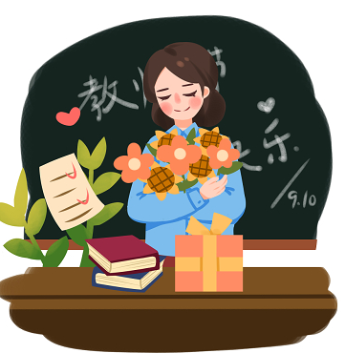
A: Which holiday do you like best?
B: I like _______.
A: When is ______?
B: It’s on ________.

Slide 24
A: Which holiday do you like best?
B: I like _______.
A: When is ______?
B: It’s on ________.

Slide 25

Good to know
The years can take away your rights of Christmas, but don’t go with you a childlike innocence forever!
岁月能带走你过节的权利，却带不走你一颗永远的童心！

Slide 26

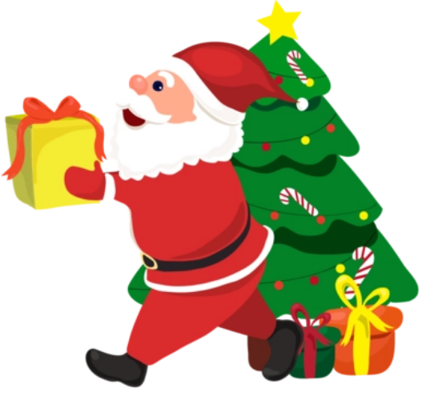
Exercises
一、图文配对。
Teachers’ Day
China’s National Day
New Year’s Day
Christmas Day

Slide 27
二、按照要求完成句子。
1.Christmas Day is on December 25th.(对画线部分提问)
____________________________________
2.There are some special days in April.(变为一般疑问句)
___________________________________
3.Day, is, National, when, China’s (?) (连词成句)
_____________________________
When is Christmas Day?
Are there any special days in April?
When is China’s National Day?

Slide 28

Summary
1.学习了下列单词：
other, special, festival等
2.学习了下列句型：
—When is …?
— It’s on…

Slide 29
Homework
ONE
TWO
Act the dialogue out with your friends.
Make up a short dialogue using the sentences we have learnt.
Investigate Chinese culture.

Slide 30



