Slide 1









人 教 PEP 版 英 语 五 年 级 下 册
Unit 4
When is the art show?
Part A
Let’s try & Let’s talk

Slide 2

Warm up
Let’s sing
The twelve months
Apples, peaches, pears and plums,
Tell me when your birthday comes.
January, February, March, April,
May, June, July, August,
September, October, November, December.
Please tell me when it’s your birthday.

Slide 3

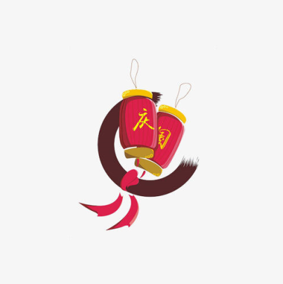

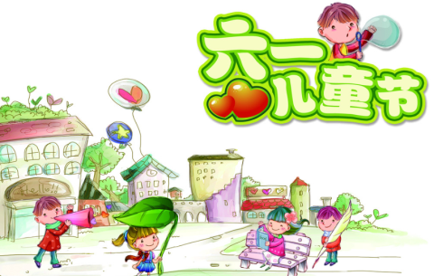
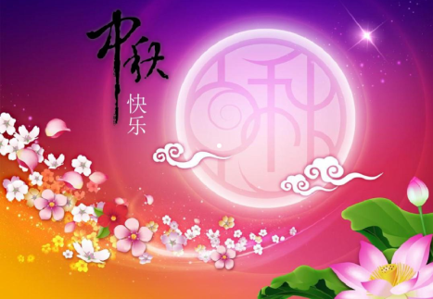
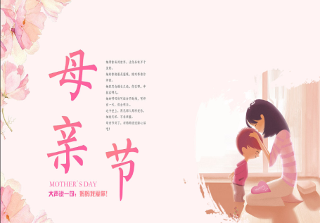
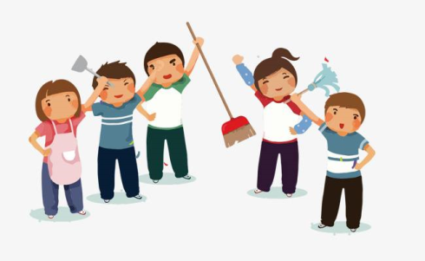
Match the words together with the pictures.
Mother’s Day
May Day
Children’s Day
Mid-Autumn Day
China’s National Day
American Thanksgiving Day

Slide 4

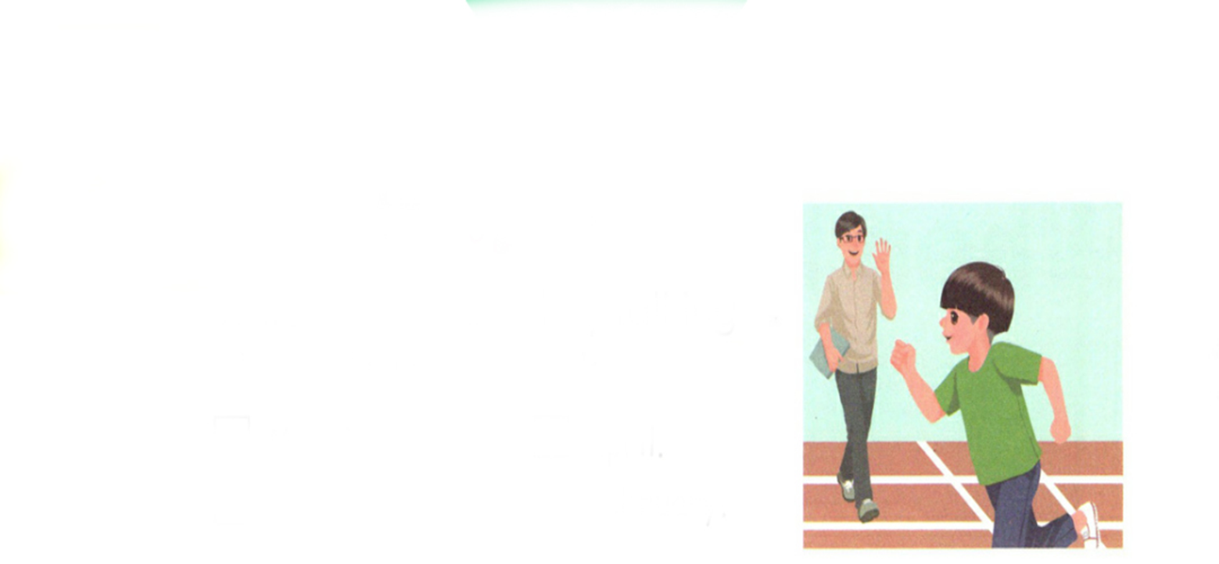
Lead in
Where is Zhang Peng?
He is on the playground.
What is he doing?
He is running.

Slide 5

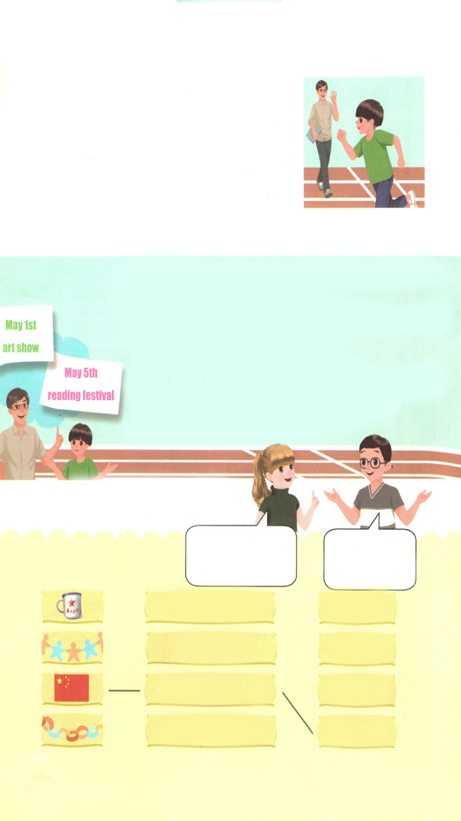
Presentation
Let’s try
Zhang Peng is practising running. Mr Jones is talking to him. Which month are they talking about? Listen and tick.
March.
√
April.
September.
February.

Slide 6
听力材料：
When is the sports meet, Zhang Peng?
It’s on April 4 th.
It’s next Friday, then. Good luck.
Thanks!
Mr Jones:
Zhang Peng:
Mr Jones:
Zhang Peng:

Slide 7
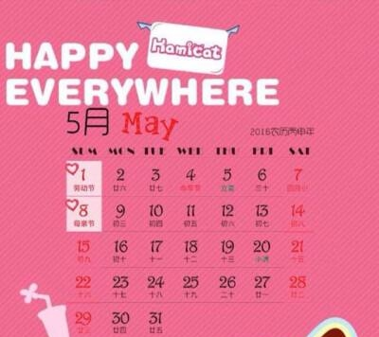
Let’s talk
There are some special days in May. What are they?
May Day and Mother’s Day.
When is May Day?
May Day is on May 1 st.
When is Mother’s Day?
It is on the second Sunday in May.

Slide 8
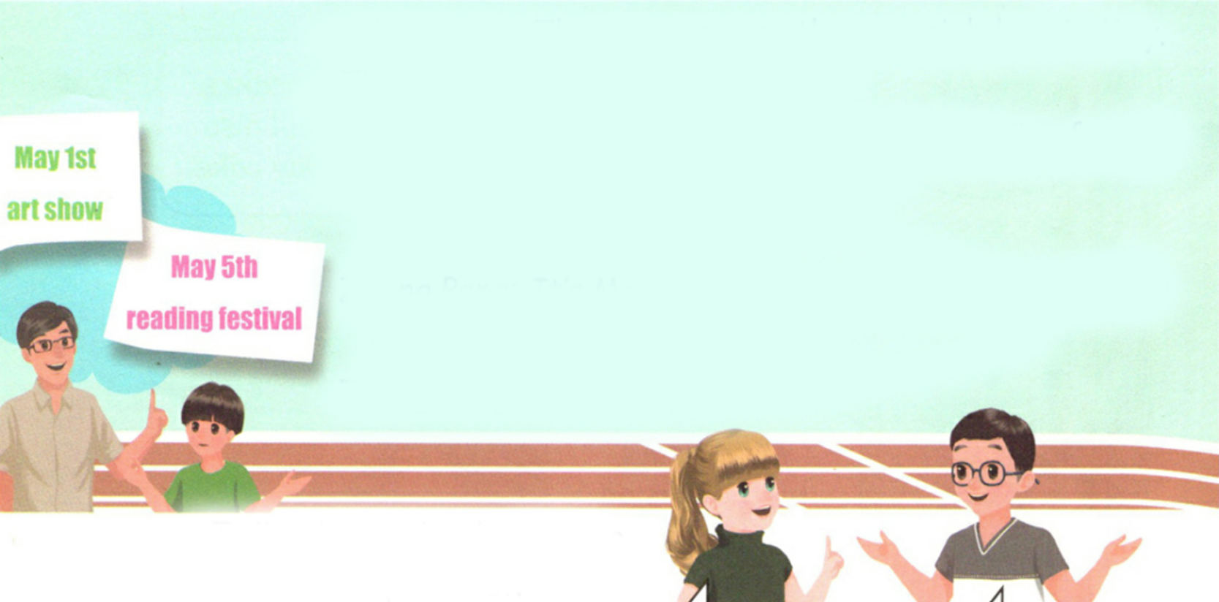
There are some other special days in May. Listen and answer the question.
What are the special days?
The school art show and the reading festival.

Slide 9
Listen again and answer.
When is the art show?
It’s on May 1st.
When is the reading festival?
It’s on May 5th.

Slide 10
Listen and read.
其他
特殊的；特别的
Mr Jones:
Zhang Peng:
Mr Jones:
Zhang Peng:
Mr Jones:
Zhang Peng:
Mr Jones:
Zhang Peng:
There are some other special days in May.
What are they?
The school art show and the reading festival.
When is the art show?
It’s on May 1st.
It’s May Day. When is the reading festival?
It’s on May 5th.
Wow! May is fun!
展览
节日

Slide 11
Language point
—When is the art show?
—It’s on May 1st.
【详解】这组对话用来询问和回答某个活动的日期。
句型结构: When + be动词 + 活动名称?
回答: It‘s + on + 具体年月日。
E.g. — When is Children ’ s Day?
— It‘s on June 1st.
— When is China’s National Day?
— It‘s on October 1st.

Slide 12
Act it out group by group. Find the best group.
Mr Jones:
Zhang Peng:
Mr Jones:
Zhang Peng:
Mr Jones:
Zhang Peng:
Mr Jones:
Zhang Peng:
There are ….. in May.
What …..?
….
When is the ……?
It’s on …...
It’s May Day. When is ….?
It’s on ….
Wow! … is fun!

Slide 13
There are some special days in a year. Please talk about the holidays with your partner.
A: There are some special days in a year.
B: What are they?
A:___________________.
B: Yes. And ____________.
A: Which holiday do you like best?
B: I like _______ because______.
A: When is ______?
B: It’s on ________.

Slide 14
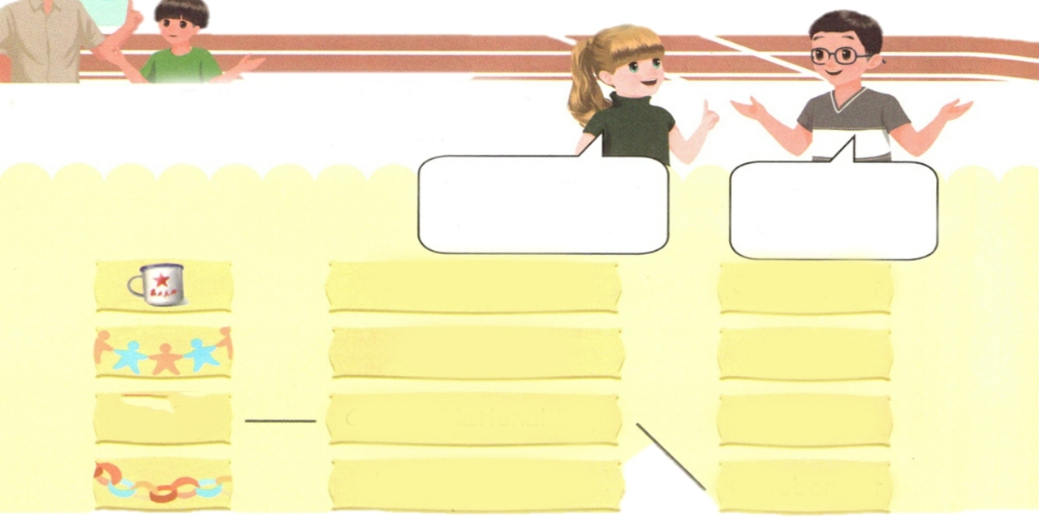

Practice
Talk about the holidays with your partner.
When is China’s National Day?
It’s on October 1st.
Children’s Day
January 1st
May Day
May 1st
China’s National Day
June 1st
New Year’s Day
October 1st

Slide 15

Exercises
一、补全单词并连线。
1. oth r A.节日
2.sp cial B.展览
3.sh w C.特别的
4. fest val D.其他
e
e
o
i

Slide 16
二、单选题。
( )1. —______ is the art show?
—It’s on April 5th this year.
A. What B. Where C. When
( )2. New Year’s Day is ______ January 1st.
A. in B. on C. at
( )3. Children’s Day is ______ June.
A. in B. on C. at
C
B
A

Slide 17
三、连词成句。
is When reading the festival ( ? )
___________________________
2. is When show the art ( . )
___________________________
3. 1st on It’s October ( . )
____________________________
When is the reading festival ?
When is the art show?
It’s on October 1st.

Slide 18
I want to know
五月份的节日有哪些？
5月1日国际劳动节(International Labour Day)
5月3日世界哮喘日(World Asthma Day)
5月4日中国青年节（Chinese Youth Day)
5月8日世界红十字日(World Red-Cross Day)
5月12日国际护士节(International Nurse Day)
5月15日国际家庭日(International Family Day)
5月17日世界电信日(World Telecommunications Day)
5月23日国际牛奶日(International Milk Day)

Slide 19


Summary
学习了下列单词：
other, special, show, festival等
2.学习了下列句型：
—When is …?
— It’s on…
七彩课堂
伴你成长

Slide 20

Homework
ONE
TWO
Act the dialogue out with your friends.
Make a short dialogue using the sentences we have learnt.
七彩课堂
伴你成长
Investigate Chinese culture.

Slide 21




