Slide 1


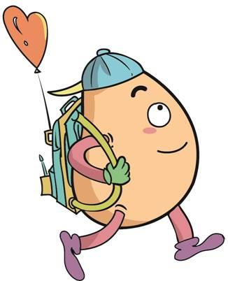






人 教 PEP 版 英 语 五年 级 下 册
Unit 3
My school calendar
Part B
Let’s learn & Ask and write

Slide 2

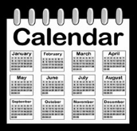
Warm up

Slide 3
Which month is it?
January
February
It’s …
March
June
May
April

Slide 4
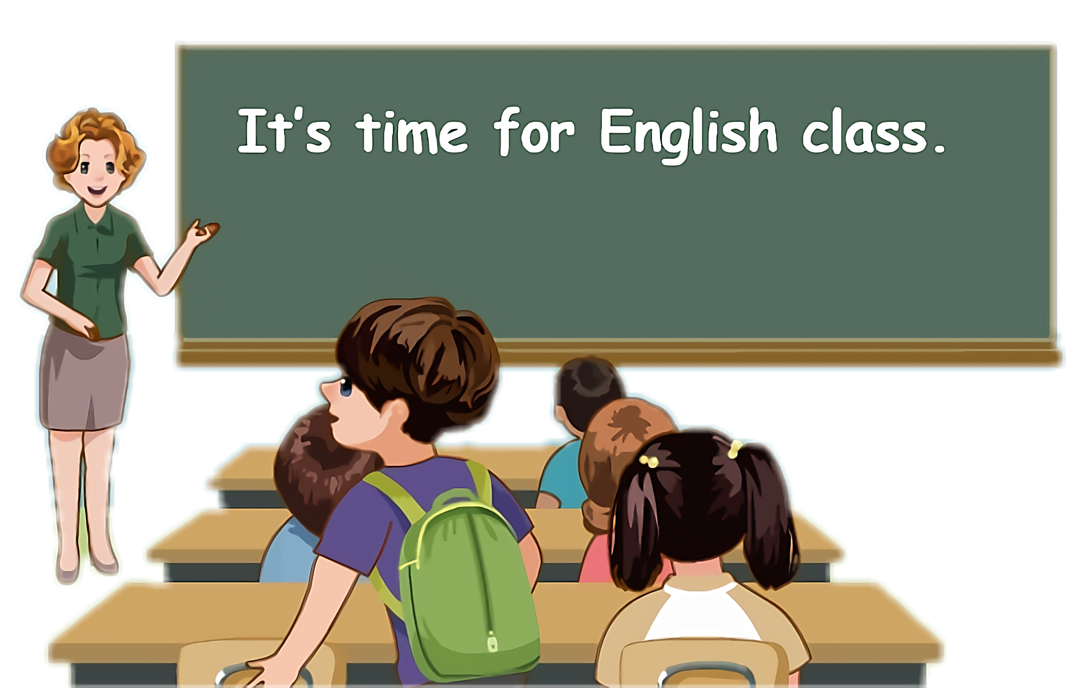
Lead in
Children, how many months are there in a year?
Twelve.

Slide 5
We know January to June.What’s more? Let’s have a look.

Slide 6
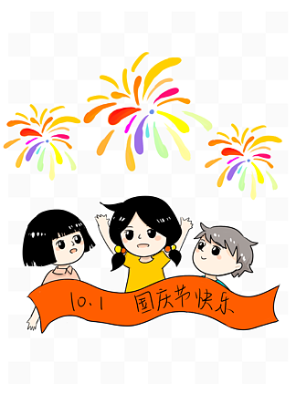


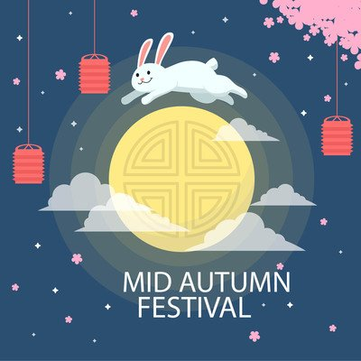
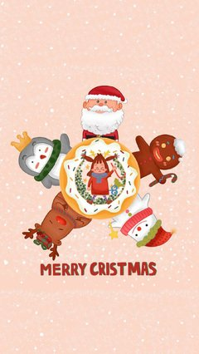

Let’s introduce the festivals.

Slide 7
Talk about the festivals and the months.
Talk about the months.
Talk about the festivals.
Talk about which months the festivals are in.

Slide 8

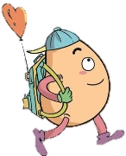

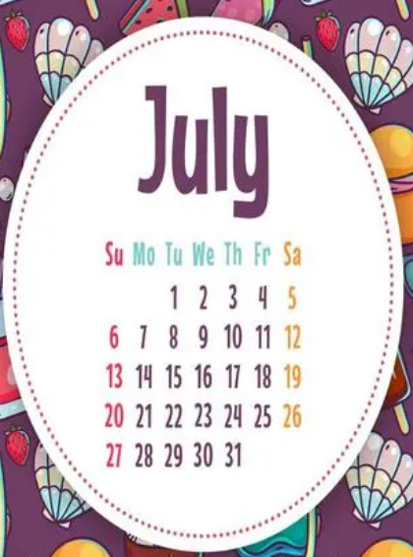
Let’s learn
Learn new words！
July/dʒuˈlaɪ/
七月
缩写形式: Jul.
注意: 月份的第一个字母必须大写。
It’s very hot in July.

Slide 9
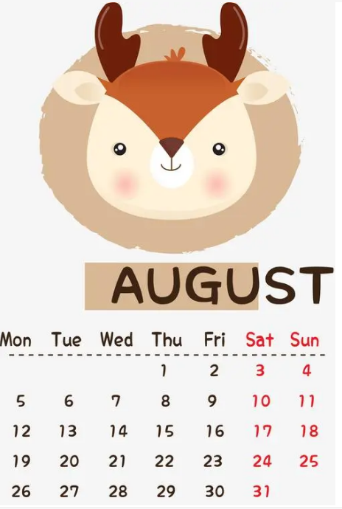
August/ˈɔːɡəst/
缩写形式: Aug.
His birthday is in August.

Slide 10
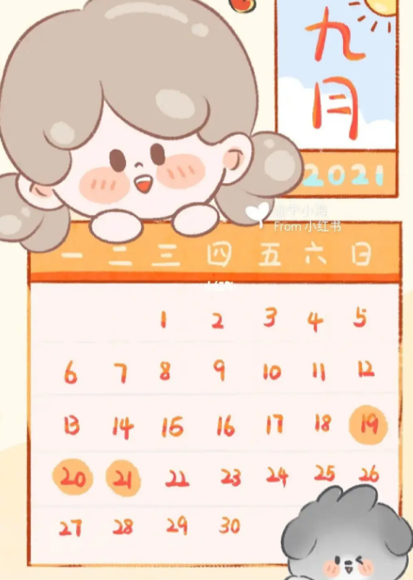
September/sepˈtembə(r)/
缩写形式：Sept.
Teachers’ Day is in September.

Slide 11
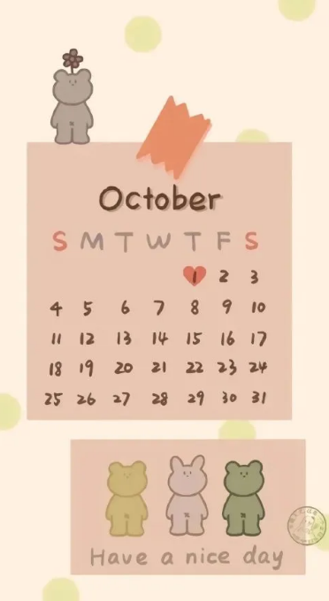
October/ɒkˈtəʊbə(r)/
缩写形式: Oct.
China’s National Day is in October.

Slide 12
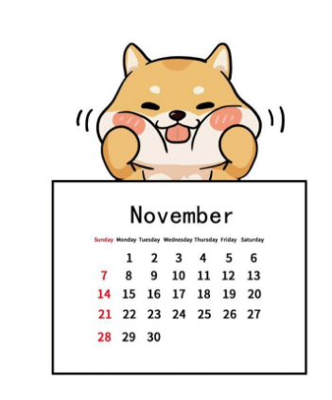
November/nəʊˈvembə(r)/
缩写形式: Nov.
Linda’s birthday is in November.

Slide 13
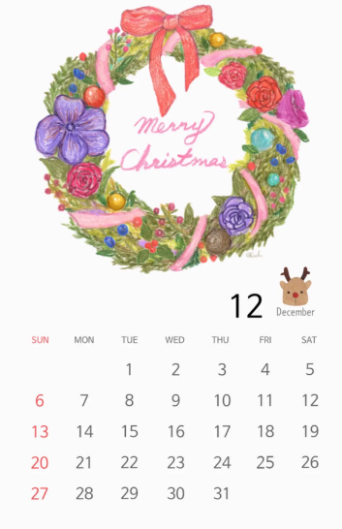
December/dɪˈsembə(r)/
缩写形式: Dec.
Christmas is in December.

Slide 14

Teachers’ Day
教师节
Teachers’ Day is in September.

Slide 15
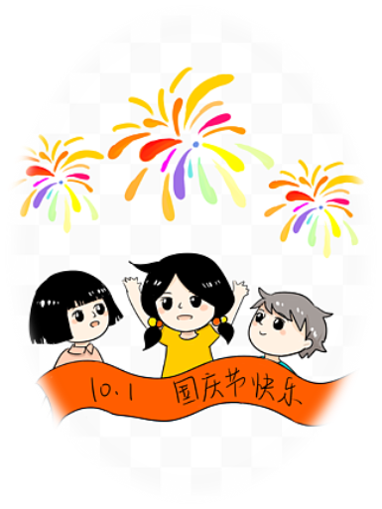
China‘s National Day
中国国庆节
China’s National Day is in October.

Slide 16

Mid-Autumn Day
中秋节
Mid-Autumn Day is in October this year.

Slide 17
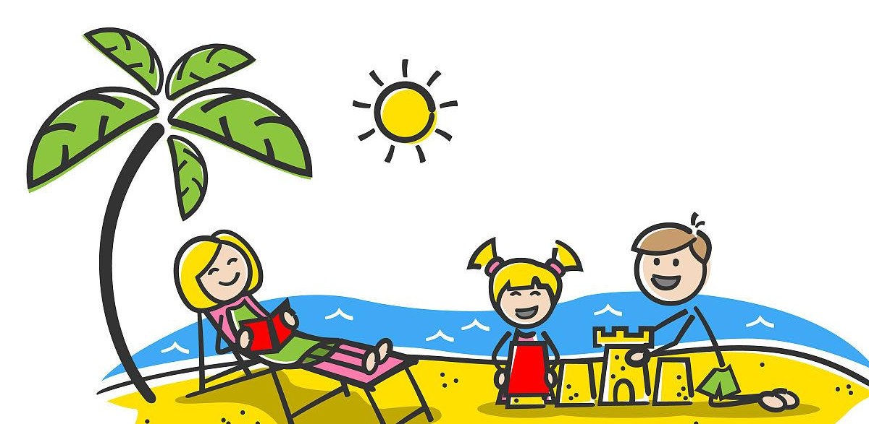
summer vacation
暑假
I like summer vacation.

Slide 18
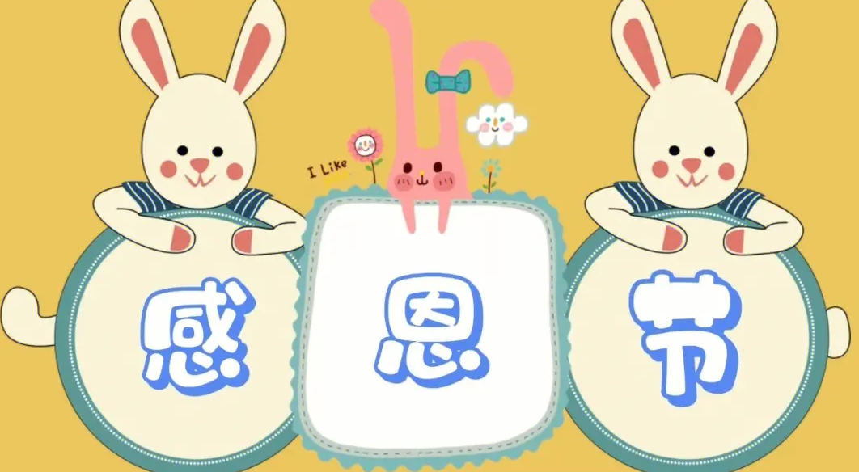
American Thanksgiving Day
美国的感恩节
America美国
拓展
on Thanksgiving Day在感恩节
短语
American Thanksgiving Day is in November.

Slide 19
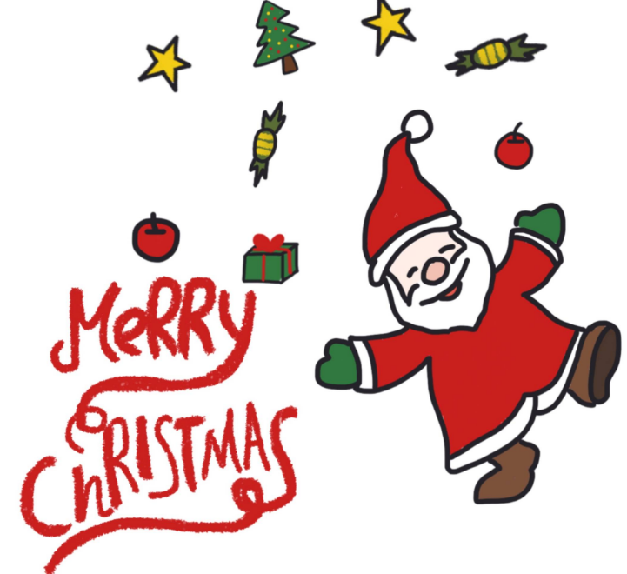
Christmas/ˈkrɪsməs/
圣诞节
at Christmas在圣诞节
短语
Merry Christmas !

Slide 20
Read quickly！
July
August
September
December
November
October

Slide 21
Read and match
Teachers’ Day
November
China’s National Day
December
Thanksgiving
September
Christmas
October

Slide 22
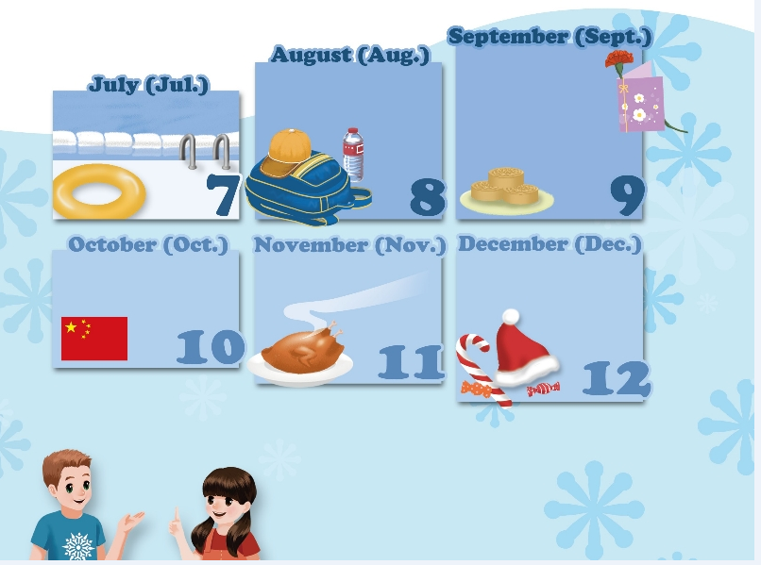
Listen to the tape.
summer vacation
Teachers’ Day
summer vacation
Mid-Autumn Day
China’s National Day
American Thanksgiving Day
Christmas
When is Mid-Autumn Day?
It’s usually in September or October. I’ll eat mooncakes with my family.

Slide 23
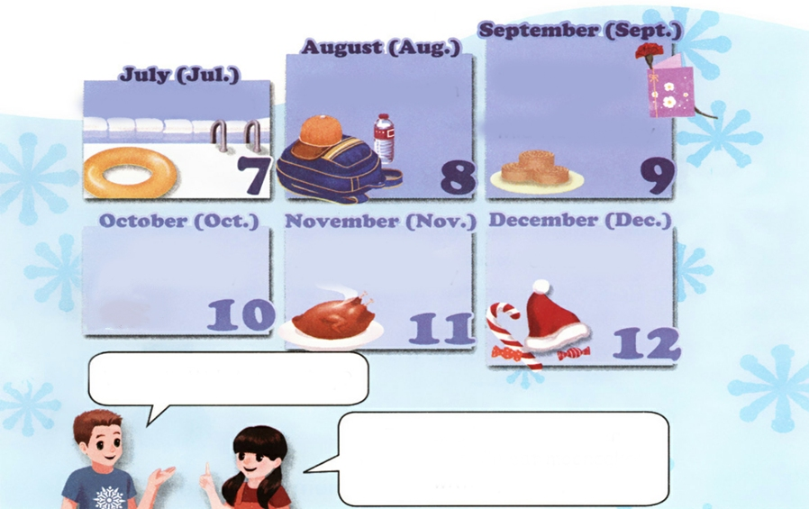

Look and say.
Teacher’s Day
Mid-Autumn Day
summer vacation
summer vacation
China’s National Day
American Thanksgiving Day
Christmas
When is …?
It’s usually in….

Slide 24
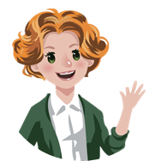
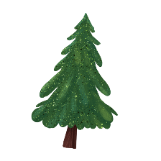


Language points.
It's usually in September or October.
表达在几月(用介词in)
句型：It’s in +月份.
eg. The school trip is in April.

Slide 25
Language points.
I'll eat mooncakes with my family.
表示将来某个时间要发生的动作或存在的状态
句型：主语 + will + 动词原形 + 其他.(一般将来时)
eg. I will play football after school.
They will go swimming on the weekend.

Slide 26

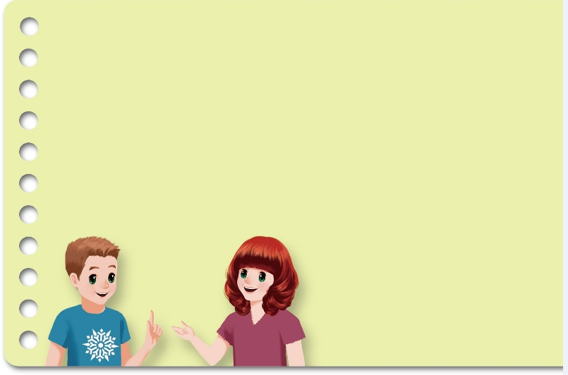
Ask and write
Teachers’ Day is in September.
New Year’s Day is in ___________.
China’s National Day is in _________.
American Thanksgiving Day is in _________.
Christmas is in _____________.
Children’s Day is in _____________.
January
When is Teachers’ Day?
October
It’s in September.
November
December
June

Slide 27
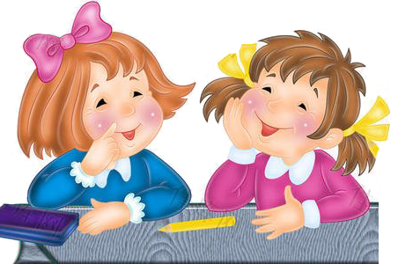
Ask and answer.
Teachers’ Day | American Thanksgiving Day | Children’s Day | New Year’s Day | China’s National Day | Christmas
September | ? | ? | ? | ? | ?
S1: When is …?
S2: It’s in ….

Slide 28
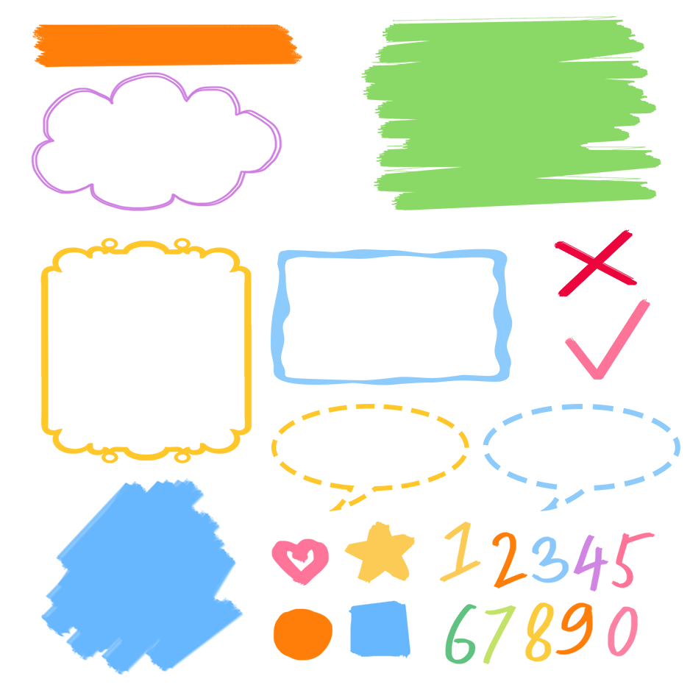
了解月份相关的词组
记忆月份相关的词组
熟练运用月份相关的词组表达

Slide 29
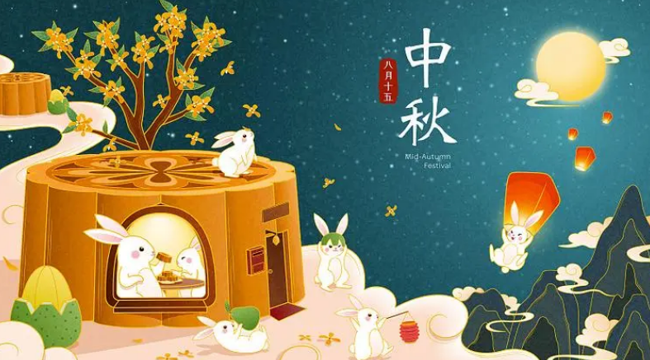
Good to know
中秋节又称月夕、 追月节、拜月节、团圆节，为每年的农历八月十五，因其恰值三秋之半，故而得名中秋节。阳历一般在9月或10月。如2017年的中秋节为10月4日，2023年的中秋节在9月29日。

Slide 30
Exercises
一、将下面节日与月份连线。
China’s National Day
Teachers’ Day
New Year’s Day
Children’s Day
Tree Planting Day
June
October
September
March
January

Slide 31
二、连词成句。
1. is Day Fool’s April when (?)
______________________________
2. birthday in is my May (.)
____________________________
3. we go will to Great Wall the (.)
___________________________
4. is school the trip when year this (?)
________________________________
When is April Fool’s Day?
My birthday is in May.
We will go to the Great Wall.
When is the school trip this year?

Slide 32
三、根据实际情况判断正(√) 误(×)。
（ ）1. Our National Day is in October.
（ ）2. Children’s Day is in July.
（ ）3. Christmas is not in November.
（ ）4. Mid-Autumn Day is in August.
（ ）5.The summer vacation is in July and August.
√
×
√
×
√

Slide 33

Summary
1. 学习了下列单词：July，August，September，October，November，December等。
2.学习了下列句型：
—When is …?
— It’s in ….

Slide 34
Homework
ONE
TWO
Act the dialogue out and show it to your parents.
Talk about your weekend and write a short passage.
Do “Ask and write” with your friends.

Slide 35



