Slide 1









人 教 PEP 版 英 语 五 年 级 下 册
Unit 3
My school calendar
Part B
Let’s learn & Ask and write

Slide 2

Which month is it?
January
February
March
June
It’s …
May
April

Slide 3

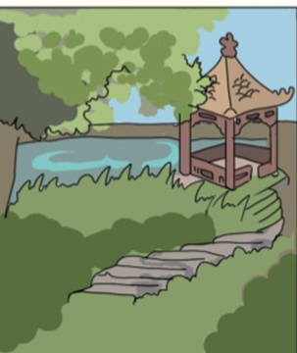
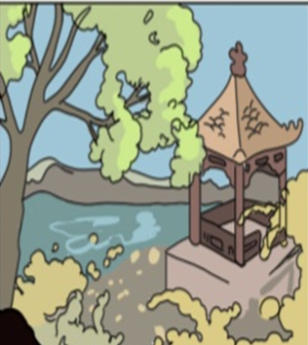
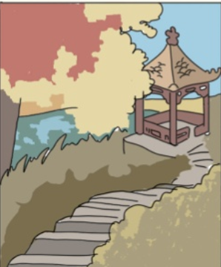
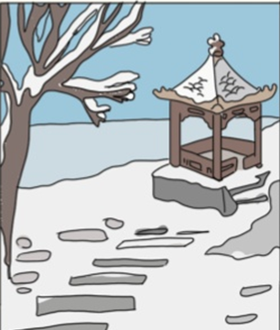
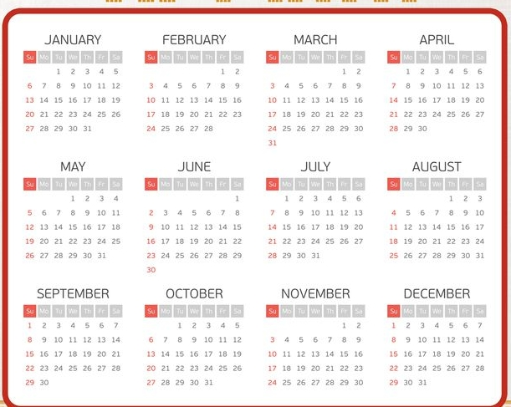

Which season do you like best?
When is summer? Which month?

Slide 4

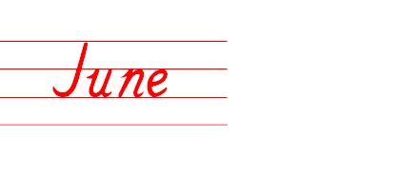
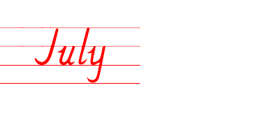
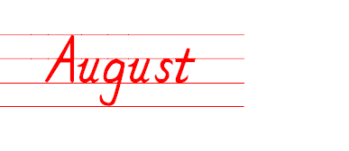

Presentation
summer.
Jun.
Jul.
Aug.
summer vacation

Slide 5

Which season do you like best?
When is autumn? Which month?

Slide 6
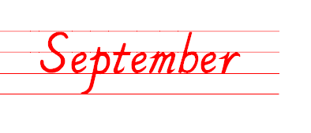
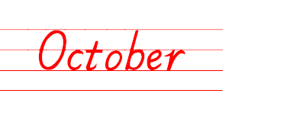
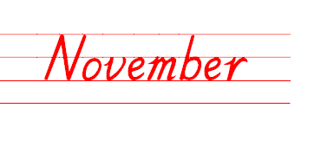
autumn.
Sept.
Oct.
Nov.

Slide 7

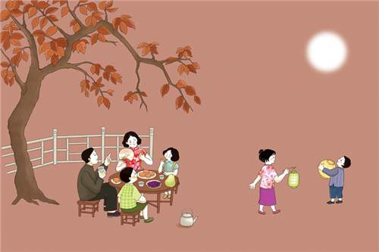
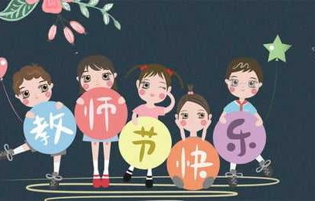
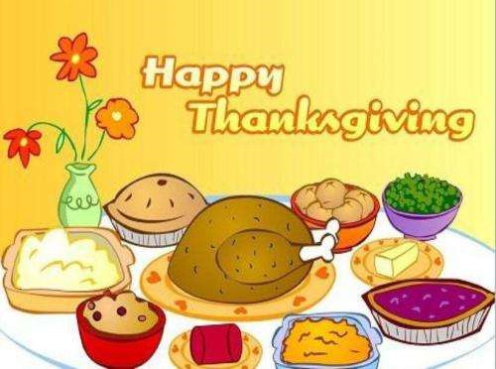
In autumn, there are some festivals.
China’s National Day
American Thanksgiving Day
Mid-Autumn Day
Teachers’ Day
September
October
November

Slide 8
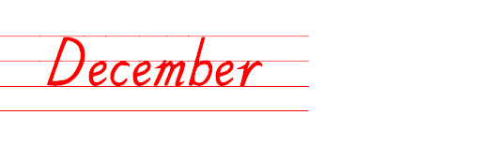
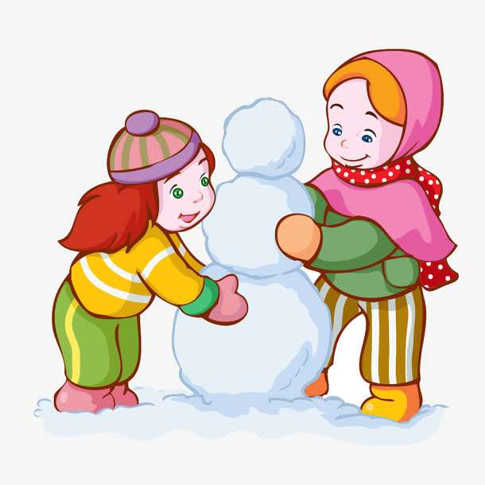
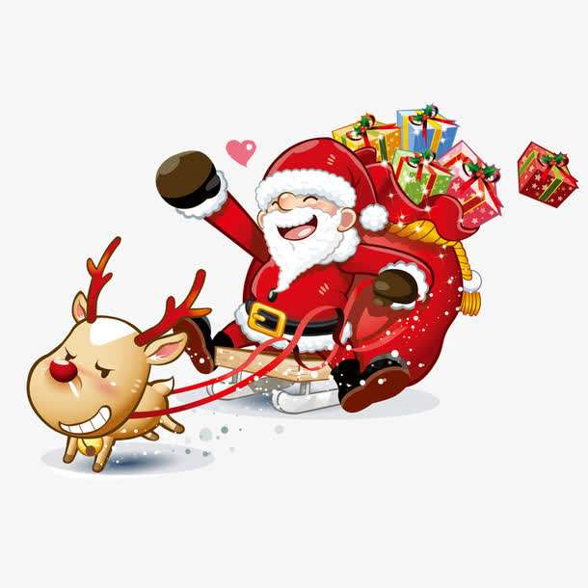
What is the last month in a year?
Dec.
It’s in winter.
What do you often do in winter?

Slide 9
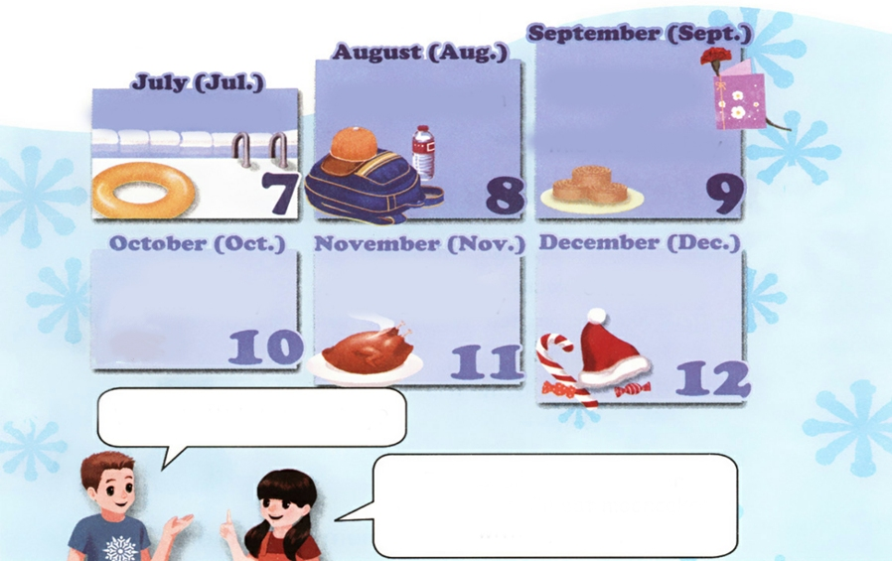

Let’s learn
Look at these pictures. And read after the tape.
Teacher’s Day
Mid-Autumn Day
summer vacation
summer vacation
China’s National Day
American Thanksgiving Day
Christmas
When is Mid-Autumn Day?
It’s usually in September or October. I’ll eat mooncakes with my family.

Slide 10
Act the dialogue.
Teacher’s Day
Mid-Autumn Day
summer vacation
summer vacation
China’s National Day
American Thanksgiving Day
Christmas
When is …?
It’s usually in….

Slide 11
Language points
1. It's usually in September or October.
【详解】 该句是表达在几月。一般表达在几月用介词in。
E.g. The English contest is in May.

Slide 12
2. I'll eat mooncakes with my family.
【详解】 I'll 是I will的缩写形式。will 是情态动词,意思是“要;将要”。 该句为一般将来时态,表达将来某个时间要发生的动作或存在的状态。
句型结构:主语 + will + 动词原形 + 其他.
E.g. I will eat lunch soon.
He will be back soon.

Slide 13
Make dialogue with your partner.
Teacher’s Day | American Thanksgiving Day | Children’s Day | New Year’s Day | China’s National Day | Christmas
September
S1:When is Teacher’s Day?
S2:It’s in September.

Slide 14
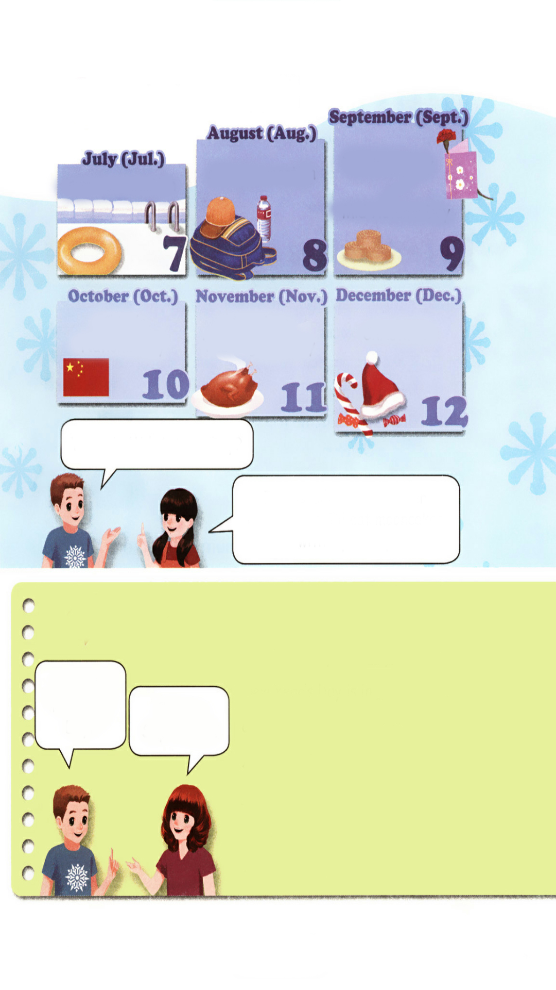
Practice
Ask and write
When is Teacher’s Day?
Teacher’s Day is in September.
New Year’s Day is in .
China’s National Day is in .
American Thanksgiving Day is in
.
Christmas is in .
Children’s Day is in .
It’s in September.
January
October
November
December
June

Slide 15
Ask and answer.
Teacher’s Day | American Thanksgiving Day | Children’s Day | New Year’s Day | China’s National Day | Christmas
September
S1: When is …?
S2: It’s in ….

Slide 16

Exercises
一、汉译英。
八月 十月
七月 九月
十二月 十一月
August
October
July
September
December
November

Slide 17

二、情景对话。
（ ）1. 如果你想问一位美国朋友他们的感恩节是什么时候，你应该问：
A. When is your National?
B. When is your Thanksgiving Day?
C. What is American Thanksgiving Day?
（ ）2.如果你想表达你的生日是在六月，你应该说：
A. My birthday is in July.
B. My birthday is June
C. My birthday is in June.
B
C

Slide 18
三、根据实际情况判断正(√) 误(×)。
（ ）1. Our National Day is in October.
（ ）2. Children’s Day is in July.
（ ）3. Christmas is not in November.
（ ）4. Mid-Autumn Day is in August.
（ ）5.The Summer vacation is in July and August.
√
×
√
×
√

Slide 19


Summary
1. 学习了下列单词：July，August，September，October，November，December等。
2.学习了下列句型：
—When is …？
— It’s in ….
七彩课堂
伴你成长

Slide 20

Homework
ONE
TWO
七彩课堂
伴你成长
Talk about your favourite month and write a short passage.
Act the dialogue out and show it to your parents.
Do “Ask and write” with your friends.

Slide 21








