Slide 1


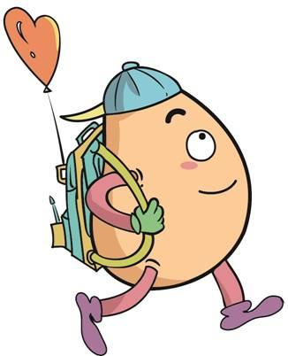

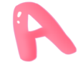




人 教 PEP 版 英 语 五年 级 下 册
Unit 3
My school calendar
Part B & Part C
Read and write—Story time

Slide 2



Warm up
New Year’s Day
winter vacation
Teachers’ Day
summer vacation
Tree Planting Day
Christmas
American Thanksgiving Day
China’s National Day
English party
April Fool’s Day
Labour Day

Slide 3
Presentation
Talk about the stories.
Talk about the English party.
Talk about how to spend my birthday party.
Talk about Zoom’s summer vacation plan.

Slide 4


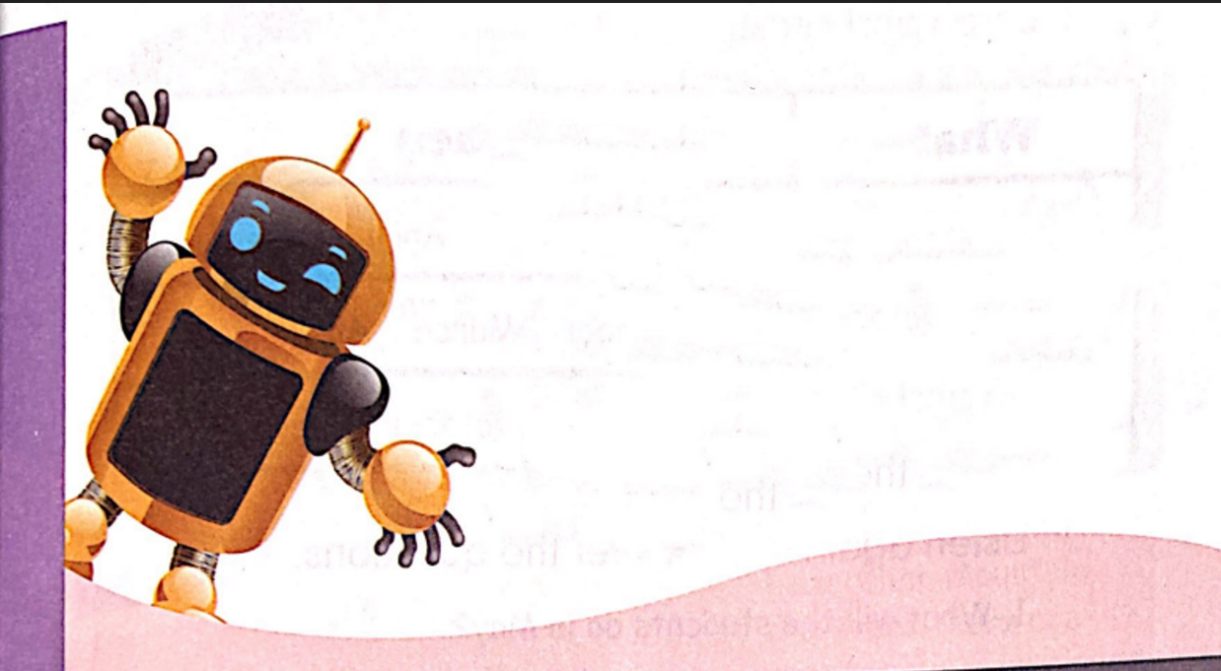
Read and write
English Party
WHEN: April 12th,7 p.m.
WHERE: Gym
WHAT: You will play games. You will
read riddles. You will act out
stories. You will meet Robin
the Robot. He is a great English
teacher!
RSVP: Will you come to the party?
Please send an email by March
23rd.
玩游戏
猜谜语
表演故事
发送
在……之前
敬请赐复
同义词please reply

Slide 5
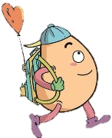
Listen and answer the questions.
1.When is the English party?
2.Where is the party held?
3.What will they do at the party?
It is at 7 p.m. on April 12th.
It is held in the gym.
They will play games, read riddles, act out
stories and meet Robin the Robot.

Slide 6
Read and tick or cross.
( ) The English party is on March 23rd.
( ) The party will start at 7 p.m.
( ) You’ll dance at the party.
( ) You’ll meet a great English teacher at the party.
X
√
X
√

Slide 7

Read and write.
What will you do if you have a birthday party? Write three sentences.
1._______________________.
2.______________________.
3.______________________.
I’ll play games at my birthday party.
dance跳舞
play games玩游戏
make a wish许愿
sing the birthday song唱生日歌
eat noodles/a birthday cake
吃面条/吃生日蛋糕
I’ll make a wish at my birthday party.
I’ll eat noodles at my birthday party.

Slide 8
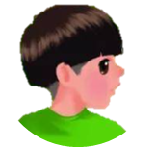



Language point.
Will you come to the party?
用来表示将要发生的事情
句型：
Will + 主语(人/物) + 动词原形 + 其他?
肯定回答: Yes, 主语 + will. 否定回答: No, 主语 + won't.
— Will you go swimming on Tuesday? —Yes, I will.
— Will you clean your room in the evening? —No, I won’t.

Slide 9

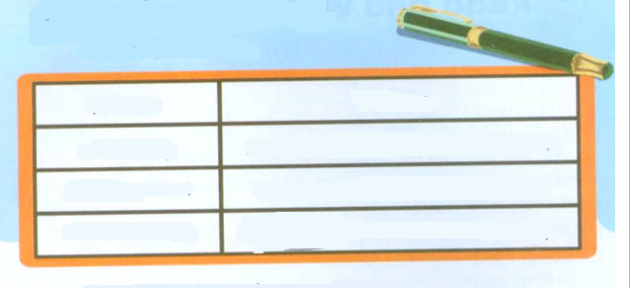
Let’s check
Listen and circle.
What
When
school trip
August March April December
singing contest
November March April May
Teachers’ Day
September October May July

Slide 10
Listen again and answer the questions.
1. What will the students do in May?
___________________________
2. What will they do in December?
__________________________
They will visit a farm.
They will have a Christmas party.

Slide 11
听力材料:
1. Miss White: We have lots of fun things this spring. In March there is the school trip. We’ll go to the Great Wall. In April, we’ll have a singing contest . In May, We’ll visit a farm.
2. John: Look at the calendar. In September, there is Teachers’ Day. In October, we’ll go to the zoo. In November, there is Thanksgiving Day. We’ll eat a big dinner. In December, there is Christmas. We’ll have a party!

Slide 12

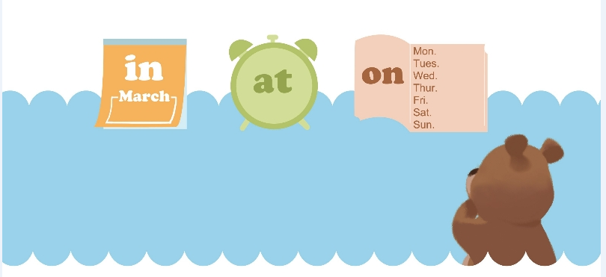
Fill in the blanks.
Let’s wrap it up
in
1. We will have an English party______ February.
2. I get up ____ 7 o’clock every day.
3. What do you have _____ Tuesdays?
at
on

Slide 13
Language point.
介词in, on, at的用法
介词与时间搭配的基本规则
讲解：
上午、下午、晚上和月份前用介词 in； 具体某个时间的上午、下午、晚上和星期前用介词 on； 时间点前用介词 at。
My birthday is in June.
I get up at 6:30 in the morning.
I will go shopping on Saturday.

Slide 14

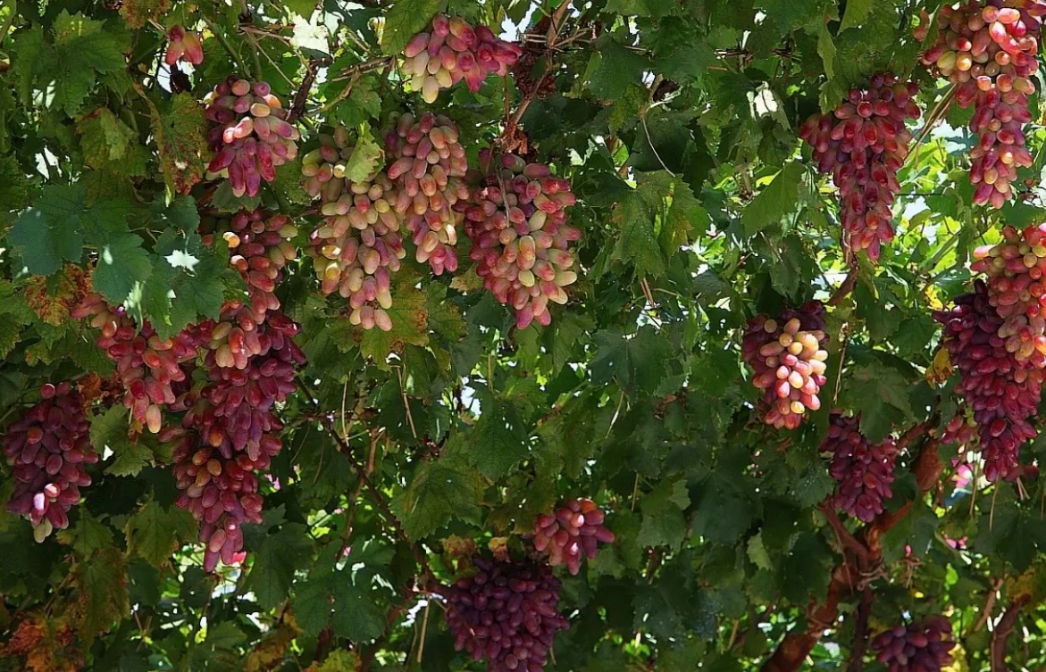
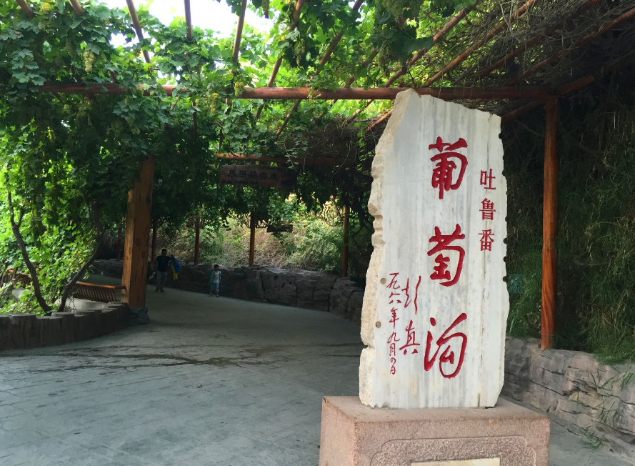
Learn new words.
Story time
Grape Valley

Slide 15
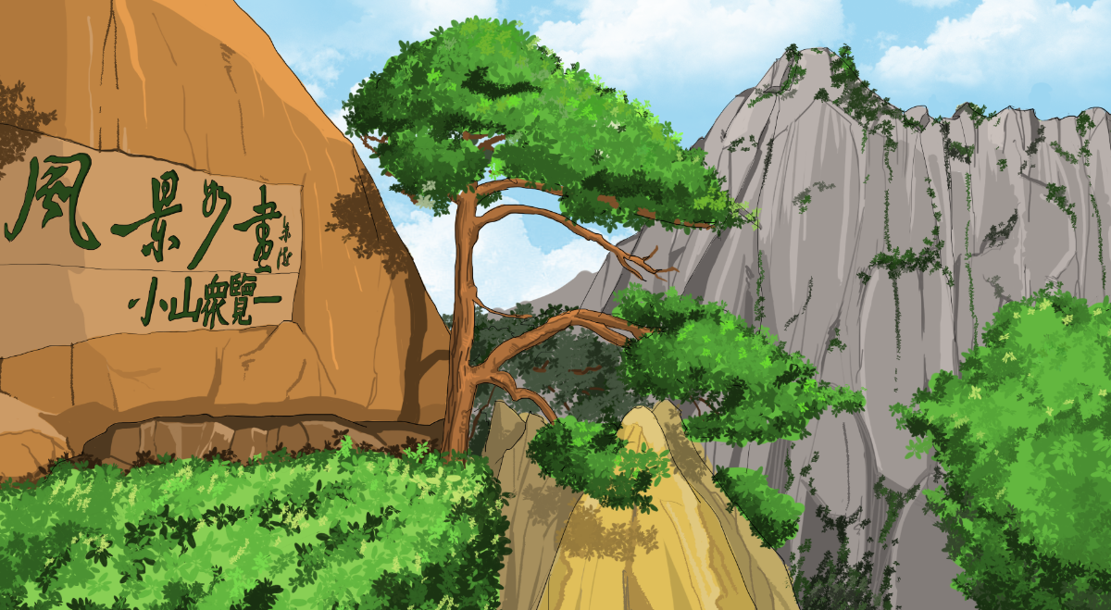
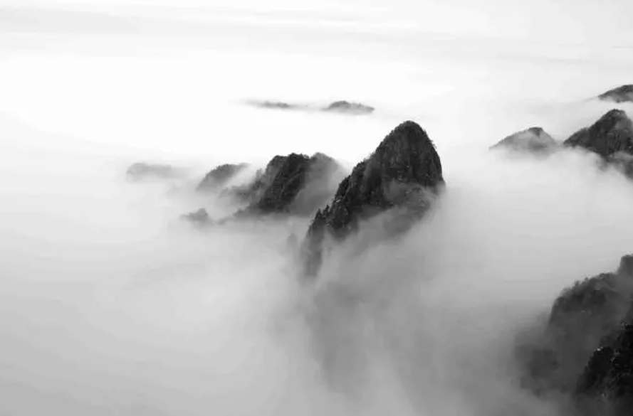
The trees are famous.
The clouds are beautiful.

Slide 16
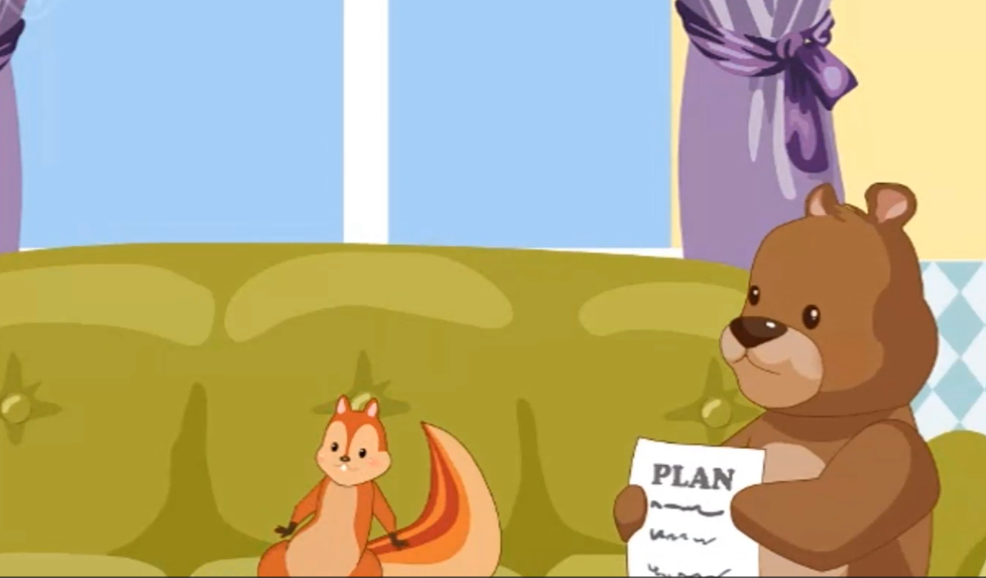
Watch the video.

Slide 17
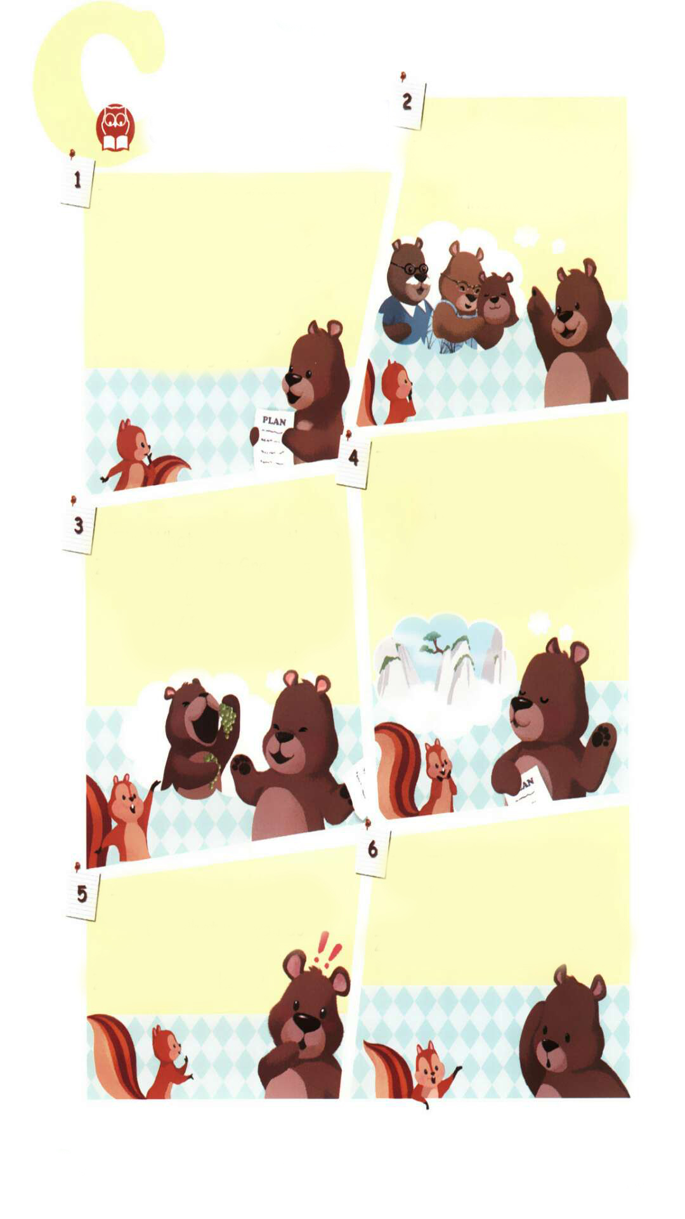
Read and answer.
Here are some pictures about Zoom’s plan. What is the plan about?
He will visit grandparents.
He will go to Grape Valley.
He will go to Huangshan Mountain.

Slide 18
Read and answer.
Zoom’s plan is so wonderful. But he forgot an important thing.
What is it?
He forgot his maths test.
数学测试

Slide 19
Choose the right answers.
Game time
1. The story is about _______ plan.
A. Zoom’s B. Zip’s
2. Zoom will visit his _______in Xinjiang.
A. grandparents B. parents
3. There will be a maths test_____ .
A. next month B. next Monday

Slide 20
Read aloud.
暑假计划
Zoom: Look at my summer vacation plan!
Zip: It’s April now. The summer vacation is still three months away.
Zoom: Early planning is always good.
Zoom: In July I’ll visit my grandparents. They live in Xinjiang.
Zip: What will you do there?
Zoom: We’ll go to Grape Valley. The grapes there are very sweet! Grapes are my favourite fruit!
Zoom: In August, I’ll go to Huangshan Mountain. The trees there are very famous. The clouds are
beautiful!
Zip: Sounds great!
Zip: You have a great plan, but what will you do this weekend?
Zoom: This weekend?
Zip: There will be a maths test next Monday. So please study hard.
Zoom: Oh my goodness! I forgot!
遥远的；在远方
早安排
葡萄沟
听起来好极了
数学测试
努力学习
v.忘记，
forget的过去式

Slide 21
Listen and fill in the blanks.
Zoom’s summer vacation :
1. Visit his __________ in Xinjiang.
grandparents
2. Go to Grape Valley: The grapes are ______.
Grapes are his_______ _______.
sweet
favourite fruit
3. Go to Huangshan Mountain: The ______ are famous.
The_______ are beautiful.
trees
clouds

Slide 22
Read and judge. (T or F).
( )1. It’s summer now.
( )2. Zoom has a good plan for summer vacation.
( )3. Zoom has a plan for this weekend.
( )4. Zoom will have an English test next Monday.
( )5. Zoom forgot the test.
F
T
F
F
T

Slide 23
Play in roles.
Zoom: Look at my summer vacation plan!
Zip: It’s April now. The summer vacation is still three months away.
Zoom: Early planning is always good.
Zoom: In July I’ll visit my grandparents. They live in Xinjiang.
Zip: What will you do there?
Zoom: We’ll go to Grape Valley. The grapes there are very sweet! Grapes are my favourite fruit!
Zoom: In August, I’ll go to Huangshan Mountain. The trees there are very famous. The clouds are
beautiful!
Zip: Sounds great!
Zip: You have a great plan, but what will you do this weekend?
Zoom: This weekend?
Zip: There will be a maths test next Monday. So please study hard.
Zoom: Oh my goodness! I forgot!

Slide 24
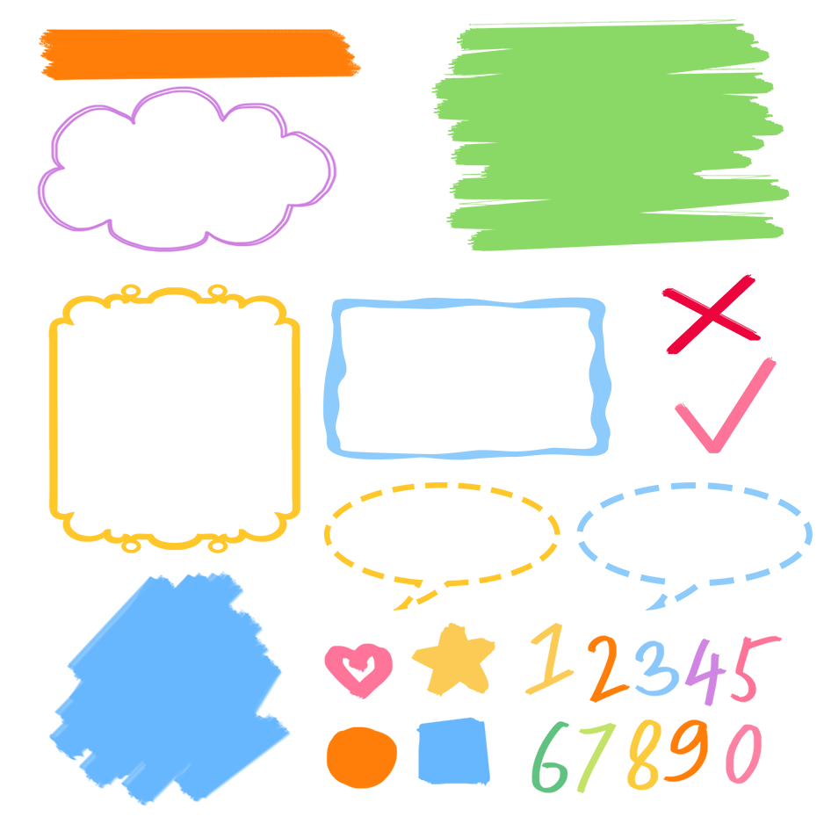
流利地朗读
流利地表演
有感情地表演

Slide 25

Good to know
Early planning is always good.
早做计划是好事，但要注意计划的合理性，一旦脱离事实，所有的计划都是空想。

Slide 26
Exercises
一、选词填空。
1. season do you like best?
2. will you do on your birthday?
3. is your bag?
4. do you like spring?
5. is Mid-Autumn Day?
When What Why Which Where
Which
What
Where
Why
When

Slide 27
二、选择最佳答案。
( )1. When ____ China’s National Day?
A. are B. is C. do
( ) 2. How many _____ are there in March?
A. days B. birthdays C. birthday
( )3. My birthday is _____ December.
A. on B. / C. in
( )4. ____ she have a birthday cake?
A. Does B. Is C. Do
( )5. What will you ____ this weekend?
A. does B. do C. /
B
A
C
A
B

Slide 28
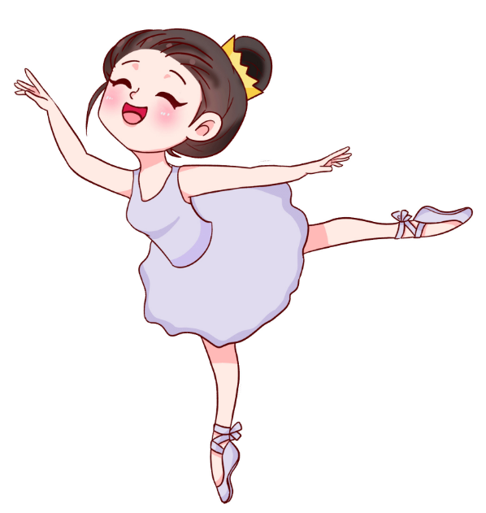
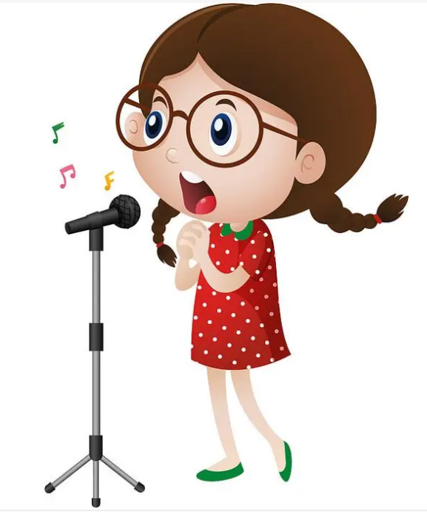
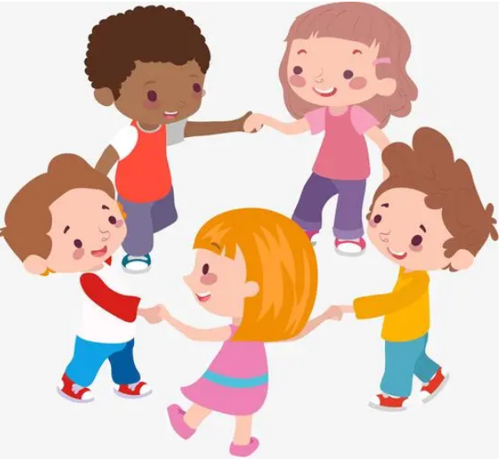
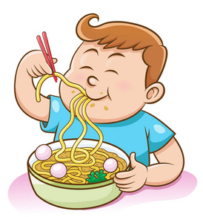
三、看图，仿照例子写句子。
例
1.
2.
3.
例: I will dance at my birthday party.
1. _______________________________.
2. ____________________________________ .
3. ____________________________________.
I will sing at my birthday party
I will play games at my birthday party
I will eat noodles at my birthday party

Slide 29
四、阅读短文，并选择正确的答案。
Today is Amy’s birthday. It’s June 2nd. She gets some presents and cards from her friends. Her grandparents give her a lovely doll. Her mother buys her a lot of delicious food. She climbs mountains(爬山) with her father. She is very happy today.
( ) 1.Today is ____ birthday.
A. Amy’s B. Amy’s mother’s C. Amy’s father’s
( ) 2. When is Amy’s birthday?
A. On July 2nd. B.In March. C. On June 2nd.
( ) 3. Amy’s mother buys her______.
A. a lot of delicious food B. a doll C. a card
( ) 4.Amy climbs mountains with her ______.
A. mother B. father C. friends
A
C
A
B

Slide 30

Summary
1.能够正确听、说、认、读单词：play games, forget, study hard, RSVP,by, send, maths test等。
2.能用We will…句型简单介绍自己将要做某事。
3.能够掌握in, at, on等介词的用法。

Slide 31
Homework
ONE
TWO
Make sentences like “read and write”.
Read the story to your parents.
Act the story out in groups.

Slide 32







