Slide 1









人 教 PEP 版 英 语 五 年 级 下 册
Unit 3
My school calendar
Part B & Part C
Read and write—Story time

Slide 2

Warm up
What’s missing?
Christmas
Teachers’ Day
American Thanksgiving Day
China’s National Day
Mid-Autumn Day
November
September
October

Slide 3


Lead in
Let’s play.
拼写单词。每说一个字母，教师就把它填在横线上，如果说错一个字母，教师则擦去一段“导火线”。若“导火线”擦光而学生未能把单词拼写完整，则“炸弹起爆”学生失败。
July
June
April
March
Notes:
点击字母后面的空白，会出现字母，点击图片后面的空白，导线会变短，三次变短后，点击炸弹，炸弹会爆炸。

Slide 4

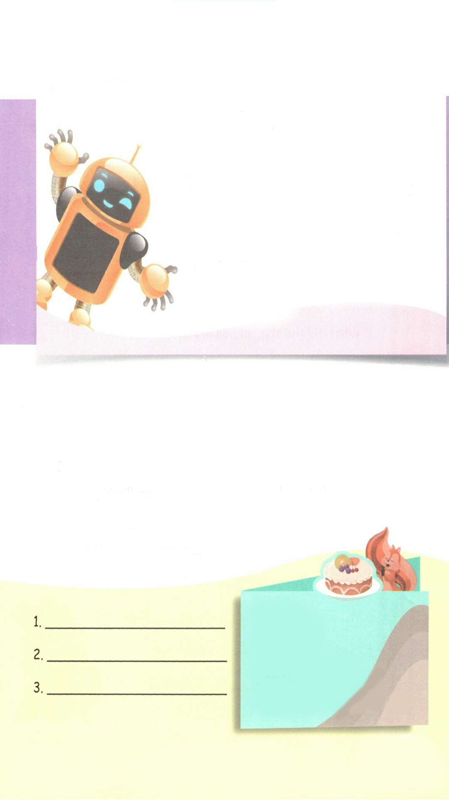
Presentation
Read and write
Listen to the tape and circle the words and phrases you don’t know.
English Party
WHEN: April 12th, 7 p.m.
WHERE: Gym
WHAT: You will play games. You will read
riddles. You will act out stories.
You will meet Robin the Robot.
He is a great English teacher!
RSVP: Will you come to the party?
please send an email by March
23rd.
把……表演出来
游戏
谜语
请赐复
发送
在……之前

Slide 5

Read and find out the words with “wh”.
English Party
WHEN: April 12th, 7 p.m.
WHERE: Gym
WHAT: You will play games. You will read
riddles. You will act out stories.
You will meet Robin the Robot.
He is a great English teacher!
RSVP: Will you come to the party?
please send an email by March
23rd.

Slide 6
Listen and answer the questions.
1.When is the English party?
2.Where is the party held?
3.What will they do at the party?
It is at 7 p.m. on April 12th.
It is held in the gym.
They will play games, read riddles, act out stories and meet Robin the Robot.

Slide 7
Read and tick or cross.
( ) The English party is on March 23rd.
( ) The party will start at 7 p.m.
( ) You’ll dance at the party.
( ) You’ll meet a great English teacher at the party.
X
√
X
√

Slide 8
Language points
Will you come to the party?
【详解】 该句为 will 引导的一般疑问句。will 是情态动词。肯定句变一般疑问句时将will 直接提至主语前。若主语为第一人称,应将其改为第二人称。
句型结构: Will + 主语(人/物) + 动词原形 + 其他?
肯定回答: Yes, 主语 + will. 否定回答: No, 主语 + won't.
E.g. — Will the trees grow well?
— Yes, they will.
— Will you go home by bus?
— No, I won't.

Slide 9
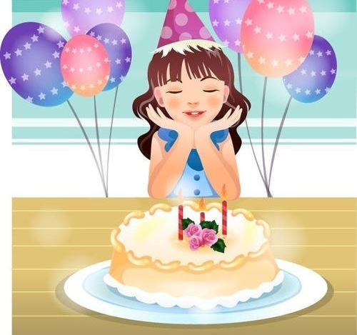
My birthday will come in October.
I will do some fun things at my birthday party.
What will I do?
make a wish
许愿

Slide 10
What will you do if you have a birthday party?
Write three sentences.
dance
play games
make a wish
sing the birthday song
eat noodles/ a birthday cake

Slide 11
If you hold an English party, write an invitation to your friends.
English Party
WHEN: …..
WHERE: ….
WHAT: You will ….. You will …..
You will ….
you will ….
He is a great English teacher!
RSVP: Will you come to the party?
please send an email by ….

Slide 12
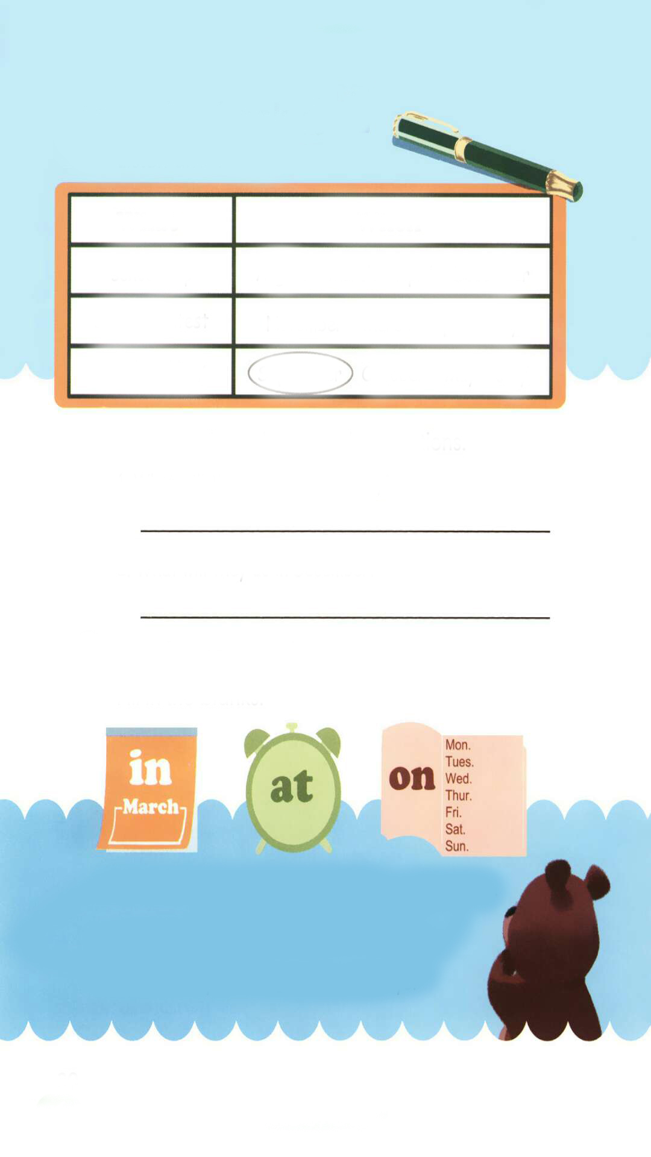
Let’s check
Listen and circle.
What
When
School trip
Singing contest
Teachers’ Day
August March April December
November March April May
September October May July

Slide 13
Listen again and answer the questions.
1. What will the students do in May?
They will visit a farm.
2. What will they do in December?
They will have a party.

Slide 14
听力材料:
1. Miss White: We have lots of fun things this spring. In March there is the school trip. We’ll go to the Great Wall. In April, we’ll have a singing contest . In May, We’ll visit a farm.
2. John: Look at the calendar. In September, there is Teachers’ Day. In October, we’ll go to the zoo. In November, there is Thanksgiving Day. We’ll eat a big dinner. In December, there is Christmas. We’ll have a party!

Slide 15
What are the differences among these three sentences?
in
1. My birthday is October.
2. My birthday is Monday.
on
3. My birthday party is 5:00 p.m.
at
in October | on Sunday | at 5’o clock
in September | on Monday | at 4’o clock

Slide 16
Language points
in ,on ,at 与时间的搭配的基本规则
【详解】月份前用介词“in ”； 星期前用介词“on” 时间点前用介词“at”.
E.g. My mother’s birthday is in March.
I go to school at 7:00 in the morning.
I will buy a storybook on this Sunday.

Slide 17
Let’s wrap it up
Fill in the blanks.
in
We will have an English party February.
I get up 7 o’clock every day.
What do you have Tuesdays?
at
on

Slide 18
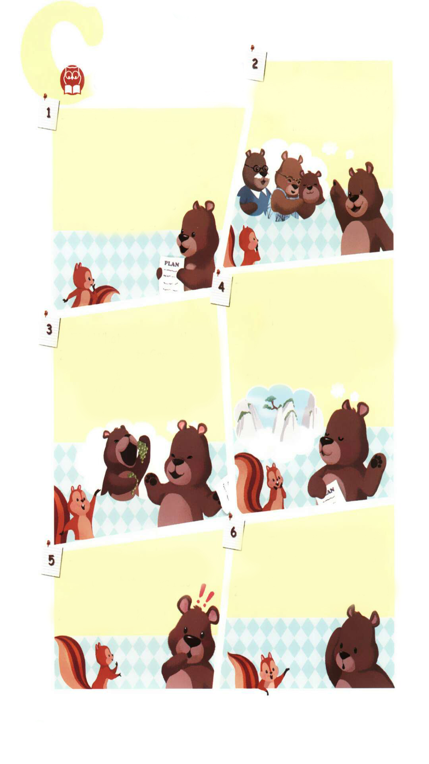
Story time
点击画面 播放视频
Watch the video.
Here are some pictures about Zoom’s plan. What is the plan about?
He will visit grandparents .
He will go to Grape Valley.
He will go to Huangshan Mountain.

Slide 19
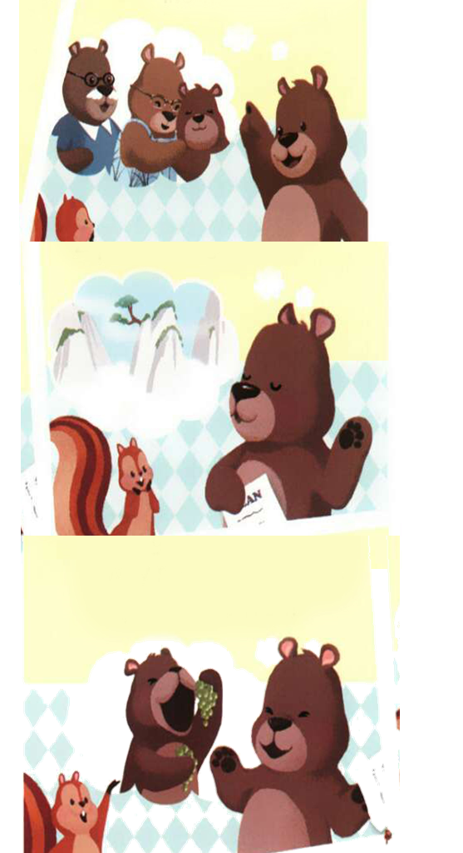
点击画面 播放视频
Let’s watch and answer.
Zoom’s plan is so wonderful. But he forgot an important thing.
What is it?
He forgot his maths test.
数学测试

Slide 20
Read and circle the words and sentences you don’t know.
Zoom: Look at my summer vacation
plan!
Zip: It’s April now. The summer
vacation is still three
months away.
Zoom: Early planning is
always good.
距离暑假还有三个月。
Zoom: In July I’ll visit my
grandparents. They
live in Xinjiang.
早做计划总是好的。

Slide 21
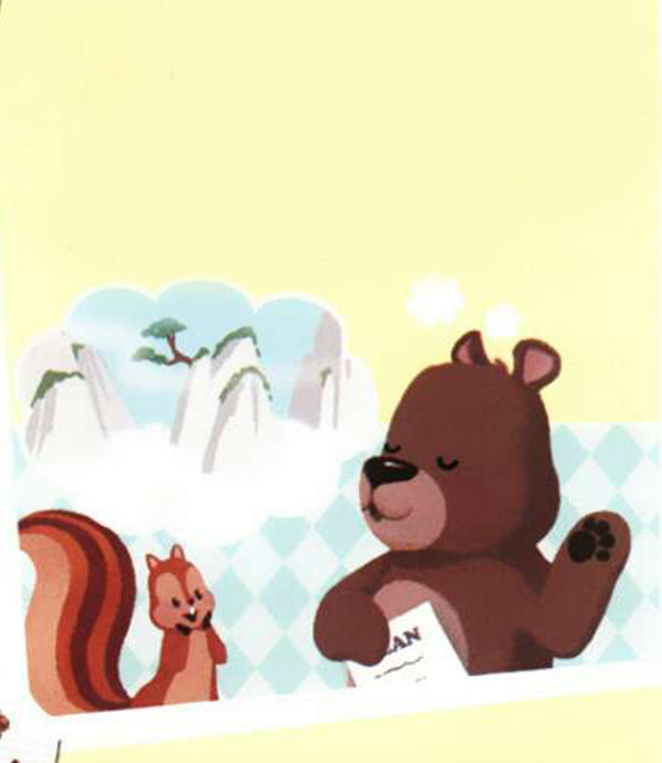
Zoom: In August, I’ll go to
Huangshan Mountain.
The trees there are
very famous. The clouds
are beautiful!
Zip: Sounds great!
Zip: What will you do there?
Zoom: We’ll go to Grape Valley.
The grapes there are
very sweet! Grapes are
my favourite fruit!
葡萄沟
听起来很棒!

Slide 22

Zip: You have a great plan,
but what will you do
this weekend?
Zoom: This weekend?
Zip: There will be a maths
test next Monday. So
please study hard.
Zoom: Oh my goodness! I forgot!
努力学习
我忘了！

Slide 23
Early planning is always good.
早做计划是好事，但要注意计划的合理性，一旦脱离事实，所有的计划都是空想，要养成吃苦在前，享乐在后的思想。

Slide 24
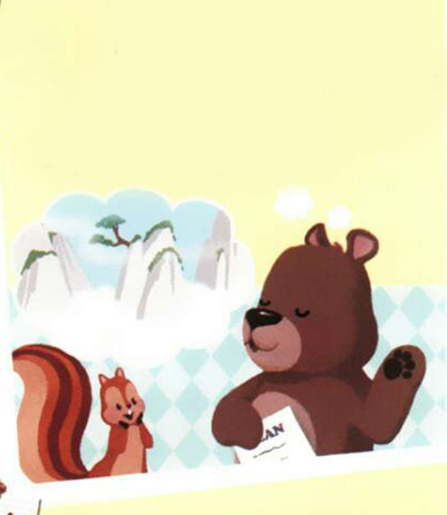

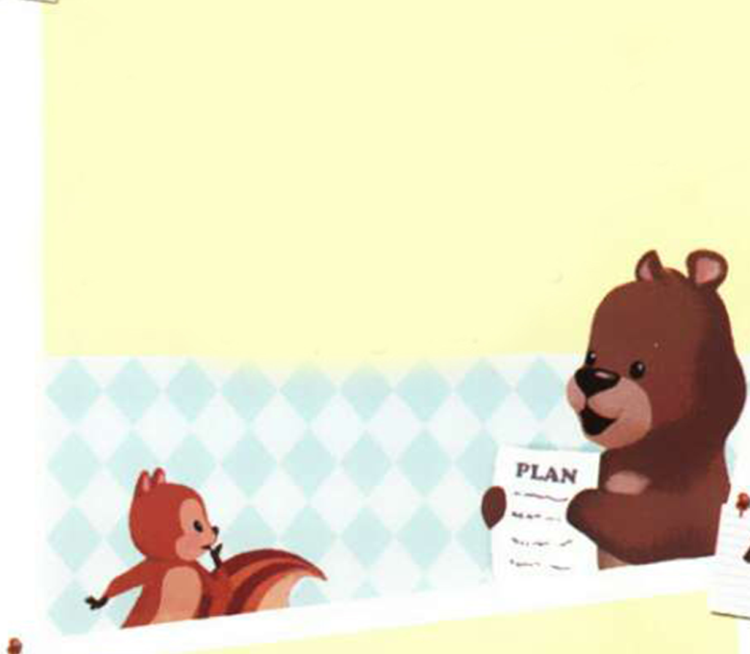
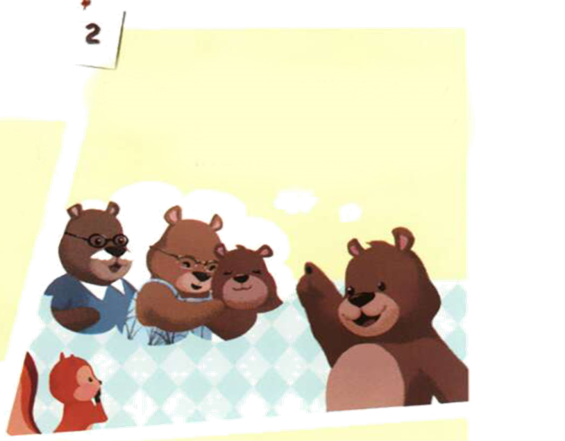

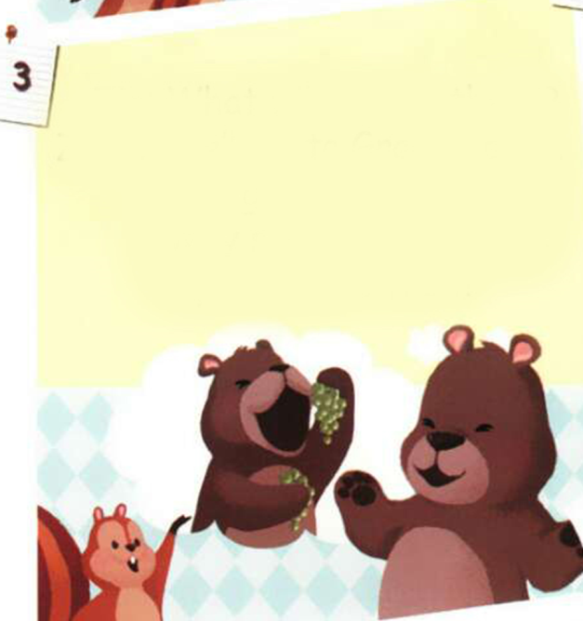
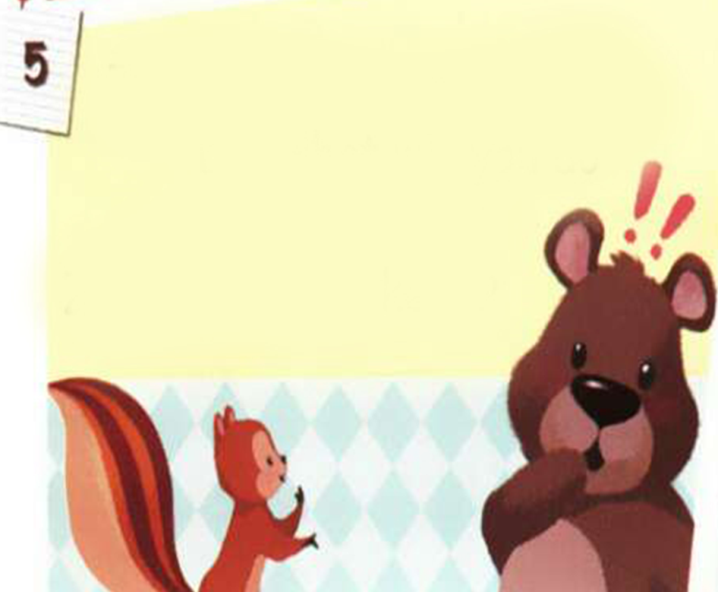
Practice
Number the pictures.
④
⑥
①
③
⑤
②

Slide 25
Act out.

Slide 26

Exercises
一、写出下列月份的简写形式。
1.December_____________ 2.September_____________
3.January_______________ 4. November_____________
5. October______________ 6. August________________
Dec.
Sept.
Jan.
Nov.
Oct.
Aug.

Slide 27
二、单项选择。
( ) 1.--______is Teachers’ Day?
-- It’s in September.
A. When B. What C. How
( ) 2. The Children’s Day is _____ June.
A. in B. on C. At
（ ）3.When _____ Christmas?
A. Are B. am C. is
A
A
C

Slide 28
三、选词填空。
1. season do you like best?
2. will you do on your birthday?
3. is your bag?
4. do you like spring?
5. is Mid-Autumn Day?
When What Why Which Where
Which
What
Where
Why
When

Slide 29


Summary
1.能够正确听、说、认、读单词：game, riddle, act, RSVP, by等。
2.能用We will…句型简单介绍自己将要做某事。
3.能够掌握in, at, on等介词的用法。
七彩课堂
伴你成长

Slide 30

Homework
ONE
TWO
Make sentences like read and write.
Read the story to your parents.
七彩课堂
伴你成长
Act the story out in groups.

Slide 31








