Slide 1


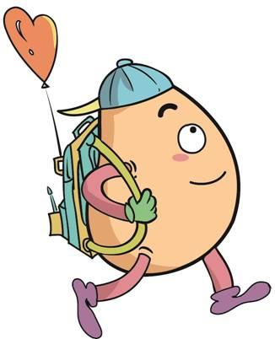





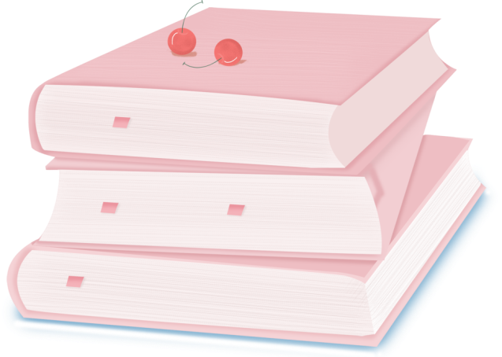
人 教 PEP 版 英 语 五年 级 下 册
Unit 3
My school cadenlar
Part B
Let’s try & Let’s talk

Slide 2

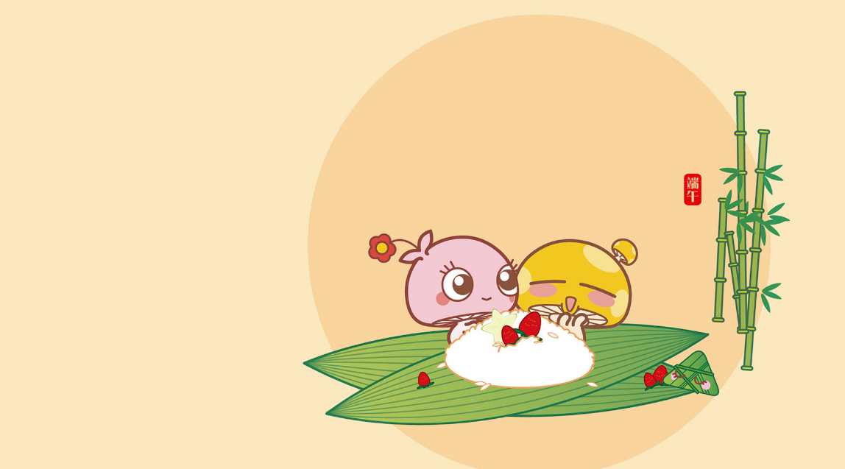
Review
一人问，全班抢答。随意挑选一个节日，看谁最快说出在几月。
New Year’s Day
Winter Vacation
Tree Planting Day
English Party
Labour Day
Mother’s Day
Children’s Day
Father’s Day
Summer Vacation
Teachers’ Day
Mid-Autumn Day
National Day
Thanksgiving Day
Christmas
When is ...?
It’s in ...

Slide 3
Lead in
What activities do you have in autumn?

Slide 4
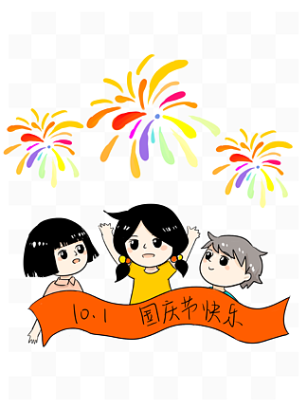
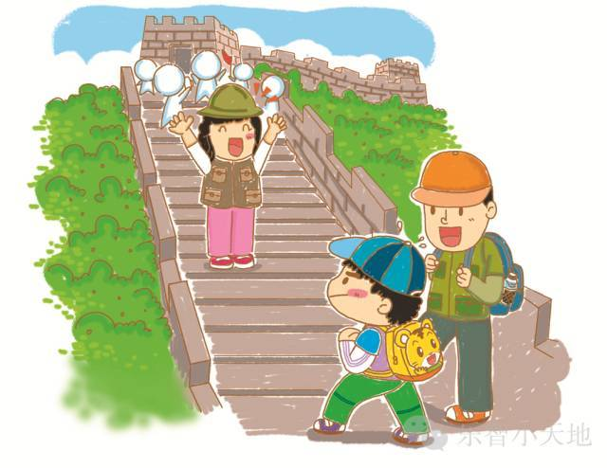
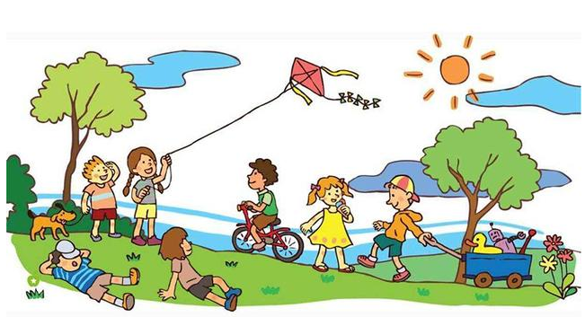
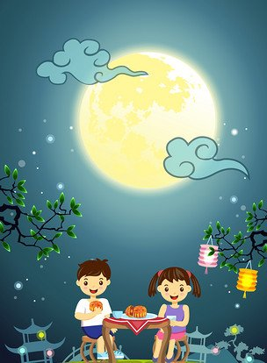
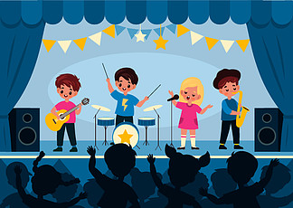
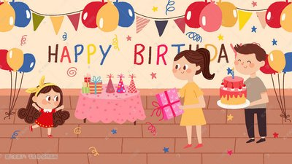
Let’s introduce my activities.

Slide 5
Presentation
Talk about the activities.
Talk about Oliver’s birthday.
Talk about Chen Jie’s activities in autumn.
Talk about your activities on Mother’s Day.

Slide 6
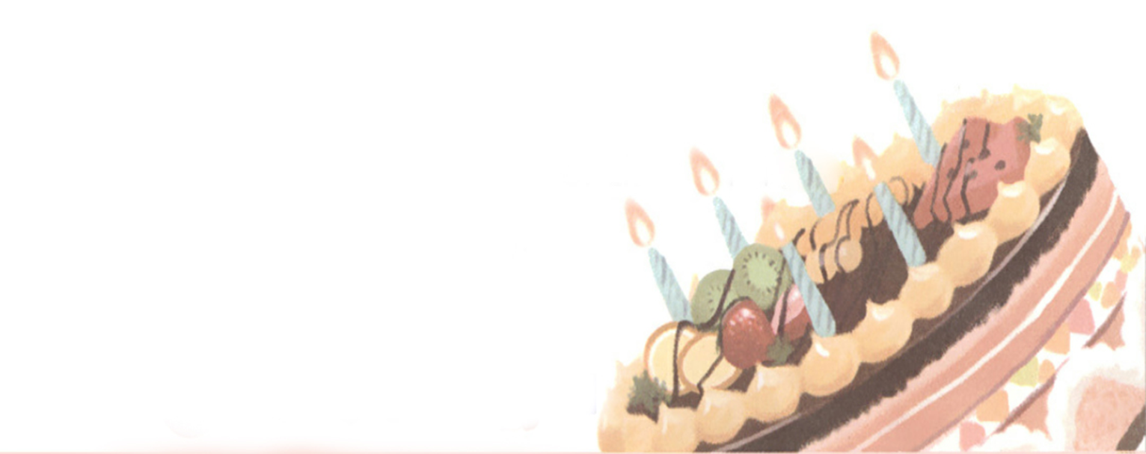
Today is Oliver’s birthday. Let’s have a look.

Slide 7


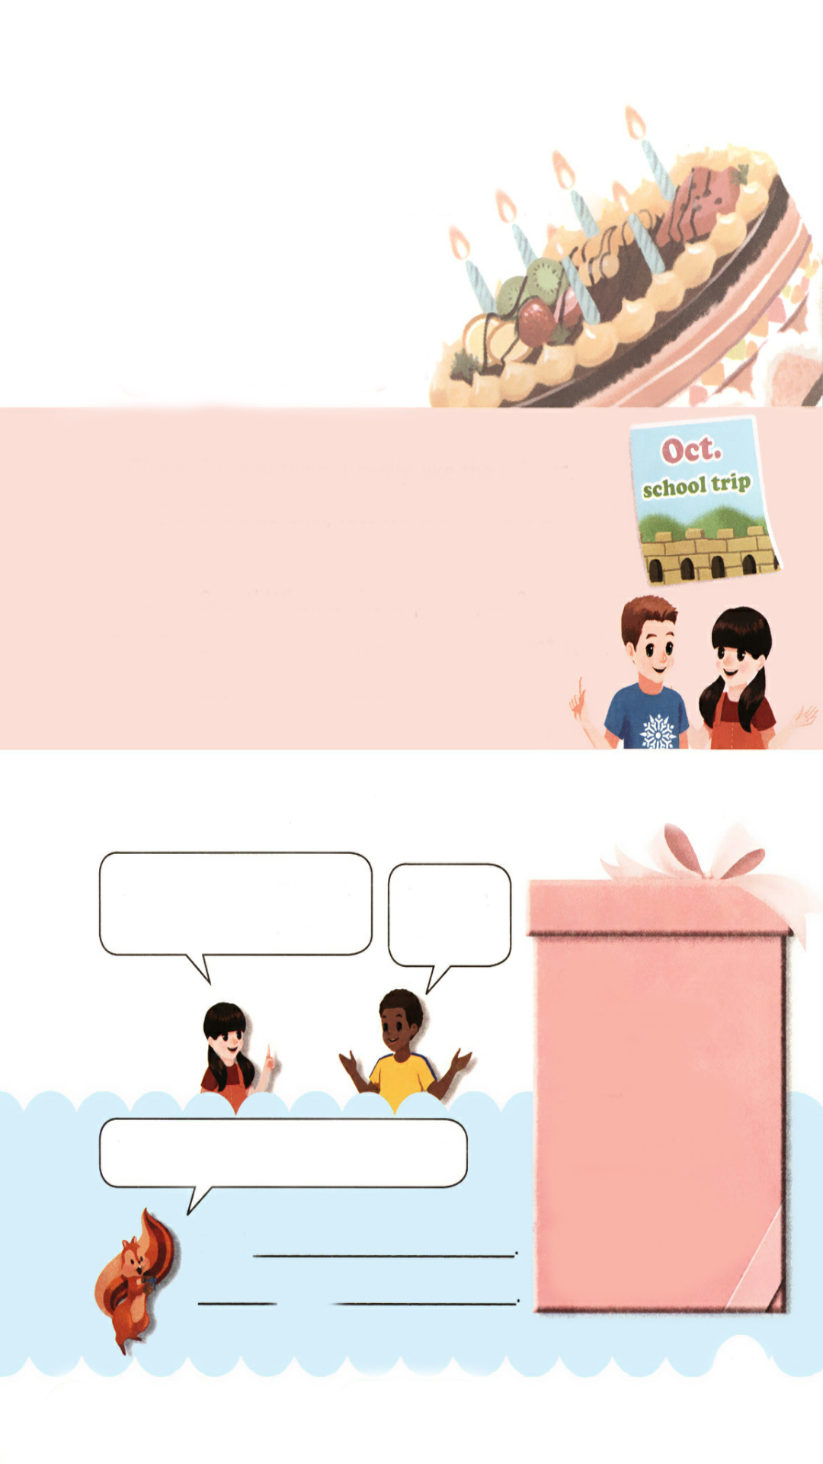
Let’s try
What will Oliver have? Listen and tick.
√
A birthday party.
A birthday cake.

Slide 8
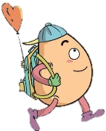
Let’s check！
听力材料：
Oliver: Today is my birthday.
Chen Jie : Really? Happy birthday!
Oliver: Thanks.
Chen Jie : What will you do today?
Oliver: I will have a party. Please come.
Chen Jie : I will.

Slide 9

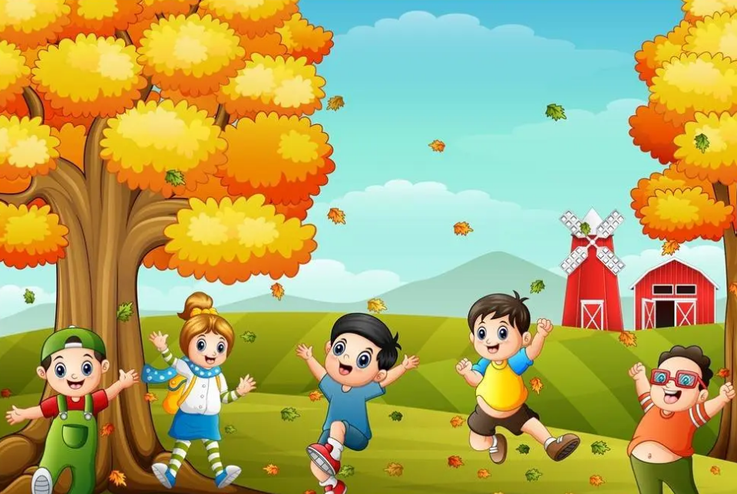
Let’s talk
My birthday is also in autumn.
I usually have a trip on my birthday.
Do you have a trip in autumn?
When is the trip this year?
It’s in…

Slide 10
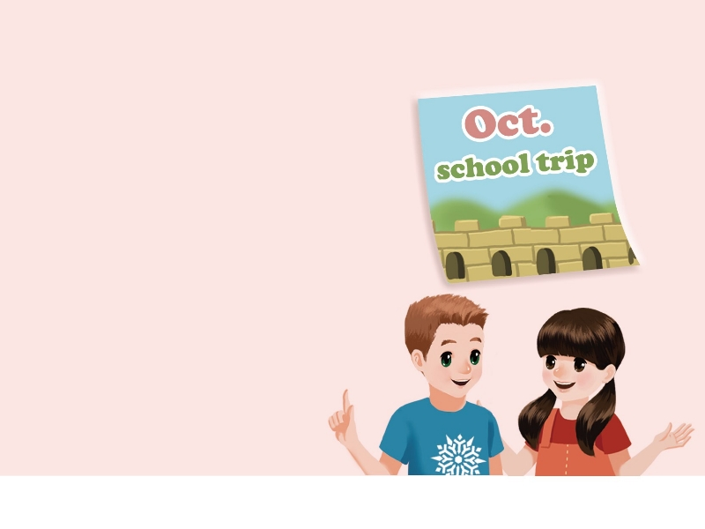

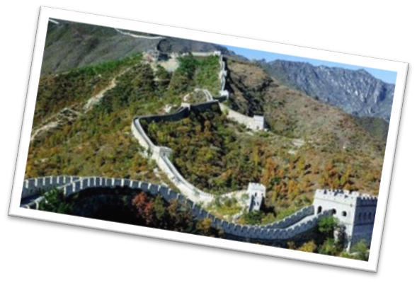
Free talk!
What can you see in the picture?
October
the Great Wall

Slide 11
Free talk!
When is the school trip?
It’s
I will
in October.
go to the Great Wall.
October
the Great Wall

Slide 12
Listen and read.
Oliver: I like autumn. I really like the
colours.
Chen Jie: I like autumn, too. We usually
have a school trip in autumn.
Oliver: Great! When is the trip this
year?
Chen Jie: It’s in October. We’ll go to
the Great Wall.
Oliver: Cool! I love the Great Wall!

Slide 13
Listen and read
Oliver: I like autumn. I really like the
colours.
Chen Jie: I like autumn, too. We usually
have a school trip in autumn.
Oliver: Great! When is the trip this
year?
Chen Jie: It’s in October. We’ll go to
the Great Wall.
Oliver: Cool! I love the Great Wall!
我喜欢秋天，我真的喜欢那颜色。
我也喜欢秋天，我们在秋天通常有一次学校郊游。
太好了！今年什么时候郊游？
在十月，我们要去长城。
好酷啊！我爱长城！

Slide 14
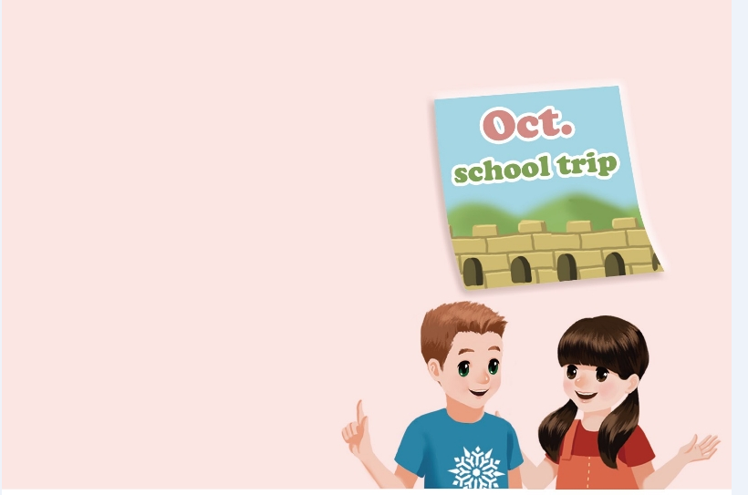
Listen and judge.
×
1.Summer is Oliver’s favourite season. ( )
2.Oliver doesn’t like the colours. ( )
3.Chen Jie likes autumn. ( )
4.The trip is in September. ( )
5.Oliver loves the Great Wall. ( )
×
√
×
√

Slide 15

Read and act.
1.Read it together.
2.Each student
reads a sentence.
Tip: Choose one to read in two. 选择一种两人练习。
3. Read in roles.
分角色朗读。

Slide 16
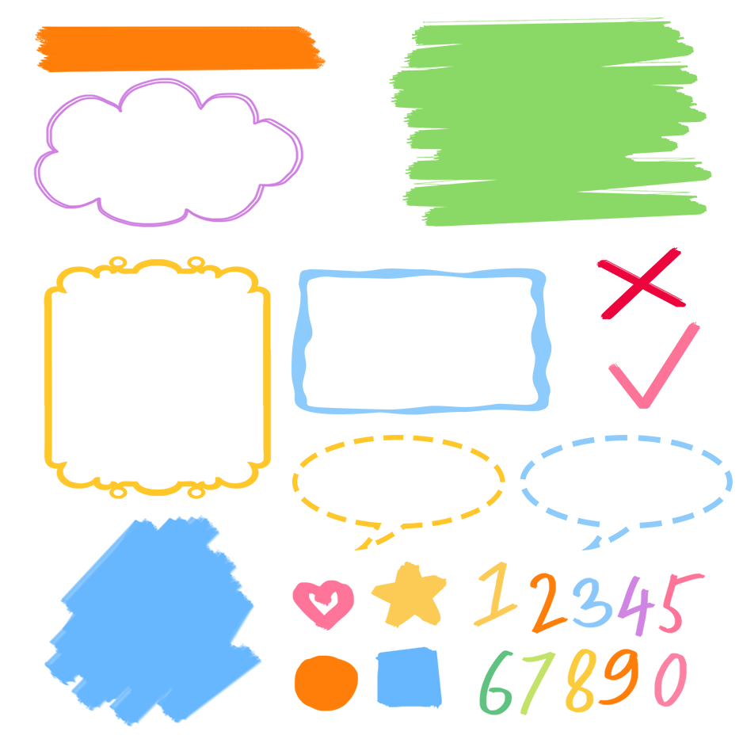
流利地朗读
流利地表演
有感情地表演

Slide 17
Listen and repeat!
确实喜欢
Oliver: I like autumn. I really like the
colours.
Chen Jie: I like autumn, too. We usually
have a school trip in autumn.
Oliver: Great! When is the trip this
year?
Chen Jie: It’s in October. We’ll go to
the Great Wall.
Oliver: Cool! I love the Great Wall!
也,放在肯定句句末
询问某个活动的时间
月份前面用in
专有名词前必须加the

Slide 18
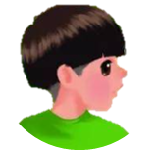

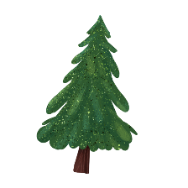

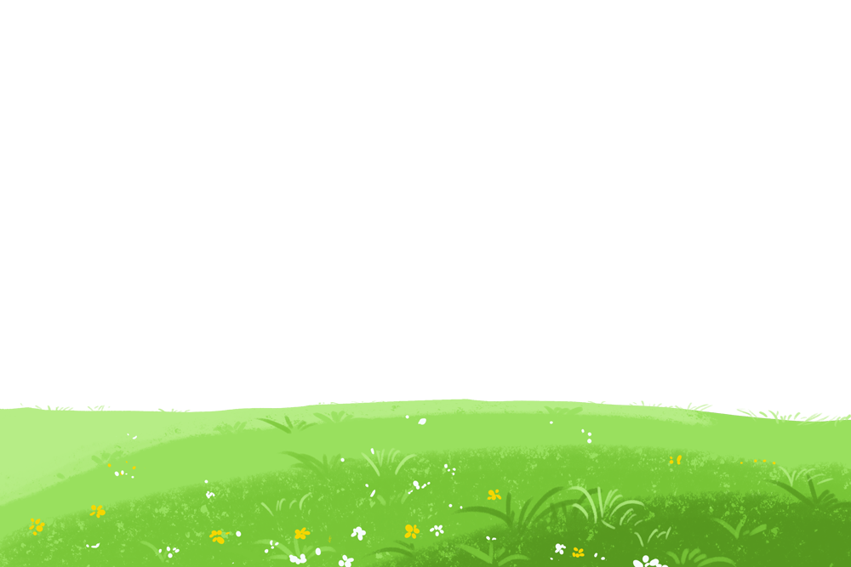
Language point.
—When is the trip this year?
—It’s in October.
用来询问某个活动的时间
句型：
—When is + 活动名词（+ 其他）？
—It’s in/on/at +月份/星期和具体时间/具体时间点.
— When is the singing contest?
— It’s in May.

Slide 19
Language point.
We’ll go to the Great Wall.我们将要去长城。
用来表示某人将要做某事(一般将来时)
句型：
主语+willdo sth.
We will go swimming tomorrow.
They will play football after school.

Slide 20
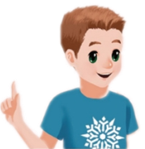
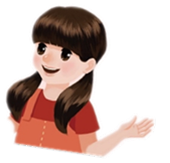
Role play.
autumn
colours
I like ________. I really like the _______.
I like autumn, too. We usually have a ________ in autumn.
Great! ______ is the trip ________?
____________. We’ll go to ____________.
Cool! I love the Great Wall.
school trip
When
this year
It’s in October
the Great Wall

Slide 21
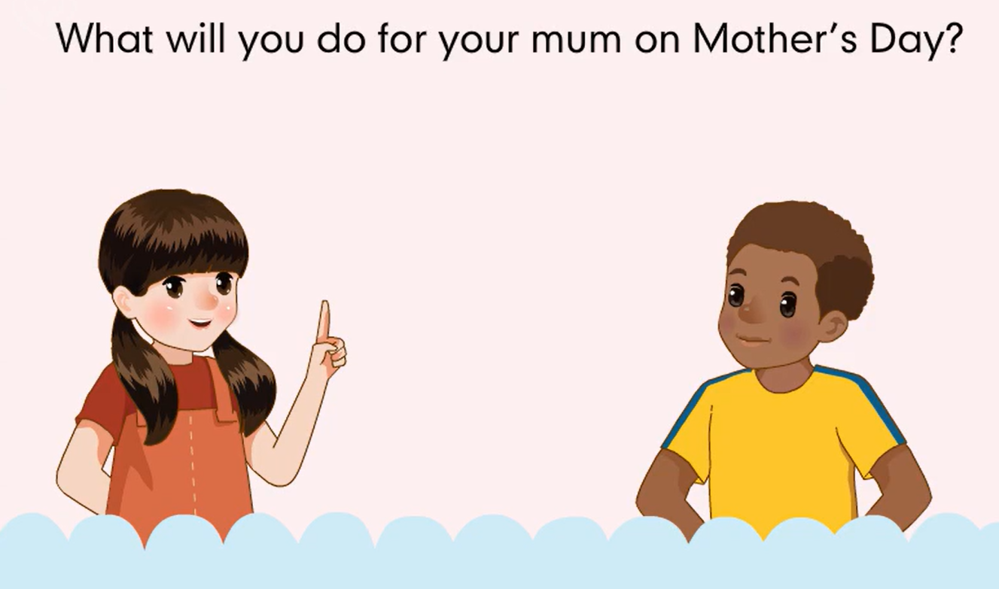
Watch the video.

Slide 22
Read and write.
What will you do for your mum on Mother’s Day?
write sb a letter=write a letter to sb给某人写信
I’ll cook for my mother.
What about you?
I’ll make a card.
cook
make a card
sing to her
say “Thank you”
write her a letter
tell her a story
play the pipa for her
What about you and your partner?
I will
play the pipa for her
Sarah
will
tell her mother a story.
tell sb sth=tell sth to sb.告诉某人某事

Slide 23
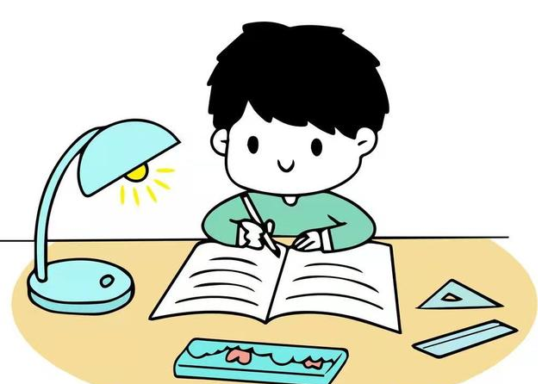
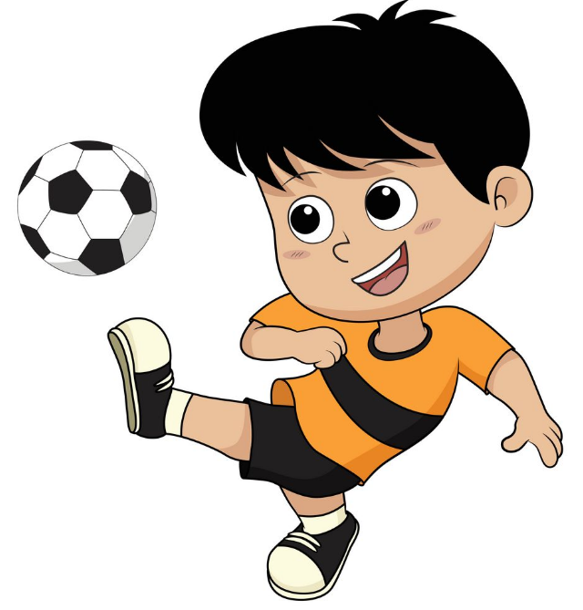
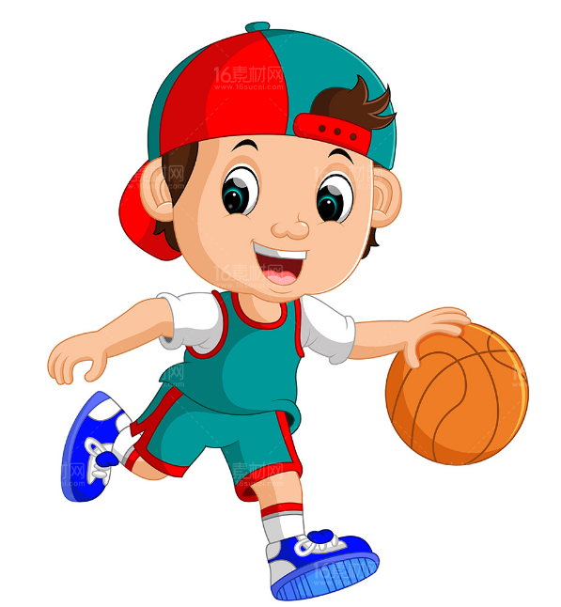
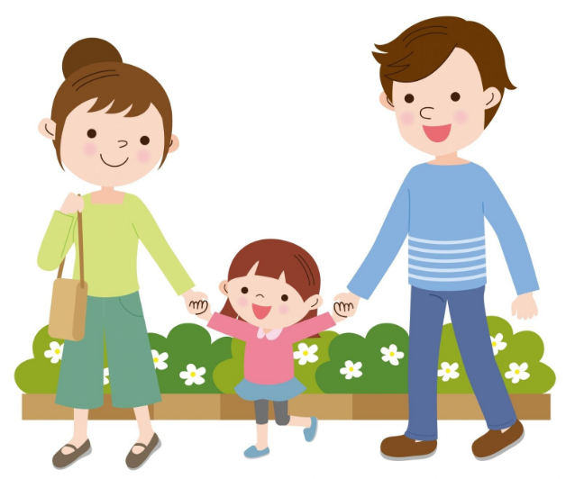
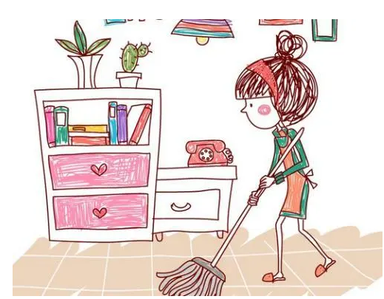
Ask and answer.
—What will you do on the weekend?
—I will...

Slide 24
Ask the question and then pass it on.
April(Apr.) | sports meet …
October(Oct.) | school trip China’s National Day singing contest …
When is …?
It’s in …

Slide 25

Good to know
Reading a good book is like a conversation with many noble people.
读一本好书，就是和许多高尚的人谈话。

Slide 26
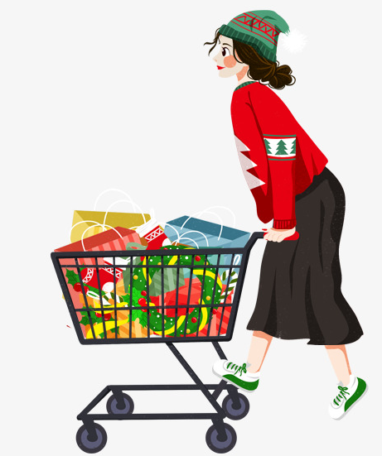
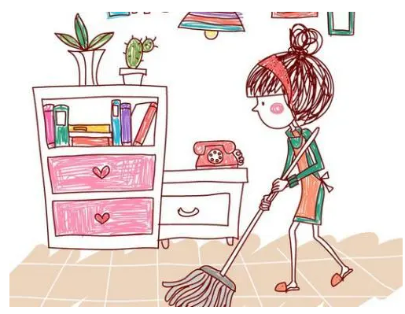
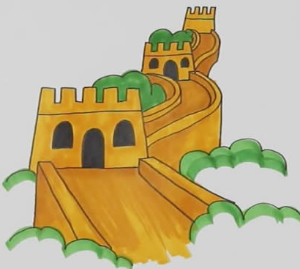
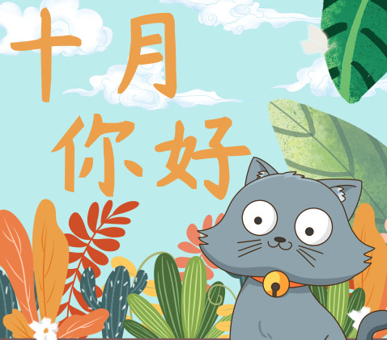
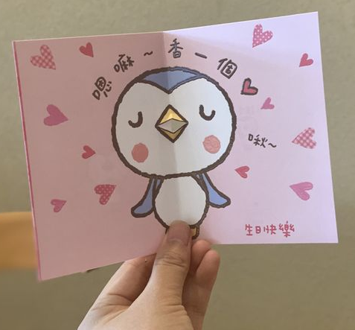
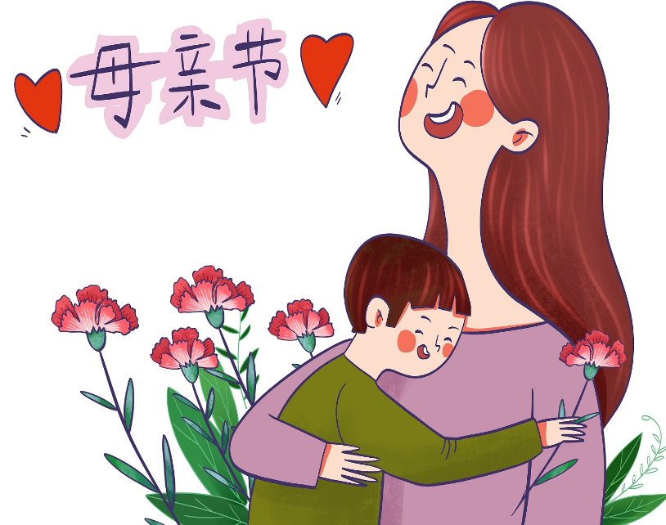
Exercises
一、看图填空。
I will ______________ and ___________ on the weekend.
2. I will go to the ___________ in ________ .
3. I will __________ for my mother on ___________.
clean my room
go shopping
Great Wall
October
make a card
Mother’s Day

Slide 27
二、按照要求完成句子。
1. I will wash my clothes on the weekend.(对画线部分提问)
________________________________________
2. Wall, we, to, Great, go, will, the (.)(连词成句)
_________________________________________
3. I will write her a letter this evening. (变为一般疑问句)
_________________________________________
What will you do on the weekend?
We will go to the Great Wall.
Will you write her a letter this evening?

Slide 28

Summary
1.学习了下列单词：
the Great Wall, October, colours等
2.学习了下列句型：
— When is the trip this year?
— It’s in October.
We’ll go to the Great Wall.

Slide 29
Homework
ONE
TWO
Act the dialogue out with your friends.
Make up a short dialogue using the sentences we have learnt.
Make a card for your mother.

Slide 30
