Slide 1






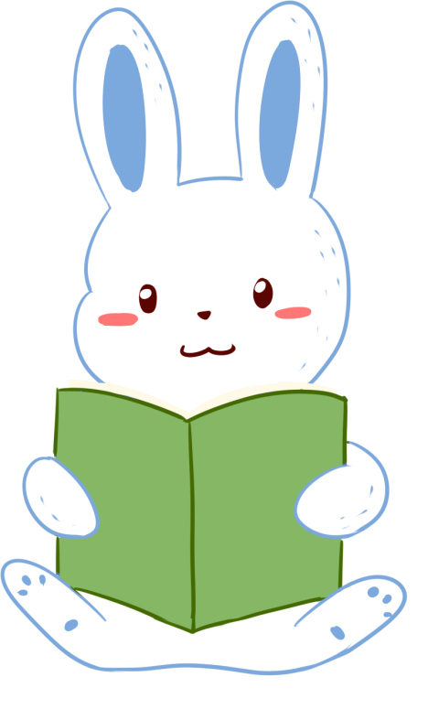
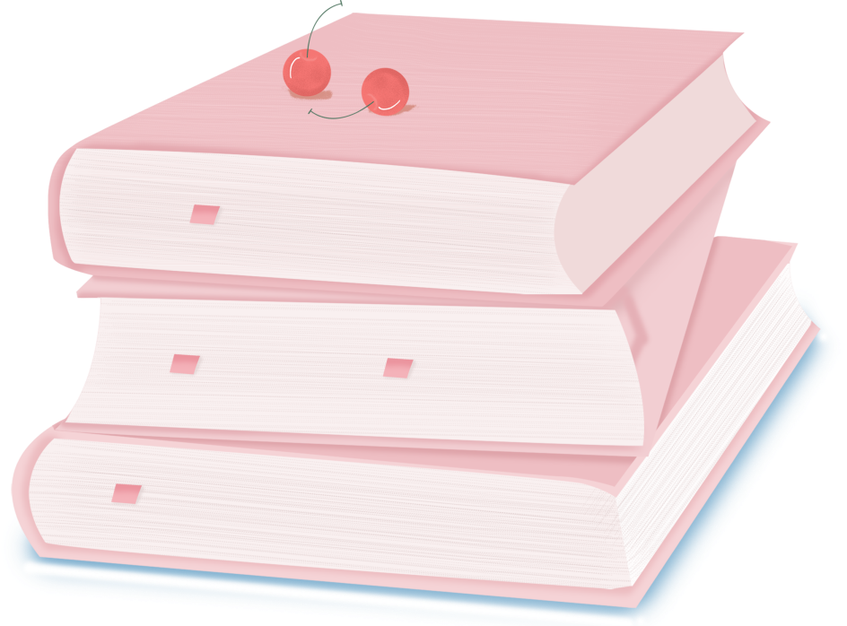

人 教 PEP 版 英 语 五 年 级 下 册
Unit 3
My school calendar
Part B
Let’s try & Let’s talk

Slide 2

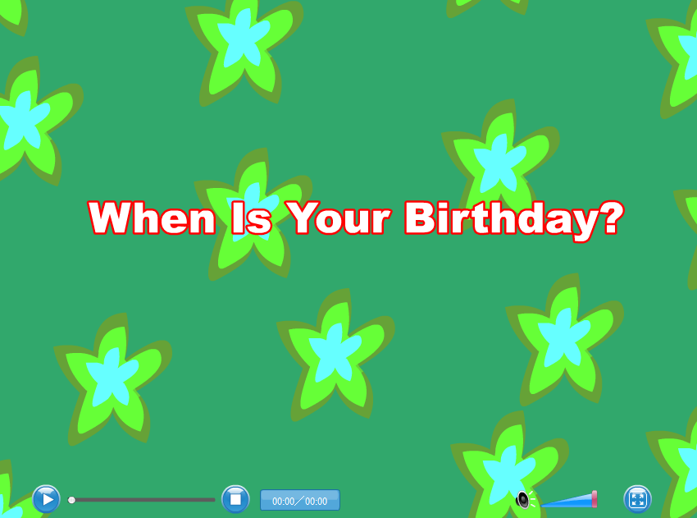
Warm up
Let’s sing!
点击画面 播放视频

Slide 3

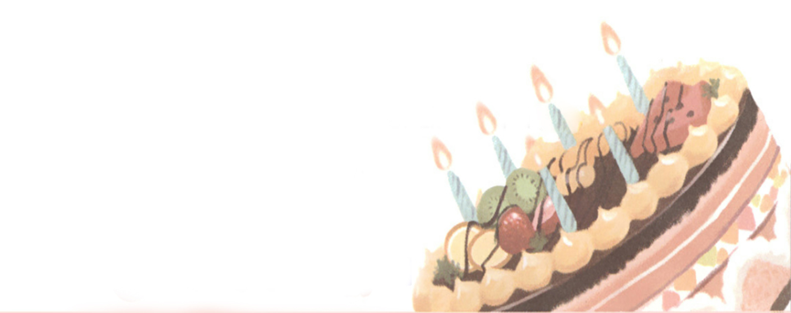
Lead in
What about Oliver’s birthday?

Slide 4

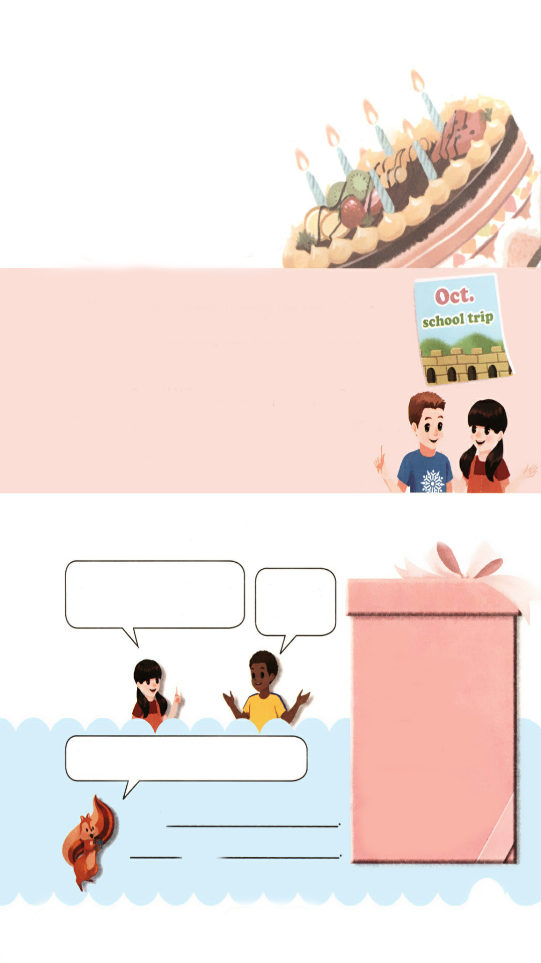
Presentation
Let’s try
What will Oliver have? Listen and tick.
√
A birthday party.
A birthday cake.

Slide 5

听力材料：
Oliver: Today is my birthday.
Chen Jie : Really? Happy birthday!
Oliver: Thanks.
Chen Jie : What will you do today?
Oliver: I will have a party. Please come.
Chen Jie : I will.

Slide 6
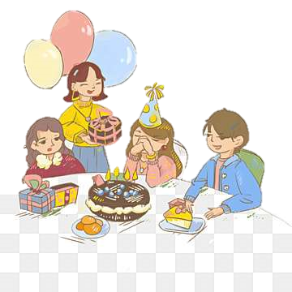
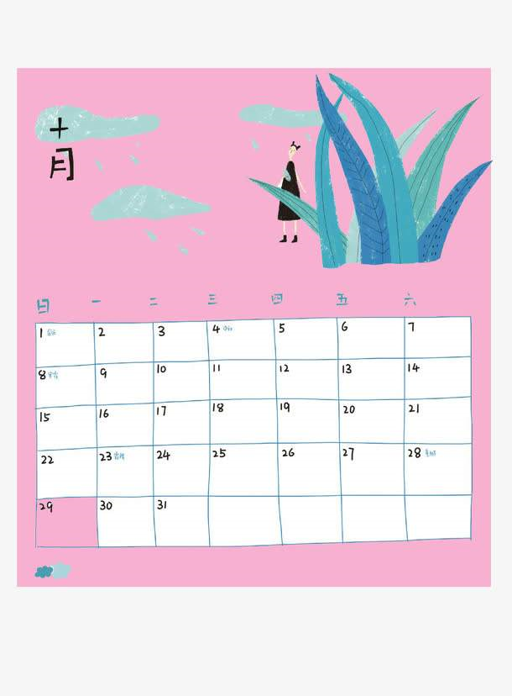
What am I doing?
Me
I am having a birthday party.
When is my birthday?
It’s in October.

Slide 7
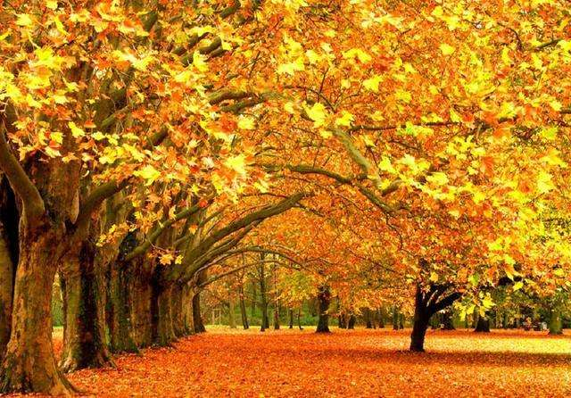
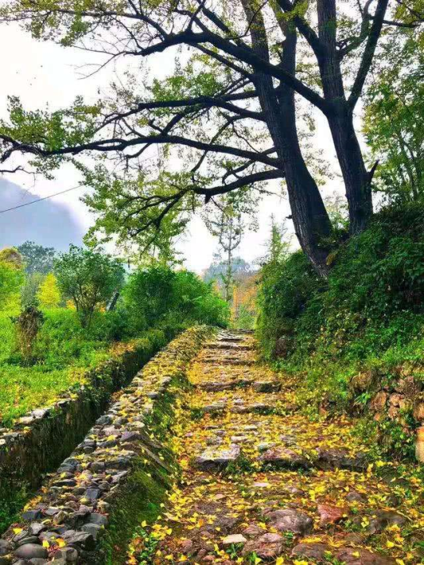
My birthday is also in autumn.
I usually have a trip on my birthday.
Do you have a trip in autumn?
When is the trip this year?
It’s in…

Slide 8
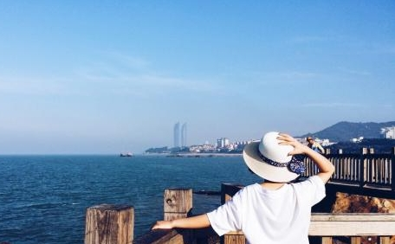
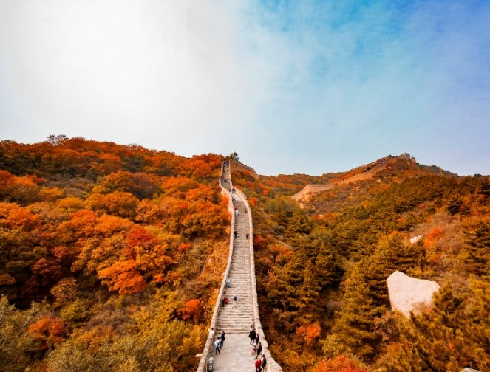
Last year, on my birthday do you know where I went?
We will
长城
This year we’ll go to the Great Wall on my birthday.
Where will you go on your birthday?
I’ll…

Slide 9
Let’s talk
Listen and read.
Oliver:
Chen Jie:
Oliver:
Chen Jie:
Oliver:
I like autumn. I really like the colours.
I like autumn, too. We usually have a school trip in autumn.
Great! When is the trip this year?
It’s in October. We’ll go to the Great Wall.
Cool! I love the Great Wall!

Slide 10
Language points
1. - When is the trip this year?
- It’s in October.
【详解】 问句是when引导的特殊疑问句。询问某个活动的时间。this year 意思是“今年”。this year 是一个表示将来的时间状语。 表达具体在几月用介词 in。在星期和具体的日期前用介词 on。表达具体时间点用介词 at。 例句:
E.g. — When is the dancing contest?
— It‘s in April.

Slide 11
Read and act.
Oliver:
Chen Jie:
Oliver:
Chen Jie:
Oliver:
I like …. I really like the ….
I like …, too. We usually …in autumn.
Great! …?
It’s in …. We’ll …...
Cool! ….

Slide 12
What will you do for your mum on Mother’s Day?
I’ll cook for my mother.
What about you?
I’ll make a card.
cook
make a card
sing to her
say “Thank you”
write her a letter
tell her a story
play the pipa for her
What about you and your partner?
I will
will

Slide 13
Practice
Ask the question and then pass it on.
April(Apr.) | sports meet …
October(Oct.) | school trip China’s National Day writing contest. …
When is …?
It’s in …

Slide 14
Choose and answer the question.
When is …?
It’s in …
Father’s Day
June
Mother’s Day
May
1
2
Tree Planting Day
March
New Year’s Day
January
3
4

Slide 15

Exercises
一、连连看。
1. make a card A. 给她唱歌
2. write her a letter B. 给她讲故事
3. sing to her C.制作卡片
4.play the pipa for her D.给她写信
5.tell story to her E. 给她弹琵琶

Slide 16
二、选择填空。
( )1. Summer is favourite season.
A. he B. his C. him
( ) 2. is your birthday?
A. When B. What C. Which
( ) 3. My birthday is May.
A. in B. on C. at
( )4. -- What will you do on Children’s Day?
-- I sing to them.
A. am B. / C. will
B
A
A
C

Slide 17
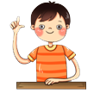
三、给下列的句子排序，组成正确的对话。
( ) Sure .
( ) Excuse me, Can I ask you a question?
( ) Which season do you like best?
( ) When is the school trip?
( ) I like spring. I really like school trip.
( ) It’s in May.
2
1
3
5
4
6

Slide 18


Summary
学习了下列单词：
the Great Wall, colours等
2.学习了下列句型：
— When is the trip this year?
— It’s in October.
We’ll go to the Great Wall.
七彩课堂
伴你成长

Slide 19

Homework
ONE
TWO
Act the dialogue out with your friends.
Make a short dialogue using the sentences we have learnt.
七彩课堂
伴你成长
Make a card for your mother.

Slide 20








