Slide 1


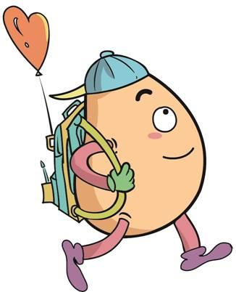






人 教 PEP 版 英 语 五年 级 下 册
Unit 3
My school calendar
Part A
Let’s learn & Read and say

Slide 2


Warm up

Slide 3
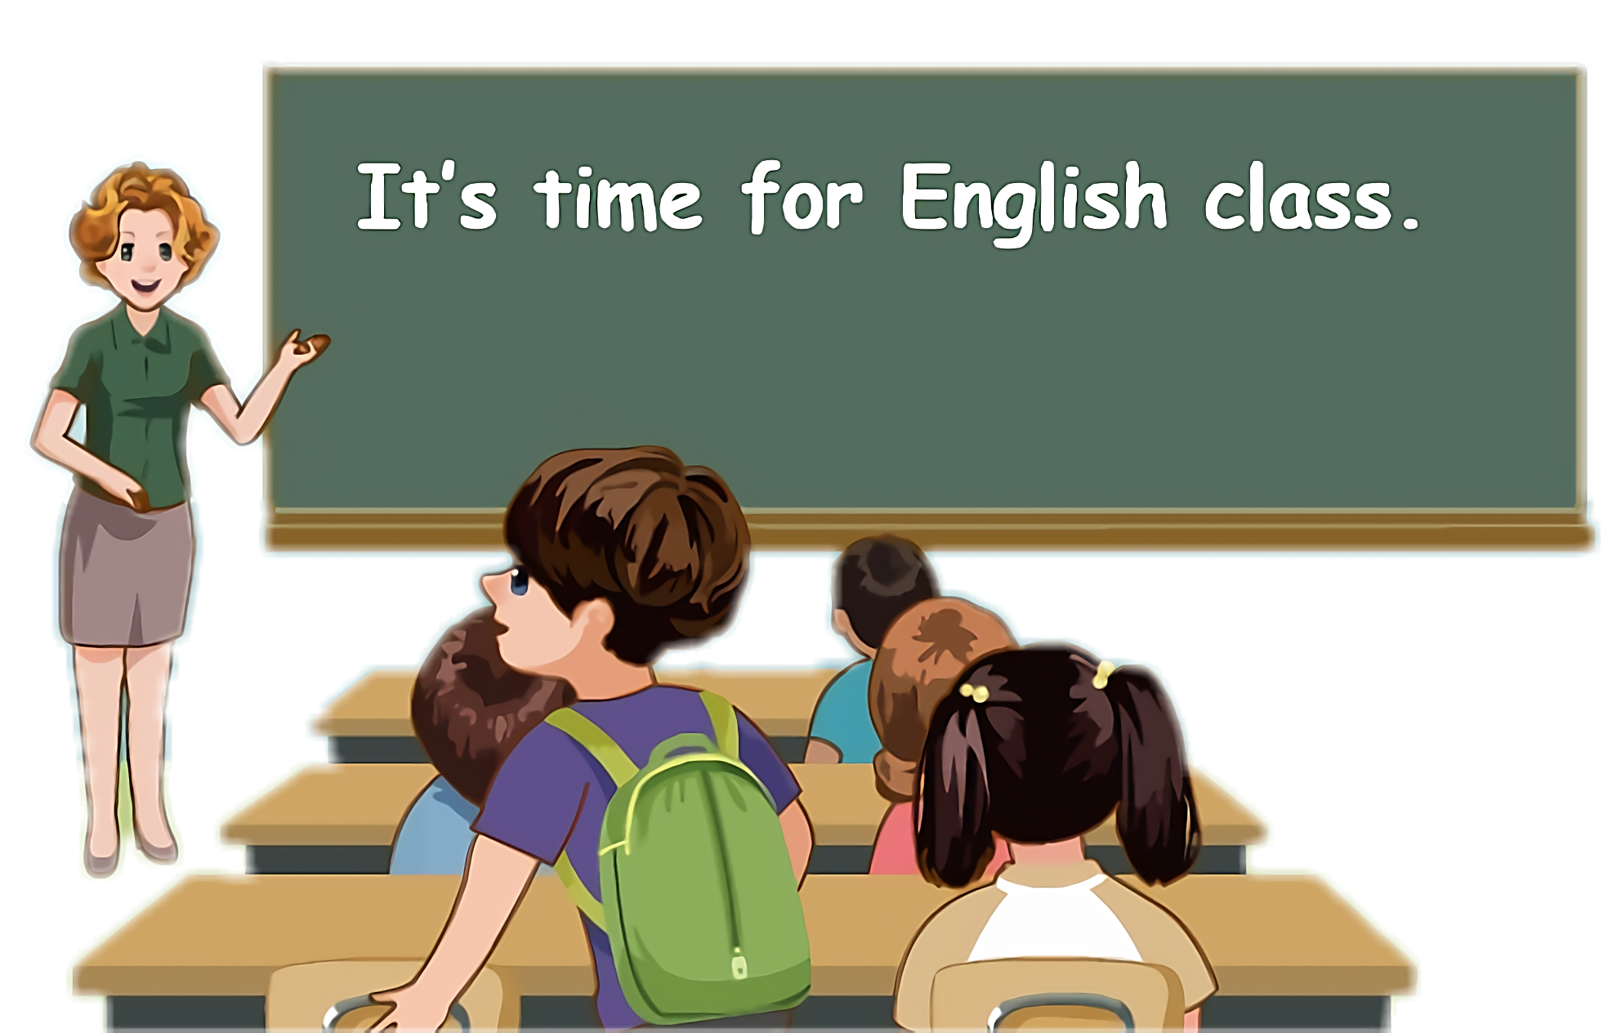
Lead in
Children, do you know any Chinese festivals?

Slide 4
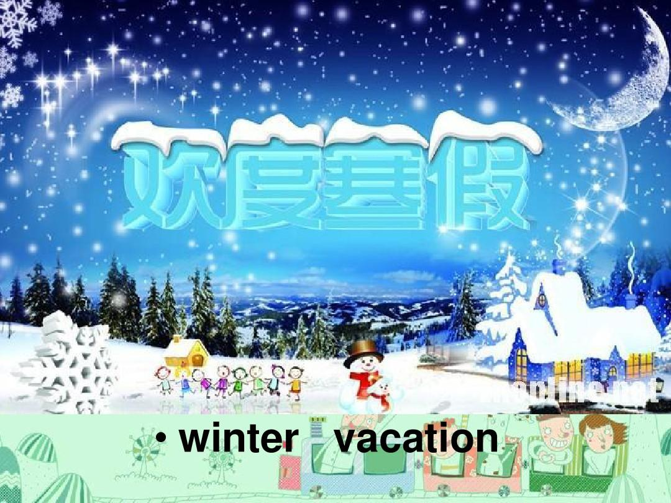
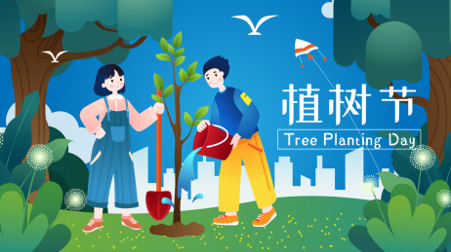
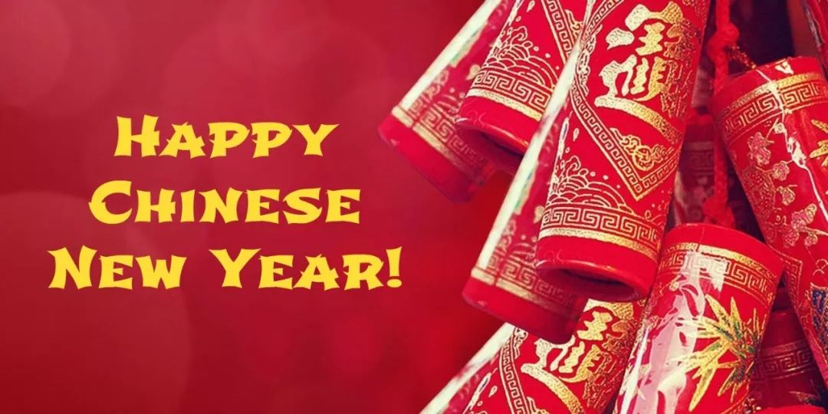
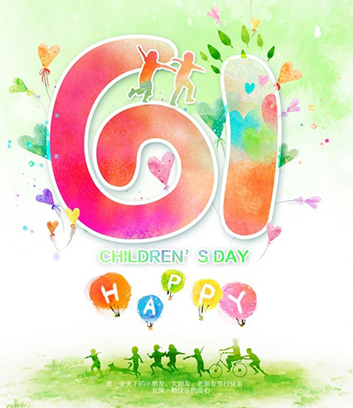

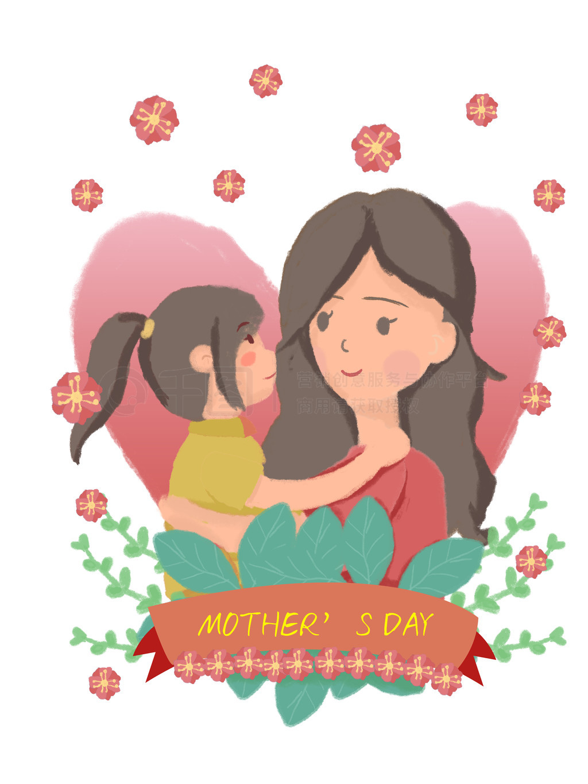
Let’s introduce Chinese festivals.

Slide 5
Presentation
Talk about festivals
Talk about festivals from January to June.
Talk about which months the festivals are in.
Talk about the sentences about the festivals being True or Fasle.

Slide 6

How many months are there in a year? What festivals are there in every month?

Slide 7
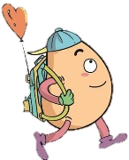

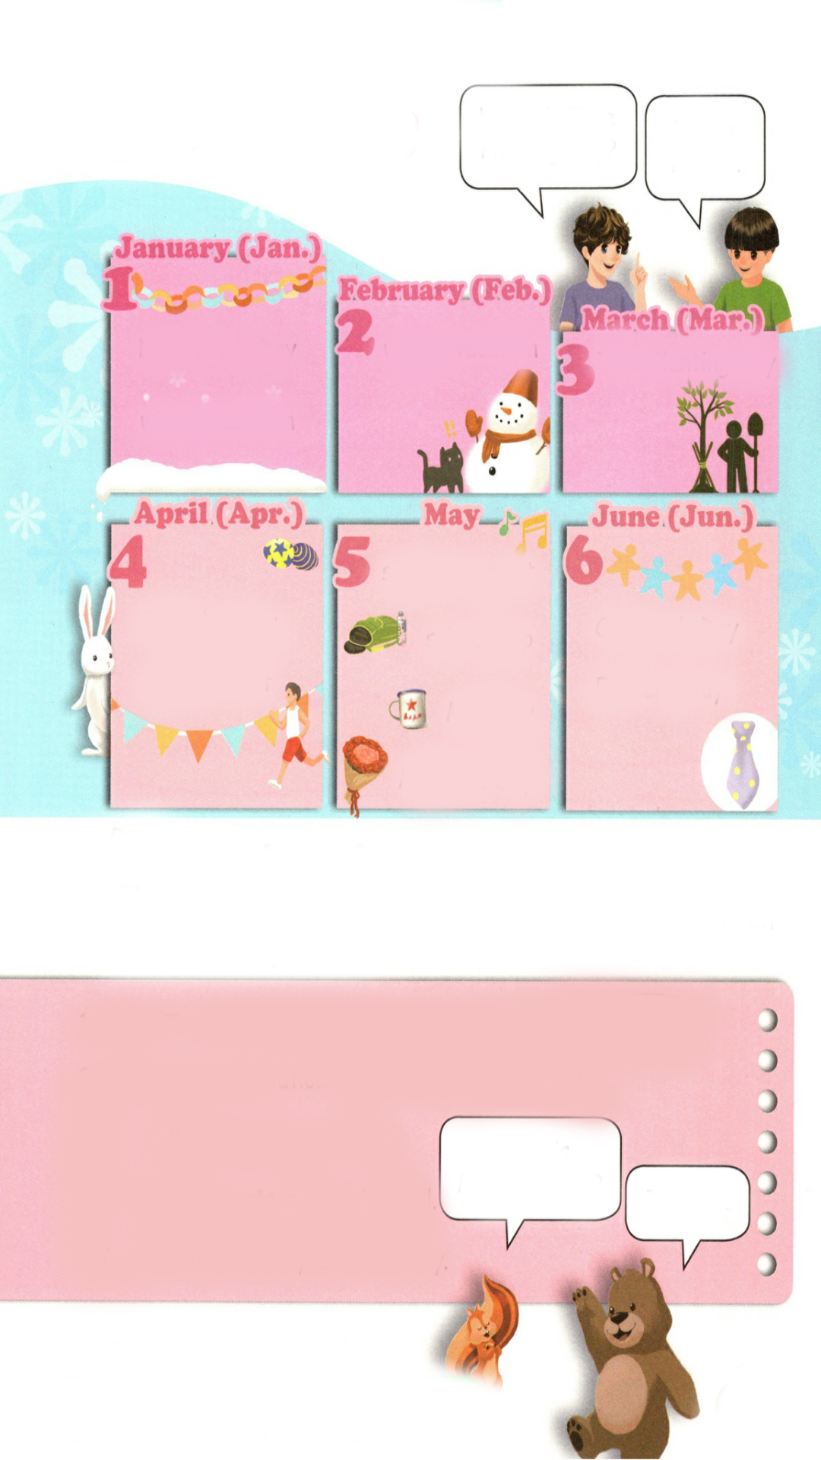

Let’s learn
Learn new words！
January Jan.一月
New Year’s Day
I like New Year’s Day. It’s in January.
winter vacation
I like winter vacation. It’s in January.

Slide 8
February Feb. 二月
winter vacation
I like winter vacation. It’s in February.

Slide 9
March Mar. 三月
Tree Planting Day is in March.
Tree Planting Day

Slide 10
April Apr. 四月
English party
The English party is in April.
sports meet
I like the sports meet. It’s in April.

Slide 11
May 五月
singing contest
I like singing contest. It’s in May.
school trip
Labour Day
I like school trip. It’s in May.
Mother’s Day
I like Labour Day. It’s in May.
I like Mother’s Day. It’s in May.

Slide 12
June Jun. 六月
Children’s Day
I like Children’s Day. It’s in June.
Father’s Day
I like Father’s Day. It’s in June.

Slide 13
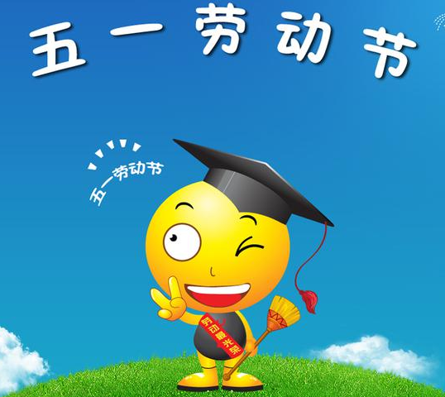


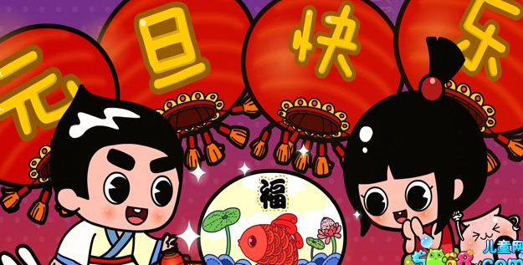
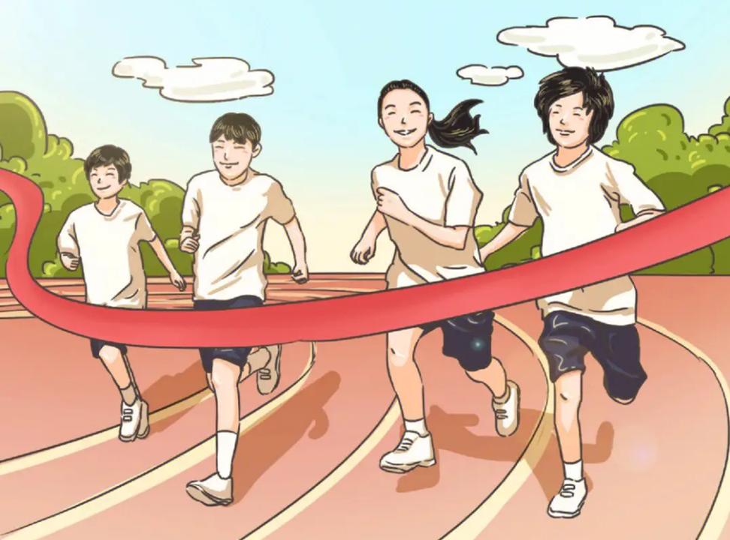
Match the phrases and pictures！
January
May
March
April
June

Slide 14
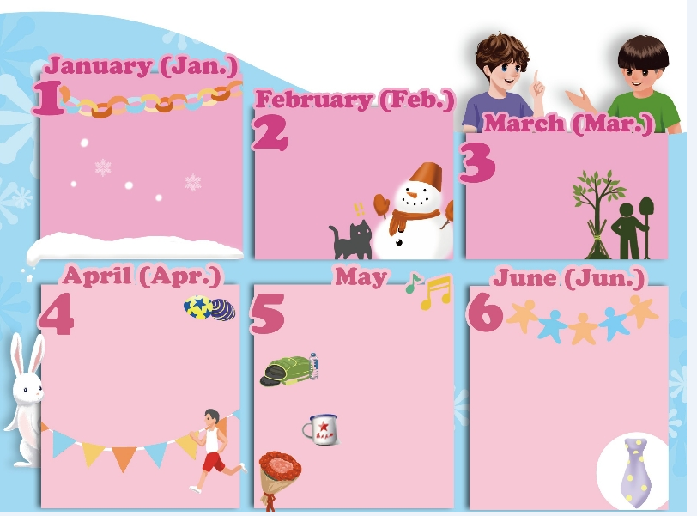
When is Tree Planting Day?
It’s in March.
Listen to the tape.
New Year’s Day
winter vacation
Tree Planting Day
winter vacation
singing contest
English party
school trip
Children’s Day
sports meet
Father’s Day
Labour Day
Mother’s Day

Slide 15
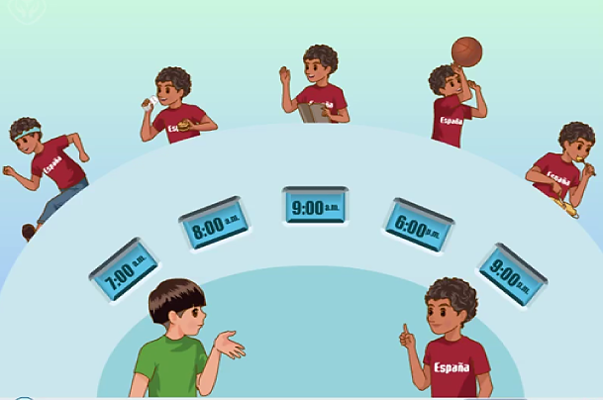
Play in roles.
When is winter vacation?
When is New Year’s Day?
When is the sports meet?
When is Children’s Day?
When is Labour Day?
It’s in February.
It’s in June.
It’s in May.
It’s in April.
It’s in January.

Slide 16



Play a game！
When is …?
winter vacation
It’s in….
Tree Planting Day
sports meet
Children’s Day
Labour Day
New Year’s Day

Slide 17

Read and say
Circle the special days.
1.（ ）Tree Planting Day is in February.
March
2.（ ）Winter vacation is in February and .
January
March
3.（ ）Mother’s Day is in May.
When is Mother’s Day?
It’s in …
4.（ ）The sports meet is in April.
5.（ ）Children’s Day is in .
January

Slide 18
Tick or cross. Correct the names of the months when necessary.
×
March
1.（ ）Tree Planting Day is in February.
×
2.（ ）Winter vacation is in February and .
January
March
√
3.（ ）Mother’s Day is in May.
When is Mother’s Day?
√
4.（ ）The sports meet is in April.
It’s in …
×
5.（ ）Children’s Day is in .
January
June

Slide 19
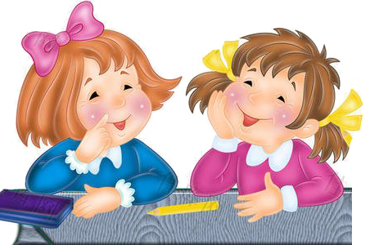
Make up dialogues using the following phrases.
New Year’s Day
sports meet
winter vacation
singing contest
Tree Planting Day
school trip
English party
Children’s Day
When is _____?
It’s in ____ .

Slide 20
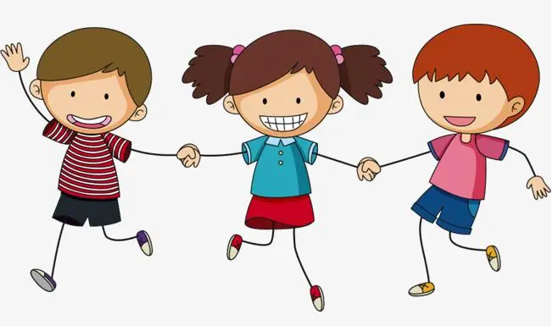
Play a game
接力表演
学生三个人一组进行表演，第一个人表演(植树)动作，第二个人说相应词语(Tree Planting Day)，第三个人说出句子。如: Tree Planting Day is in March.

Slide 21
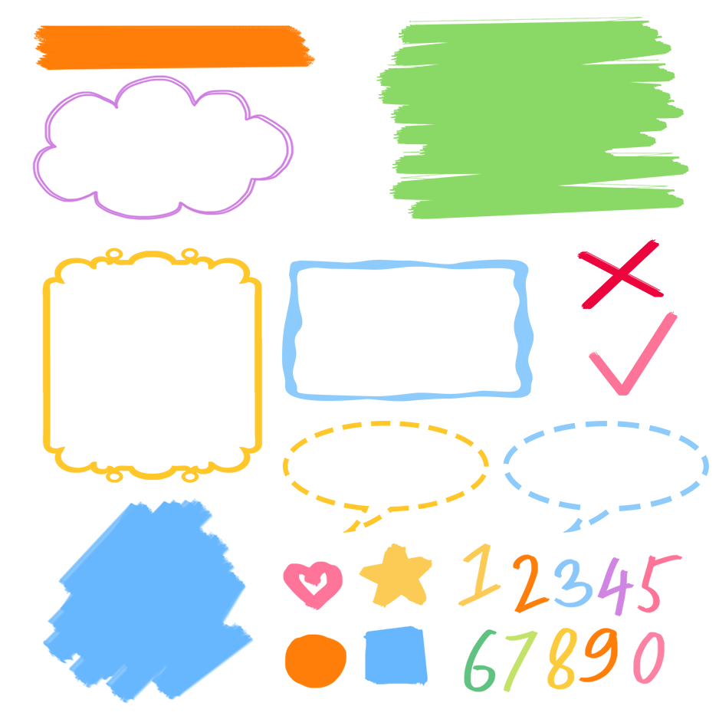
了解节日相关的词组
记忆节日相关的词组
熟练运用节日相关的词组表达

Slide 22

Good to know
Life is a journey, not about the destination, but about the scenery along the way and
the mood of watching the scenery.
人生就是一场旅行，不在乎目的地，在乎的是沿途的风景以及看风景的心情。

Slide 23
Exercises
一、英汉互译。
1. 儿童节________________________ 2. 四月___________
3. 植树节__________________ 4.sports meet_________
5. 寒假____________________ 6. Mother’s Day_______
7. January_________________ 8.五月_________
9. 二月_______________ 10. June________
11. 三月____________ 12.元旦__________
Children’s Day
April
Tree Planting Day
运动会
winter vacation
母亲节
一月
May
February
六月
March
New Year’s Day

Slide 24
二、单项选择。
( )1. Tree Planting Day is _____ March.
A. at B. in C. on D. Of
( )2. ______ is the first month of a year.
A. February B. December C. October D. January
( )3. —______ is Children’s Day? —On June 1st.
A. When B. What C. Which D. Why
( )4. When is your birthday? –It’s in ______
A. third B. January C. home D. 8:30
B
D
A
B

Slide 25
三、按照要求完成句子。
1.New Year’s Day is in January. (对画线部分提问)
____________________________________
2.Day, Tree, is, when, Planting (?)(连词成句)
___________________________________
3. February, vacation, is, winter, in (.) (连词成句)
______________________________
When is New Year’s Day?
When is Tree Planting Day?
Winter vacation is in February.

Slide 26

Summary
学习了下列单词：
January, February, March, April, May, June
2.学习了询问节日的句型：
—When is New Year’s Day?
—It’s in January.

Slide 27
Homework
ONE
TWO
Say and do the actions in pairs.
Make up a short dialogue using the sentences we have learnt.
Ask your parents when Labour Day is.

Slide 28



