Slide 1









人 教 PEP 版 英 语 五 年 级 下 册
Unit 3
My school calendar
Part A
Let’s learn & Read and say

Slide 2

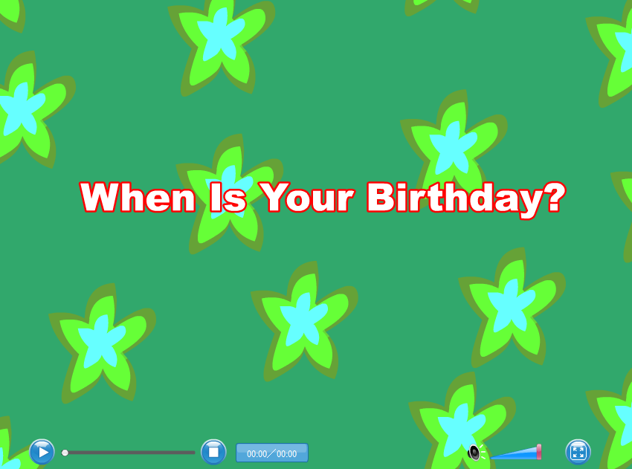
Warm up
Let’s sing!
点击画面 播放视频

Slide 3


Ask and answer.
When do you get up on Monday?
…
What do you do on Mondays?
…

Slide 4

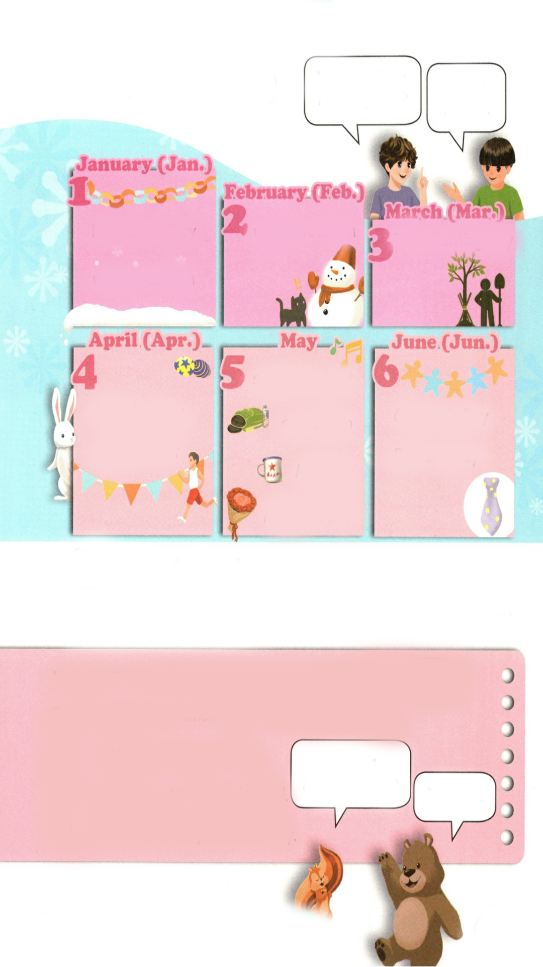
Presentation
Let’s learn
I usually get up at six o’clock and then go to school for classes. But this week our sports meet is coming.
When is the sports meet?
It’s on Friday.
English party
sports meet
Which month is it now?
It’s April.
四月

Slide 5


Talk about your favoutite things in the school calendar.
April
四月
Apr.
I like sport meet. It’s in April.
English party
sports meet
I like English party. It’s in April.
…

Slide 6
January
Jan.
一月
I like New Year’s Day. It’s in January.
New Year’s Day
winter vacation
I like winter vacation. It’s in January.
…

Slide 7
February
Feb.
二月
winter vacation
I like winter vacation. It’s in February.
…

Slide 8
March
三月
Mar.
Tree Planting Day
I like Tree Planting Day. It’s in March.
…

Slide 9
May
五月
I like singing contest. It’s in May.
singing contest
I like school trip. It’s in May.
school trip
I like May Day. It’s in May.
May Day
I like Mother’s Day. It’s in May.
Mother’s Day
…

Slide 10
June
六月
Jun.
I like Children’s Day. It’s in June.
I like Father’s Day. It’s in June.
Children’s Day
Father’s Day
…

Slide 11
Listen and read after the tape.
When is Tree Planting Day?
It’s in March.
New Year’s Day
winter vacation
winter vacation
Tree Planting Day
singing contest
English party
sports meet
Children’s Day
school trip
May Day
Father’s Day
Mother’s Day

Slide 12
Listen again read them by yourselves.
When is Tree Planting Day?
It’s in March.
New Year’s Day
winter vacation
winter vacation
Tree Planting Day
singing contest
English party
sports meet
Children’s Day
school trip
May Day
Father’s Day
Mother’s Day

Slide 13






Play a game.
winter vacation
When is …Day?
It’s in….
Tree Planting Day
sports meet
May Day
Children’s Day
New year’s Day

Slide 14
Read and say
Tick or cross. Correct the names of the months when necessary.
×
1.（ ）Tree Planting Day is in February.
March
×
2.（ ）Winter vacation is in February and .
March
January
√
3.（ ）Mother’s Day is in May.
When is Mother’s Day?
√
4.（ ）The sports meet is in April.
It’s in …
×
5.（ ）Children’s Day is in .
January
June

Slide 15
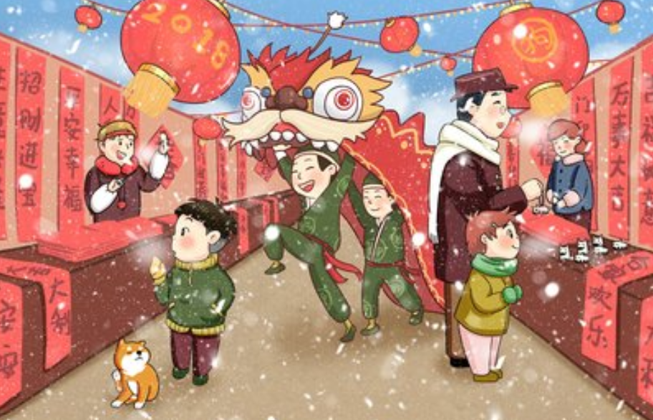
Practice
Practice in pairs.
When is …?
It’s in …

Slide 16
When is …?
It’s in …

Slide 17
When is …?
It’s in …

Slide 18
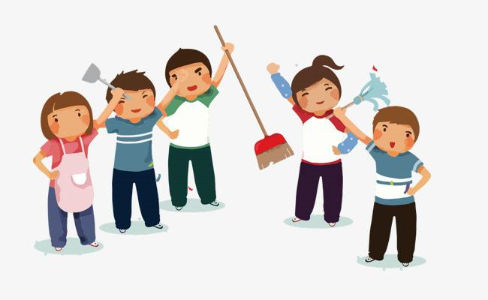
When is …?
It’s in …

Slide 19
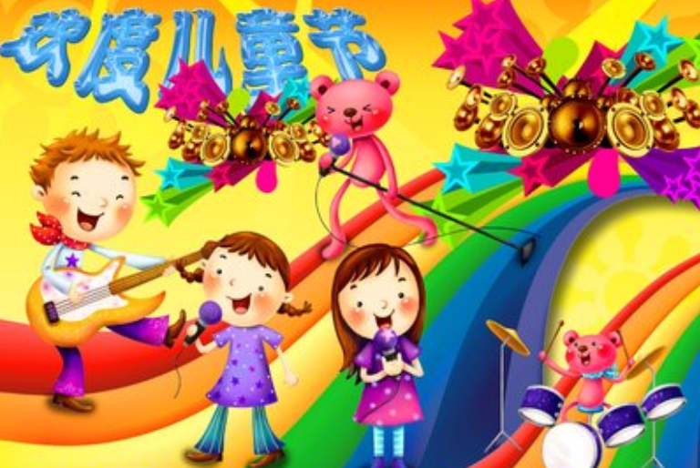
When is …?
It’s in …

Slide 20
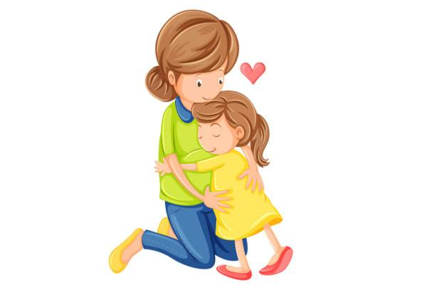
I want to know
A mother's love is a great flame.
Romain Rolland
母爱是一种巨大的火焰。——罗曼罗兰
We must be filial to our parents!
我们必须孝顺父母！

Slide 21

Exercises
一、译成汉语。
1. February________ 2. April________
3. January _______ 4. May_________
5. June _________ 6. March________
二月
四月
一月
五月
六月
三月

Slide 22
二、单项选择。
( ) 1. Winter vacation is February.
A. at B. in C. on
( ) 2. is the first month of a year.
A. February B. December C. January
( ) 3. is Children's Day?
A. When B. What C. Why
B
C
A

Slide 23
三、连词成句。
1. have school trip we a ( . )
2. singing when is the contest ( ? )
3. March is in it( . )
We have a school trip.
When is the singing contest?
It is in March.

Slide 24


Summary
学习了下列单词： January, February, March, April, May, June.
2.学习了询问节日的句型：
—When is …?
—It’s in …
七彩课堂
伴你成长

Slide 25

Homework
ONE
TWO
Say and do the actions in pairs.
Make a short dialogue using the sentences we have learnt.
七彩课堂
伴你成长
Ask your parents when May Day is.

Slide 26




