Slide 1









人 教 PEP 版 英 语 五年 级 下 册
Unit 3
My school cadenlar
Part A
Let’s spell

Slide 2

Review
June
Children’s Day is in ______.
Mother’s Day is in _______.
New Year’s Day is in _________.
Tree Planting Day is in _______.
The English party is in __________.
May
January
March
April

Slide 3

Free talk.
New Year’s Day
winter vacation
Tree Planting Day
sports meet
English party
singing contest
Mother’s Day
school trip
Labour Day
Children’s Day
Father’s Day
When is…?
It’s in …

Slide 4

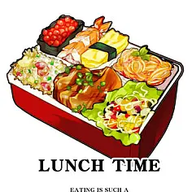

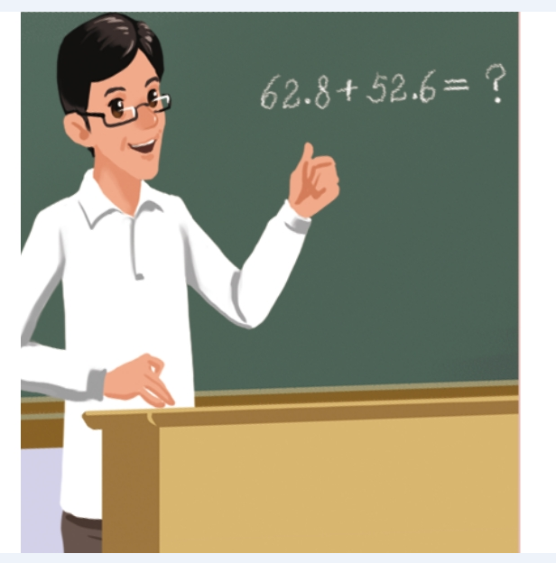



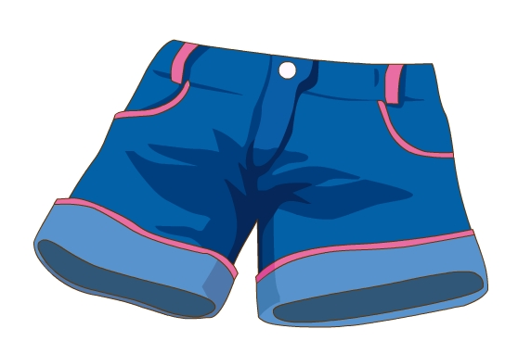
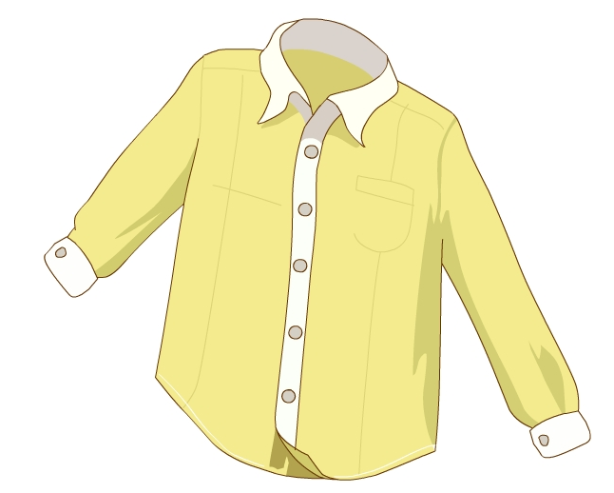

Let’s introduce new words.

Slide 5
Presentation
How to spell ch and sh?
Talk about the pronunciation of “ch” in the words.
Talk about the pronunciation of “sh” in the words.
Talk about the rules of pronuncing “ch” and “sh”.

Slide 6



Let’s spell
Watch the video.

Slide 7

Let’s spell
China/ˈtʃaɪnə/

Slide 8
Let’s spell
chicken/ˈtʃɪkɪn/

Slide 9
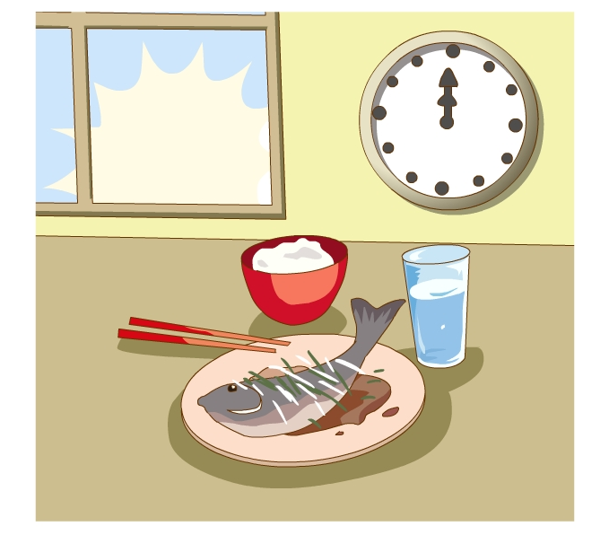
Let’s spell
lunch/lʌntʃ/

Slide 10
Let’s spell
teacher/ˈtiːtʃə(r)/

Slide 11

Let’s spell
China
teacher
chicken
lunch
What does “ch” sound?
ch-/tʃ/

Slide 12
Let’s spell
China
chicken
lunch
teacher
ch
/tʃ/

Slide 13
Let’s spell
sheep/ʃiːp/

Slide 14
Let’s spell
fish/fɪʃ/

Slide 15
Let’s spell
shirt/ʃɜːt/

Slide 16
Let’s spell
shorts/ʃɔːts/

Slide 17
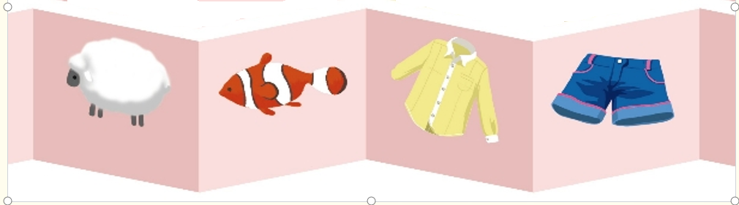
Let’s spell
sheep
fish
shirt
shorts
What does “sh” sound?
sh-/ʃ/

Slide 18
Let’s spell
sheep
fish
shirt
shorts
sh
/ʃ/

Slide 19

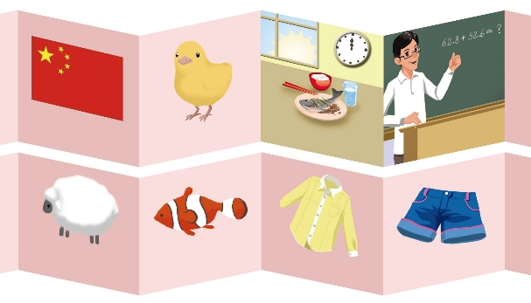
Let’s spell
China
chicken
teacher
lunch
fish
sheep
shirt
shorts

Slide 20
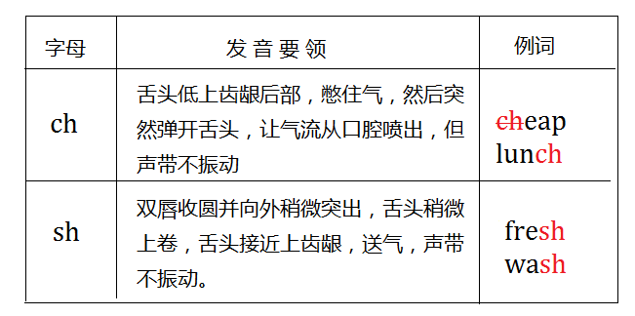
Language points

Slide 21
Practice
Can you read them?
bush
bunch
cash
watch
sh
ch
share
church
wash
bench
shade
French

Slide 22




Let’s play！
Find the right house.
sheep
fish
shorts
China
teacher
chicken
shirt
lunch
ch
sh

Slide 23

Let’s chant

Slide 24
Teacher, teacher,
What’s for lunch today?
Chicken or fish
Chicken or fish.
I love chicken, HOORAY!
听到ch时坐正，听到sh时拍下手。

Slide 25
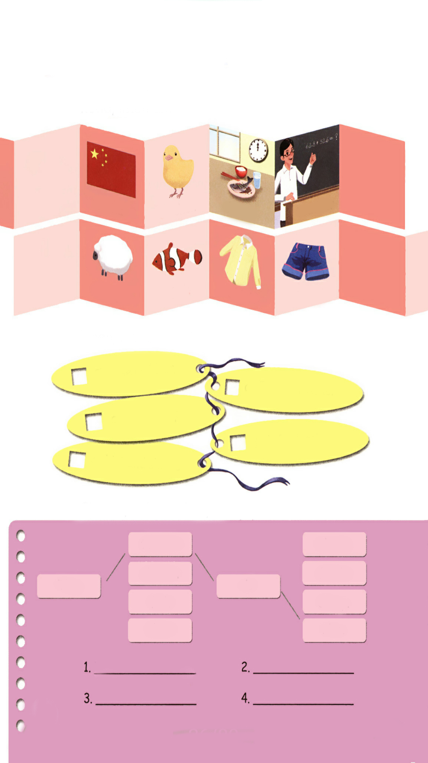
Listen, number and say.
Chinese children
5
1
an English teacher
a short sheep
3
2
fish for lunch
4
a shirt and shorts

Slide 26
Choose, write and say.
teacher
short.
chicken
fresh.
The
is
fish
cheap.
shirt
nice.
The teacher is nice.
The chicken is cheap.
The fish is fresh.
The shirt is short.

Slide 27

了解ch,sh的发音规则
记忆ch,sh的发音规则
根据发音规则读出生词

Slide 28
Exercises
一、读一读，判断画线部分读音，相同写“T”，不同写“F”。
( )1. A. how B. slow C. cow
( )2.A. China B. lunch C. child
( )3.A. rain B. April C. May
( )4.A. fish B. sheep C. cheap
( )5.A. fly B. easy C. sky
F
T
T
F
F

Slide 29
二、用适当的介词填空。
1. China’s National Day is ______ October.
2. Let’s have lunch ______ 12:00.
3. I often watch TV ______ the weekend.
4. What do you have ______ Sundays?
5. I can make a snowman ______ winter.
in
at
on
on
in

Slide 30

Summary
字母/字母组合
发音
词语
ch
/ tʃ /
China chicken
lunch teacher
sh
/ ʃ /
sheep fish
shirt shorts

Slide 31
Homework
ONE
TWO
Read the words.
Play the Bingo game with your friends.
Collect words with “sh” or “ch”.

Slide 32







