Slide 1









人 教 PEP 版 英 语 五 年 级 下 册
Unit 3
My school calendar
Part A
Let’s spell

Slide 2


Warm up
Free talk.
What’s the weather like today?
…
When is New Year’s Day?
…
When is…
…

Slide 3


Lead in
Look at the picture. What is it?
It’s a farm.
Yes, it’s Old MacDonald’s farm. Let’s go to see the farm.

Slide 4

Presentation
Let’s spell
Where is the teacher from?
The teacher is from China.

Slide 5

What does the student wear today?
The student wears a T-shirt and shorts today.

Slide 6
What animals do they see at the farm?
They see fish, sheep and chicken.

Slide 7
Read and find the rules.
teacher
China
T-shirt
shorts
sheep
fish
chicken

Slide 8

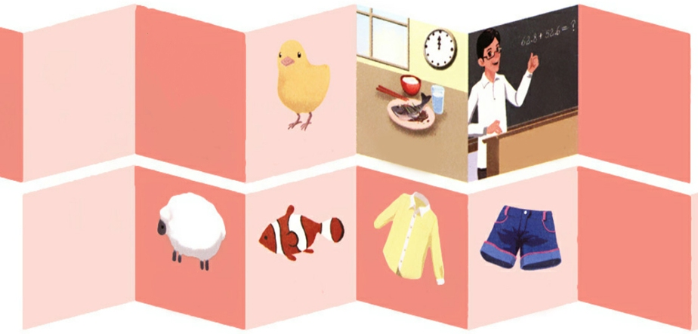
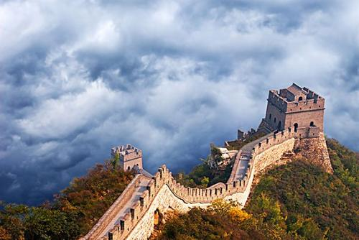
/tʃ/
Read after the tape.
chicken
lunch
teacher
China
sheep
shorts
fish
shirt
/ʃ/

Slide 9
Listen and chant together.
Let’s chant.
点击画面 播放视频
Teacher, teacher,
What’s for lunch today?
Chicken or fish
Chicken or fish。
I love chicken, HOORAY!

Slide 10
Language points
1. 发音组合 ch 发 / tʃ /的音。 音标特征:舌端齿龈摩擦清辅音。 发音要诀: 双唇微开, 舌尖舌端抬起, 先用舌尖抵上齿龈, 形成阻碍, 然后张开,使气流外泄而成音。气流冲破这个阻碍后, 舌和齿龈间仍保持一个狭缝,发出摩擦的声音。/ tʃ /是清辅音, 发音时声带不振动。类似的词语有: cheap便宜的， China中国。
点击画面 播放视频

Slide 11
2. 发音组合 sh 发/ ʃ /的音。 音标特征:舌端齿龈后部摩擦清辅音。 发音要诀:舌尖和舌端向上抬至齿龈较后部分, 整个舌身抬起靠近上腭, 开成一条狭长的通道, 用力将气息送出来,气流由此通道流过, 引起摩擦成音。/ ʃ /是清辅音,发音时声带不振动。类似的词语有: ship轮船、 fish鱼。
点击画面 播放视频

Slide 12
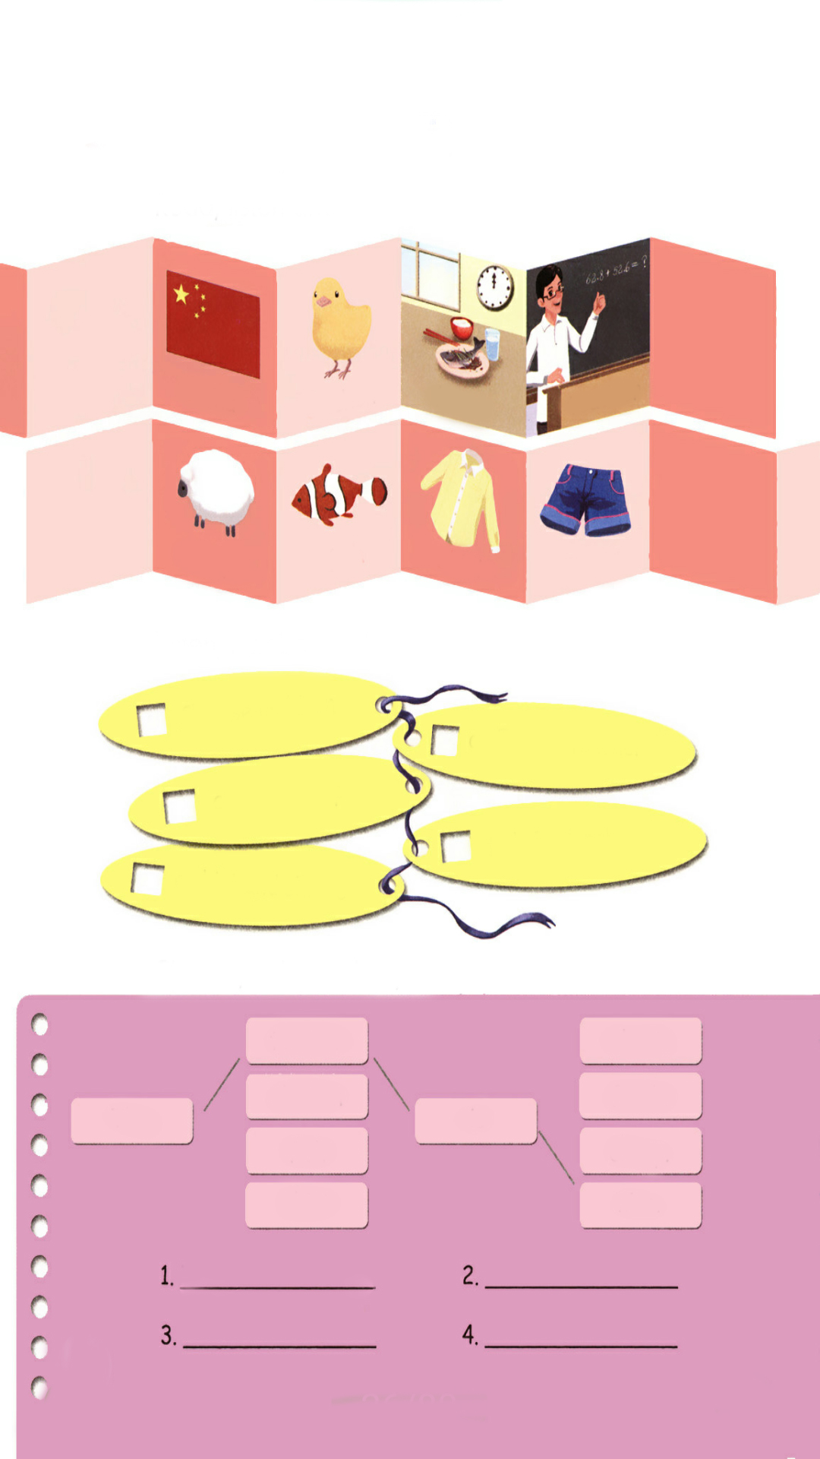
Listen, number and say.
点击画面 播放视频
Chinese children.
5
1
an English teacher.
a short sheep.
3
2
Fish for lunch .
4
a shirt and shorts.

Slide 13
Choose, write and say.
teacher
short.
chicken
fresh.
The
is
fish
cheap.
shirt
nice.
The teacher is nice.
The chicken is cheap.
The fish is fresh.
The shirt is short.

Slide 14
Practice
Can you read them?
bush
bunch
cash
watch
sh
ch
share
church
wash
bench
shade
French

Slide 15




Game: Find the right house.
sheep
fish
shorts
China
teacher
chicken
shirt
lunch
ch
sh

Slide 16

Exercises
一、英译汉。
午餐
老师
1. lunch___________ 2. teacher___________
3. chicken_________ 4. shirt ____________
5. sheep __________ 6. China_____________
小鸡
衬衫
绵羊
中国

Slide 17
二、连词成句
teacher The nice is ( . )
2. usually Sports meet in is May ( . )
3. Children’s Day June in is ( . )
The teacher is nice.
Sports meet is usually in May.
Children’s Day is in June.

Slide 18

三、给单词分类。
chicken
sheep
cheap watch catch chip such bench
sheep wash cash ship bush wish
cheap sheep wash watch cash catch ship chip bush bench such wish

Slide 19


Summary
字母/字母组合
发音
词语
ch
七彩课堂
伴你成长
China chicken
lunch teacher
/ tʃ /
sh
/ ʃ /
sheep fish
shirt shorts

Slide 20

Homework
ONE
TWO
七彩课堂
伴你成长
Read the words.
Make sentences using the words we have learnt.
Collect words with “sh” and “ch”.

Slide 21








