Slide 1


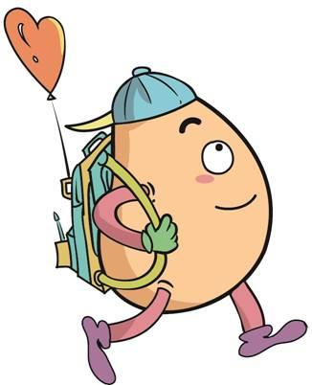






人 教 PEP 版 英 语 五年 级 下 册
Unit 3
My school calendar
Part A
Let’s try & Let’s talk

Slide 2

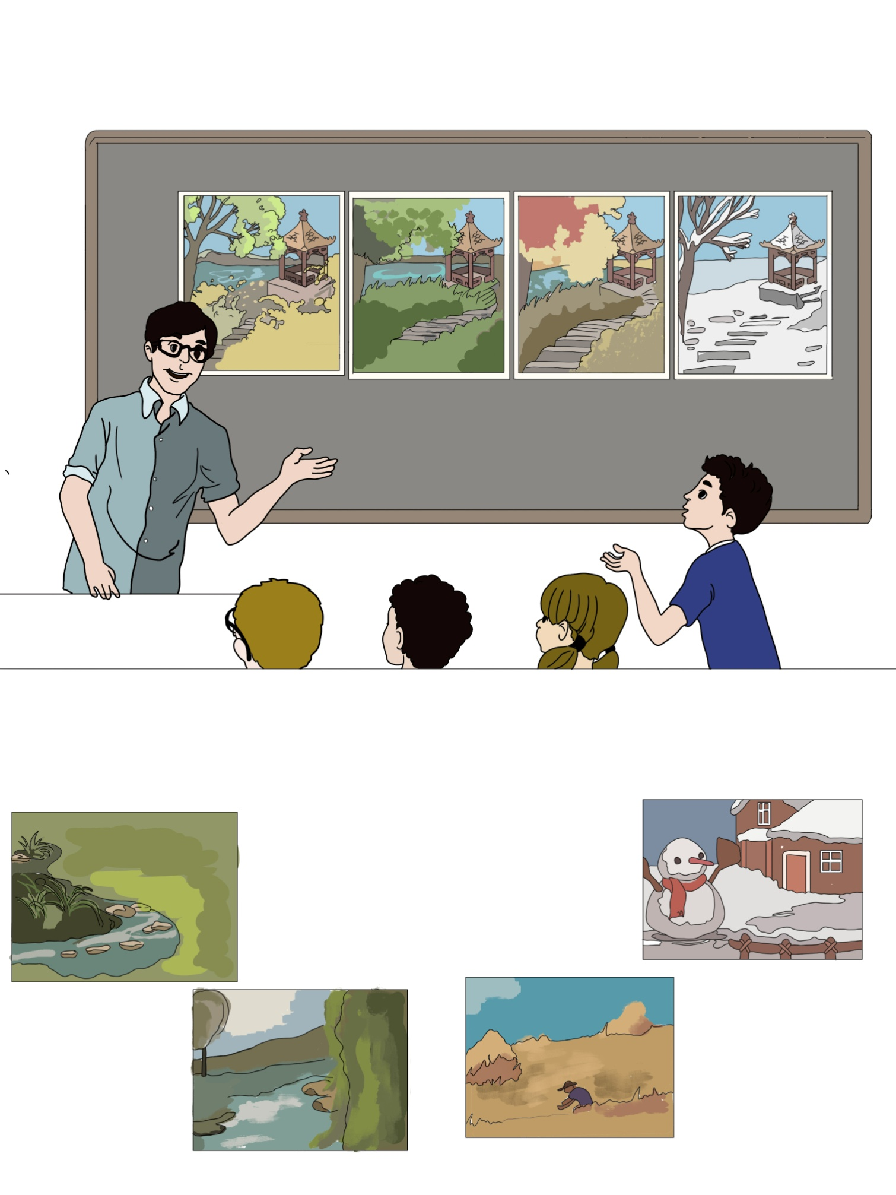
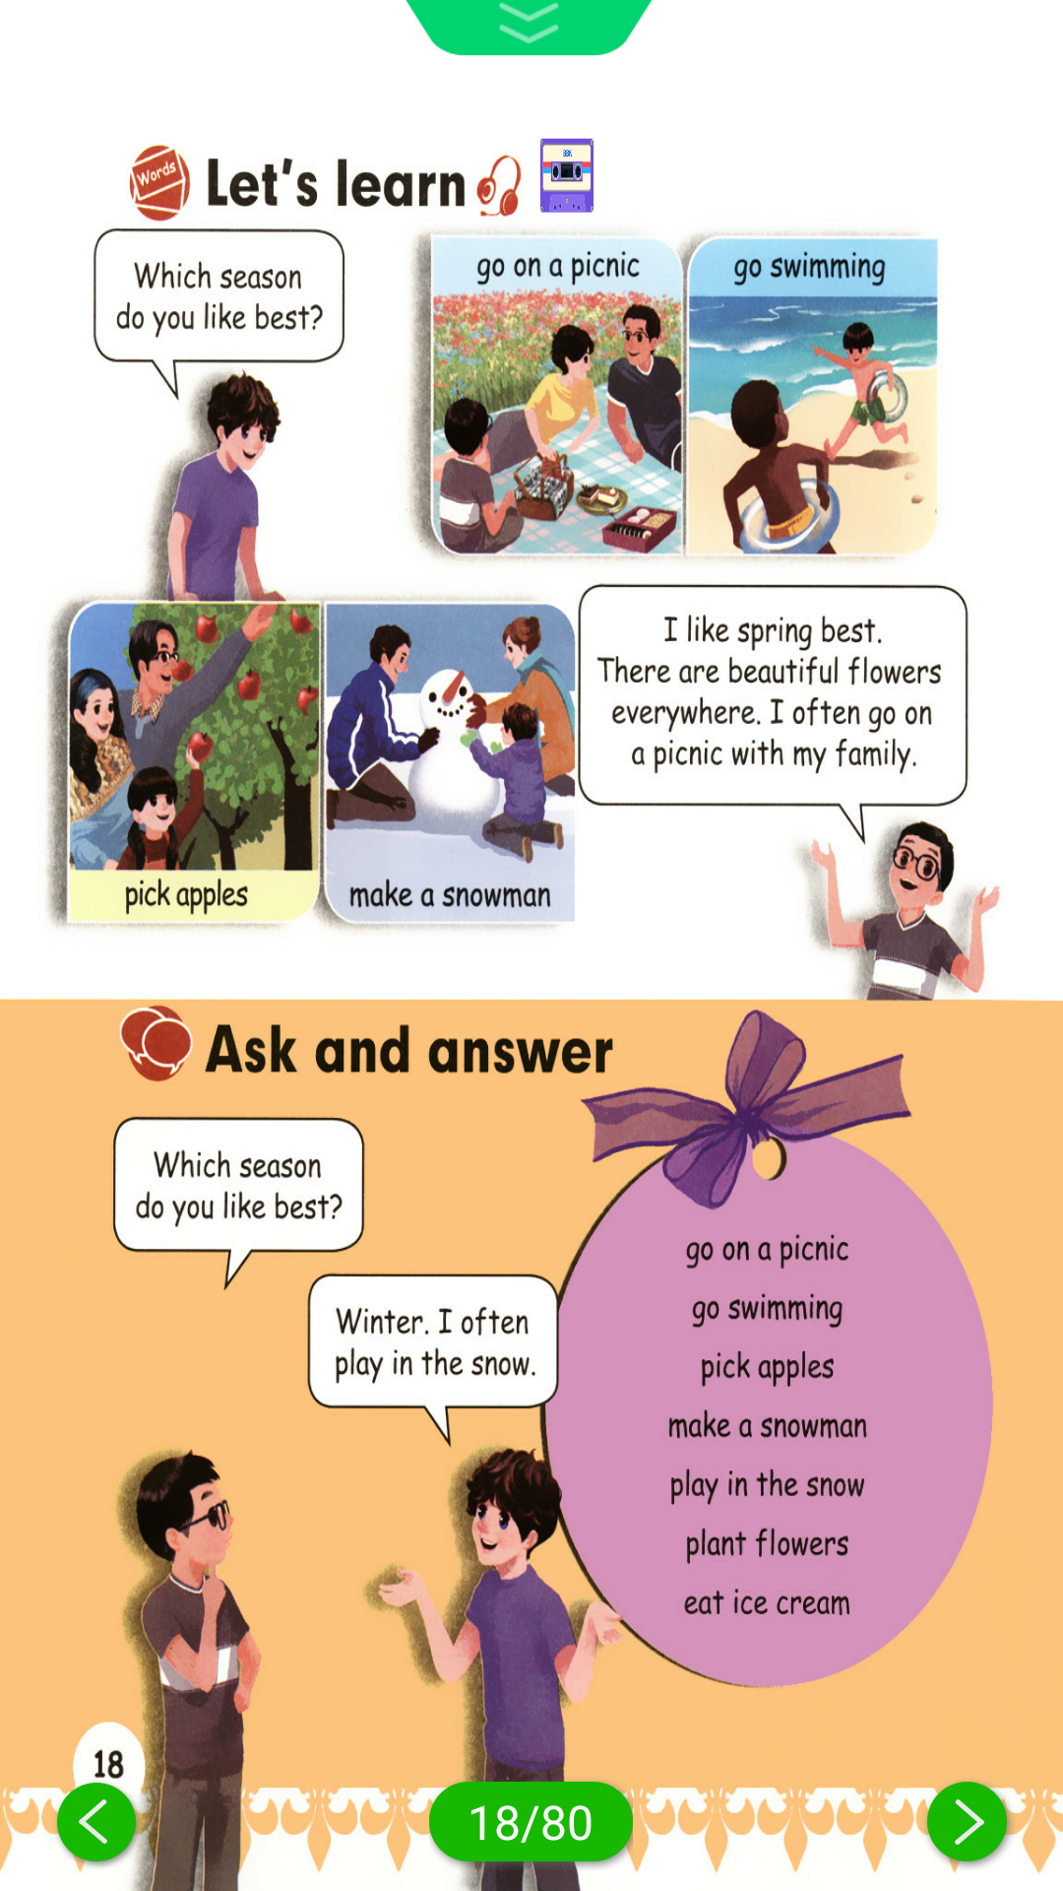
Warm up
Match the words with the pictures.
summer
winter
autumn
spring
go on a picnic
make a snowman
pick apples
go swimming

Slide 3
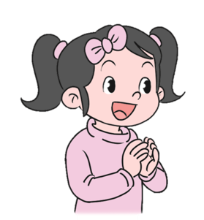
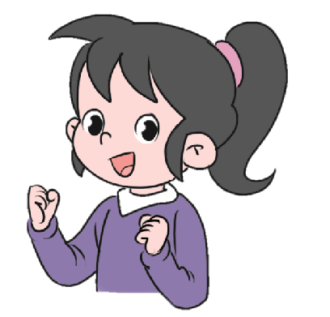
Lead in
Which season do you like best? Why?
I like spring best.
Because I can go on a picnic.

Slide 4

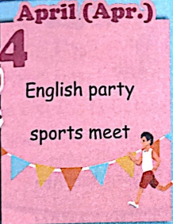
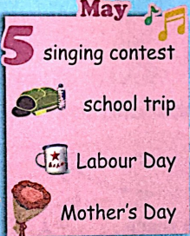
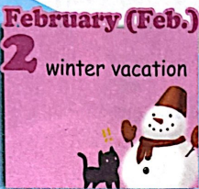

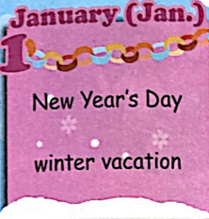

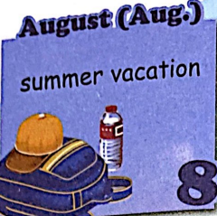
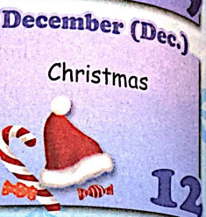
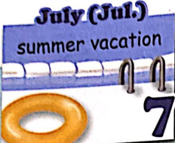
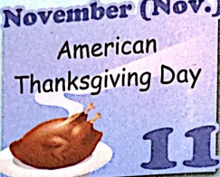
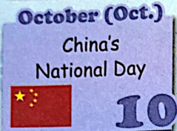
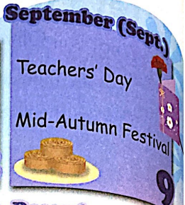
Let me introduce my school calendar.

Slide 5
Presentation
How to talk about the school calendar?
Talk about Zhang Peng attending the school sports meet.
Talk about the activities after the sports meet.
Talk about your classmates’ birthdays.

Slide 6


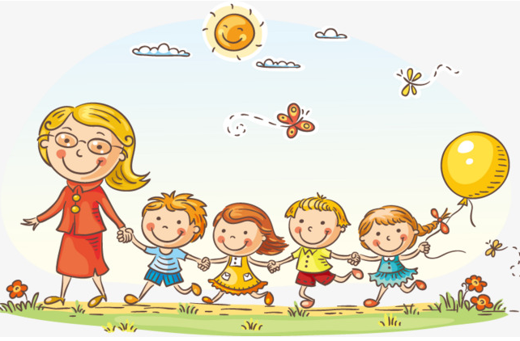
Let’s learn！
school trip
[skuːl trɪp]
学校郊游
We have a school trip in May.

Slide 7
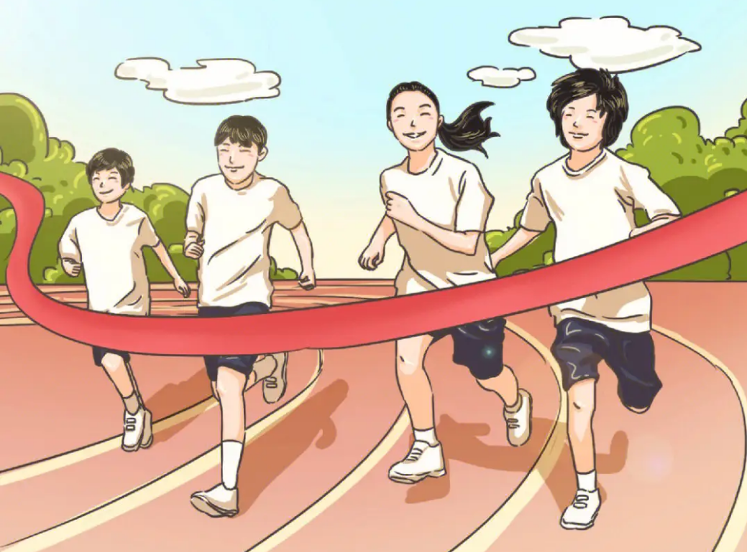
sports meet
[spɔːts miːt]
运动会
There will be a sports meet in our school.

Slide 8
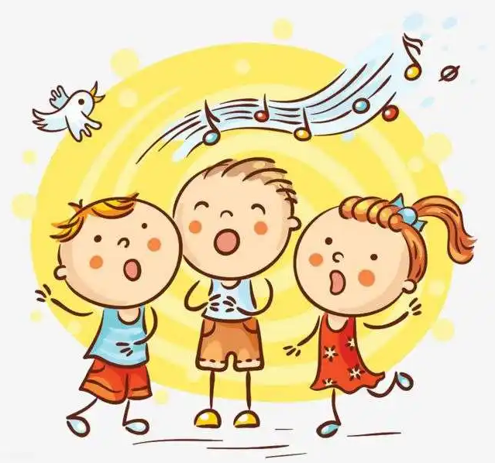
singing contest
[ˈsɪŋɪŋ ˈkɒntest]
歌唱比赛
The singing contest is in May.

Slide 9

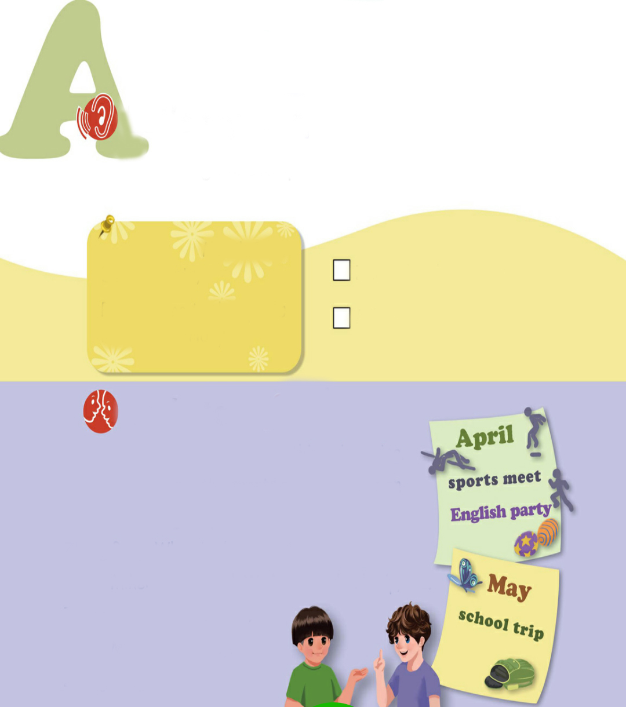
Let’s try
What’s this?
March 24th
Dear parents,
Please come to the sports meet next Friday.
It’s an invitation.

Slide 10

Listen and tick.
Who will go to the sports meet next week? Listen and tick.
March 24th
√
Zhang Peng’s parents
Dear parents,
Please come to the sports meet next Friday.
Mike’s parents

Slide 11
Let’s check！
Who will go to the sports meet next week? Listen and tick.
Mike：What’s that, Zhang Peng?
Zhang Peng：It’s an invitation for my mum and dad.
Mike：What for?
Zhang Peng：For the sports meet next week. I will run.
Mike：I see. Good luck!
Zhang Peng：Thank you!

Slide 12
Listen and answer！
When is the sports meet?
Who will come to the sports meet next Friday?
3. What is the invitation for?
4. What will Zhang Peng do in the sports meet?
Next Friday.
Zhang Peng’s parents.
To ask parents to come to the sports meet.
He will run.

Slide 13
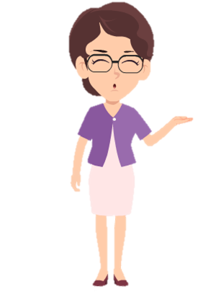
After the sports meet, what activities will they have ?
Let’s listen to their dialogue.

Slide 14

Let’s talk
Read and answer.
When is the English party?
2. When is the school trip?

Slide 15
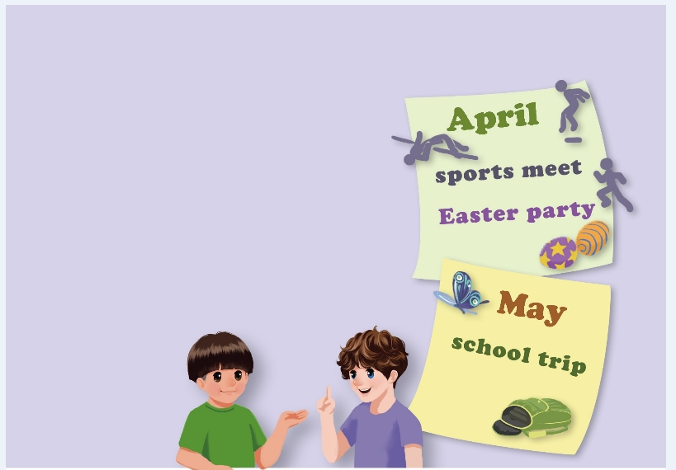

Listen to the tape.
Mike: We have a few fun things in
spring. After the sports
meet, we have an English party.
Zhang Peng: When is the party?
Mike: It’s in April. We have a
school trip, too.
Zhang Peng: When is that?
Mike: It’s in May.
Zhang Peng: Cool!

Slide 16
When is the English party?
It’s in April.
2. When is the school trip?
It’s in May.

Slide 17
Fill in the blanks.
Mike: We have _____ fun things in
_____. After the ________
we have ___ English party.
Zhang Peng: When is the ______?
Mike: It’s in _____. We have a
___________, too.
Zhang Peng: When is that?
Mike: It’s in _____.
Zhang Peng: Cool!
a few
spring
sports meet
an
party
April
school trip
May

Slide 18

Read and act.
1.Read it together.
2.Each student
reads a sentence.
Tip: Choose one to read in two. 选择一种两人练习。
3. Read in roles.
分角色朗读。

Slide 19
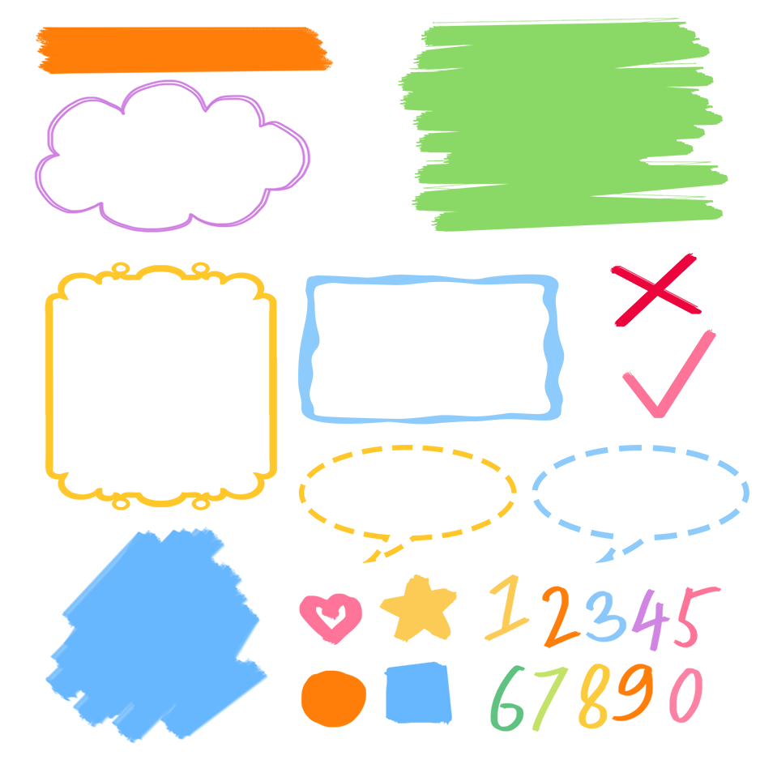
流利地朗读
流利地表演
有感情地表演

Slide 20
Listen and repeat.
一些
拓展:something某事，某物
anything任何事物
nothing没有什么
Mike: We have a few fun things in
spring. After the sports
meet, we have an English party.
Zhang Peng: When is the party?
Mike: It’s in April. We have a
school trip, too.
Zhang Peng: When is that?
Mike: It’s in May.
Zhang Peng: Cool!
询问某活动或节日在什么时候
在四月
学校郊游
在五月

Slide 21
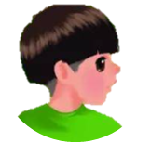



Language points.
什么时候
When
— When is the party?
— It’s in April.
询问某活动或节日在什么时候
句型：
—When is + 活动/节日名词?
— It‘s in +季节/月份.
— When is the school trip ?
— It's in May.

Slide 22
Language points.
few, a few和little, a little的用法
few， a few 接可数名词复数，little，a little 接不可数名词。
a few， a little 表示肯定意思，有一些，有一点。
few， little 表示否定意思，几乎没有。
eg. She has a few friends in school. 她在学校有一些朋友。
There is a little oil in the dish. 菜里有点儿油。
She has few friends in school. 她在学校几乎没有朋友。
There is little oil in the dish. 菜里几乎没有油。

Slide 23
Language points.
时间介词的用法
1. in +上午/下午/晚上/月/季节/年
in the morning/ in April/ in winter/ in 2024
2.on+具体的某一天/具体的某一天的上午、下午或晚上
on Monday/ on April 3rd/ on Friday morning
3. at+具体的几点钟/固定搭配
at six o’clock/ at 12:30/ at noon

Slide 24
Language points.
时间介词的用法
年月前要用in， 日子前面却不行。
遇到几号要用on， 上午下午又是in。
要说某日上下午，用on换in才能行。
at用在时间前，星期前面才是on。

Slide 25
Make up diaguages in pairs.
Ask your classmates about their birthdays.
A: When is your birthday?
B: It’s in …When is your birthday?
C: It’s in …When is your birthday?
D:It’s in …

Slide 26

Write and talk.
When is the singing contest?
school trip
sports meet
Chinese/ maths/ … test
singing contest
It’s usually in May.

Slide 27
Write and talk.
When is the ...?
school trip
sports meet
Chinese/maths/…test
singing contest
It’s usually in ...

Slide 28

Good to know
Be at war with your vices,
at peace with your neighbors,
and let every New Year find you a better man.
战胜恶习，睦邻友好，让每一个新年看见一个更棒的你。

Slide 29
Exercise
一、补全单词并连线。
1. Ap l A.宴会
2.M y B.旅行
3.t p C.五月
4. sp ts D.四月
5.p ty E.体育活动
ri
a
ri
or
ar

Slide 30
二、按照要求完成句子。
1.The school trip is in May. (对画线部分提问)
________________________
2.spring, a, fun, we, in, few, have, things (.)(连词成句)
___________________________________
3.singing, when, contest, the, is (?) (连词成句)
_____________________________
When is the school trip?
We have a few fun things in spring.
When is the singing contest?

Slide 31

Summary
学习了下列单词：
few, thing, sports meet, school trip, singing contest, English party等
2.学习了下列句型：
—When is the sports meet?
— It’s in April.

Slide 32
Homework
ONE
TWO
Act the dialogue out with your friends.
Make up a short dialogue using the sentences we have learnt.
Investigate Chinese culture with your classmates.

Slide 33







