Slide 1


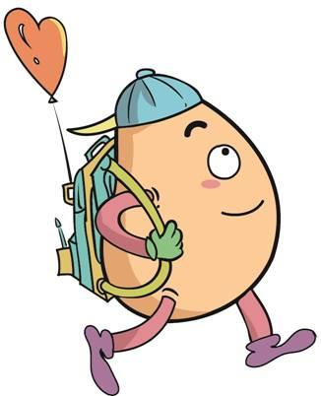

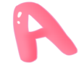



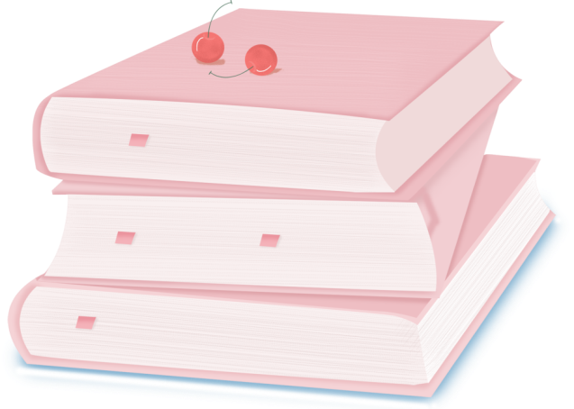
人 教 PEP 版 英 语 五年 级 下 册
Unit 2
My favourite season
Part B
Let’s learn & Ask and answer

Slide 2
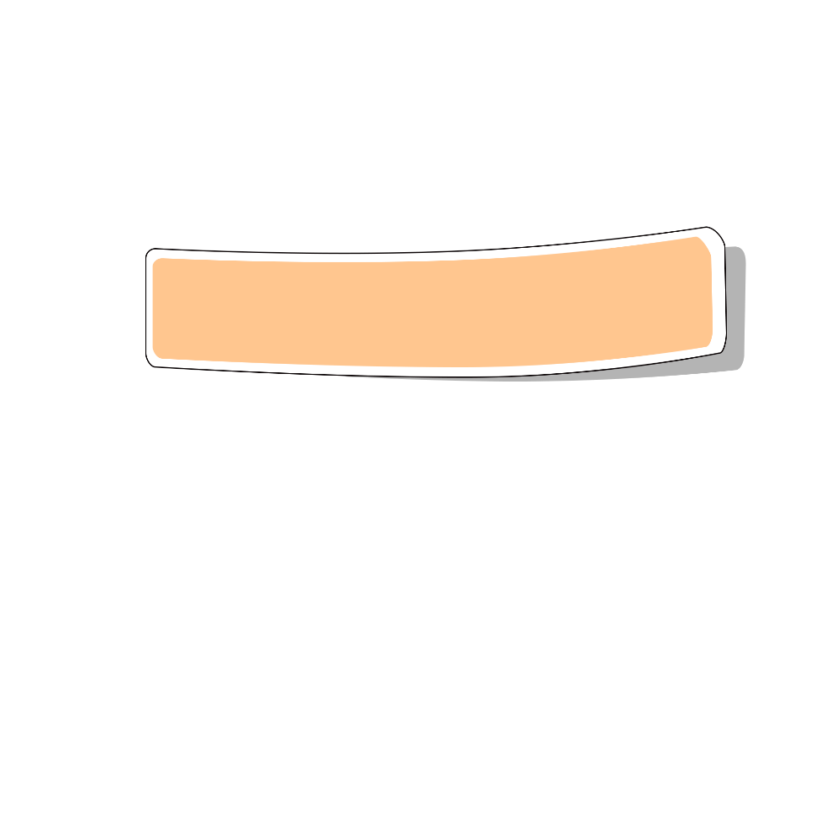
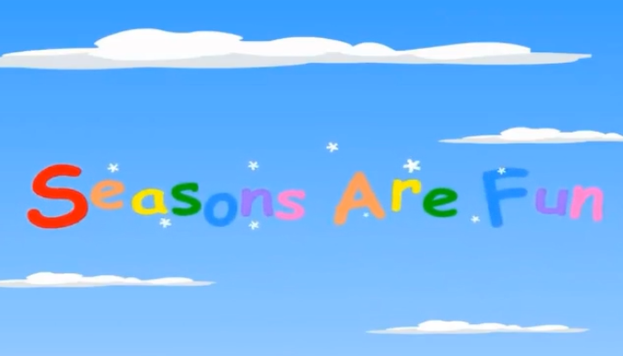
Warm up

Slide 3
Lead in
What can we do in the four seasons?
Let's talk about it.

Slide 4
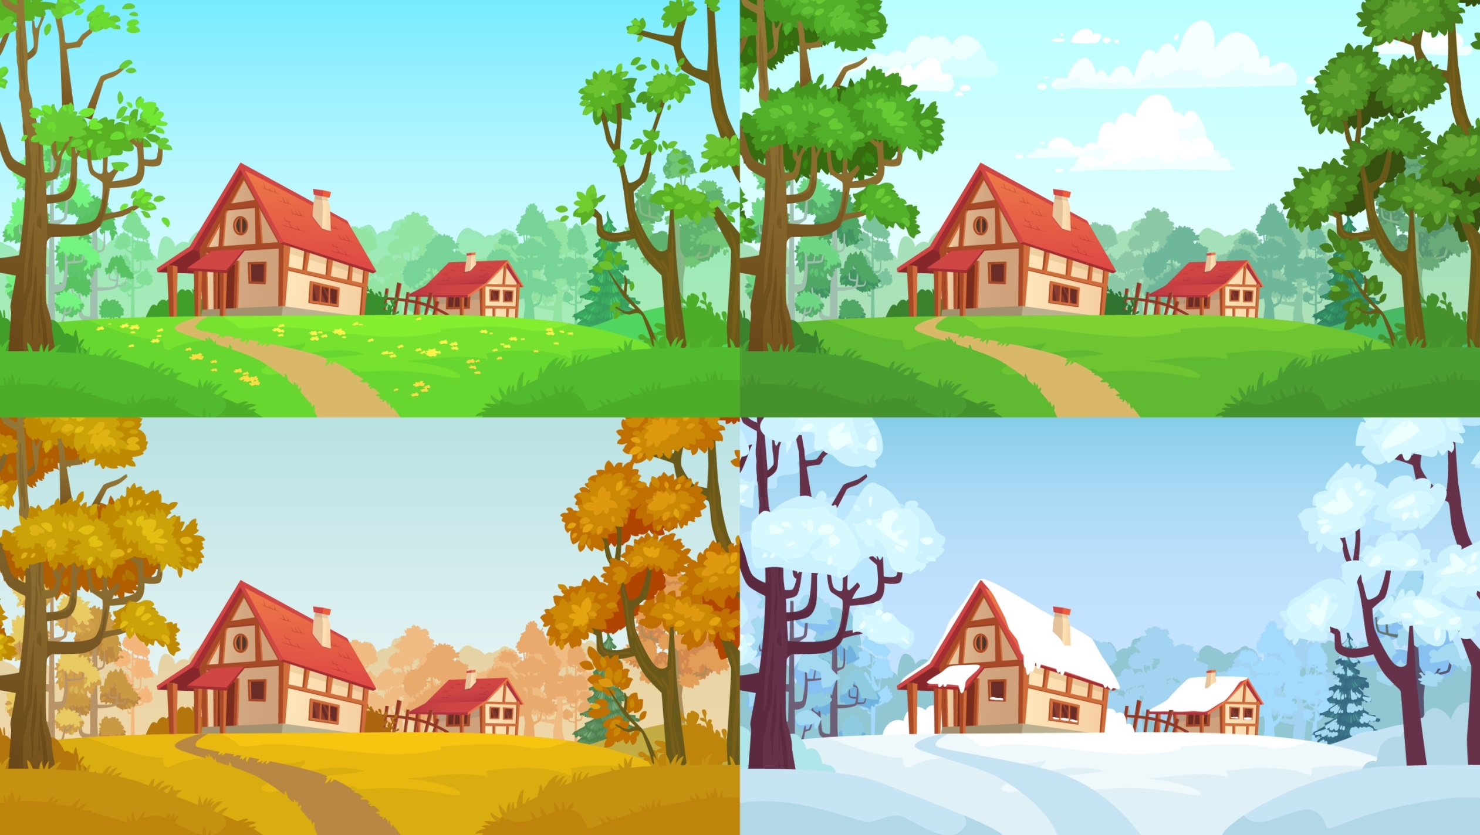
Plant trees
Go swimming
See flowers
Eat ice cream
Pick pears
Play in the snow

Slide 5
Talk about different activities in the four seasons.
Learn four activities.
Wu Binbin and Mike talk about favorite seasons and activities.
Talk about other activities.

Slide 6
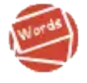
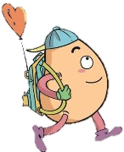
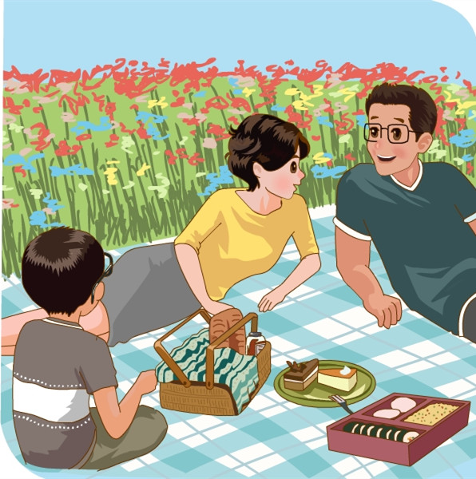

Let’s learn
Learn new words！
go on a picnic
去野餐
go for a picnic
同义短语
I often go on a picnic with my family.

Slide 7
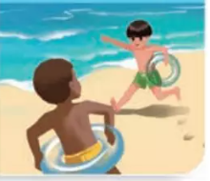
go swimmin 去游泳
go for a swim
同义短语
go shopping去购物
go fishing去钓鱼
go running去跑步
go skating去滑冰
拓展
go+v-ing
I often go swimming in summer!

Slide 8
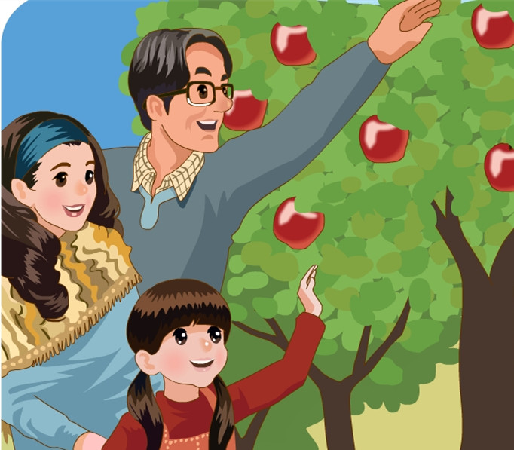
pick apples
摘苹果
pick up拾起，拿起
pick out挑选出
拓展
I can pick apples in autumn.

Slide 9
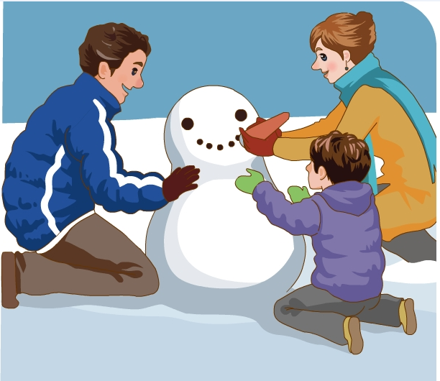
make a snowman
堆雪人
make the bed整理床铺
make a fire生火
make friends交朋友
make a face做鬼脸
拓展
I can make a snowman in winter.

Slide 10
Let’s play a game！
快速读出所出现图片的英语。

Slide 11

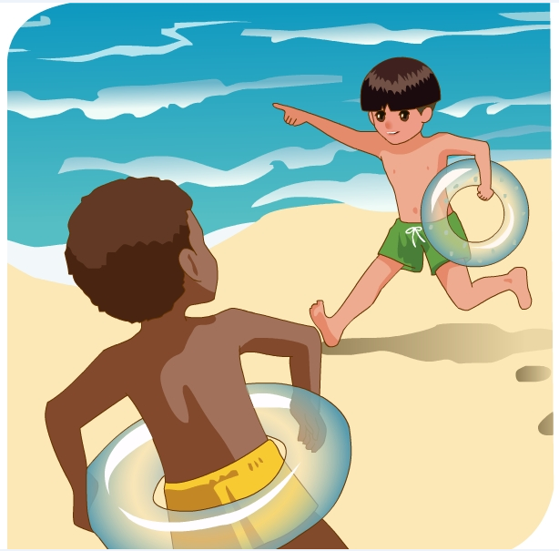
go swimming
go on a picnic
pick apples
make a snowman

Slide 12
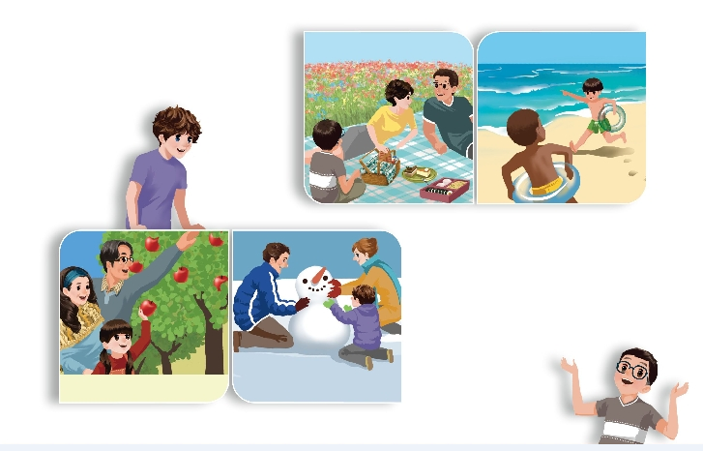
Listen to the tape.
Which season do you like best?
go on a picnic
go swimming
I like spring best. There are beautiful flowers everywhere. I often go on a picnic with my family.
pick apples
make a snowman

Slide 13
Look and say .
—Which season do you like best?
go swimming
—
I like summer best. The weather is hot. I often go swimming with my brother.

Slide 14
Look and say .
—Which season do you like best?
—
I like autumn best. The weather is good and the colours are beautiful. I often pick apples with my parents.
Pick apples

Slide 15
Look and say .
—Which season do you like best?
—
I like winter best. The weather is cold. I can make a snowman with my parents.
make a snowman

Slide 16
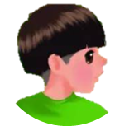
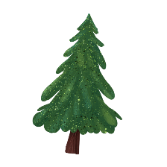

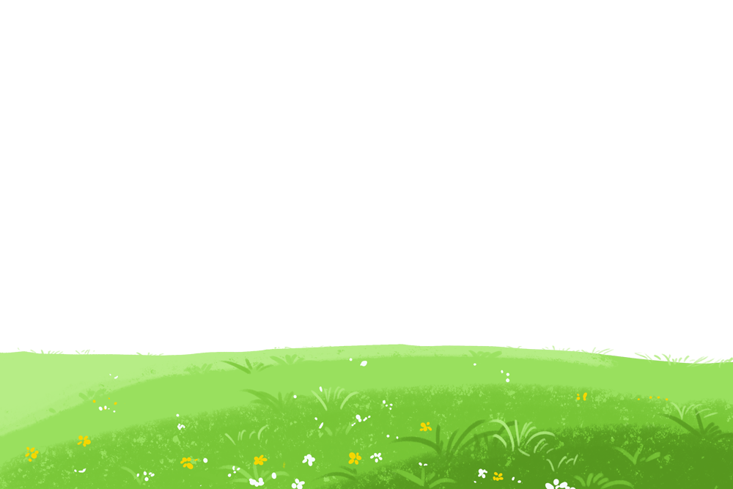
Language point.
There are beautiful flowers everywhere.
there be句型结构
句型：
There be(is/are/was/were)+名词+地点状语.
该句为there be句型结构的句子。表示的是“某处有（存在）某人或某物”。everywhere意思是“每个地方；到处”

Slide 17
there be句型结构
【注意】 there be句型中, be动词的单复数要和其后的主语在人称和数上保持一致(就近原则)
如果句子的主语是单数的可数名词,或是不可数名词, be动词用 is或was。
如果句子的主语是复数名词, be动词就用 are或were。
eg. There is a pen and two pencils on the desk.
There are two pencils and a pen on the desk.

Slide 18
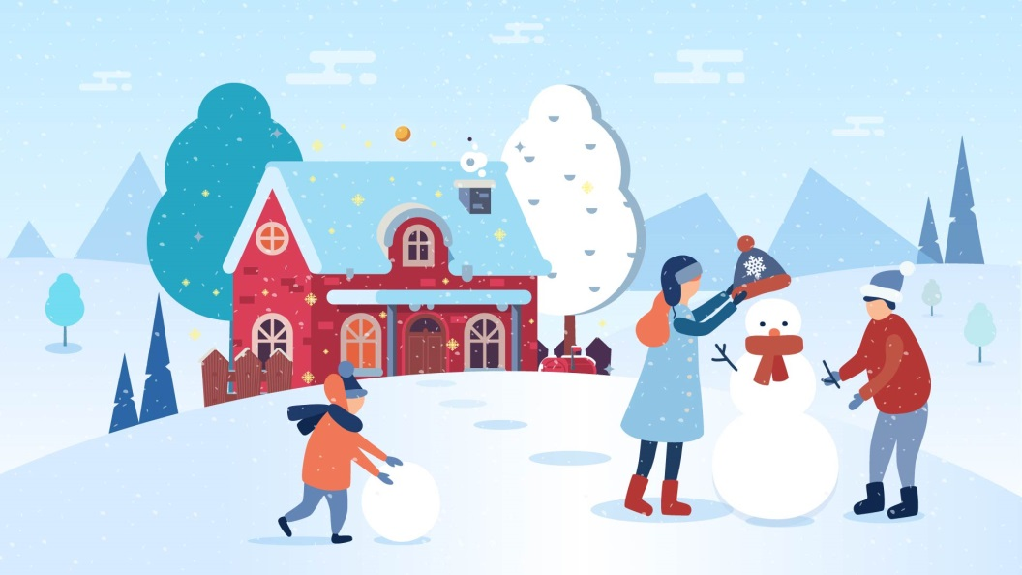
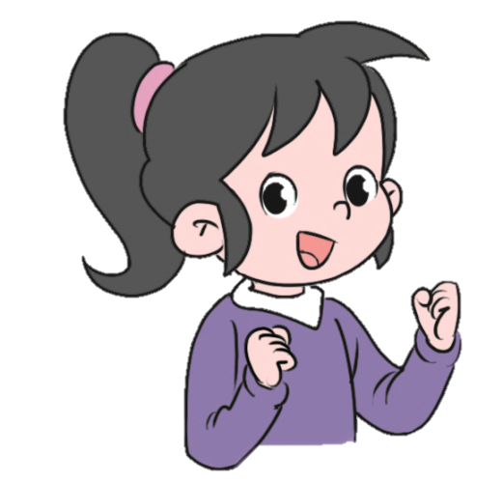
There is a snowman in the ground.

Slide 19
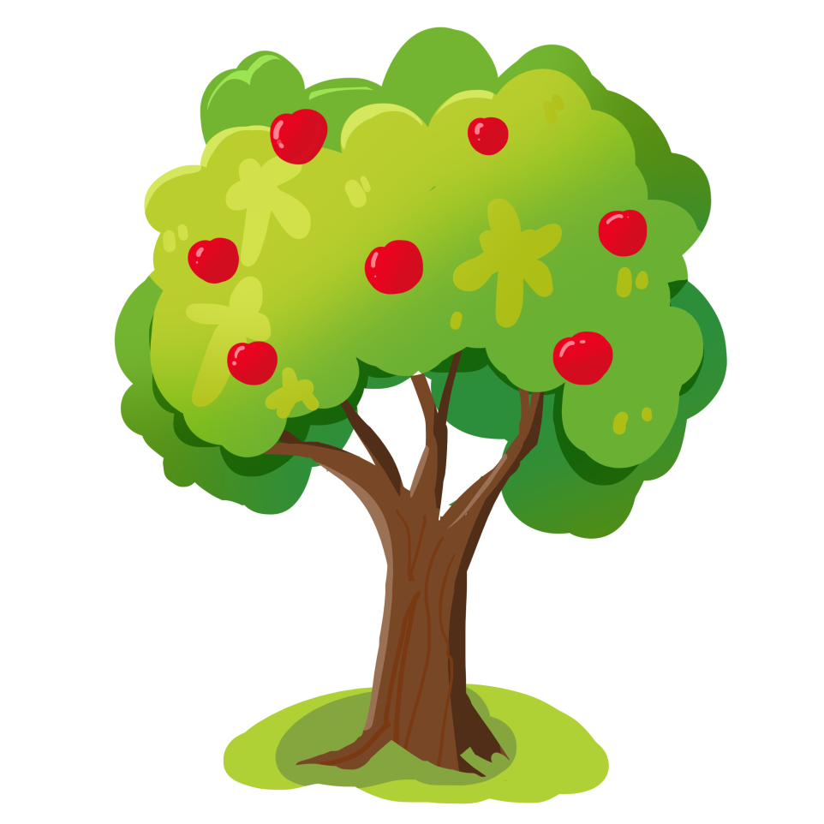
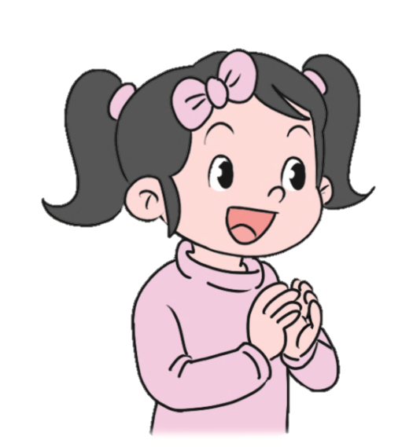
There are many apples in the tree.

Slide 20

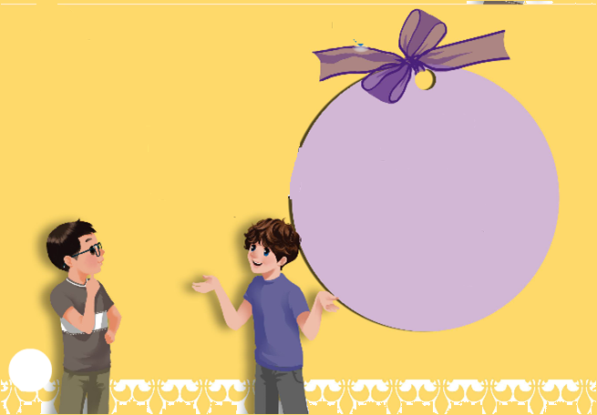
Ask and answer
Which season do you like best?
Winter. I often play in the snow.
go on a picnic
go swimming
pick apples
make a snowman
play in the snow
plant flowers
eat ice cream

Slide 21
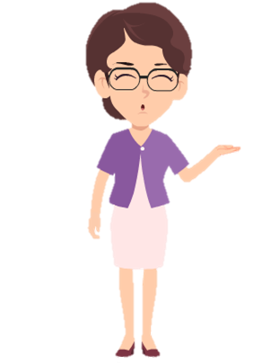
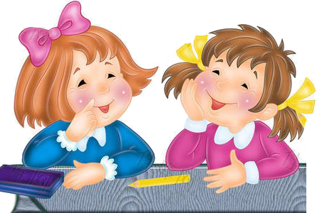
Make dialogues in pairs.
go on a picnic go swimming
pick apples make a snowman
play in the snow plant flowers
eat ice cream
Which season do you like best? Why?
I like____best. Because_____.

Slide 22
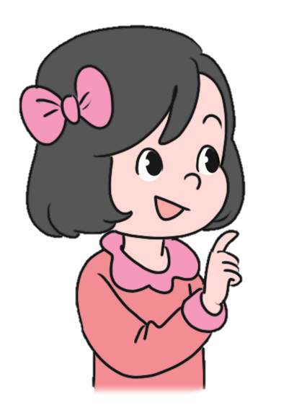
Write something about your favourite season.
My favourite season is summer. Because I like summer vacation. I can swim and eat ice cream...

Slide 23
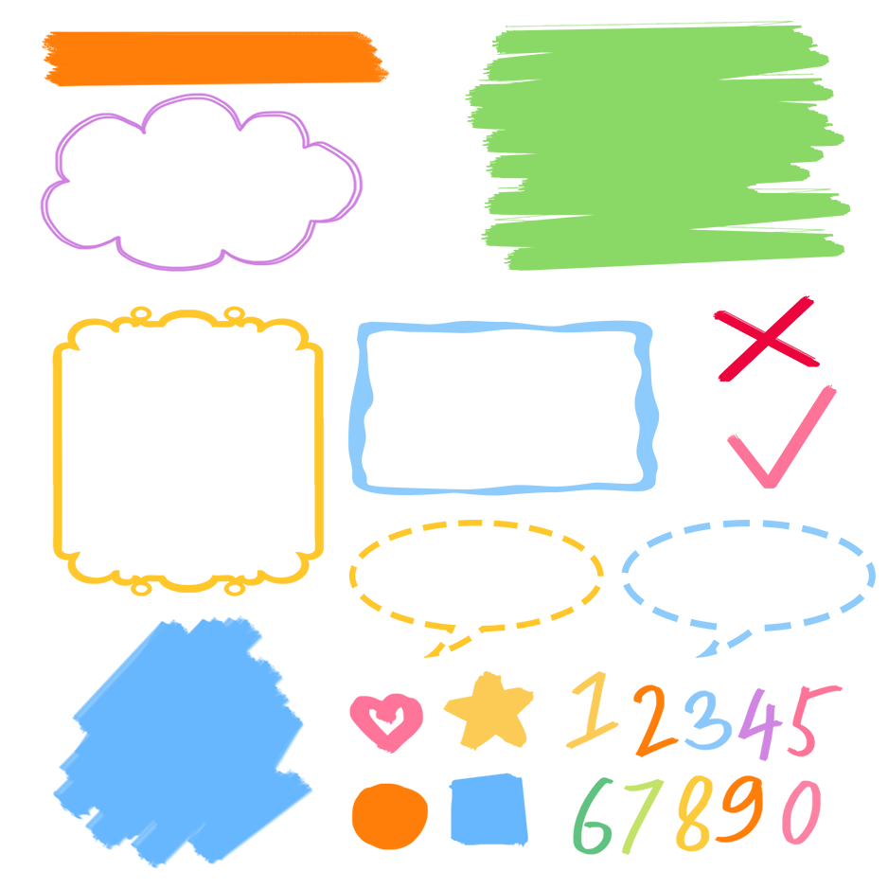
了解季节相关的活动词组
记忆季节相关的活动词组
熟练运用季节相关的活动词组表达

Slide 24
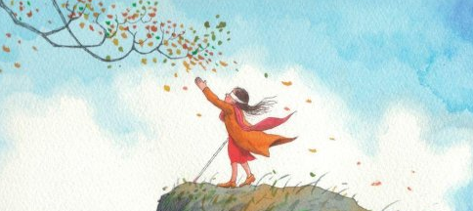
Good to know
Happiness exists in life, while life exists in labor.
幸福存在于生活之中，而生活存在于劳动之中。
——列夫·托尔斯泰

Slide 25
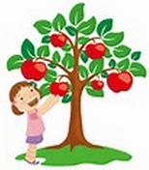
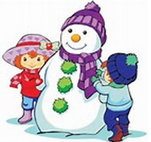


Exercises
一、看图片写短语。
pick apples
make a snowman
go on a picnic
go swimming

Slide 26
二、单项选择
( ) 1. ____ season do you like best?
A. What B. Which C. Why
( ) 2. ________ does Amy like summer best?
A. What B. Which C. Why
B
C

Slide 27
( ) 3.I often play ________ the snow.
A. in B. on C. at
( ) 4. There ____a ruler and two pens on the desk.
A. is B. are C. have
A
A

Slide 28
三、按照要求完成句子。
1.I like winter best.(对划线部分提问)
____________________________________
2.family, often, on, I, picnic, my, go, with, a (.)(连词成句)
_________________________________________
3.There are many beautiful flowers everywhere.(变为一般疑问句)
____________________________________
Which season do you like best?
I often go on a picnic with my family.
Are there many beautiful flowers everywhere?

Slide 29

Summary
1. 学习了下列单词：go on a picnic, pick apples, make a snowman, go swimming
2.学习了下列句型：
（1） —Which season do you like best?
— Winter. I often play in the snow.
（2）There are beautiful flowers everywhere.

Slide 30
Homework
ONE
TWO
Do “Ask and answer” with your friends.
Talk about your favourite season and write a short passage.

Slide 31



