Slide 1




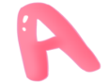

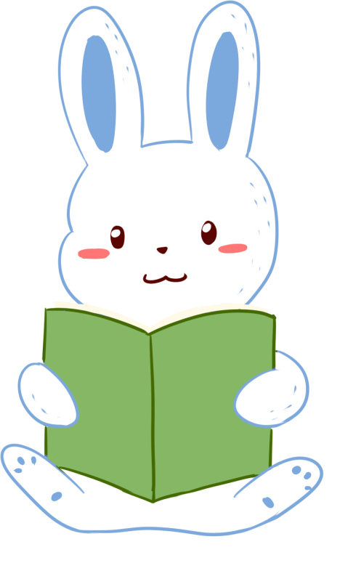
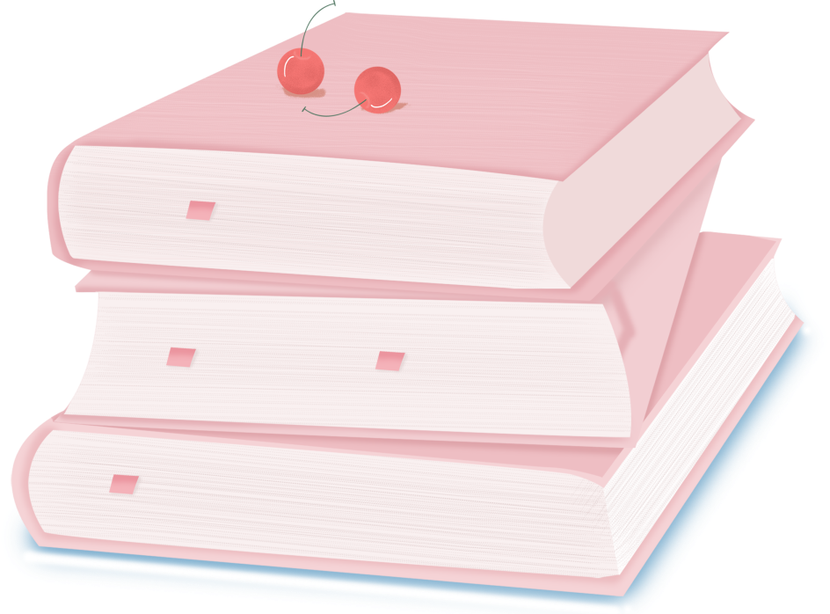

人 教 PEP 版 英 语 五 年 级 下 册
Unit 2
My favourite day
Part B
Let’s learn & Ask and answer

Slide 2

Warm up
Make a dialogue.
－Which season do you like best?
－I like …best.
－Why?
－Because…

Slide 3

Lead in
Which season does Amy like best?
Amy likes autumn best.
What about Wu Binbin?

Slide 4

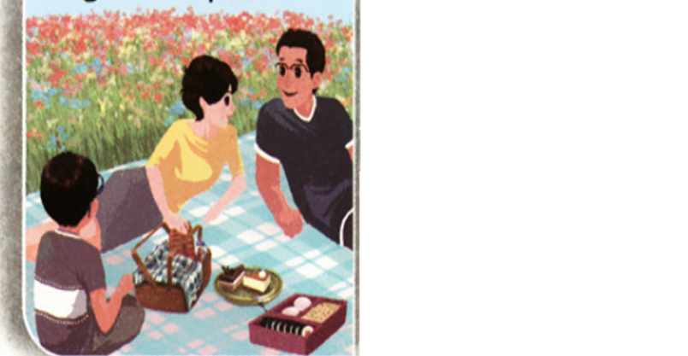
Presentation
Let’s learn
Listen and answer the questions.
Which season does Wu Binbin like best?
Spring.
Why does Wu Binbin like spring best?
go on a picnic
Because he often goes on a picnic with his family in spring.

Slide 5

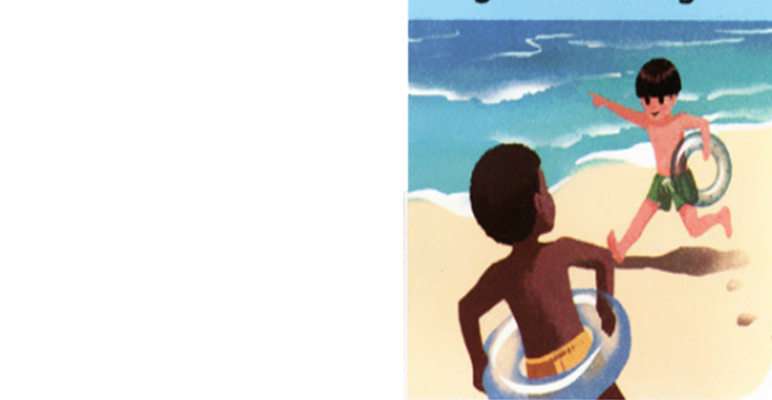
Which season is it?
Summer.
What do you do in summer?
I often go swimming.
go swimming

Slide 6
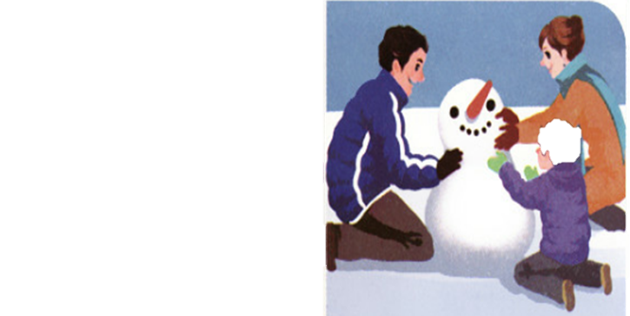
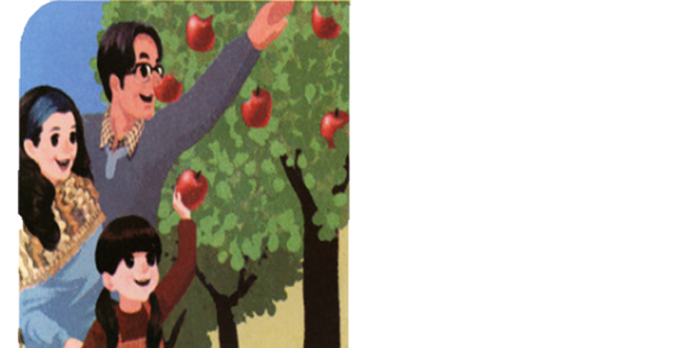
What about autumn and winter? What can you do?
make a snowman
pick apples

Slide 7
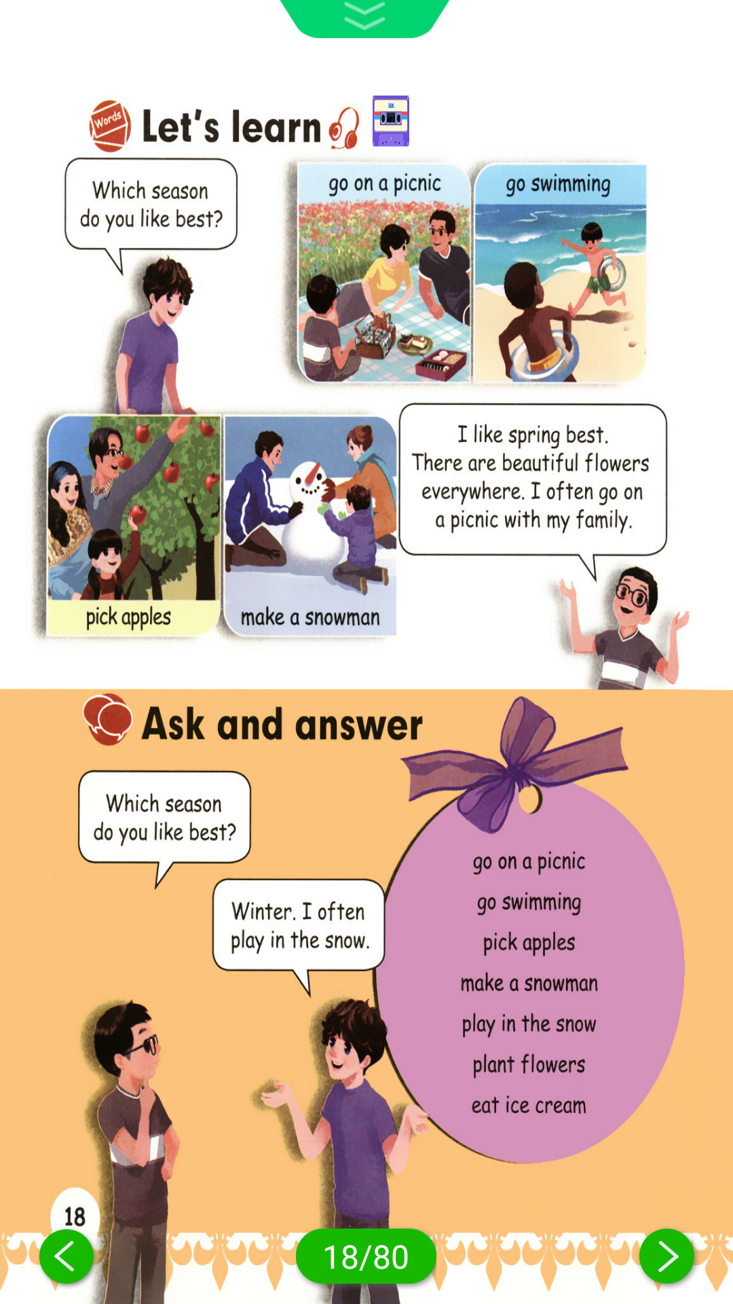
Look at the pictures based on phrases.
go swimming
go on a picnic
pick apples
make a snowman

Slide 8
Listen and read after the tape.
go on a picnic
go swimming
Which season do you like best?
I like spring best.
There are beautiful flowers everywhere. I often go on a picnic with my family.
pick apples
make a snowman

Slide 9
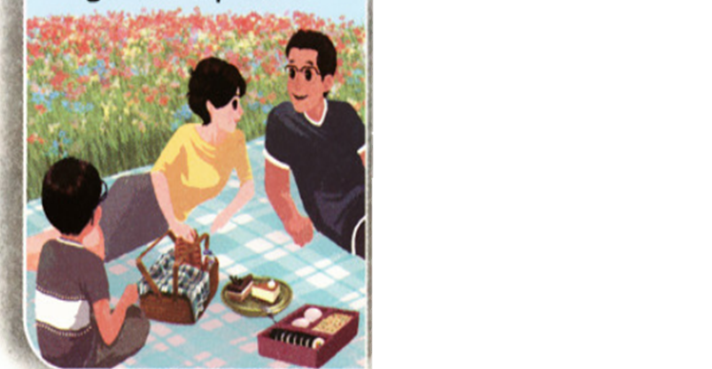
Work in pairs.
A say, B do.
For example:
A: I like spring best. I often go on a picnic.
B:

Slide 10
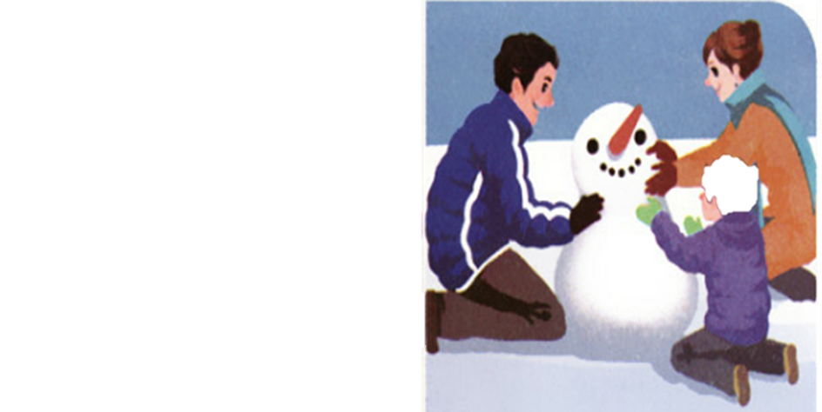
A do, B say.
For example:
A:
B: I like winter best. I often make a snowman.

Slide 11
Look at the picture and say the phrases.
go swimming
go on a picnic
pick apples
make a snowman

Slide 12
Language points
How to write the sentence.
Which season do you like best?
I like the spring best.
There are beautiful flowers everywhere.
I often go on a picnic with my family.
在练习书写时，不要写的太快，笔尖不要太轻，一定要有力度，放慢速度，笔画一定要写到位，但注意不要出格。
点击画面 播放视频

Slide 13
There are beautiful flowers everywhere.
【详解】该句为there be句型结构的句子。表示的是“某处有（存在）某人或某物”。everywhere意思是“每个地方；到处”。
句型结构: There be(am/is/are/was/were)+名词+地点状语.
【注意】 1. there be句型中 be动词的形式要和其后的主语在人称和数上保持一致

Slide 14
如果句子的主语是单数的可数名词,或是不可数名词, be动词用 is或was。
2.如果句子的主语是复数名词, be动词就用 are或were。
e.g. There are three books on the desk.
There is a basketball in the box.

Slide 15
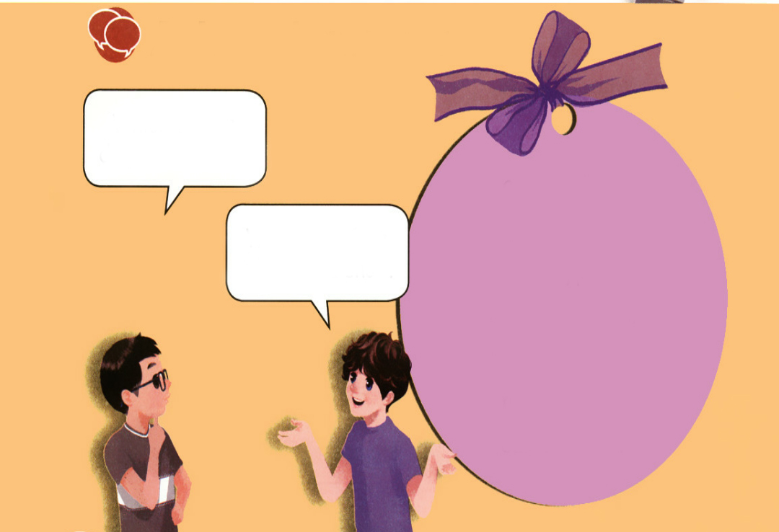
Practice
Ask and answer
Ask and answer.
Which season do you like best?
go on a picnic
go swimming
pick apples
make a snowman
play in the snow
plant flowers
eat ice cream
Winter. I often play in the snow.

Slide 16
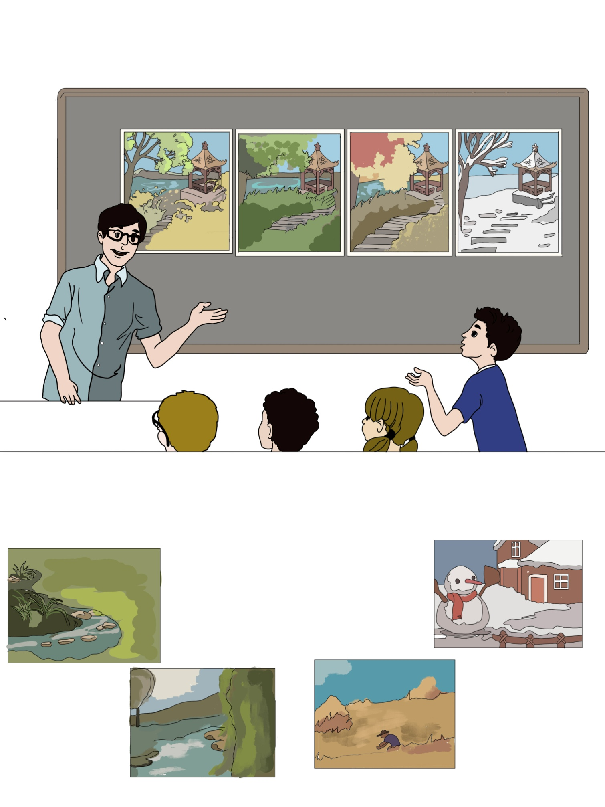


Pair work.
Which season do you like best?
Spring. I often….
Summer. I often….
Autumn. I often….
Winter. I often….

Slide 17
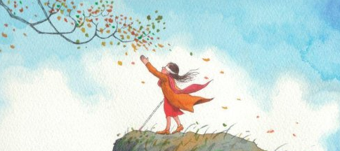
I want to know
幸福存在于生活之中，而生活存在于劳动之中。——列夫·托尔斯泰
Happiness exists in life, while life exists in labor.

Slide 18

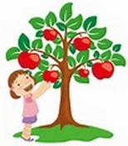
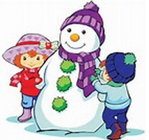


Exercises
一、看图片写短语。
pick apples
make a snowman
go on a picnic
go swimming

Slide 19
二、单项选择。
( ) 1.There ________beautiful flowers.
A. am B. is C. are
( ) 2.I often plant flowers ________ my family.
A. with B. and C. both
( ) 3.I often play ________ the snow.
A. on B. under C. in
C
A
C

Slide 20
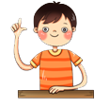
三、连词成句。
1. snow，often，the，I，in，play (.)
______________________________________
2. season，like，which，best，you，do (?)
______________________________________
3. winter，like，best，do，why，you (?)
______________________________________
I often play in the snow.
Which season do you like best?
Why do you like winter best?

Slide 21


Summary
1. 学习了下列单词：picnic, pick, snowman, swimming等，并复习了表示频度的副词often。
2.学习了下列句型：
—Which season do you like best?
— Winter. I often play in the snow.
七彩课堂
伴你成长

Slide 22

Homework
ONE
TWO
七彩课堂
伴你成长
Talk about your favourite season and write a short passage.
Act the dialogue out and show it to your parents.
Do “Ask and answer” with your friends.

Slide 23




