Slide 1


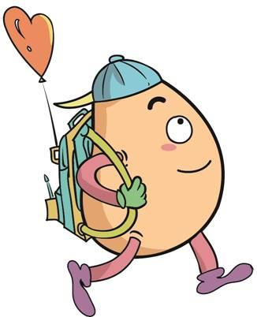






人 教 PEP 版 英 语 五年 级 下 册
Unit 2
My favourite season
Part B & Part C
Read and write — Story Time

Slide 2

Lead in
Guessing game
What season is it?
It’s warm. It’s windy and rainy. There are beautiful flowers everywhere. We can fly kites.
spring

Slide 3
What season is it?
It is hot. It’s sunny.
We can go swimming in the river.
summer

Slide 4
It’s cool and cloudy. Leaves fall and fall. They’re yellow. We can go for a walk in the park.
What season is it?
autumn

Slide 5
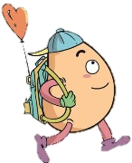

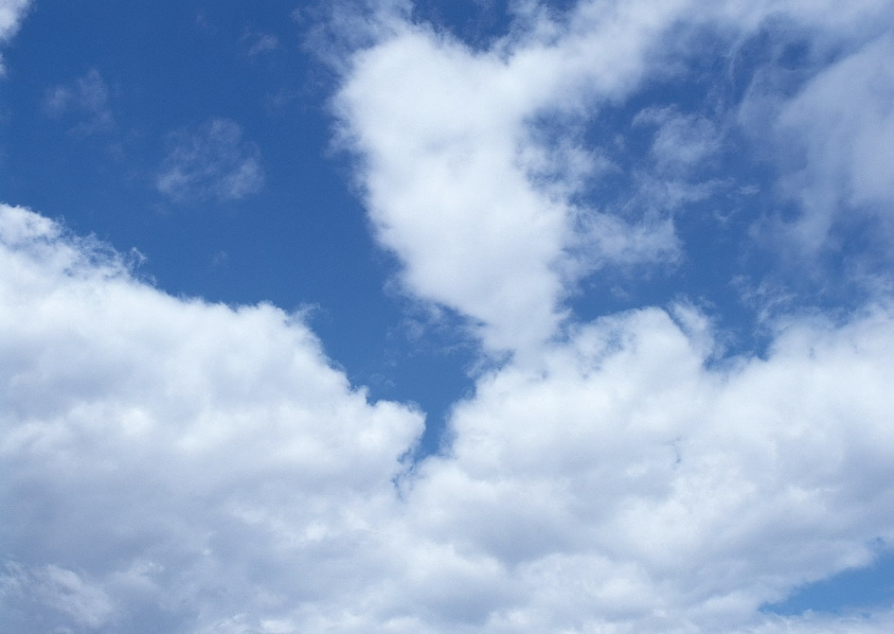
Play a game！
plant flowers
go swimming
eat ice cream
make a snowman
go for a walk
go on a picnic
plant trees
pick apples
play with snow
Which season do you like best?
plant flowers

Slide 6
Presentation
How to talk the seasons?
Talk about Robin's favorite seasons.
Talk about reasons.
Zip and Zoom talk about Christmas activities.

Slide 7

Read and write
Read and answer.
1. Which season does Robin like?
2. Why does Robin like spring?
3. Why does Robin like winter?

Slide 8

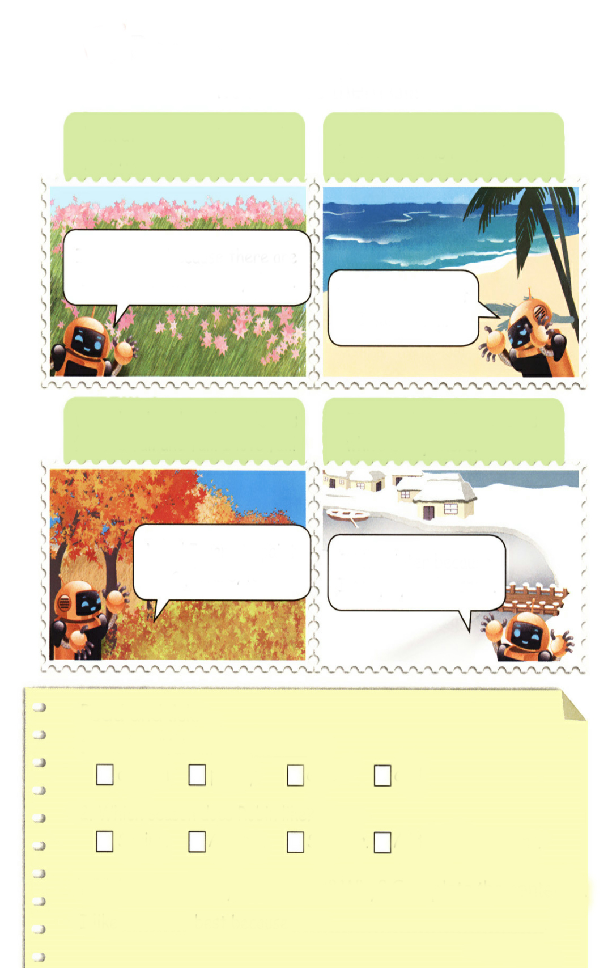
Robin likes them all!
Look at the green trees and pink flowers.
The weather is hot, hot, hot!
I like spring because there are beautiful flowers everywhere.
I like summer, but I can’t swim.
What lovely colours! The leaves fall and fall and fall. I love fall!
There is lots of snow. It is white everywhere.
Wow! I want to paint a picture, too!
I like winter because I can play in the snow.

Slide 9
1. Which season does Robin like?
2. Why does Robin like spring?
3. Why does Robin like winter?
Robin likes spring. Robin likes summer. Robin likes fall and winter.
He likes spring because there are beautiful flowers everywhere.
He likes winter because he can play in the snow.

Slide 10

Listen and repeat.
Look at the green trees and pink flowers.
I like spring because there are beautiful flowers everywhere.
到处

Slide 11
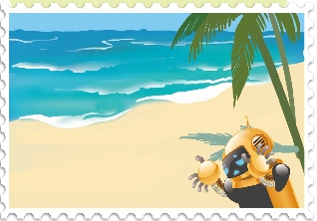
The weather is hot, hot, hot!
I like summer, but I can’t swim.

Slide 12

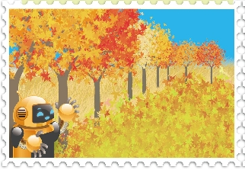
感叹句
What lovely colours! The leaves fall and fall and fall. I love fall!
leaf的复数，叶子
落下
秋天
Wow! I want to paint a picture, too!
画一幅画

Slide 13
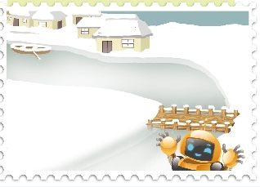
There is lots of snow. It is white everywhere.
不可数名词
I like winter because I can play in the snow.
在雪地里玩耍

Slide 14

Read and tick.
The last “fall” means _____.
A.autumn B. pretty C.cute D. cool
2. Which season does Robin like?
A.Spring B.Autumn C. Summer D. All the four seasons
Which season do you like best? Why? Complete the sentence.
I like ______ best because _________________.
summer
I like summer vacation

Slide 15
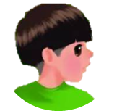
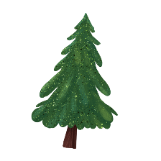


Language point.
What lovely colours!
由What引导的感叹句的用法
1)What +a/an +adj+可数名词单数+主语+谓语！
eg.What a nice girl she is!她是个多好的女孩啊！
(2)What +adj+可数名词复数+主语+谓语！
eg. What beautiful flowers they are!
(3)What +不可数名词+主语+谓语！
eg.What fine weather it is!多好的天气啊！

Slide 16
由how引导的感叹句的用法
How在感叹句中修饰形容词或副词，其基本结构为：
How+ adj/ adv +主语+谓语!
eg. How beautiful the flower is! (修饰形容词)
How well she sings! (修饰副词)

Slide 17


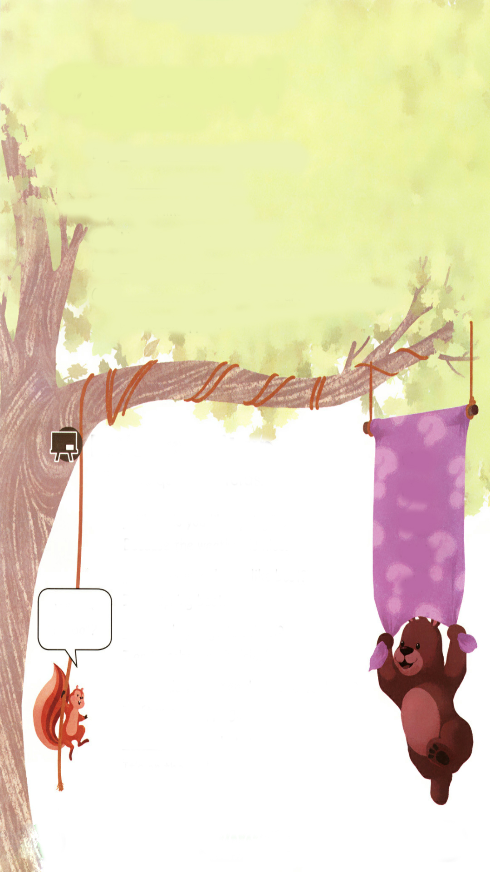
Let’s check
Listen and write.
Boy: ?
Girl: .
Boy: Do you like summer?
Girl: No, I don’t. It’s too hot.
Boy: ?
Girl: . The colours are beautiful. I can pick fresh apples.
When is your birthday
It’s in summer
Which season do you like best
Autumn

Slide 18
Boy：When is your birthday?
Girl：It’s in summer.
Boy：Do you like summer?
Girl：No, I don’t. It’s too hot.
Boy：Which season do you like best?
Girl：Autumn. The colours are beautiful. I can
pick fresh apples.

Slide 19

Let’s wrap it up
Read the following words.
what when where which why
疑问词

Slide 20
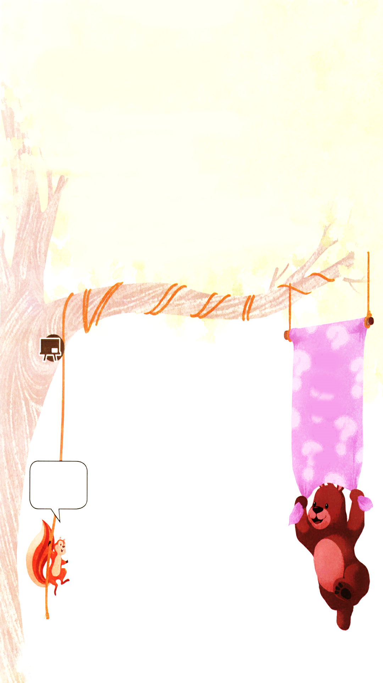
Read and write.
Fill in the question words.
do you like spring best?
Because the weather is nice.
what
when
where
which
why
Why
season do you like best?
I like spring best.
Which
do you go to school?
I go to school at 8 o’clock.
When
Where is “do”?
do you often do on the weekend?
I often go shopping.
What
is your photo?
It’s on the wall.
Where

Slide 21

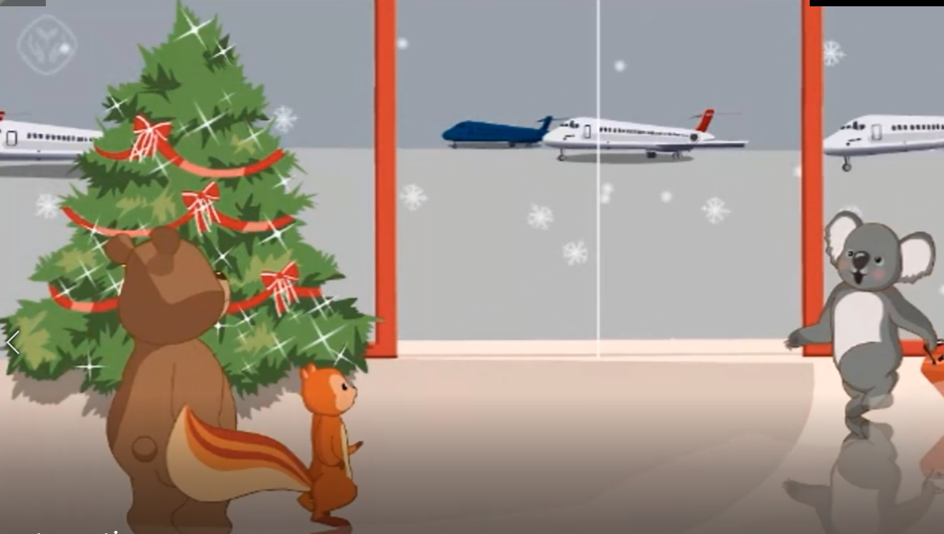
Story time
Watch the video.

Slide 22
Read and answer.
What does Koala usually do on Christmas Day?
2. Which season does Koala like best? Why?
3. Do they make a snowman?
He usually goes to the beach and swims in the sea.
He likes summer best because he likes sunny days.
Yes, they do.

Slide 23
Read and answer.
4. Are they in Australia or China?
5. What season is it now? Why?
6. Why Koala can swim on Christmas Day?
They are in China.
Winter. Because it’s Christmas Day.
Christmas is in summer in Australia.

Slide 24
Listen to the tape.
Zip & Zoom: Welcome!
Koala: Thank you. Merry Christmas!
Zip & Zoom: Merry Christmas!
Zoom: What do you usually do on Christmas Day?
Koala: I usually go to the beach and swim in the sea!
Zoom: You swim in winter?!
Koala: Christmas is in summer in Australia, so we never have snow for Christmas.

Slide 25
Zoom: Which season do you like best?
Koala: Summer. I like sunny days.
Koala: Wow! A white Christmas!
Zoom: Let’s make a snowman.
Zip & Koala: Great!
Zip: Say “cheese”!
Koala: Cheese!

Slide 26
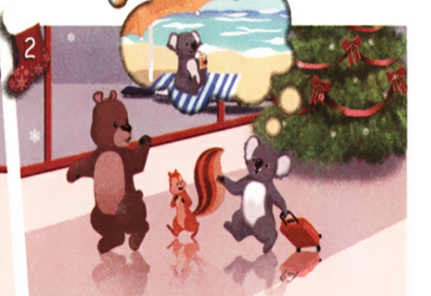
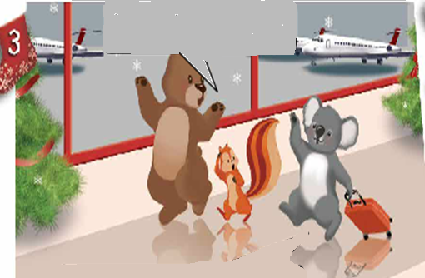
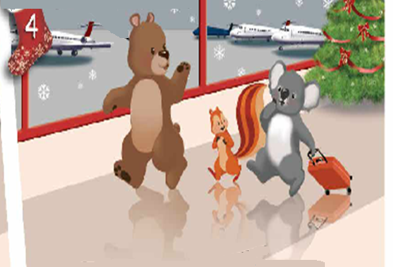
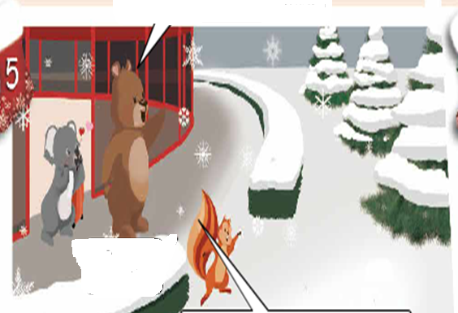
Read and fill in the blanks
A white Christmas
swim
1. I usually go to the _____ and _____ in the sea on Christmas Day.
beach
2. Christmas is in ______in Australia.
summer
3. I like ______ best. I like _____ days.
summer
sunny
4. Let’s make a _________!
snowman

Slide 27
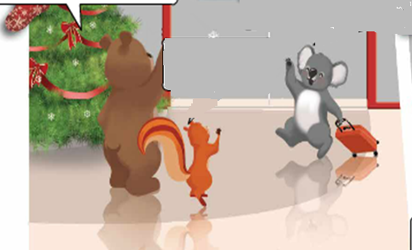
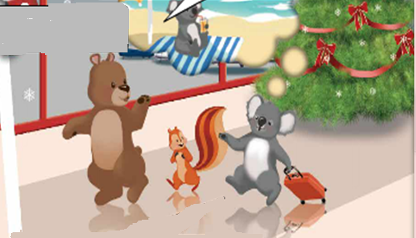
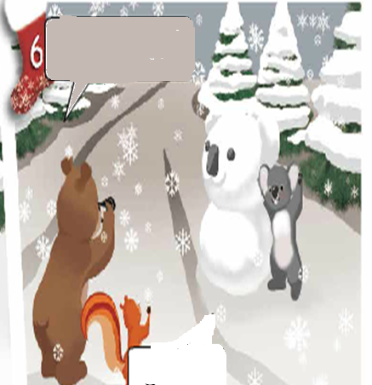
Play in roles.
You swim in winter?
Merry Christmas!
Thank you. Merry Christmas!
What do you usually do on Christmas Day?
I usually go to the beach and swim in the sea!
Welcome!
Christmas is in summer in Australia, so we never have snow for Christmas.
Which season do you like best?
Let’s make a snowman.
Great!
Cheese!
Summer. I like sunny days.
Wow! A white Christmas!
Great!
Say “cheese”!

Slide 28
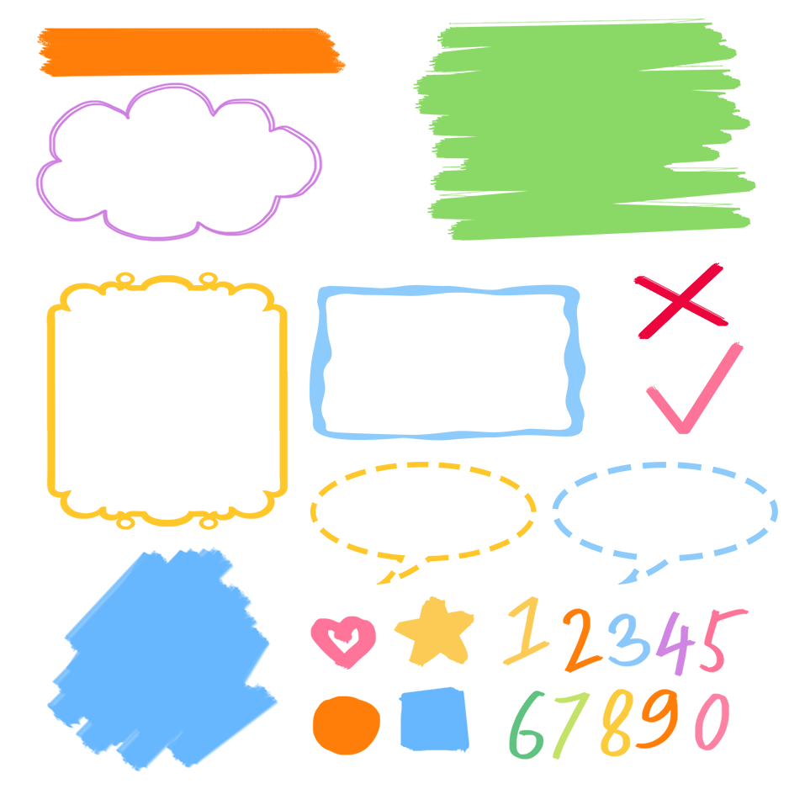
流利地朗读
流利地表演
有感情地表演

Slide 29
Exercises
一、填写合适的疑问词
_________ do you do on the weekend? I often go for a walk.
2. _______ is your pencil? It’s on the desk.
3. ________ do you go to school? At 7:30.
4. _______do you like summer? Because I like summer vacation.
5. ________season do you like best? I like winter best.
What
Where
When
Why
Which

Slide 30
二、选择最佳答案
( )1. –-What’s your favourite season? --______.
A. I like season. B. My favourite season is autumn.
C. Because I can play.
( ) 2. --___________ --Because I can eat ice cream.
A. How do you do? B. Do you like eat ice cream?
C. Why do you like summer?
( )3. –-What’s the weather like in Beijing in summer? --_______.
A. It’s hot. B. It’s cold. C. I can play with snow.
B
C
A

Slide 31

Summary
1.能够正确听、说、认、读单词：spring，summer，autumn，winter，because等。
2.能简单介绍自己最喜欢的季节及原因。
3.能够掌握why，what，when，where，which等五个特殊疑问词不同的功能和用法。

Slide 32
Homework
ONE
TWO
Make sentences like read and write.
Read the story to your parents.
Act the story out in groups.

Slide 33







